Slide 1
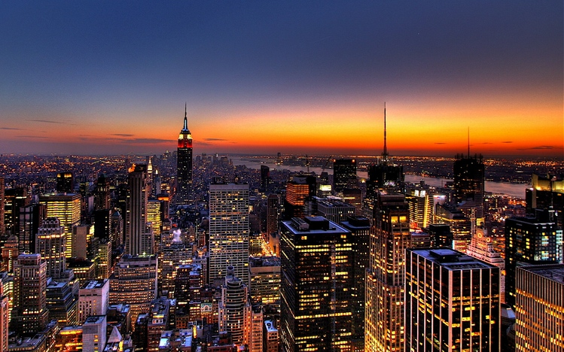
Los Angeles
Kwame, Milton, Ana

Slide 2
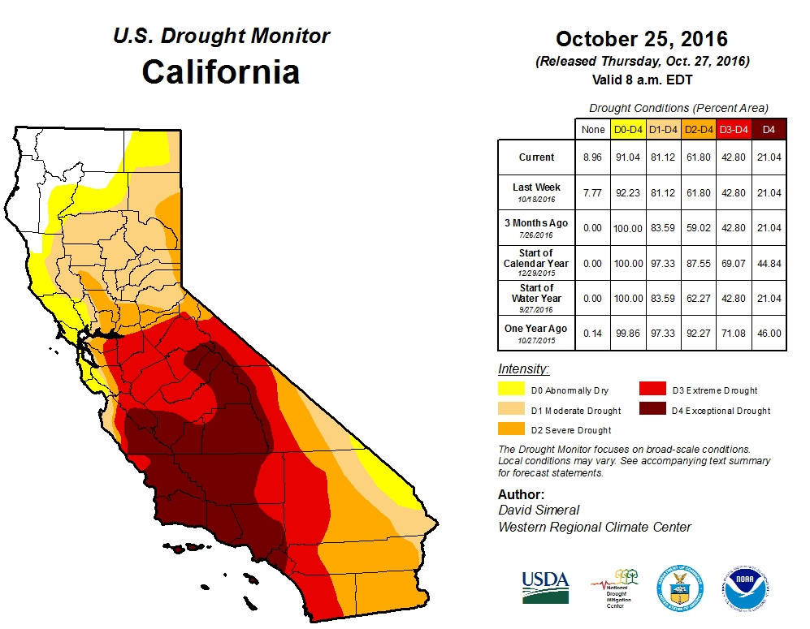
Global Warming : Droughts and Floodings
Global warming is the is the increase of Earth’s average surface temperature due to the effect of greenhouse gases. For the past years and in the present the burning of fossil fuels has increased Global Warming. With the increase of global warming natural disasters have also increased. With the Earth becoming warmer, regions/countries will be experiencing warmer temperatures and others will not. This may also affect crops and plants because of the dry areas. Stronger greenhouse effects will warm the ocean which will contribute to the melting of glaciers and the rise in sea level. Rising sea
levels can cause flooding in some areas. Focusing on los angeles we can already see how the climate is affecting L.A.

Slide 3
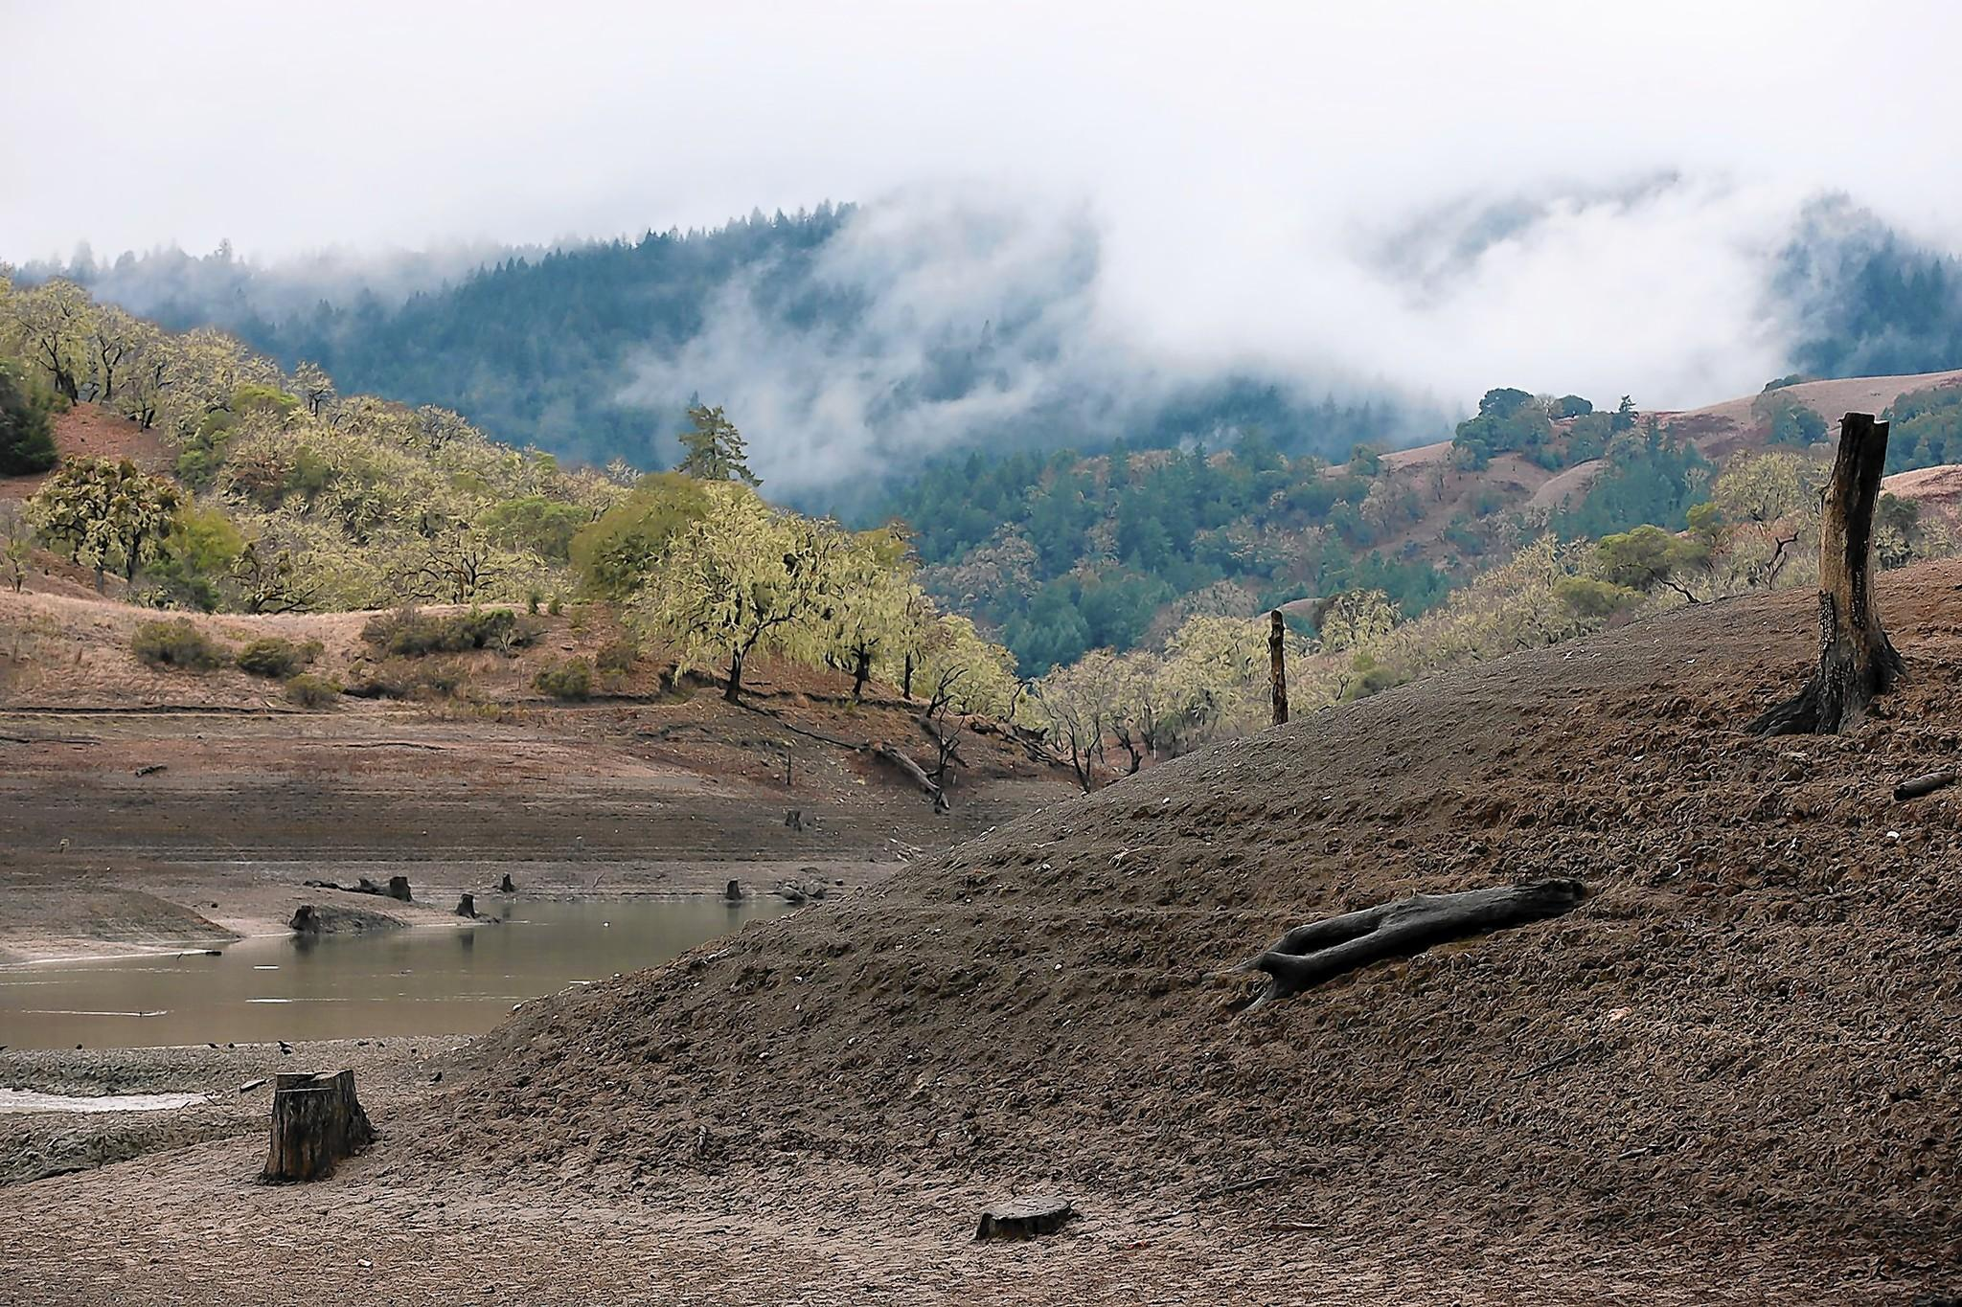

Slide 4
Environmental Factors Leading To Drought
The drought is believed to be caused in part by a mass of warm water in the Pacific Ocean that has drifted closer to the West Coast recently. The warm water formation, known as “the blob,” has persisted in about the same location for over two years. La Niña likely kicked off the drought cycle in 2011 by creating a persistent high-pressure system just off of the West Coast, close to California. The high-pressure system created by La Niña also rerouted cold air away from this location over the Pacific, which prevented the atmosphere from removing the usual amount of heat from the ocean, contributing to “the blob.” Another factor influencing the drought is the form of precipitation – because of the way water resources are managed in California, snow is more beneficial than rain for drought relief. California relies upon the buildup of a snowpack in the winter to melt into runoff in the spring for the state’s water supply. Unfortunately, the blob, which is two to seven degrees Fahrenheit warmer than usual for water in that part of the
ocean, heats the atmosphere above it, making rain more likely than snow. During this drought, California has had record-high temperatures and record-low snowpack depths.

Slide 5
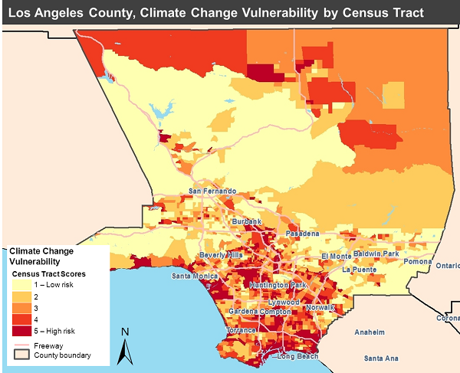

Slide 6
Emission driving
• Congestion mitigation strategies that reduce severe congestion and increase traffic speeds (e.g. ramp metering, incident management, and congestion pricing); •Speed management strategies that bring down excessive speeds to more moderate speeds of approximately 55 mph (e.g. enforcement and ISA)
• Traffic smoothing strategies that reduce the number and intensity of acceleration and deceleration events (e.g. variable speed limits and ISA).

Slide 7
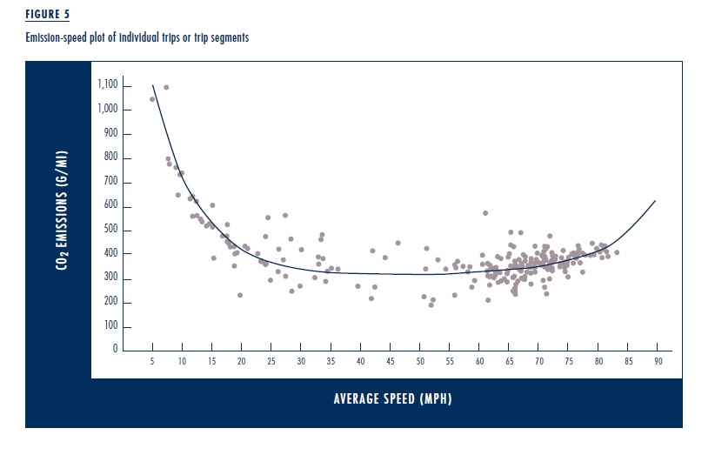

Slide 8
Fossil fuels contribution
When fossil fuels are burned they release carbon dioxide into the atmosphere which contributes to global warming. Using fossil fuels to generate energy also releases pollutants into the atmosphere - such as sulphur dioxide.(Sulfur dioxide is the chemical compound with the formula SO 2. At standard atmosphere, it is a toxic gas with a pungent, irritating smell).
Carbon levels in the atmosphere because they can lead to increased intensity of drought and flooding.(polar vortex)
(is an upper level low-pressure area, that lies near the Earth's pole.)

Slide 9
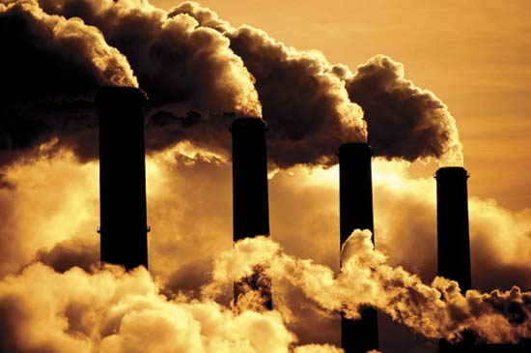

Slide 10
Contribution to climate change
In 2010 California consumed over 18 million gallons of gasoline and diesel fuel. The estimated emission is over 200 million metric tons of greenhouse gas. According to the latest statewide inventory of greenhouse gas emissions values, in 2009 the transportation sector represented 38 percent of statewide greenhouse gas emissions.

Slide 11
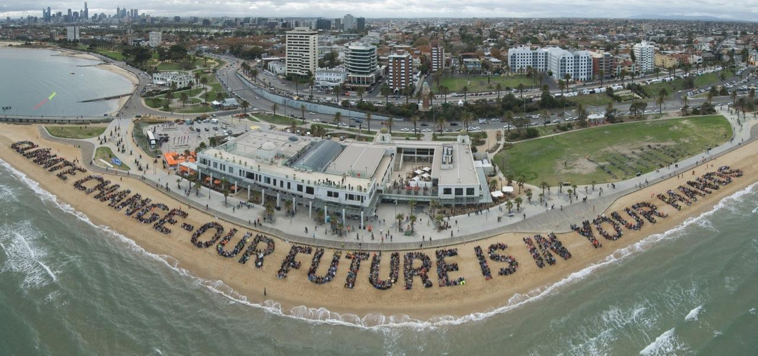

Slide 12
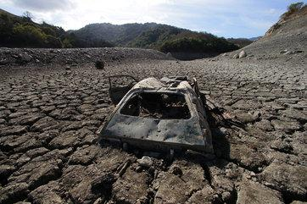
Predictions.
By decreasing the use of fossil fuels Los Angeles will be able to return to their previous state fairly easily. They will gain most of what they had lost because of their efforts in keeping the climates damage to a minimum. But if they continue to use fossil fuels they will surely become part of a lost civilization since many people will leave due to the harsh living conditions. Also if they continue on like this it will make it harder for them to fix, since they’ll be putting even more damage on their land so instead of waiting until it's too late they should do something about this while they still can .

Slide 13
Factors and cope
•Renewable Energy
•Energy Efficiency
•Green Building
•City Vehicle Fleets

Slide 14
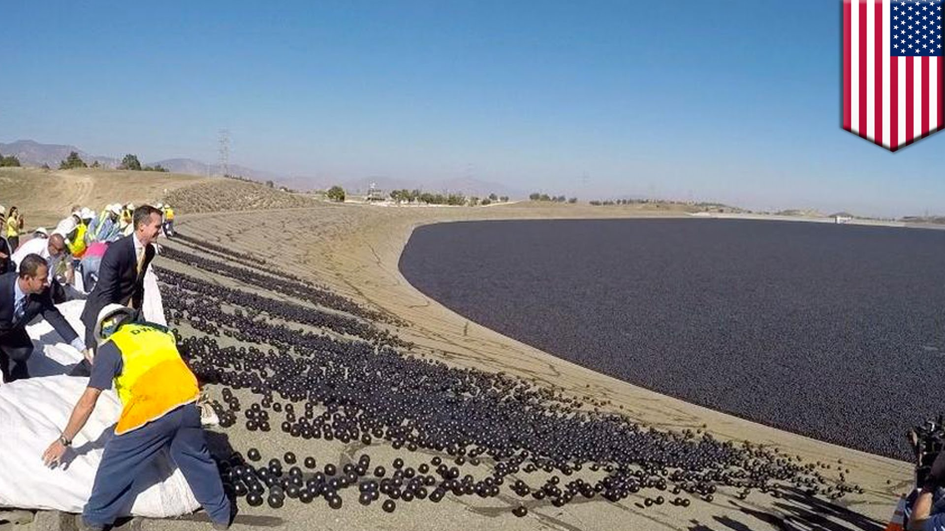

Slide 15
The Future of Los Angeles
We expect that L.A will be part of the lost civilization’s. It will be abandoned because of the hard living conditions. An increase of temperature means an increase in people who have asthma and heart diseases. Speaking of disease there will also be an increase in diseases due to the warmer weather, for example the sika virus which was only known to be found in areas like southern Africa is being found in the
LA. People who are living in LA will also experience extreme heat days where temperatures can rise above 95 degrees, yes they already do have these “extreme heat days “ but now they’ll be having an average of 22 heat days a year, 11 times their usual amount.

Slide 16
Sources
1.https://www.epa.gov/climatechange/climate-change-basic-information
2. http://climate.naauses/sa.gov/c
3.http://www.energy.ca.gov/transportation/
4.lhttp://la.curbed.com
5. http://www.latimes.com

