Slide 1
I N D I A
CLIMATE CHANGE
Fayza Houssain, Asmaa bykbane, Vincent Chen

Slide 2
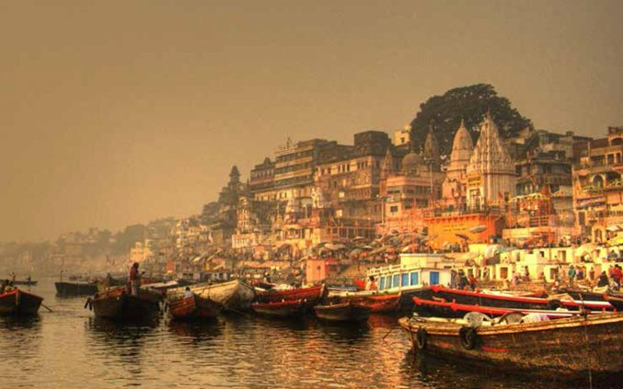
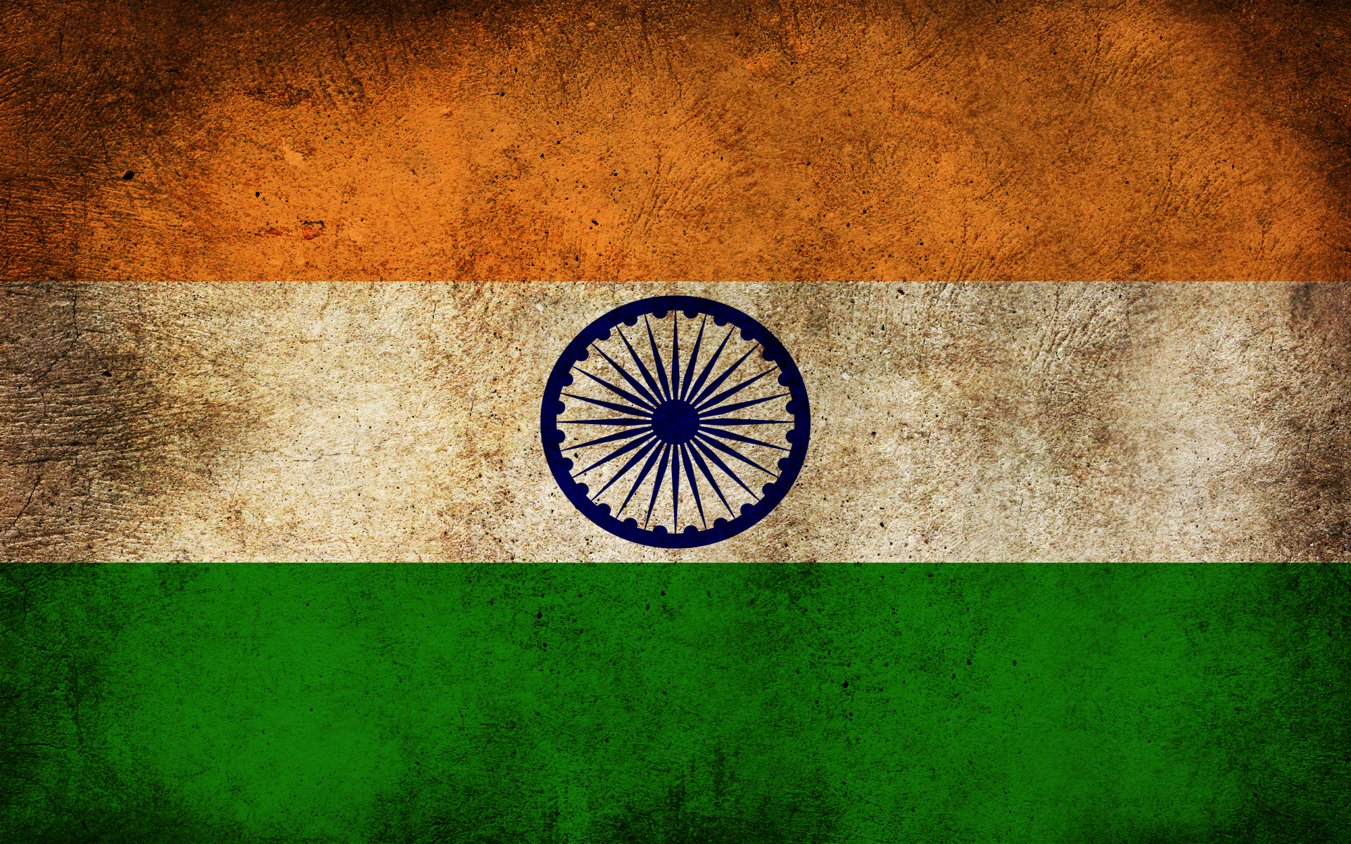
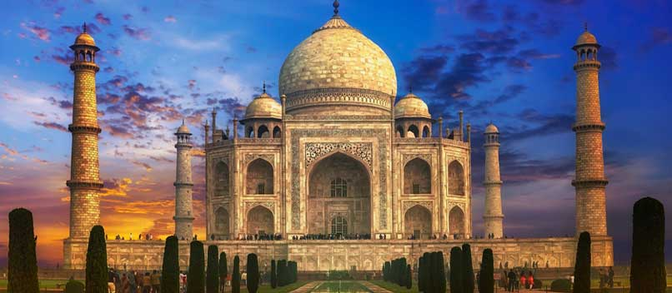
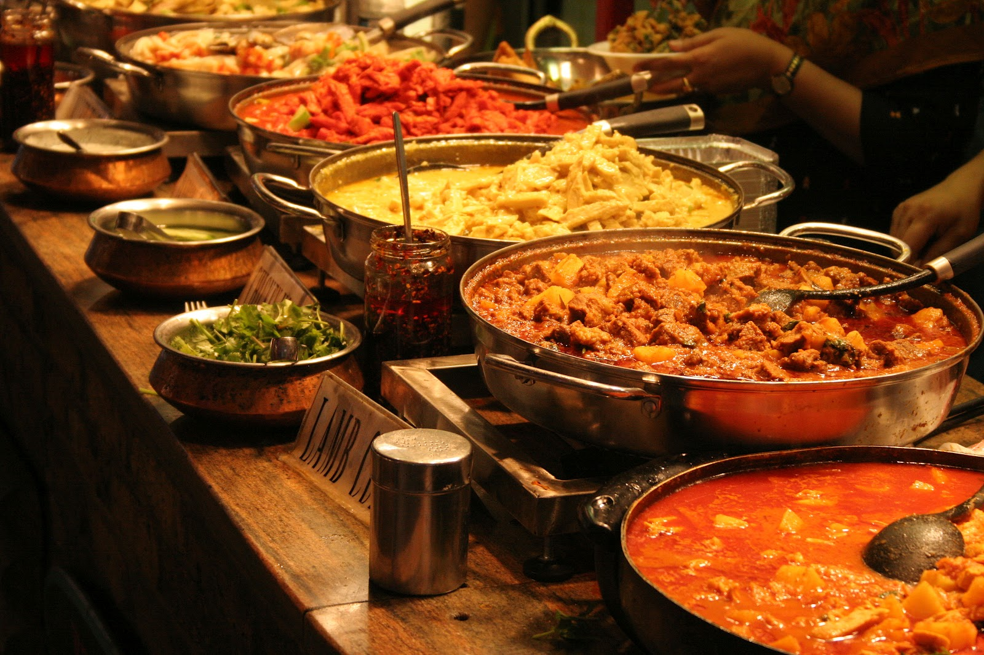

Slide 3
INTRODUCTION
India, the second most populous country of the world with a population over 1.3 billion, is a large country in South Asia. It shares a coast line of 7517 km with the Indian Ocean, the Arabian Sea and the Bay of Bengal. It has land boundaries with Pakistan, China, Nepal, Bhutan, Burma and Bangladesh.
The Indian economy is considered as one of the fastest growing major economies. However, the country is plagued by the climatic disasters that continue to wreak havoc on its economy. As a result, in spite of the leaping economical progress, the majority of the people of India continue to live in poverty, with malnutrition and diseases corroding the society.

Slide 4
CLIMATE OF INDIA
India exhibits a wide diversity of temperatures. The Himalayas participate in warming by preventing the cold winds from blowing in, and the Thar desert attracts the summer monsoon winds, which are responsible for making the majority of the monsoon season of India. However, the majority of the regions can be considered climatically tropical.
The climate of India is dominated by the monsoon season, which is the most important season of India, providing 80% of the annual rainfall. The season extends from June to September with an average annual rainfall between 750–1,500 mm across the region. The monsoon India is regarded as the most productive wet season on the earth.

Slide 5
Natural Factors which Influence the Climate of India
1. Location and Latitudinal Extent:
Areas south of the Tropic of Cancer are closer to the equator and experience high temperature throughout the year. The northern parts on the other hand lie in the warm temperature zone.Some places record considerably low temperatures particularly in winter. Water bodies comprising the Arabian Sea and the Bay of Bengal surround the peninsular India and make climatic conditions mild along the coastal areas.
2. Distance from the Sea:
Areas near the coast have equable or marine climate. On the contrary, interior locations are deprived of the moderating influence of the sea and experience extreme or continental climate.
3. Upper Air Circulation:
The changes in the upper air circulation over Indian landmass influence the climate of India to a great extent. Jet streams in the upper air system is responsible for Winter rain and heat storms in north-western plains and occasional heavy snowfall in hilly regions.

Slide 6
Natural Factors which Influence the Climate of India
4. Monsoon Winds:
The most dominating factor of the Indian climate is the ‘monsoon winds’ as a result of which it is often called the monsoon climate.The complete reversal of the monsoon winds brings about a sudden change in the seasons—the harsh summer season suddenly giving way to eagerly awaited monsoon or rainy season.
The south-west summer monsoons from the Arabian Sea and the Bay of Bengal bring rainfall to the entire country.
5. El-Nino Effect:
El-Nino is a narrow warm current which occasionally appears off the coast of Peru in December. This current is responsible for wide spread floods and droughts in the tropical regions of the world.
6. Southern Oscillation:
There is a strange linkage of meteorological changes often observed between the Indian and the Pacific Oceans. When the winter pressure is high over the Pacific Ocean and low over the Indian Ocean, the south-west monsoons in India tend to be stronger. In the reverse case, the monsoons are most likely to be weaker.

Slide 7
Impacts of global warming on climate of India
The effect of global warming on the climate of India has led to climate disasters as per some experts. India is a disaster prone area, with the statistics of 27 out of 35 states being disaster prone, with foods being the most frequent disasters. The process of global warming has led to an increase in the frequency and intensity of these climatic disasters.
The anticipated increase in precipitation, the melting of glaciers and expanding seas have the power to influence the Indian climate negatively, with an increase in incidence of floods, hurricanes, and storms.
Global warming may also pose a significant threat to the food security situation in India.
According to the Indira Gandhi Institute of Development Research, if the process of global warming continues to increase, resulting climatic disasters would cause a decrease in India’s GDP to decline by about 9%, with a decrease by 40% of the production of the major crops.
A temperature increase of 2° C in India is projected to displace seven million people, with a submersion of the major cities of India like Mumbai and Chennai.
Notes:
https://upload.wikimedia.org/wikipedia/commons/3/35/India_climatic_disaster_risk_map_en.svg

Slide 8
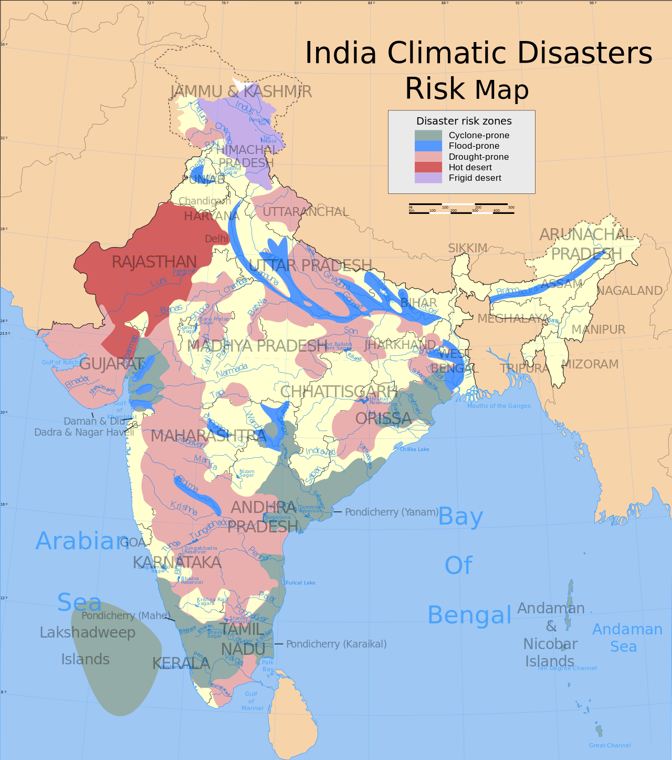

Slide 9
Recent climatic disasters in India due to global warming
Floods
India is the most flood distressed state in the world after Bangladesh, accounting for 1/ 5th of the global deaths every year with 30 million people displaced from their homes yearly.
Approximately 40 million hectares of the land is vulnerable to floods, with 8 million hectares affected by it. Unprecedented floods take place every year at one place or the other, with the most vulnerable states of India being Uttar Pradesh, Bihar, Assam, West Bengal, Gujarat, Orissa, Andhra Pradesh, Madhya Pradesh, Maharashtra, Punjab and Jammu & Kashmir.
The climatic history of India is studded with a very large number of floods, which have wreaked havoc on the country’s economy.

Slide 10
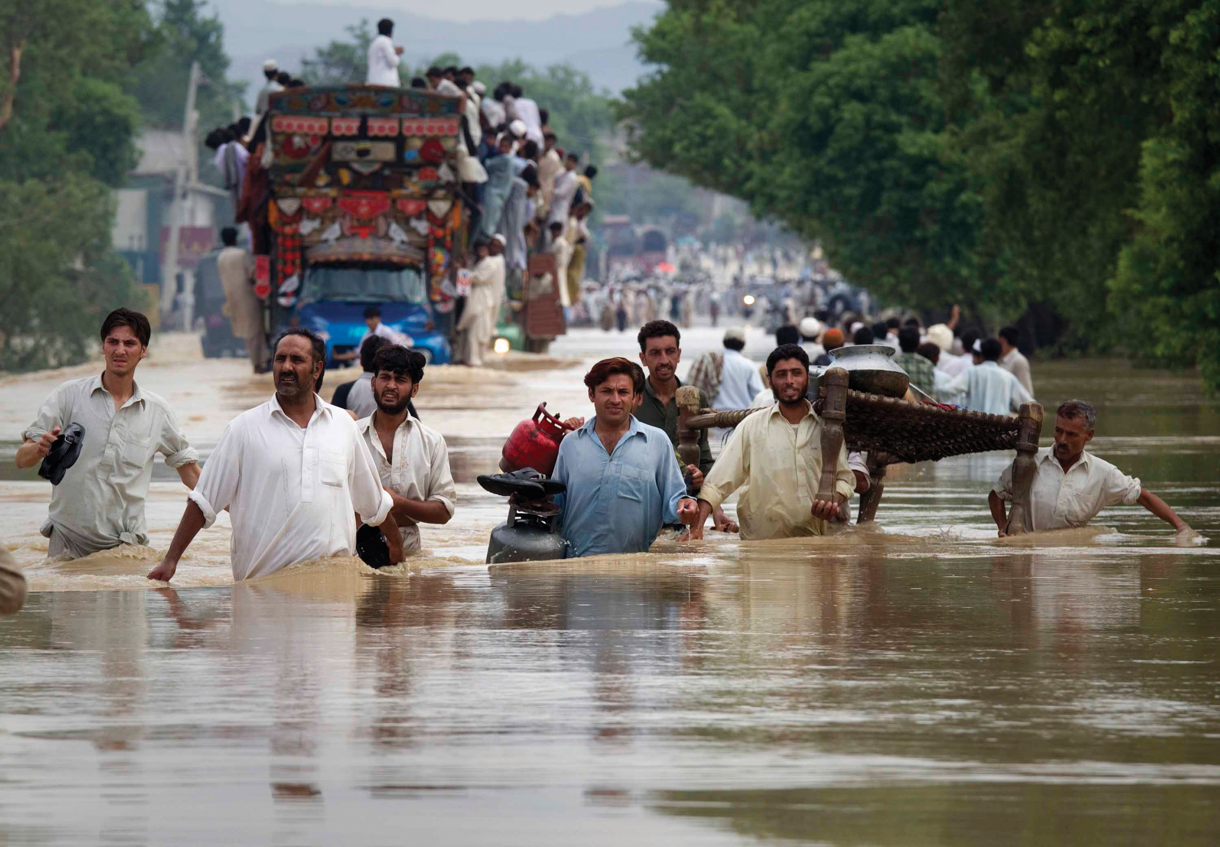
Notes:
https://youtu.be/ DbQL804QXMk

Slide 11
Recent climatic disasters in India due to global warming
Droughts
The process of global warming has such an impact on the climate that it increases the severity of precipitation at one time, and minimizes it in the other. Therefore, this process has resulted in severe drought like conditions in India, with tens of millions of deaths resulting from it in the past few centuries.
India depends heavily on prolonged and optimum monsoons for its agricultural productivity, failure of which results in the decreased crop productivity, leading to droughts.
Of the total agricultural land in India, about 68% is prone to drought of which 33% is chronically drought prone, receiving rainfall of less than 750mm per year.

Slide 12
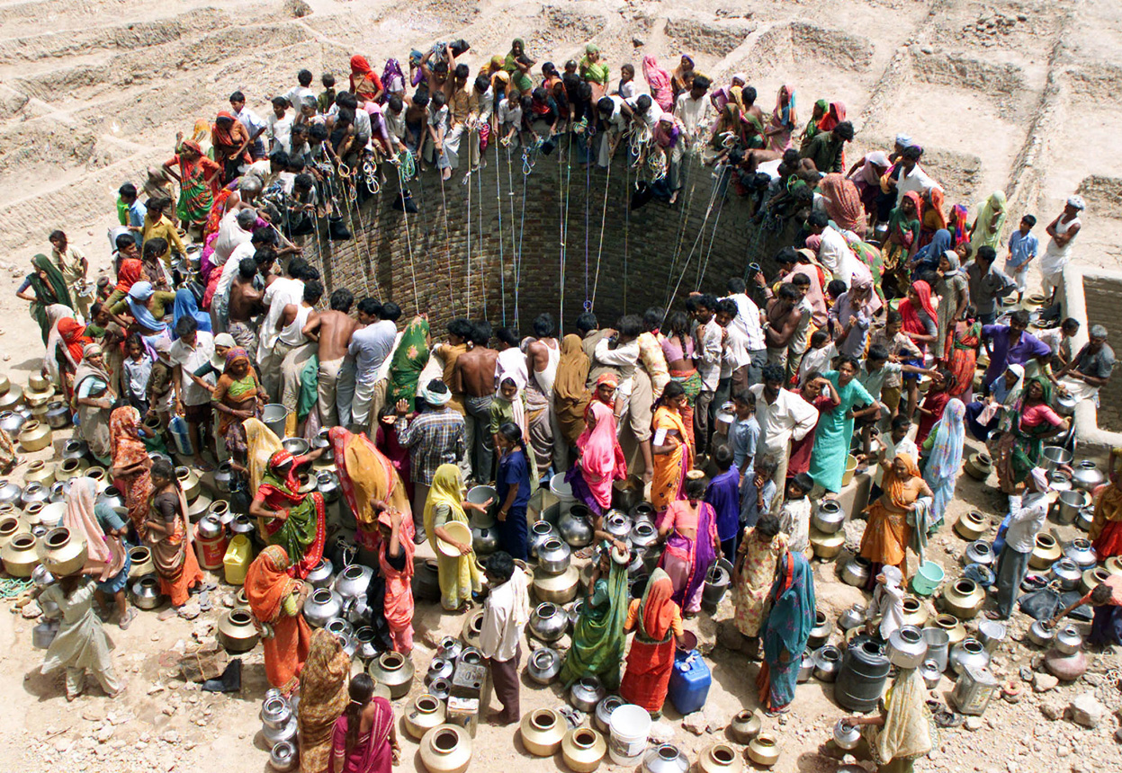
Notes:
https://youtu.be/4zf4VvhCBMk

Slide 13
Recent climatic disasters in India due to global warming
CYCLONES
As a result of global warming, the average number of Category 4 and 5 hurricanes per year has increased over the past 30 years. India has an 800 km coastline, and is therefore very susceptible to cyclonic activity.
Cyclones have been observed to be more frequent in the Bay of Bengal than the Arabian Sea.
The National Institute of Oceanography (NIO), under the Council of Scientific and Industrial Research (CSIR), Government of India, researched on the impacts of climate change on sea level, and concluded that an increased occurrence of cyclones in the Bay of Bengal, particularly in the post-monsoon period, along with increased maximum wind speeds associated with cyclones and a greater number of high surges under climate change has been observed. In addition, the strength of tropical cyclones, which represent a threat to the eastern coast of India and to Bangladesh, is also likely to increase.

Slide 14
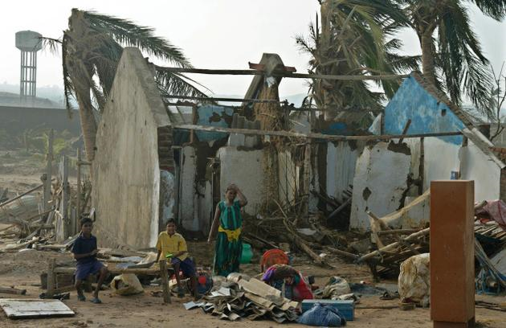
Notes:
https://youtu.be/0aJZbM-qOAk

Slide 15
INDIA: Climate Change Impacts
Groundwater
More than 60% of India’s agriculture is rain-fed, making the country highly dependent on groundwater.Even without climate change, 15% of India’s groundwater resources are overexploited.
Glacier Melt
At 2.5°C warming, melting glaciers and the loss of snow cover over the Himalayas are expected to threaten the stability and reliability of northern India’s primarily glacier-fed rivers, particularly the Indus and the Brahmaputra. The Ganges will be less dependent on melt water due to high annual rainfall downstream during the monsoon season.
Sea level rise
With India close to the equator, the sub-continent would see much higher rises in sea levels than higher latitudes.
Sea-level rise and storm surges would lead to saltwater intrusion in the coastal areas, impacting agriculture, degrading groundwater quality, contaminating drinking water, and possibly causing a rise in diarrhea cases and cholera outbreaks, as the cholera bacterium survives longer in saline water.

Slide 16
INDIA: Climate Change Impacts
Agriculture and food security
Seasonal water scarcity, rising temperatures, and intrusion of sea water would threaten crop yields, jeopardizing the country’s food security.Under 2°C warming by the 2050s, the country may need to import more than twice the amount of food-grain.
Energy Security
Climate-related impacts on water resources can undermine the two dominant forms of power generation in India - hydropower and thermal power generation - both of which depend on adequate water supplies to function effectively.
Water Security
Many parts of India are already experiencing water stress, satisfying future demand for water will be a major challenge. Urbanization, population growth, economic development, and increasing demand for water from agriculture and industry are likely to aggravate the situation further.
Notes:
https://youtu.be/A8gcGaIzqIw

Slide 17
INDIA: Climate Change Impacts
Health
Climate change is expected to have major health impacts in India- increasing malnutrition and related health disorders such as child stunting - with the poor likely to be affected most severely. Child stunting is projected to increase by 35% by 2050 compared to a scenario without climate change.
Malaria and other vector-borne diseases, along with and diarrheal infections which are a major cause of child mortality, are likely to spread into areas where colder temperatures had previously limited transmission.
Heat waves are likely to result in a very substantial rise in mortality and death, and injuries from extreme weather events are likely to increase.
Migration and conflict
South Asia is a hotspot for the migration of people from disaster-affected or degraded areas to other national and international regions.
The Indus and the Ganges-Brahmaputra-Meghna Basins are major trans boundary rivers, and increasing demand for water is already leading to tensions among countries over water sharing.

Slide 18
INDIA STEPS TO FACE THE CLIMATE CHANGE
India has formally joined the Paris climate change agreement that was signed on April 22, 2016.
The Paris agreement is the first kind of global agreement that aims to control global warming.
The Paris agreement calls on countries to take actions post-2020 to combat climate change and intensify their efforts needed for a sustainable low carbon future. it is meant to limit global warming " well below" 2 degrees Celsius and as close to 1.5 degrees Celsius as possible to increase economic ability to adapt to extreme climate.
The government of India has taken an action know as the community based disaster preparedness. It functions with the help of the local people as well as the non governmental organization in order to help prepare the people for different climatic disasters. They helped prepare, organize, and provide relief to the affected community. They also prepared seasonal calendars to predict the climatic disasters, mapped the risks faced by the community and took actions to prevent them.

Slide 19
Example of adaptation with climate change
In India, climate change is forcing farmers to adapt in order to survive. While scientists race to breed a new batch of climate-resilient super seeds, locals are instead turning to the ways of their ancestors.
Notes:
https://youtu.be/A8gcGaIzqIw

Slide 20
SUGGESTION : Before The Flood
The term climate change may seem unimportant to most individuals, this heavy scientific word is believed by most people as nonsense and has nothing to do with us.
National Geographic has produced a documentary called "Before The Flood" talking about the case of "Climate change " or the so-called global warming" . The movie itself opens your eyes to a lot of things and proves the theory of climate change.
This movie came out on October 30,2016 which Leonardo DiCaprio is starring in and is directed by Fisher Stevens with the subject of climate change.
Notes:
https://www.youtube.com/watch?v=90CkXVF-Q8M

