Slide 1
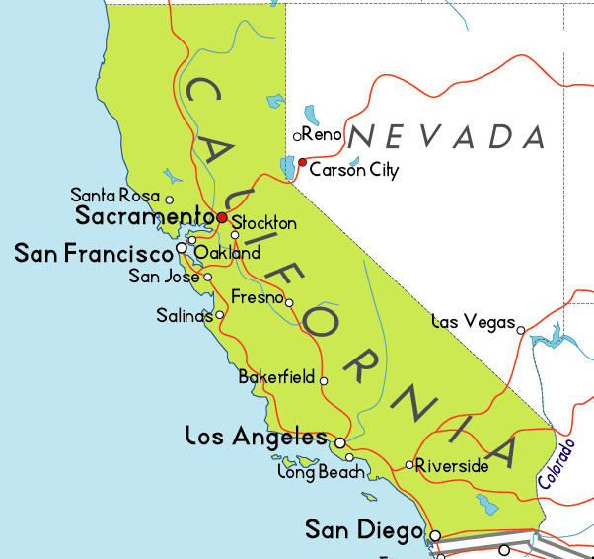
Climate Change Affects on California
BY: Irene
Mirella
Umama

Slide 2
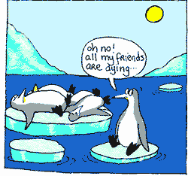
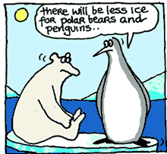
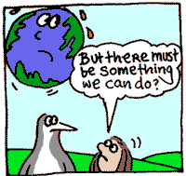
What is Climate change ?
So, Climate Change is a long-term change in the earth's climate, especially a change due to an increase in the average atmospheric temperature. It includes patterns of temperature, rain or snow, humidity, wind and seasons.
And Caused by:
NO1. Human Activities !!!!!!!!
The Greenhouse Effect
Gases that Play a Part Volcanic Eruptions
Deforestation

Slide 3
How Much Does Human Activity Affect Climate Change?
It’s clear, based on over a century of scientific investigation by scientists, that humans are responsible for most of the climate change. Basically, Human activities contribute to climate change by causing changes in Earth’s atmosphere in the amounts of greenhouse gases, aerosols (small particles), and cloudiness.
Human activities result in emissions of four :
principal greenhouse gases:
1) Carbon dioxide (CO2)
2) Methane (CH4)
3) Nitrous oxide (N2O)
4) Halocarbons (a group of gases containing fluorine, chlorine and bromine).

Slide 4
How does greenhouse gases affect the atmosphere?

Slide 5
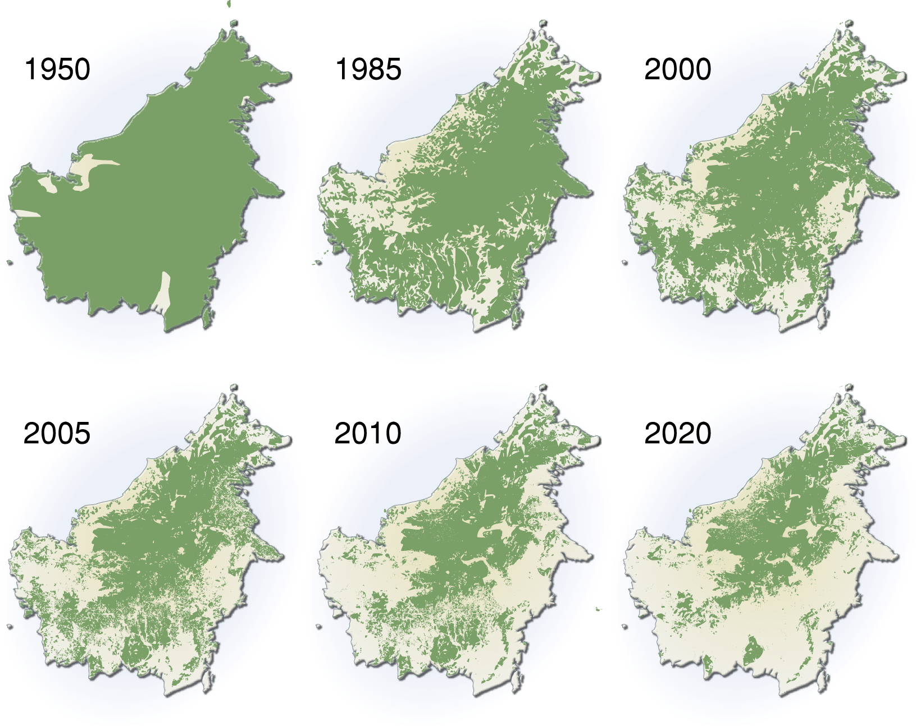
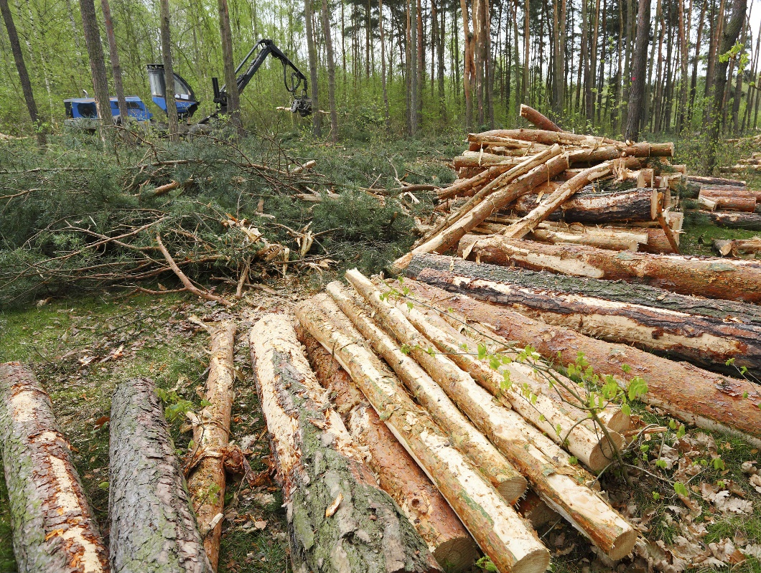
Deforestation
Deforestation-This increases soil temperature and the rate of carbon oxidation in the soil. Carbon oxidation is a process by which carbon in the soil reacts with oxygen in the atmosphere to produce carbon dioxide.

Slide 6
Temperature Change In California

Slide 7
California drought over time

Slide 8
Causes of Drought in California ( or Country)
The scientists said the type of atmospheric conditions causing California’s drought very likely exist because of human-created emissions of large amounts of carbon dioxide and other greenhouse gases.
The report concluded that human-caused climate change increased the severity of heat waves in Asia, Australia and Europe, while an extremely cold and wet winter in Europe.
Global warming caused by human emissions has most likely intensified the drought in California by 15 to 20 percent, the future dry spells in the state are almost certain to be worse than this one as the world continues to heat up.

Slide 9
Impacts of Drought in California
Economic Impacts ( Industries)
Farmers may lose money if a drought destroys their crops.
Businesses that depend on farming, like companies that make tractors and food, may lose business when drought damages crops or livestock.
Water companies may have to spend money on new or additional water supplies.
Businesses that sell boats and fishing equipment may not be able to sell some of their goods because drought has dried up lakes and other water sources.
If a farmer's water supply is too low, the farmer may have to spend more money on irrigation or to drill new wells.
Barges and ships may have difficulty navigating streams, rivers, and canals because of low water levels, which would also affect businesses that depend on water transportation for receiving or sending goods and materials.
Environmental Impacts
Losses or destruction of fish and wildlife habitat.
Increase in disease in wild animals, because of reduced food and water supplies
Increased stress on endangered species or even extinction
Social Impacts
- Health problems related to low water flows and poor water quality.
- Threat to public safety from an increased number of forest and range fires
- People may have to move from farms into cities, or from one city to another.

Slide 10
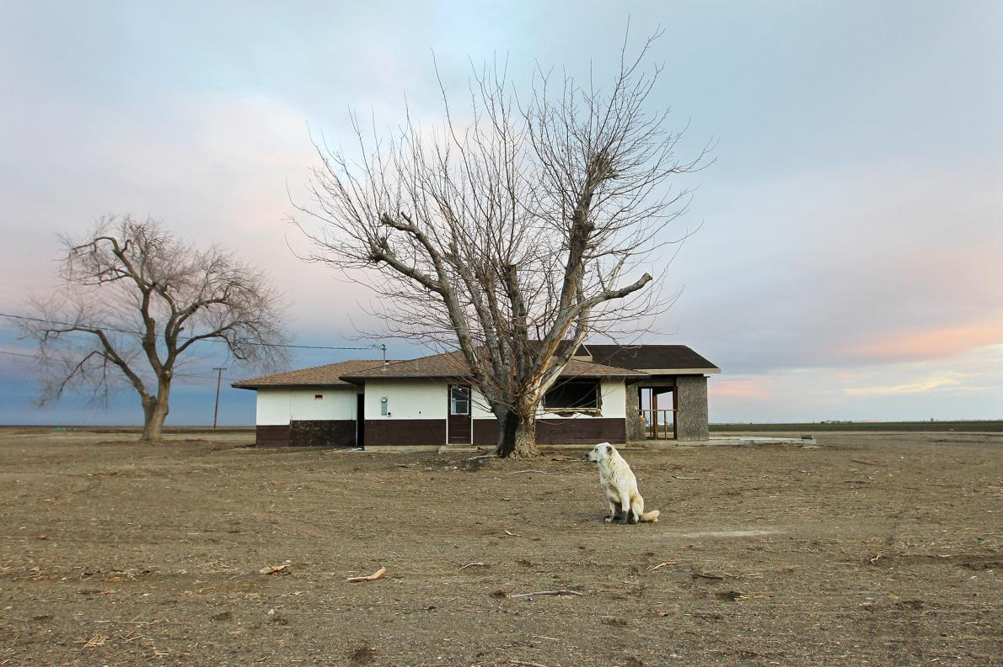
5 Key Threats to California From Climate Change
Drought and Wildfires
-Climate scientists predict the region will get even hotter and drier. And as more of the state's precipitation falls as rain instead of snow in the mountains, it will run off the land more quickly, ending up in the ocean. Lack of water has also led to more and larger wildfires.
Coastal Danger
-The majority of Californians live along the coast, where they enjoy the storied beaches and bask in the mild climate created by ocean currents and winds.
Bad Air Days
-California already has the toughest air quality standards in the country, but much of the state still suffers from pollution.
Spreading Disease
-Increasing dust also promotes the spread of valley fever, a potentially fatal disease that affects about 150,000 people a year.
Loss of Native Fish
-California once supported vibrant commercial and recreational fisheries, but the fish have long been in decline.

Slide 11
So Next Time when you think of California, don’t just think of beach babes, Cars, or Movie Stars instead think of the real problems actually happening.. Or else yknow.. you DIE.
Plain and simple

