Slide 1
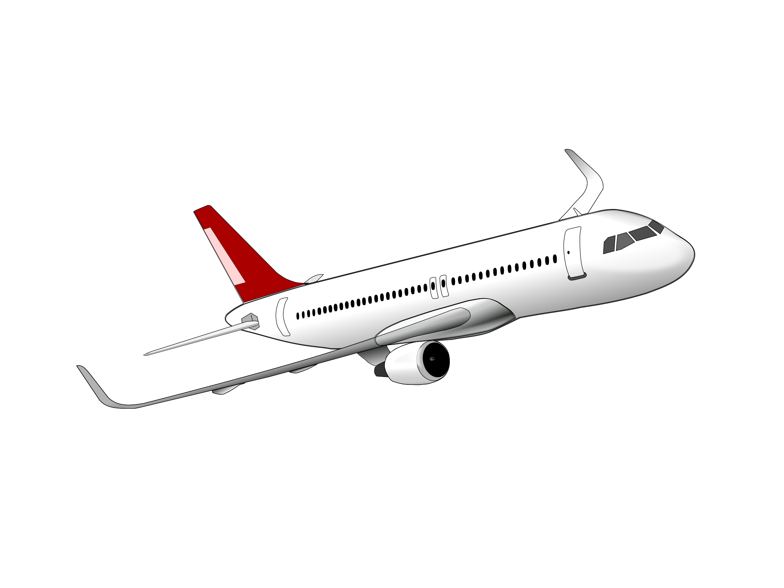
ROBOTS IN SPACE
BLOG by HUSAAN IQBAL

Slide 2
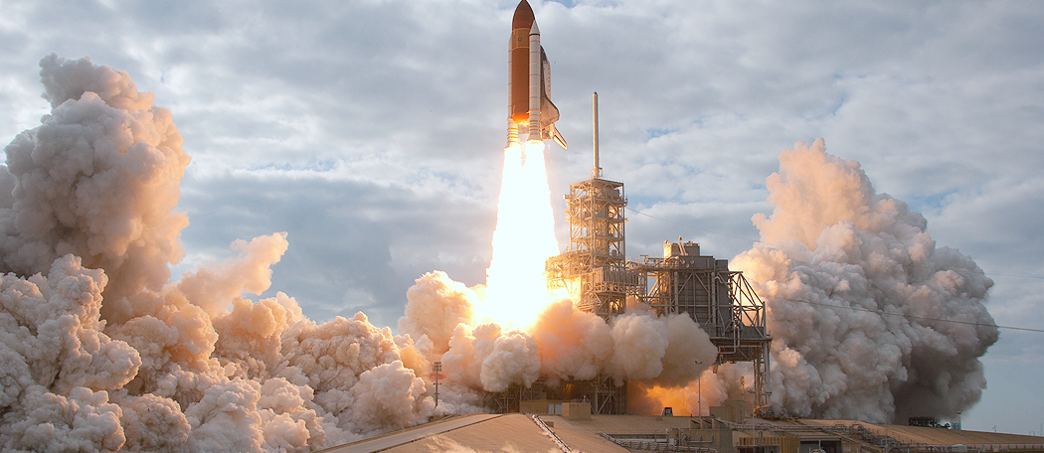
Bio
My name is Husaan Iqbal. I’m a born and raised New Yorker out of Queens. I attend New York City College of Technology with a major in Mechanical Engineering. I’m also an Aircraft Maintenance Engineer who works on Airbus and Embraer Aircraft. My profession keeps me interested in the field of Aviation and Robotics, but I’ve been an enthusiast of space exploration and mechanical devices from an early age. I can be contacted through email at Husaan.Iqbal@mail.citytech.cuny.edu, I’m also available to take requests and ideas to post here. Thank You for subscribing.

Slide 3
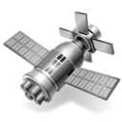
Mission Statement
The goal of Robots in Space is to engage today’s readers with industries and technologies that are shaping our future. Thinkers and innovators are busy bringing us into another space race. By discovering our universe through new space vehicles and wondrous robotics, there is so much to know and learn. This blog will explore how space exploration and robotics are inching us further from our exosphere. The focus is to keep readers of similar majors and interests informed on space exploration through the growing industry of space transport and zero gravity flights. The other focus of this blog is to keep readers up to date on the growing industry of robotics through news on the progress of robot development, such as new sensory equipment and portability for remote use. Hopes are that such information will attract students and professionals of engineering descent but also gain readers from other fields.

Slide 4
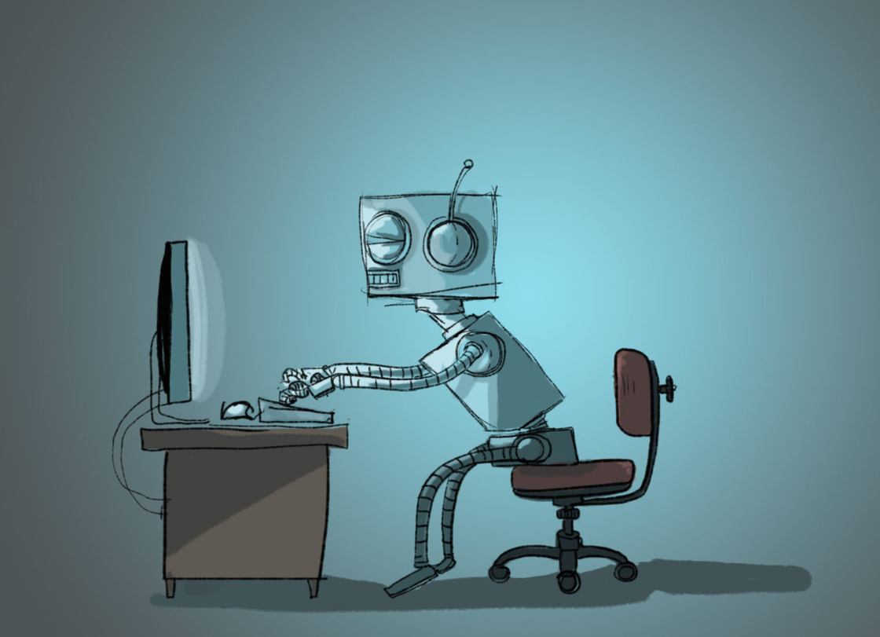
Typical Blogging
A Typical blog post consists of a new idea or invention for Space Exploration and research. An image is included that proposes what the space vehicle or satellite might look like while it’s still under development or testing phase. An explanation is given of why the project is being commissioned and what are the plans to do with it. Specs are given to show what went it to making the orbiter and how it will use its technology to make us understand space life.

Slide 5
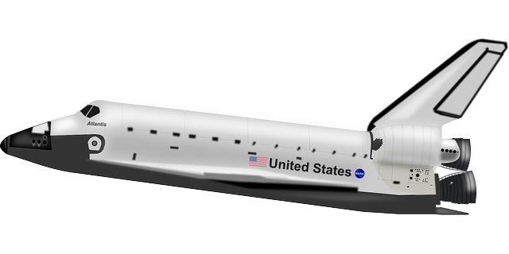
Series Blogging
My blog series is about multiple projects in progress from India, China, and the United States to design and build the next generation rovers that will study the soil and atmosphere of Mars. Some of these projects will return the soil to Earth for analysis.

Slide 6
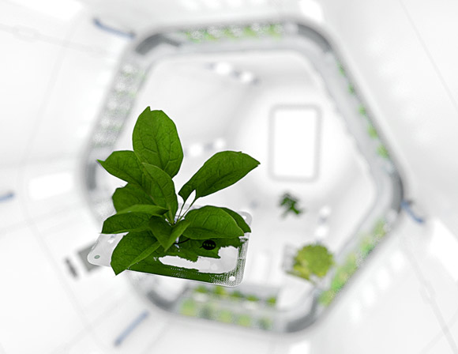
Guest Blog
To stay relevant with my peer’s food blog, My blog post is about growing vegetables in Space to provide Astronauts with a healthy dose of veggies. By the use of LED lights and an environmentally controlled atmosphere, Astronauts will test weightless growth of plants in hopes to have a future presence of veggies in Space.

Slide 7
Conclusion
Although there is so much happening in the Space Exploration industry and the field of Robotics, there is only limited time in the semester left. My hopes are to keep the “Robots in Space” blog updated as long as I can after the semester is over and provide subscribers with an interesting feed of news. Thank You Ms. Sears for enabling us to blog and express our interests.

