Slide 1
Xerostomia
By Emily Wong

Slide 2
Xerostomia:
is defined as dry mouth resulting from reduced or absent of saliva.
Importance of saliva:
Lubricates oral cavity
Helps chew food
Prevents decay
Regulate acidity
Helps kill bacteria

Slide 3
Causes of xerostomia
Medication such as antihistamines or hypertensive medication (high blood pressure) and many others
Poorly controlled diabetes
Age is NOT a risk factor, but elderly take more medications that can cause dry mouth
Radiation to the head and neck
Damage to salivary glands
Tobacco use
Sleeping with mouth open
Dehydration

Slide 4
symptoms that patients may complain about
Dryness in the mouth
Cracked lips
Red parched or fissured tongue
Caries at the cervical 1/3 of teeth
Bad breath
Painful tongue
Problems speaking
Problems swallowing and chewing
Problems tasting food

Slide 5
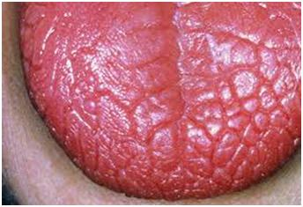
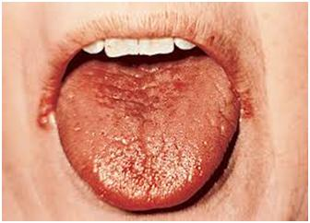

Slide 6
symptoms that effects patients’ hygiene
More frequent gum disease
More tooth decay
More calculus build up
Enamel erosion

Slide 7
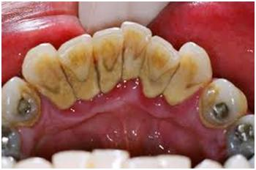
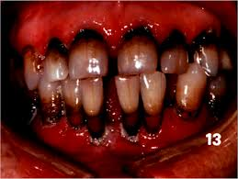
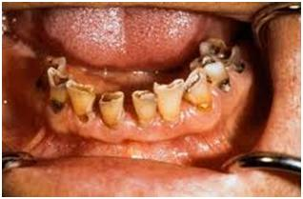

Slide 8
treatments
If other medication is the problem, then the doctor can alter the dosage or prescribe another drug that is less likely to cause dry mouth
Prescribe medication that stimulates saliva production
Change of diet: minimize alcohol and caffeine consumption
Use mouth rinse such as Biotene

Slide 9
Dental hygiene care
As the first line of defense, it is important to identify the problem if there is one and educate patient
Teach patient ways to prevent further gum disease and tooth decay
Suggest a mouth rinse for the dry mouth and tooth paste with fluoride.

