Slide 1
Theobromine
By: Jose Torija Gutierrez, Elizabeth Ramirez and Helen Chen
Section:D206

Slide 2
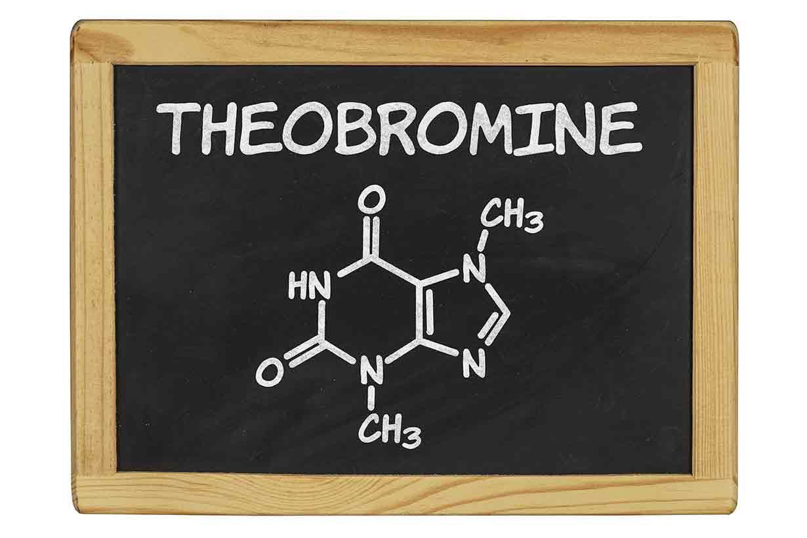
Theobromine
Alkaloid and Naturally Occurring Compound

Slide 3
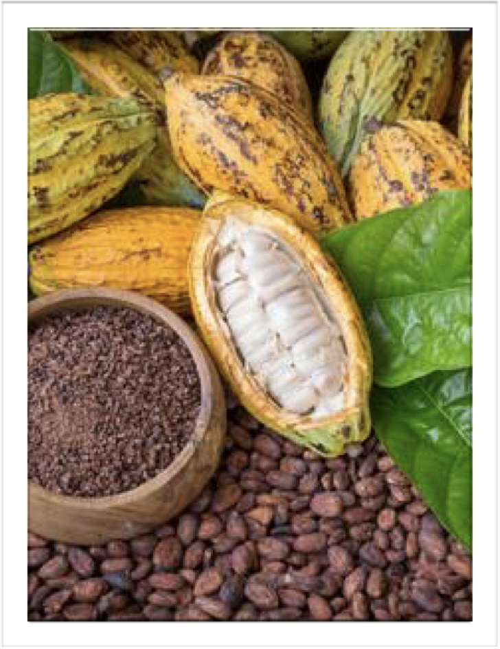
Theobromine: Introduction
While we came across the most expensive toothpaste, we noticed the ingredient it contained, theobromine. Theobromine is a bitter alkaloid and naturally occurring compound found in leaves of tea plants, kola nut, and as well as in a few other foods, but the most common and with higher amounts of theobromine is found in the cacao plant therefore is found in dark chocolate.

Slide 4
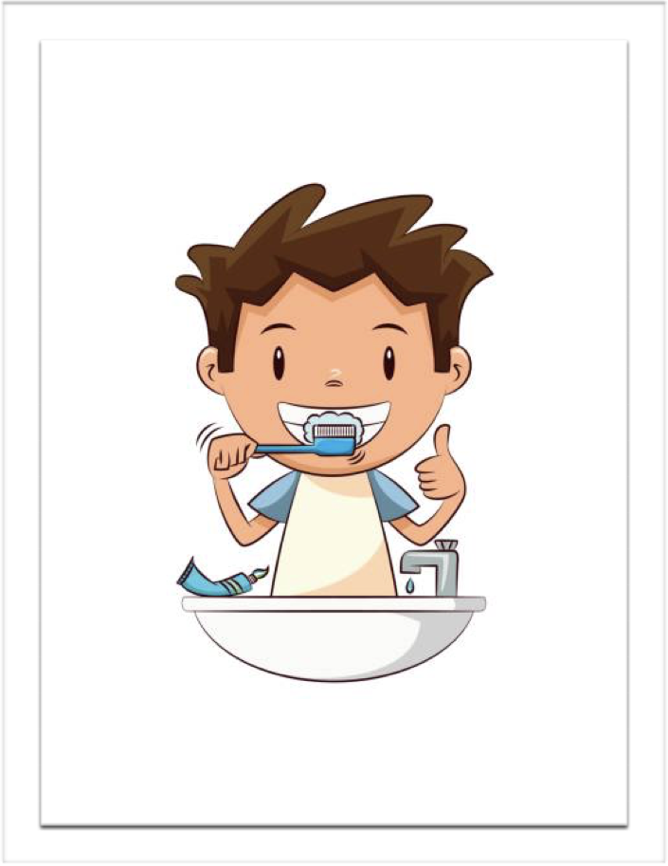
Why Theobromine?
With very little knowledge on this ingredient, we dug further for research. According to some studies that we found, Theobromine alone has been shown to reduce the roughness of the enamel surface caused by erosion, desensitizer and antimicrobial agent, which is why we decided to focus on this topic. Unfortunately, only one expensive toothpaste was found with this ingredient. If theobromine was known more in the dental field, there might be a possibility to produce more affordable dentifrices containing this ingredient.

Slide 5
Theobromine and Its Antimicrobial Activity
Effect of theobromine in antimicrobial activity is an in Vitro study conducted by Arthi Lakshmi, C. Vishnurekha, and Parisa Norouzi Baghkomeh.
The study purpose is to compare the antimicrobial activity of theobromine toothpaste (a non-fluoridated paste) and two well-known kids fluoride toothpaste.
Theobromine is an alkaloid and naturally occurring compound mostly found in the cacao plant and therefore it can be found in high amounts in dark chocolate, it can also be found in small amounts in tea leaves.
This study was done with Freeze-dried cultures that included Streptococcus mutans, Lactobacillus acidophilus, Enterococcus faecalis, and Candida albicans which are known to be cariogenic. They were cultured in Muller-Hilton agar with Theobromine toothpaste, Kidodent toothpaste, and Colgate Kid’s toothpaste to demonstrate the antimicrobial effects of each toothpaste.
They recorded the results by using a Hi Antibiotic zone scale, a convenient and means of accurate antibiotic zone reading, and to overcome any technical error the test was repeated six times and then they were statistically analyzed.

Slide 6
Theobromine and Its Potential Remineralization
The authors conduct this study because they want to investigate the potential of remineralization with concentrations of Theobromine (100mg/mL and 200mg/mL), Fluoride, Nova min, and Nano-hydroxyapatite.
Before the study, dental caries is a complex disease that disregard any gender, age, and ethnicity, and it's a continuous process. In there for remineralization is the most immediate and straightforward repair damaged enamel. As familiar to everyone, three elements- calcium, phosphate, and fluoride can act together to reverse the demineralization of teeth. So most of the toothpaste that use commonly in every family are included these three elements. Thus people are frequently exposed to a low level of fluoride and have a proper prevention of dental caries. And regularly using these three elements made authors interest in finding other newly invented ingredients that can alternatively use to prevent dental caries, and that is Theobromine.
The authors aim to learn from this investigation is the ingredient Theobromine can rebuild the damaged enamel, and it has the same effect as other ingredients that commonly use in toothpaste.The study finds fluoride's mean 60.74, Nano-hydroxyapatite'smean 65.48, and Theobrome (100mg/mL 's mean 66.27 and 200mg/mL's mean 62.47 ) were having closer mean percentages to each other, and just Nova Min had a stand out mean rate is 31.99. These data proved that Theobromine has a similar effect to Fluoride and Nano hydroxyapatite.The results weren't statistically significant when researchers wanted to get the evidence that Theobromine could be an ingredient to remineralized the teeth and capable of preventing caries.

Slide 7
Results of Potential Remineralization Activity
The authors concluded that all the ingredients can be helpful to remineralize the enamel surfaces and in there for better preventing dental caries, which caries could be happening on any gender, age, and ethnicity. These experiments help authors to understand better and would share the knowledge of Theobromine is another ingredient and choice to help reduce enamel demineralized. The authors mentioned that the cost constraint of this experiment was limited. Thus they couldn't have a better result and recommend future similar operations should gain a large sample size in there for better evaluation of the remineralization potential of Theobromine.

Slide 8
Effectiveness of Theobromine
A pre-clinical research study, Effectiveness of Theobromine on Enamel Remineralization: A Comparative In- Vitro Study, by Parvathy Premnath, Joseph John, Nithin Manchery et al. The research study compared the effects of dentifrices [(Theodent) - theobromine, (ClinPro)0.21% Sodium Fluoride (NaF) plus functionalized Tricalcium phosphate(f-TCP), and (AmFlor) amine fluoride)] on enamel remineralization. The study was conducted in the Department of Public Health Dentistry, Saveetha Dental College and Hospital and was published on, September 17, 2019.
The aim of this study was to demonstrate the remineralization of early carious lesions. Fluoride works in the presence of calcium and phosphate ions in saliva. However, dentifrices containing fluoride does not effectively benefit those with a salivary gland disorder and may be toxic to someone with severe thyroid conditions. Theobromine, a bitter alkaloid found in cocoa, has been found to have remineralizing effects on carious lesion. Research on theobromine has also shown to benefit those with respiratory tract problems, which we see a lot in those affected by this year’s pandemic (COVID-19).
Design method: Human maxillary premolars (in good condition) were extracted and demineralized. A demineralizing solution was composed and set at a pH level of 4.4 to create artificial lesions. After being submerged in the demineralizing solution for 96 hours the teeth were sectioned into 27 longitudinal slices and placed into groups. Group A (NaF + f -TCP) + 9 specimens, Group B (amine fluoride) + 9 specimens, and Group C (theobromine) + 9 specimens. The specimens were exposed to pH cycles in an orbital shaker for seven days. Each day consisted of 2 DML cycles ( 3 hours each) and 1 remineralizing solution(with a pH of 7.0) in between the DML cycles. Before the first DML and before and after the second DML cycle, all groups were exposed to the supernatant for 60 seconds to mimic toothbrushing(3x/day). Each toothpaste supernatant consisted of a mixture of one of the toothpastes with deionized water. A CLSM (confocal laser scanning microscopy) was used to take before and after records. All specimens were placed on frosted glass slides and images were captured at 10x magnification. Data were collected using SPSS software for windows. A paired t-test and one-way analysis of variance (ANOVA) were used to compare the lesion depths. A p- value of <0.05 was set for all tests.

Slide 9
Results of Theobromine
Results showed that all dentifrices showed remineralization. However, theobromine showed the least effect:
Group A, containing the dentifrice Clinpro (0.21% NaF) with f-TCP, showed the most effective remineralization. Group B, containing the dentifrice AmFlor (amine fluoride), came in second most effective. Group C containing the dentifrice Theodent (theobromine) with calcium and phosphate, showed to be the least effective.
Conclusion: Authors acknowledge the fact that theobromine, although the least effective, doesn’t have adverse effects as with dentifrices containing fluoride. Adverse effects include dental fluorosis and gastric irritation. Mottled teeth are an outcome of fluorosis. Fluorosis can be a hazard to children as well as those with motor disadvantages. Therefore, theobromine is a safe alternative to fluoride. Authors also take into consideration limitations such as variation in sample selection and allocation. Limitations also include factors that influence susceptibility of teeth (age of donor and exposures to environmental factors).

Slide 10
Theobromine and Fluoride
Theobromine can be a good option for an extra component in the oral health care system for desensitizer and prevention of caries. Recommending chocolate for anticavity might not be a good idea, but theobromine containing products such as teas can be a good alternative for now. Of course, there is not enough evidence that theobromine can replace fluoride, thus we should always recommend fluoride and proper treatment according to each patient’s needs.

Slide 11
Role of the Dental Hygienist
In a society were holistic methods are rapidly increasing; we found it interesting to know there was an ingredient found in cocoa that can be a safe alternative to fluoride. Many patients go into whole foods and these holistic shops buying anything they believe is a natural remedy. We believe it is essential for a clinician to learn more about these holistic approaches, that way teach patients about the pros and cons. Theobromine could also be safe for children to use. Although, parents should supervise their young one while brushing, many parents don’t have the luxury to watch over their children throughout their whole regimen. Theobromine would benefit those who have an impairment because it is safe if swallowed. Fluorosis would not be a concern with theobromine. It would be interesting if Theobromine became known in the dental world to see and hear the opinions of many dentists. Those with lower socio-economic status would benefit from an ingredient found in cocoa, especially since many are not able to receive proper dental treatments.

Slide 12
References
Arthi Lakshmi, C. Vishnurekha and Parisa Norouzi Baghkomeh. Effects of theobromine in antimicrobial activity: An in vitro study. [PubMed] https://www.ncbi.nlm.nih.gov/pmc/articles/PMC6364351/#__ffn_sectitle.
M I P Irawan et al 2017 J. Phys. The effect of time in the exposure of theobromine gel to enamel and surface hardiness after demineralization with 1% citric acid. [Journal of Physics]https://iopscience.iop.org/article/10.1088/1742-6596/884/1/012005/pdf.
Taneja V, Nekkanti S, Gupta K, Hassija J. Remineralization Potential of Theobromine on Artificial carious Lesions. [PubMed] https://www.ncbi.nlm.nih.gov/pubmed/32039078.
Images taken from:https://www.nutritionadvance.com/theobromine-benefits/, https://www.123rf.com/photo_81163560_ripe-cocoa-pod-and-nibs-cocoa-beans-setup-background-.html, https://media.istockphoto.com/vectors/child-brushing-teeth-vector-id684589628?k=6&m=684589628&s=612x612&w=0&h=hj0KiJKGZd1luclb4jhXKuwwlydNzTnpcpfPIxuEg1U=

