Slide 1
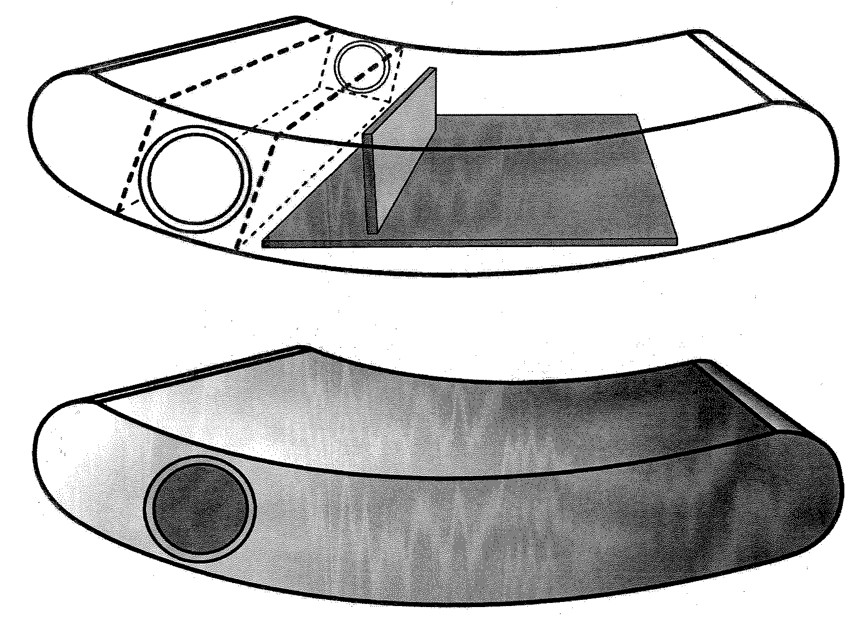
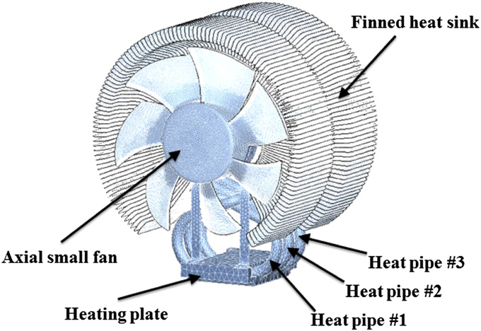
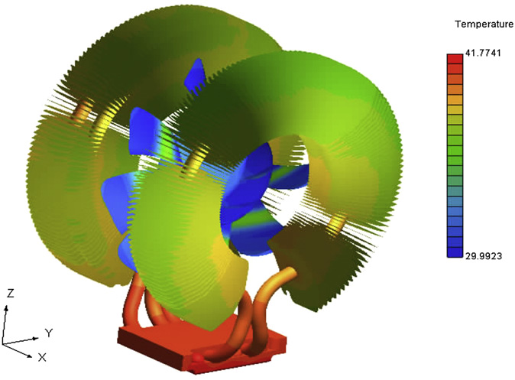
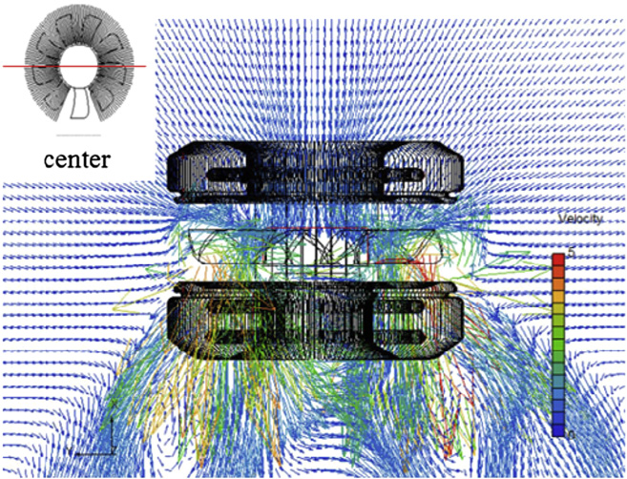
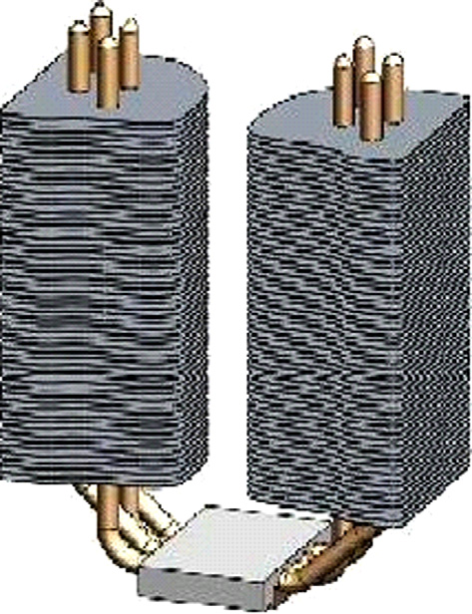
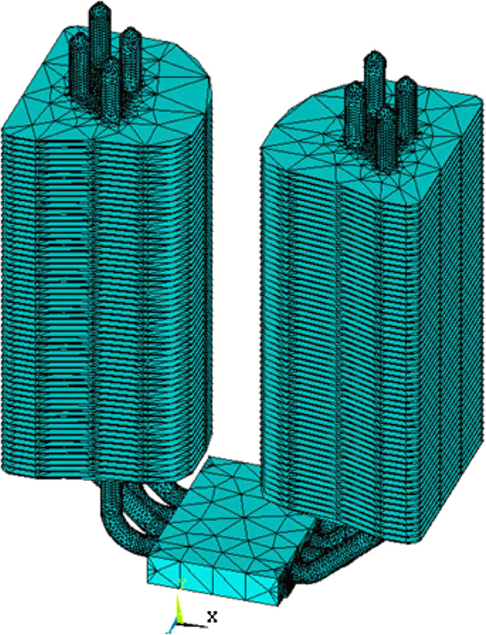
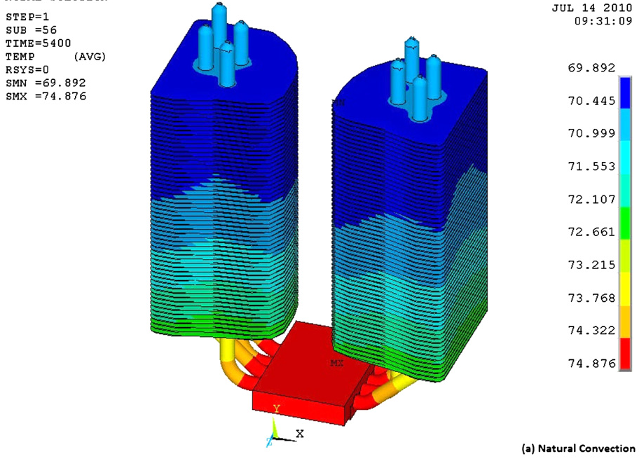
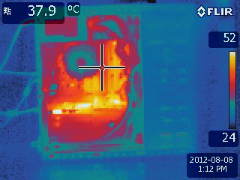
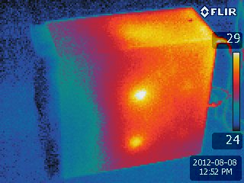
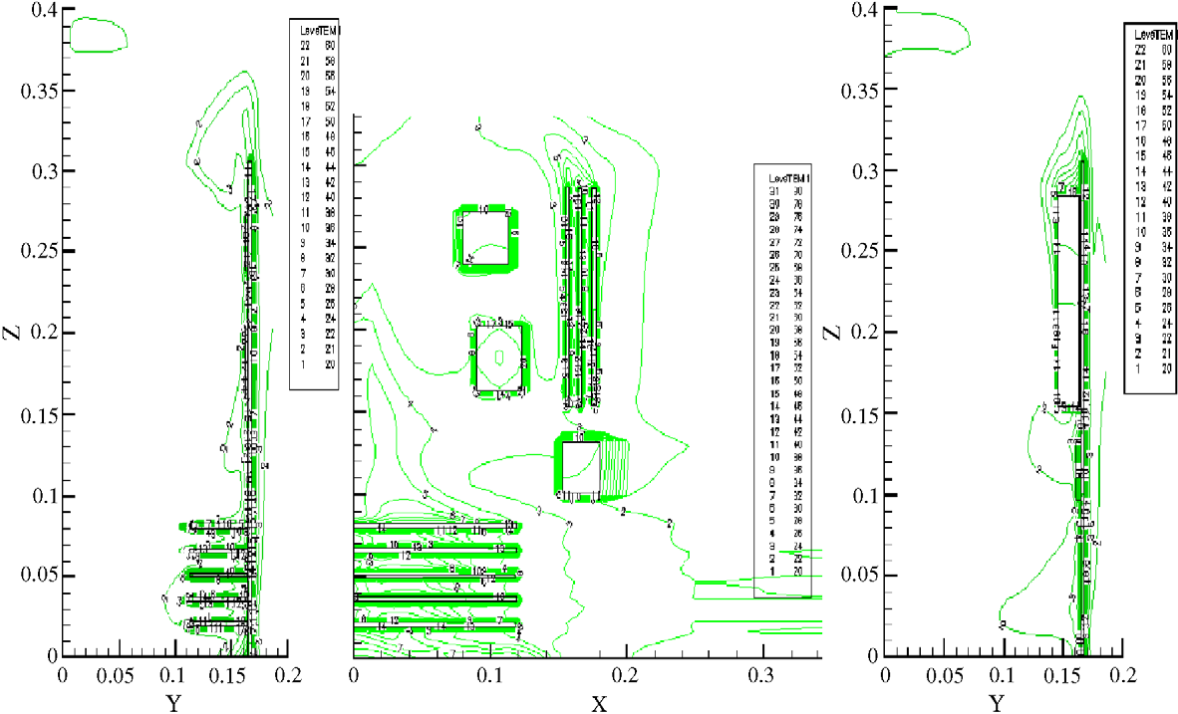
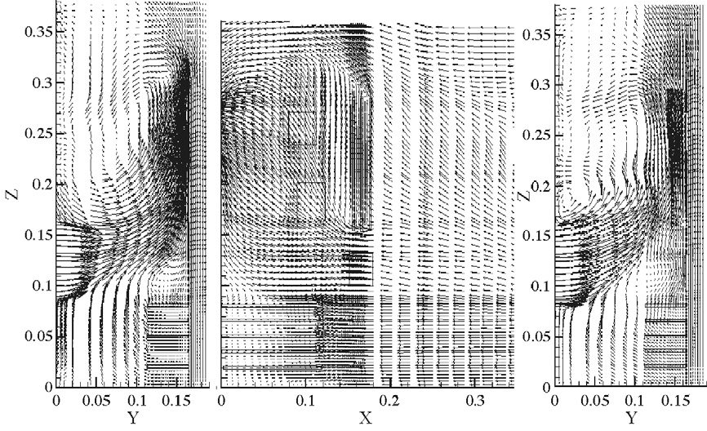
Heat Transfer Analysis of Computer Components for Electronic Waste (e-waste) Reduction: Cardboard PC Case Design Project
Ling Chia Wang (student) and Masato R. Nakamura (advisor)
Department of Mechanical Engineering and Industrial Design Technology
New York City College of Technology (City Tech), City University of New York (CUNY), Brooklyn, NY 11201
Background
Comparison of PC Cooling Systems
Cardboard PC Case Design
Reducing electric wastes (e-wastes) has been one of the main concerns in sustainable solid waste management since the development of Information Technology (IT) was started to accelerate.
Low-noise CPU cooler
Fans
GPU
HDD and DVD/Blu-ray Drive
A low-noise CPU cooler was proposed in 2012 that provides a more efficient heat dissipation capacity from the CPU to a finned heatsink without adding more heat pipes at a lownoise level of a small fan under the confined space constraints of a computer chassis. Computational fluid dynamics (CFD) simulations were used to search for a proper cooling design².
A short life cycle of computers demands an efficient recycling process, as well as re-design of computer components.
E-waste of desktop PC in China and South Africa will rise by 500% in 2020 compared to their 2007 levels.
One of the major components of desktop computers is a PC case: 49.8% by weight of wasted desktop computers.
During the e-waste recycling process, dismantling obsolete computers (mainly liberating components from computer cases) takes a lot of workload of skilled workers.
Motherboard
Summary
Figure 2: schematic diagram of cooler (left), calculated temperature distribution (center), calculated velocity distribution (right) ²
Figure 5: Tentative design of cardboard PC
U-shape heat pipe
Summery and Future Work
A finned U-shape heat pipe used for CPU cooling for a desktop PC was presented and the performance analysis of the cooling system was carried out. The experiments are conducted by mounting the system vertically over a heat source situated inside a rectangular tunnel, and force convection is facilitated by means of a blower. The coolant velocity and heat input to achieve minimum total thermal resistance are found out and the corresponding effective thermal conductivity is calculated. The transient temperature distribution in the finned heat pipe is also observed³.
Literature Review: The performance of PC cooling system primarily depends on the forced air convection created by computer fans. Boosting the fan speed, however, results in noise, vibration problems, and increased power consumption.
Simulation for heat transfer: based on the new design of cardboard PC case. Numerical analysis for heat transfer from CPU and other heat sources will be carried out.
Prototyping: a cardboard PC case will be created as a prototype and is analyzed by means of a Infrared camera.
Figure 1: Seven treatment scenarios of desktop computers by combining different options in each treatment stage¹
Figure 3: schematic diagram of cooler (left), meshed simulation model (center), calculated temperature distribution (right) ³
Objectives
Figure 6: Thermal image of a regular PC case using an infrared camera (FLIR E40)
CFD Simulation of components in a PC case
In order for reducing e-wastes and simplifying the liberation process, a new design of desktop PC case will be created using cardboards that is efficiently recyclable, environmental friendly, easy to dismantle, and less costly.
The heat transfer analysis of two side-wall fans in a three-dimensional desktop computer was investigated The parameters are focused on the inlet Reynolds number and the locations of two fans on one of the side-wall boards. This study shows findings not only set up a numerical heat transfer analysis of desktop computer but also provide a basis for further simulation of the associated heat transfer for more complicated situations⁴.
References
[1] F. Wang et.al, “The Best-of-2-worlds philosophy: developing local dismantling and global infrastructure network for sustainable e-waste treatment in emerging economies’” Waste Management 32 (2012) 2134-2146
[2] J. Choi et al. “A new CPU cooler design based on an active cooling heatshink combined with heat pipes” Applied Thermal Engineering 44 (2012) 50-56
[3] M.H.A. Elnaggar et al. “Experimental analyses and FEM simulation of finned U-shape multi heat pipe for desktop PC cooling
[4] J. S. Chiang et el. “Numerical simulation of heat transfer in a desktop computer with heat-generating components,”. International Communications in heat and mass transfer 32 (2005) 184-191
The heat transfer of components generating heat in the computer case will be measured by an infrared camera.
A 3D Computer-aided Design (CAD) model of the case will be created for heat transfer analysis by using Computational Fluid Dynamics (CFD).
Figure 4: schematic diagram of PC case (left), calculated temperature distribution (center), calculated velocity distribution (right) ³

