Slide 1
Communication
Production Management
Notes:
Hello Managers today we are going to discuss communication with your team and your clients
Face to face vs written and virtual. What tools you can develop to be successful in communicating with your team and your clients

Slide 2
Agenda
Types of communication
Presenting yourself
Tool kit
The difference between responsibility and Authority
Notes:
We are going to talk about types of communication
How to present your self
Your personnel tool kit
And the difference between responsibility and authority

Slide 3
Presentation
Genuine
Respectful
Empathy
Notes:
When we are in person I have the class play a game have each person come up with a one word synonym for each word
Genuine sincere, honest, truthful,
Respectful
:deferential, reverent, admiring, humble, reverential, dutiful, subservient; polite, well mannered, civil, courteous, chivalrous, gallant, gracious, considerate, obliging, solicitous, thoughtful, attentive
Empathy
the ability to understand and share the feelings of another.
These words are part of your arsenal of how you think about yourself when preparing to run a meeting with your team and a client

Slide 4
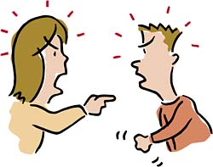
Types
Face to face
Phone
Written
Notes:
What can you do to prepare before you meet?
Make notes
Write a script
Plan A, B, C

Slide 5
Face to Face Skills
Eye contact
Listen
Smile (When appropriate)
Thoughtful
Thank you and your welcome tools
Notes:
Practice these skills
In a mirror
Think about the word kind and look in the mirror gain how does your face look. This is the face you need to present to the outside world
Think about a close friend are your smiling
What does it mean to be thoughtful How do you feel when you are thoughtful . Look in the mirror and see how your face changes
Keep the words thank you and your welcome at the for front of your arsenal. Even if you are dealing with a difficult personality the person who is in control of the meeting is the person who is in control of their one thoughts and actions

Slide 6
In person concerns
Nonverbal communication
Immediate feedback
Paravocalics
Notes:
Nonverbal communication includes gestures, facial expressions, and body positions (known collectively as “body language”), as well as unspoken understandings and presuppositions, and cultural and environmental conditions that may affect any encounter between people.
Feedback- in person response to a comment or questions
Paravocalics A process whereby people, through the intentional or unintentional manipulation of normative actions and expectations, express experiences, feelings, and attitudes in order to relate to and control themselves, others, and their environments. (Hickson & Stacks, 1985) [paravocalics or paralanguage] not what you say but HOW you say it

Slide 7
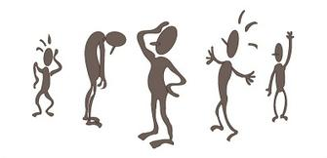
Body Language
Amy Cuddy Body Language
Proxemics
Personnel space vs territory
Notes:
Body language the process of communicating nonverbally through conscious or unconscious gestures and movements.
Proxemics-is the study of space and how we use it, how it makes us feel more or less comfortable, and how we arrange objects and ourselves in relation to space. The term was coined by the anthropologist Edward Hall. Hall was interested in understanding how humans use space in communication.
According to Hall, the study of proxemics is valuable in evaluating not only the way people interact with others in daily life, but also "the organization of space in [their] houses and buildings, and ultimately the layout of [their] towns".^{[4]} Proxemics remains a hidden component of interpersonal communication that is uncovered through observation and strongly influenced by culture.
Choose location of meetings carefully on neutral ground.
Amy Cuddy research was discredited. Knowing this what do you believe to be true about body language and power posing.
Is this idea more about how men and women treat each other. How does dominance and stress take part in any conversation.
She updated her research in 2018 and followed the academic standards to show she is correct
https://www.forbes.com/sites/kimelsesser/2018/04/03/power-posing-is-back-amy-cuddy-successfully-refutes-criticism/
https://www.nytimes.com/2017/10/18/magazine/when-the-revolution-came-for-amy-cuddy.html

Slide 8
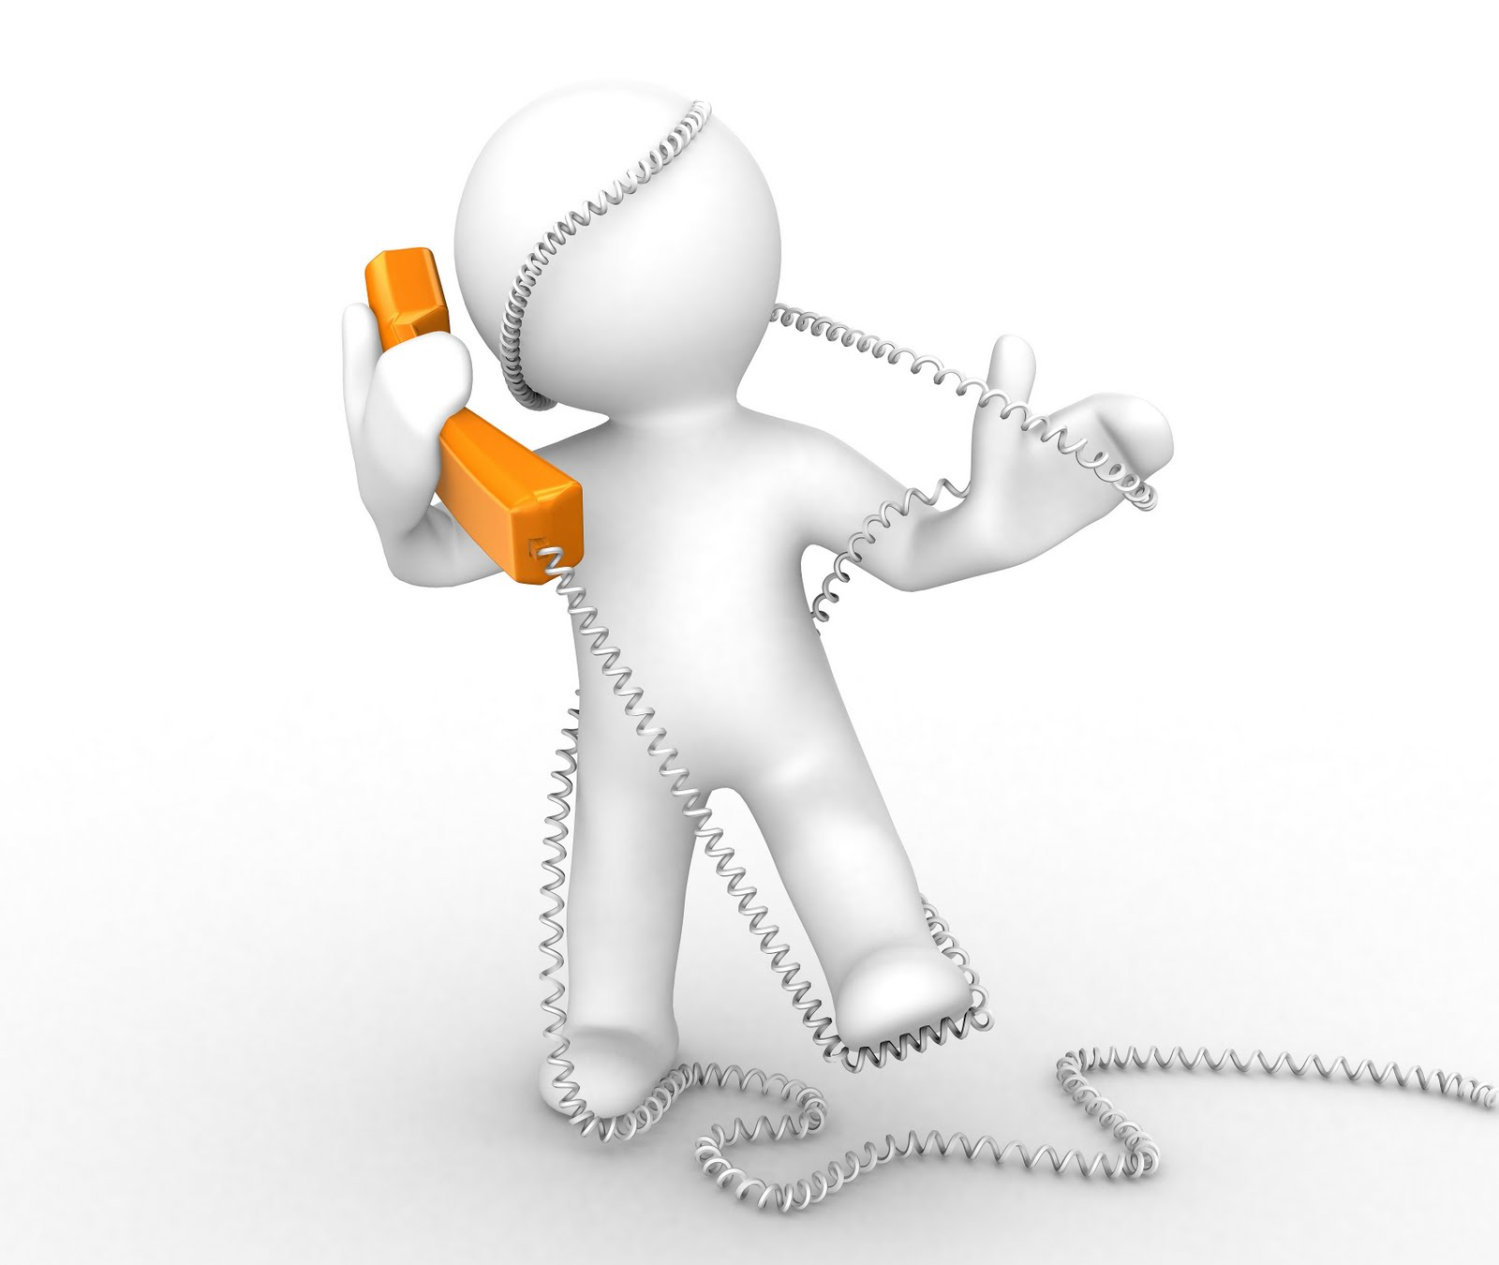
Phone Verbal tools
Tone
Speed
Write a script
Practice
Notes:
When a manager needs to discuss difficult topics; practice before making the call. Observe your own tenor and speed ass= you talk. Write a script to read to assure yourself you will cover all the key topics and practice your script a few times before you call.

Slide 9
Written types
Text
Email
Letter
Notes:
At this point in the lecture, I stop and have a conversation with the class: what do Pluses and minuses of each type of written communication?

Slide 10
Texting issues
Goes between two people
Can be very distracting during a meeting

Slide 11
Email Issues
Easy to misinterpret
Size and color of fonts
Emogee
Notes:
How to avoid the pitfalls?

Slide 12
Improve your Writing skills
Edit
Use thesaurus
Proof
Neat
Format
SMART PHONE pictures
Notes:
Always be informed.
Never guess

Slide 13
Toolkit
Tactful
Timely
specific
Notes:
Define the words and how they can be used in the planning process

Slide 14
Comparison
Introvert
Extrovert
Behavior: Reserved, solitary
Goals: often choose long-term goals over immediate gratification
Energy : derived from "alone time."
Behavior: Outgoing, talkative, energetic
Goals: often choose immediate gratification over long-term goals
Energy : Typically derived from social interaction.
Notes:
Dealing with artists and designers in one to one conversations and in a group setting. Being aware of which type you are dealing with can help to support good outcomes when making decisions, doling out responsibility and using your authority.

Slide 15
So you want to say YES
No immediate no
Engage the idea
Challenge the obstacles
Collect all the facts
Find an expert
Try the idea
Notes:
When your first inclination is to say no, stop think and listen
Have your audience describe their idea in detail (if they can’t assign him or her to do the research with a deadline)
Have them define the obstacles with their own words
Have them research the facts
Find the expert, collaborate
Try it

Slide 16
You need to say NO
Present a positive no
Issues : Money, Time, Resources, Safety
Do not leave without a positive response from your collaborator
Notes:
Be positive about the idea
Present the obstacle (time, money, resources)
Leave with a positive impression on your audience
Keep the conversation going

Slide 17
Difficult Conversations
Create a dialog where each view point is valid
Never personnel
Your collaborator needs to voice all their issues and concerns
Validate their point of view
Stand firm in you have the authority and responsibility
This may take several meetings to resolve
Notes:
When you know it will not be an easy meeting, plan for it.
Be prepared to let them talk out their frustrations and concerns
Be supportive of their point of view.
Know yourself
You do not need to be at the same pace or energy level
Be prepared to not argue
Stand your ground
This may be more than one conversation
Keep all communication channel open.

Slide 18
Communication: Listen
Notes:
Key to good communication keep the conversation alive;
Have a plan of action in place to trigger a
Follow up be on the content your communicated

Slide 19
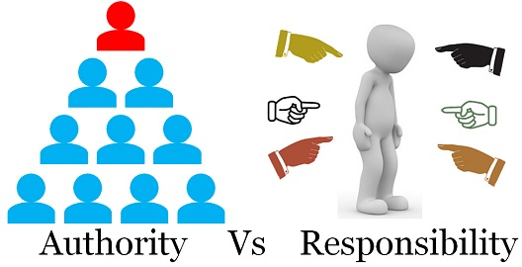
Authority vs Responsibility
https://keydifferences.com/difference-between-authority-and-responsibility.html
Notes:
Authority Vs responsibility
Authority is the legal right to give the command, order or instruction and compel the subordinates to do a certain act. On the other hand,
Responsibility is the outcome of authority. It entails the obligation of the subordinate, who has been assigned the duty by his or her superior.
BASIS FOR COMPARISON AUTHORITY RESPONSIBILITY
Meaning
Authority refers to the power or right, attached to a particular job or designation, to give orders, enforce rules, make decisions and exact compliance.
Responsibility denotes duty or obligation to undertake or accomplish a task successfully, assigned by the senior or established by one's own commitment or circumstances.
What is it?
Authority Legal right to issue orders.
Responsibility Corollary of authority.(provides little or no proof from a already proven statement
Results from
Authority Formal positon in an organization
Responsibility Superior-subordinate relationship
Task of manager
Authority Delegation of authority
Responsibility Assumption of responsibility
Requires
Authority Ability to give orders.
Responsibility Ability to follow orders.
Flow of information or orders
Authority Downward
Responsibility Upward
Objective
Authority To make decisions and implement it.
Responsivity To execute duties, assigned by superior.
Duration
Authority Continues for long period.
Responcibility Ends, as soon as the task is accomplished.

Slide 20
Summary
Types of communication
Presenting yourself
Tool kit
The difference between responsibility and Authority
Notes:
We are going to talk about types of communication
How to present your self
Your personnel tool kit
And the difference between responsibility and authority

