Slide 1
POSTER SESSION
2017

Slide 2
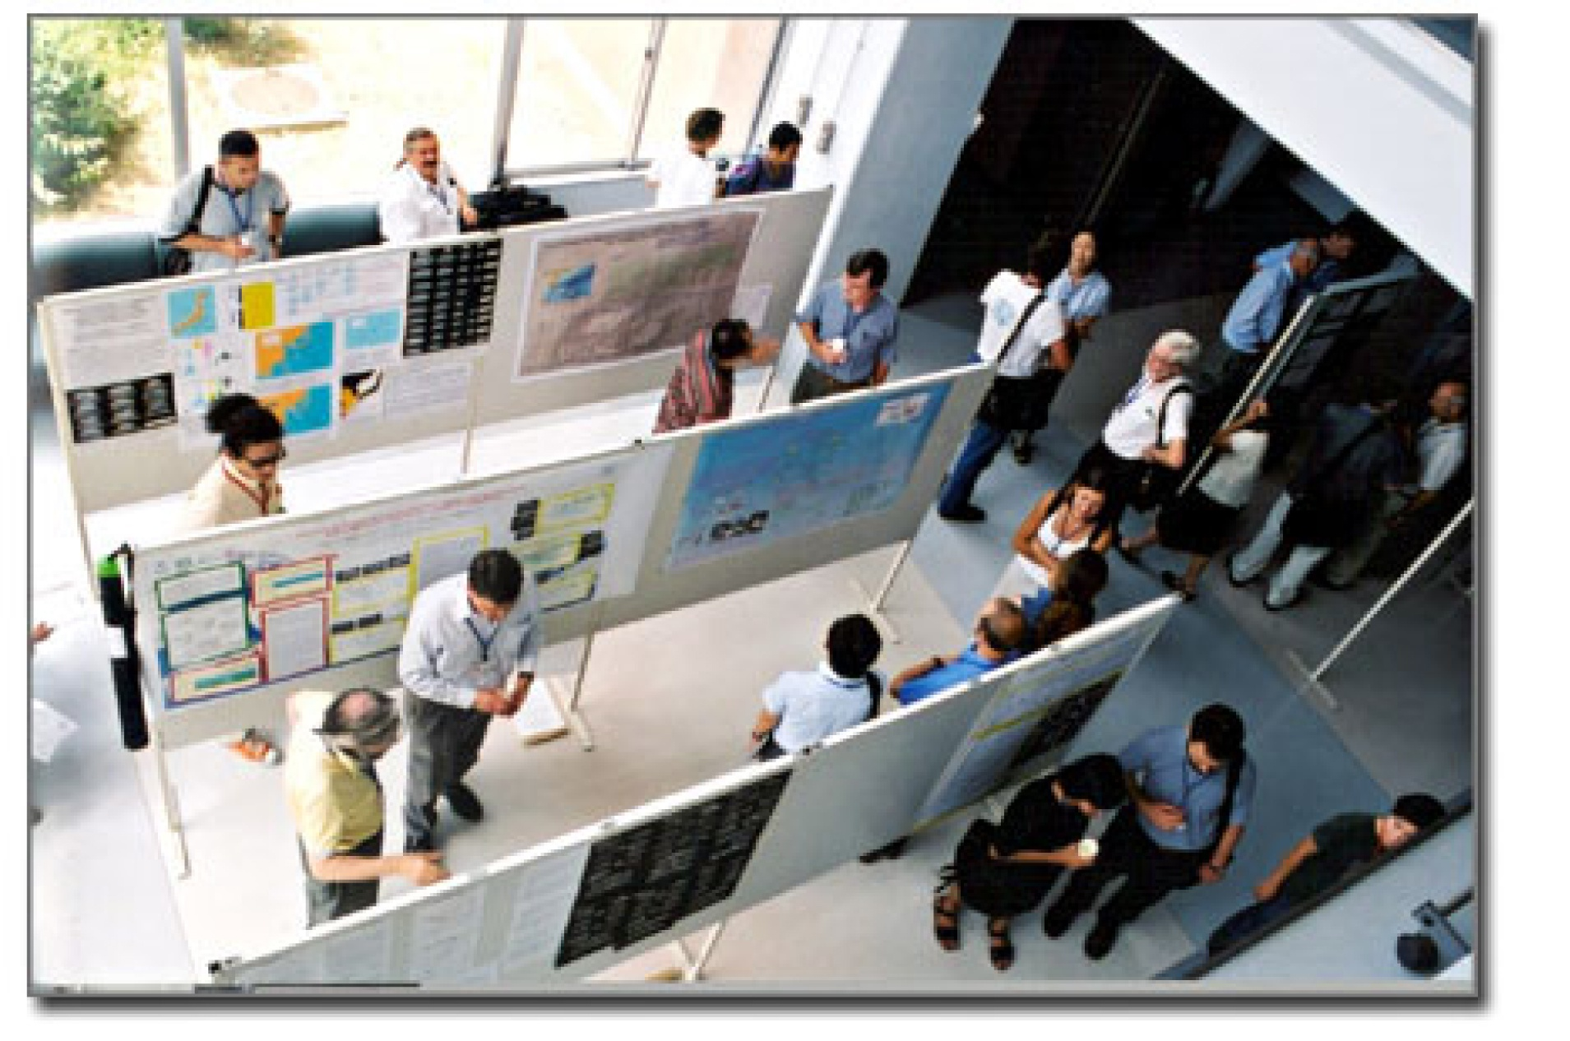

Slide 3
Why a poster session?
An opportunity to present to a small audience in a large venue
Many projects presented at one time

Slide 4
Poster session defined
the time to present a compelling effort
viewers to take in the content.

Slide 5
Prompt discussion and discourse about the project.

Slide 6
Goal of Poster
Answer a question
Solve a problem

Slide 7
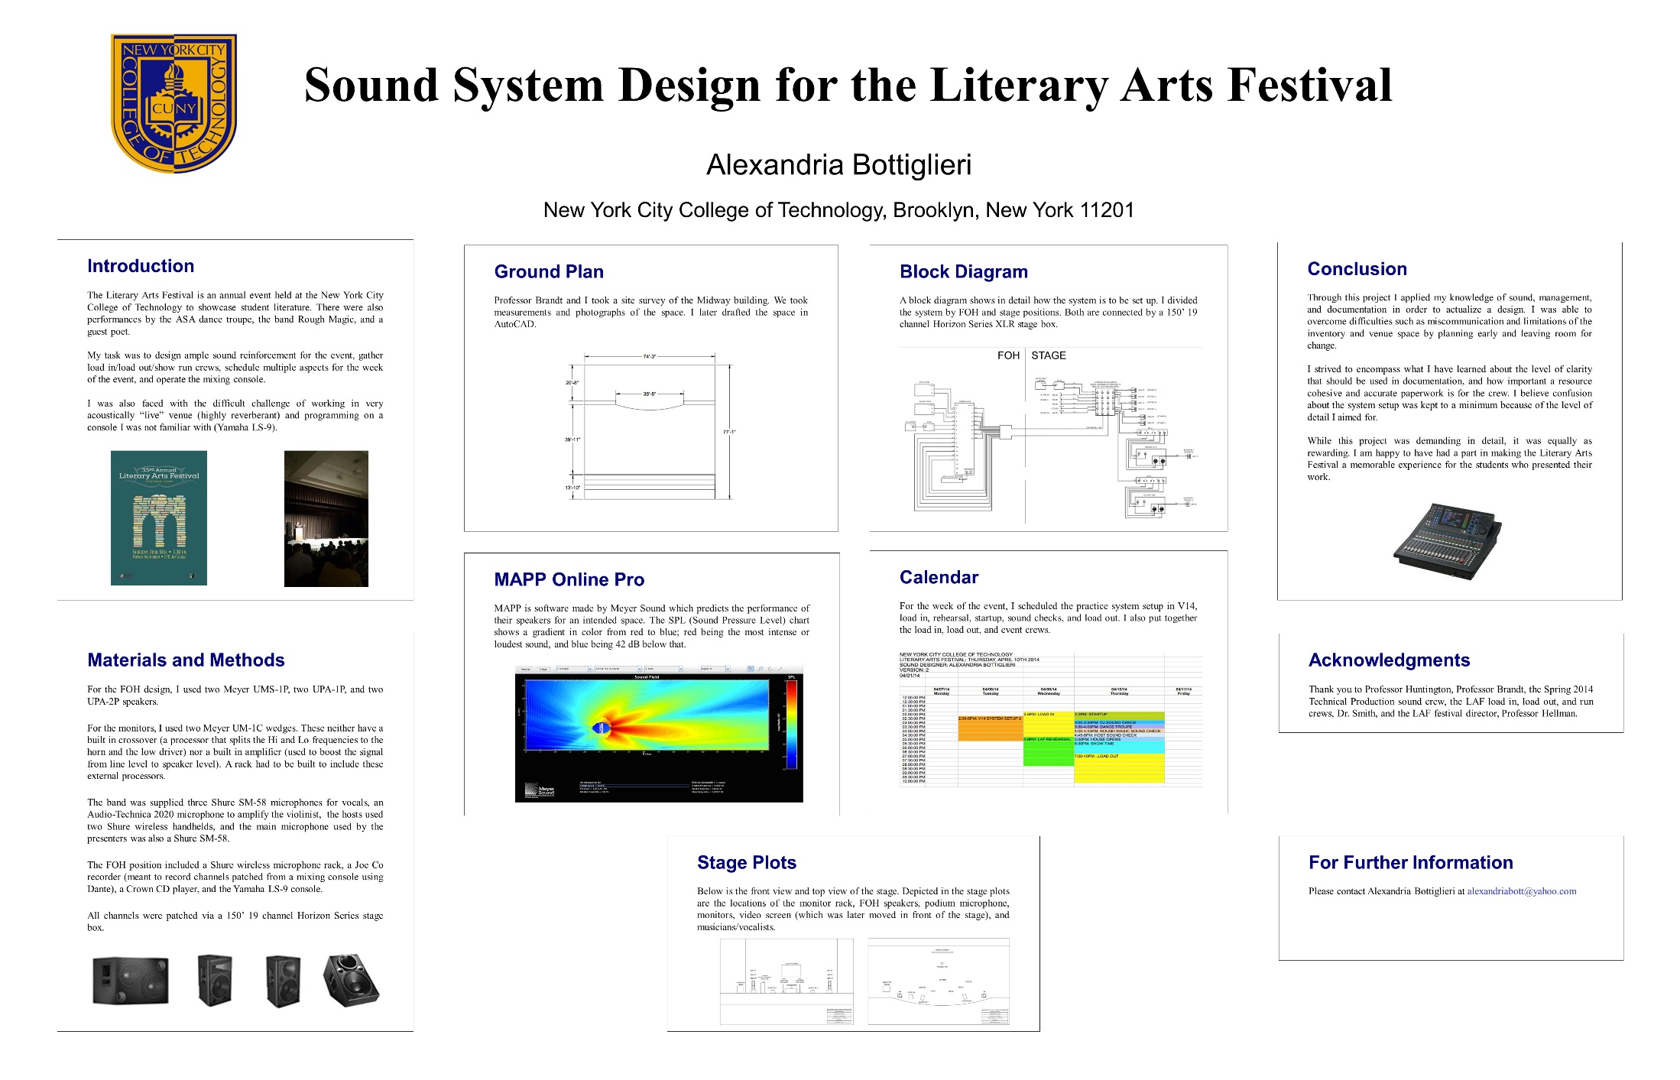
Example of simple poster format

Slide 8
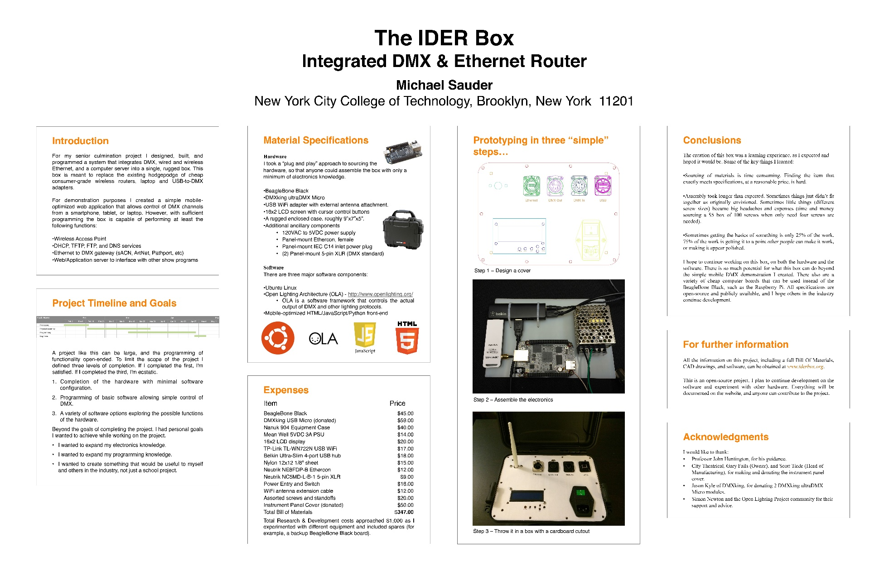
Smart Poster

Slide 9
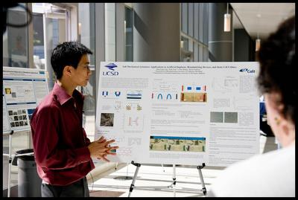
One board

Slide 10
Two simple rules
1) Imagination should not replace facts.
2) A complex poster may take a lot of time.

Slide 11
Visual Presentation
show what was done
use diagrams
Or Arrows
or Mapping

Slide 12
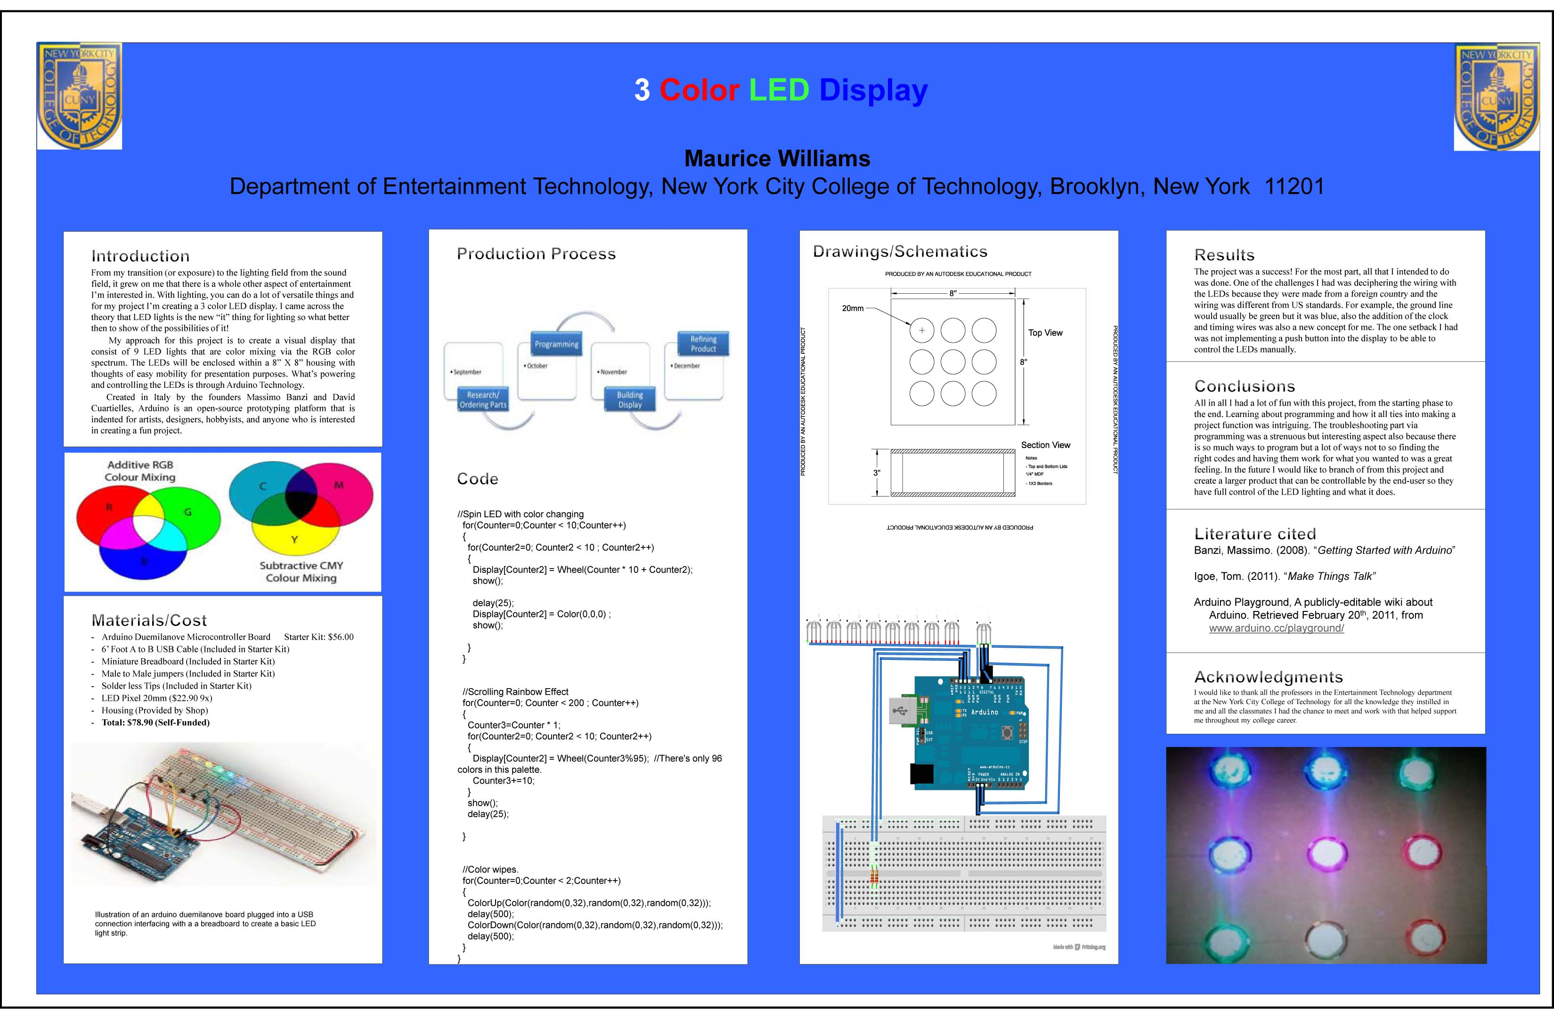

Slide 13
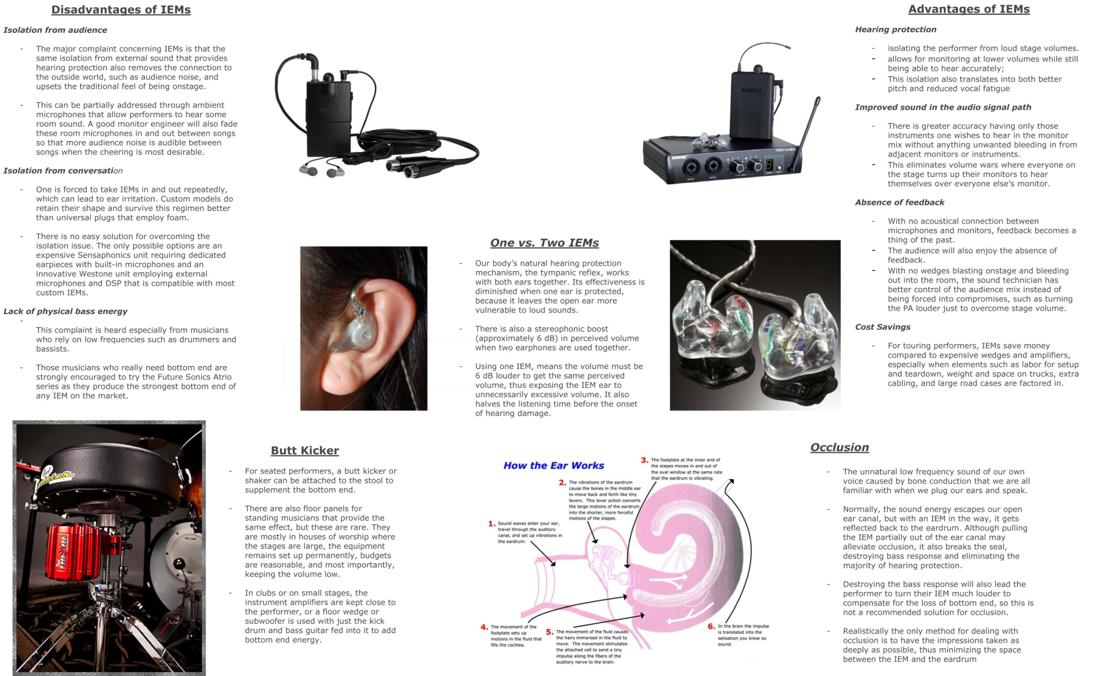

Slide 14
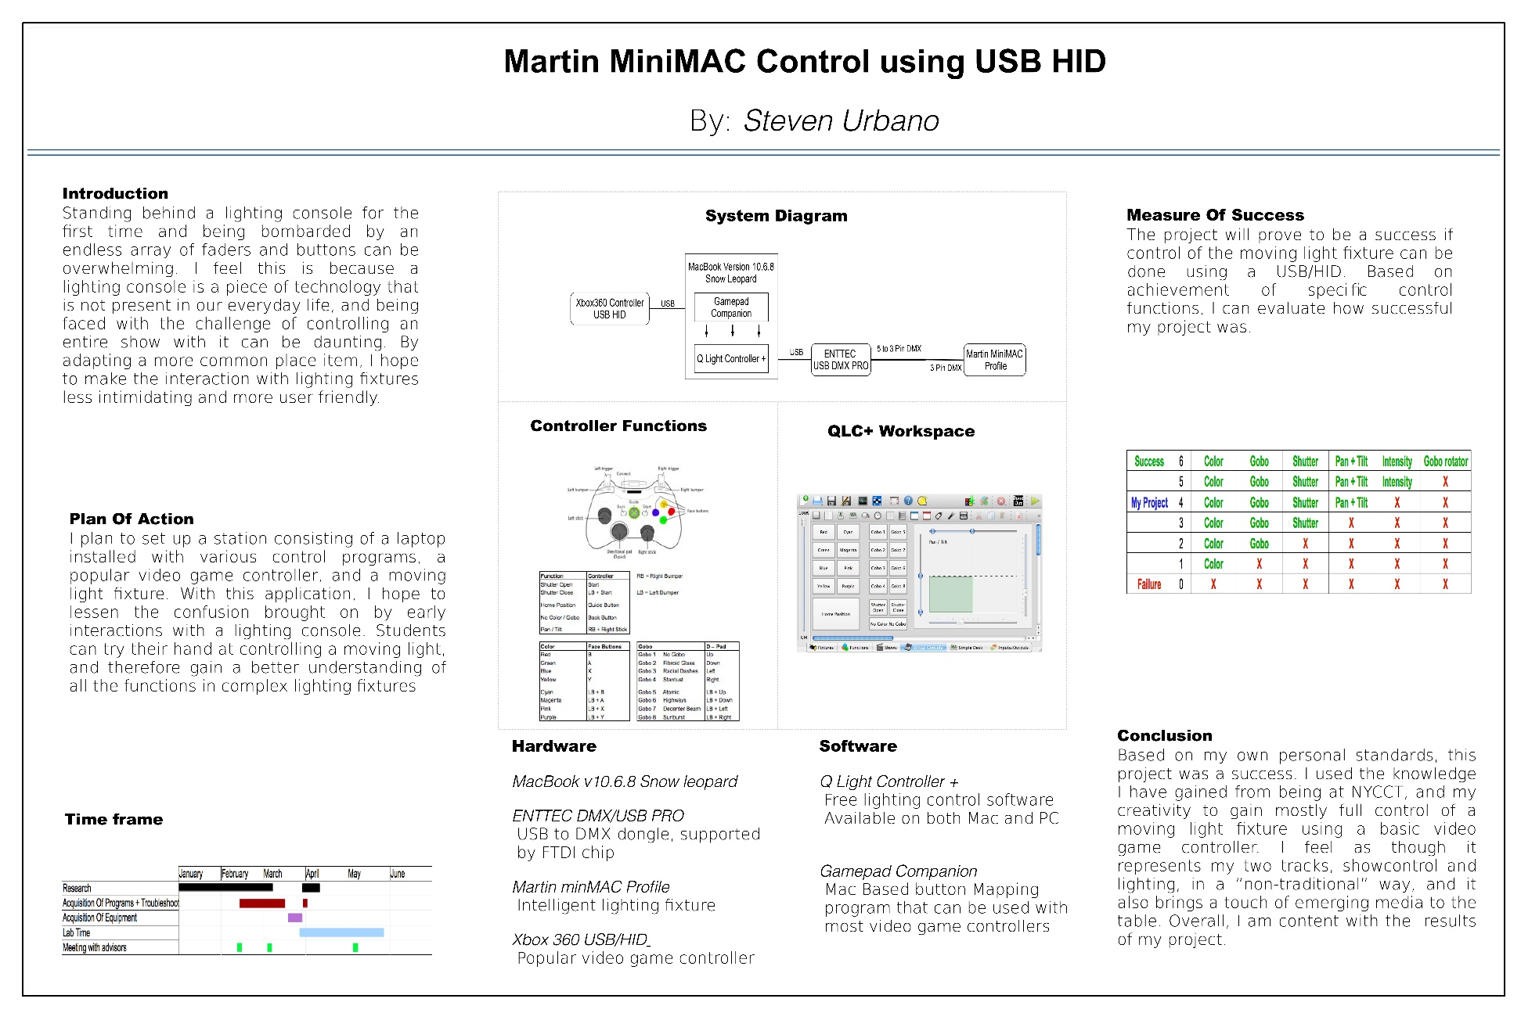
Smart Simple Poster

Slide 15
Title
Could Be
A question
Your job title
Production name
[Maximum length: 1-2 lines.]

Slide 16
Abstract
a short summary about your topic.
A statement of the question you are addressing
( 5 sentences max)

Slide 17
Introduction
Your background information and definitions.
A description and justification of area of study.
Present your research question.
[Maximum length: approximately 200 words.]

Slide 18
Hypothesis
a proposed explanation for an observable phenomenon.
An overview of the work done
Scientific: The test will present the idea of an expected outcome.
a proposed explanation of fact or experience.

Slide 19
Materials and methods could include:
Calendar: GANTT
Budget of labor include the time you spent. Plans(Excel)
Drawings, charts and or diagrams.
JPG

Slide 20
results
Outcomes
Data collected
Tasks completed

Slide 21
Conclusions:
Restate your question
Purpose of project
where would you like to go with your City Tech degree?
What did you accomplish with your culmination Project?

Slide 22
Research cited:
Citations
Resources
Advisers

Slide 23
Acknowledgments:
Thank individuals for specific contributions to project
equipment donation
professional advice
Who has provided funding;
do not list people's titles.

Slide 24
Avoiding common mistakes
Keep written content short and sweet
Not a novel
Avoid titles with colons
text boxes about 40 characters (on average: 11 words per line).
No blocks of text longer than 10 sentences.
Use lists of sentences rather than blocks of text.
Use italics instead of underlining.
Do not use a dark back ground, hard for readers to view

Slide 25
Back ground
Avoid using dark backgrounds.

Slide 26
Presenting your poster
Dress professionally.
Stage blacks are ok
No logo wear
Speak to your viewers
If more viewers arrive halfway into your talk, finish the tour for the earlier arrivals first.
Treat your audience like it is a job interview

