Slide 1
Reporting Status of Budget for The Visitor Tour
General Manager
Susan Brandt
Notes:
Hello Managers today I am going to show you a fictional budget report for the visitor.
I have created a few issues for the team to discuss.
And budget problems to be resolved collaborating with the producer

Slide 2
STATUS SUMMARY
Project is on track for tour
Deliverables are on track
Current estimate $130,000
Status of Project
Materials have arrived build in progress
New costs to be discussed today
Notes:
Start out with a summary of where you are and current estimate total

Slide 3
Production plan
Notes:
Review the schedule as needed. I two.
One is a list from excel

Slide 4
GANT Chart
Notes:
The other is a timeline using a GANT CHART

Slide 5
DELIVERABLES
LIST MAIN CRITICAL DELIVERABLES
Scenery, props and costumes installed at Voorhees by 1/28/20
Lights and sound installed at Voorhees by 1/30/20
Production tech complete by 2/3/20
Production packed in truck ready to tour by 2/4/20
COMPLETION for each production area as of today
props 40%
costumes 50%
Sound 50%
Lights 50%
Scenery 50%
Notes:
I made a list of current deliverables to help focus the team on their current dates to be concerned with.
I made a completion percentage for each production are to let the team know where we stand

Slide 6
PROGRESS
ON TIME
LATE
Scenery materials ordered and arrived
Costume materials ordered and arrived
Cuelab rental an additional cost
ION rental and additional cost
Props materials ordered not all arrived
Notes:
A progress report

Slide 7
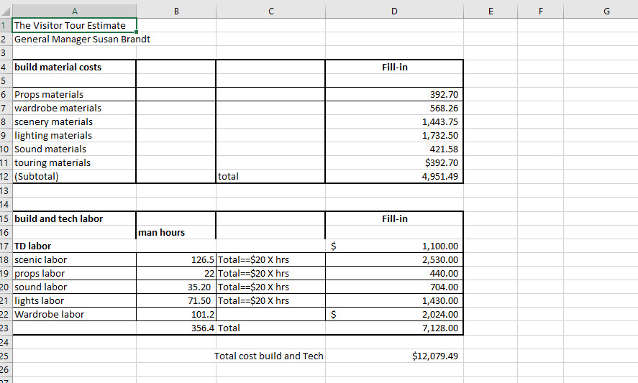
Notes:
Current estimate for the build and tech of the production
it is on the handout with a summary

Slide 8
Updated Touring costs review
Touring Load-in and Load-out estimates
Load-in estimate $1848.00
Load out estimate $1364.00
MAKE SURE YOU UNDERSTAND ASSUMPTIONS
No repair time for broken scenery or props
Laundering on site at all locations
Crew and truck arrival at 5am at all locations
Load out done by 8pm at all locations
Notes:
Touring team labor
Concern expressed by the touring team with a list of assumptions to be addressed.

Slide 9
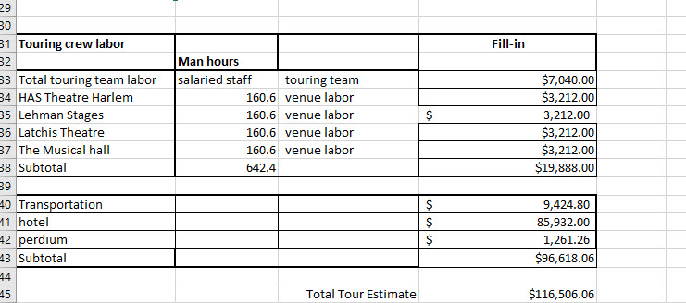
Notes:
Touring cost estimate it is on the handout with a summary

Slide 10
Effective use of time
Notes:
A chart of the calendar presenting days with no scheduled work time.
This can be used to discuss the needed repair, clean and maintenance time not in the current schedule or budget

Slide 11
TECHNOLOGY
List Technical Problems That Have Been Solved
List Outstanding Technical Issues That Need To Be Solved
Networking consoles to be done when gear arrives at Voorhees
List Any Dubious Technological Dependencies For Project
Issue Can Cue to cue to be completed on time
Summation: Plan for OT on tech day 2 if needed
Rental of mac with Cuelab and ION light board
Notes:
A page dedicated to technology can be a tool for you explain the need for rental technology such as consoles for this production

Slide 12
COSTS
LIST NEW PROJECTIONS OF COSTS
Original Estimate $130,000
Review outsourcing VS freelance designers any savings
Add in costs of rental consoles
Add in costs of prop rebuild
IF THERE ARE COST OVERRUNS
Prop build update request $500.00 to resolve issue
Items not available had to re-order from a local vender
Collaborate props designer with TD to lock in prices
Notes:
A page to talk about the additional costs that may need to be added to your budget

Slide 13
RESOURCES
SUMMARIZED PROJECT RESOURCES
Dedicated (full-time) resources touring team and artists
Part-time resources Freelance designers
If project is constrained by lack of resources, suggest alternatives
Communication to Producer
Cost overruns of console rentals vs time saved on the tour
Prop Ray gun needs redesign and planning
Can cost overruns be covered in revenue or?
Notes:
A reminder of the staffing resources dedicated to the project
A bullet point on specific items to be addressed to the producer

Slide 14
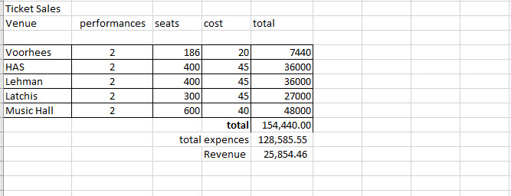
Revenue projection
Notes:
A page on the revenue projection vs the projected expenses estimate
it is on the handout with a summary

Slide 15
GOALS FOR NEXT REVIEW
DATE OF NEXT STATUS UPDATE 1 week
LIST OF GOALS FOR NEXT REVIEW
Completion of load-in at Voorhees
Prop gun design and build
Cue to Cue schedule in Voorhees
ACTION PLAN REVIEW
Coordinate production meetings with design team and touring team to resolve outstanding issues
Estimate updates
Budget spent
Notes:
The last page is a summary of the goals for your next meeting and your action plan for inbtween meetings

