Slide 1
Taking your show on the road

Slide 2
Getting started
This Photo by Unknown Author is licensed under CC BY-SA

Slide 3
Who is needed
Cast
Crew
Management
Front man or women

Slide 4
What to take
Scenery
Props
Costumes
Lights
sound
This Photo by Unknown Author is licensed under CC BY-NC-SA

Slide 5
Travel choices
Car vs Bus vs train vs plane
This Photo by Unknown Author is licensed under CC BY

Slide 6
What fits
Bus
Truck
Plane
Shipping

Slide 7
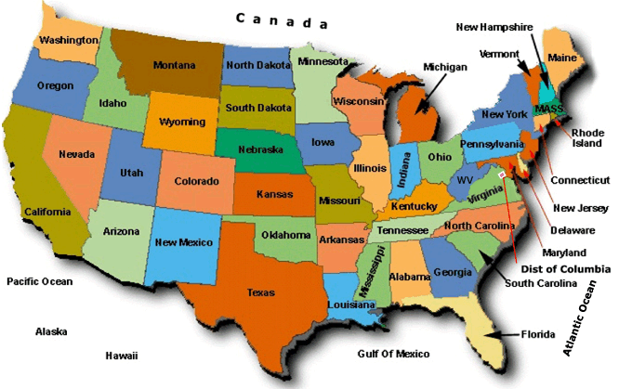
Tour calendar
Locations
This Photo by Unknown Author is licensed under CC BY-SA

Slide 8
Touring Table
Include:
Distance
Estimated Travel time
HAS Theatre Harlem
Leman Stages
Latchis Theatre
The music Hall
City Tech

Slide 9
Your locations
Start and Tech at City Tech 186 Jay St, Brooklyn NY 11201
HAS Theatre Harlem, 645 St Nicholas Ave, NY NY 10030
New York, Bronx, Lehman Stages, Lehman college CUNY
Vermont, Brattleboro The Latchis Theatre, 50 Main St, Brattleboro, VT 05301
New Hampshire, The Music Hall, NH28 Chestnut St, Portsmouth, NH 03801

Slide 10
Dates
13 Jan. – 2 Feb.
Build and tech Voorhees 1/13-2/2
2 Mar. – 2 Apr.
Opening Voorhees Performance
2 May – 2 Aug.
HAS Theatre 2/5-2/8
2 Dec. – 15 Feb.
Lehman Theatre 2/12-2/15
19–22 Feb.
Latchis 2/19-2/22
26–29 Feb.
Closing Music Hall 2/26-2/29

Slide 11
Outcomes
Update the spread sheet that represents your estimate savings
Map of your route with timings
Transportation plan for your company
Update the Schedule of Load-in, rehearsal, tech performance and strike
Total man hours
Total cost break down by location

