Slide 1

Approaching Writing in and Beyond College
Dr. Caroline Chamberlin Hellman

Slide 2
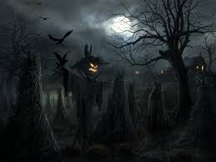

3AM. We face off against the white screen of a blank Microsoft Word document. The terror is overwhelming! We run screaming from the room!

Slide 3


Or, we can walk determinedly back to the computer. We refuse to be intimidated! Yes, writing can be frightful, but if we break down projects into increments and small tasks– if we *scaffold* and build gradually– eventually we will have a pleasant house before us. How do we start building? Come along and find out!

Slide 4
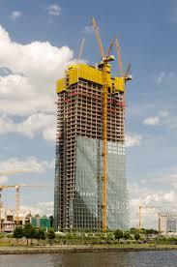
Writing, like building, is a process.
No matter what we are writing (a job cover letter? An essay? A podcast? An editorial? A presentation for class?), there are 3 useful steps:
Pre-writing (brainstorming, sketching structure, outlining)
Writing
Proofreading (checking clarity of ideas, organization, development, grammar, formatting)

Slide 5
Major Categories to Consider | Definition
Argumentation | Expressing your ideas and supporting them with evidence
Organization | Sensible structure and how ideas are presented; paragraph sequence contributes to a progression of ideas, avoiding repetition
Development | Supporting and expanding upon ideas with specific examples and details
Grammar, Sentence Structure, & Word Choice | Clarity of sentences; appropriate word choice; subject-verb agreement; tense consistency; avoiding run-on sentences and sentence fragments; variety of sentence structure; appropriate punctuation (period, comma, semi-colon, etc)

Slide 6
Essay Structure
Introduction
Begins with a HOOK (to grab reader’s attention)
  Possible hooks: brief anecdote (personal story or current events story), quote from relevant source (source citation info needed), ample detail about setting of story to come (set the scene for your reader)
After hook, transition to introducing topic and providing background info to orient your reader, lay groundwork for discussion to follow
Can end with thesis statement or main point of essay (if writing persuasive essay; sometimes narrative essays end with a thesis, too)
No set length; typical minimum 4-5 sentences

Slide 7
Essay Structure
Body Paragraphs
Conventional academic essays have 3 or more paragraphs but there is a whole world beyond this; do not feel constrained
Paragraph chronology (sequence) should help you progress through your ideas
Paragraphs= minimum 4-5 sentences
Content Breakdown
  Topic sentence: first sentence of paragraph that indicates your main idea and provides an overview
  Supporting sentences: develop and explain your idea; supporting details elaborate on what you mean and include examples and evidence in form of personal story, sometimes connections to outside material (texts, TV, film, current events/ newspaper articles, statistics, etc)
  Wrap-up/ concluding sentence: draws conclusions from info just presented, supports thesis

Slide 8
Essay Structure
Conclusion
Reflects back on subject matter and wraps up ideas of essay
Potential implications of your work
No set length; can be shorter than intro and BPs (3 or more sent)

Slide 9
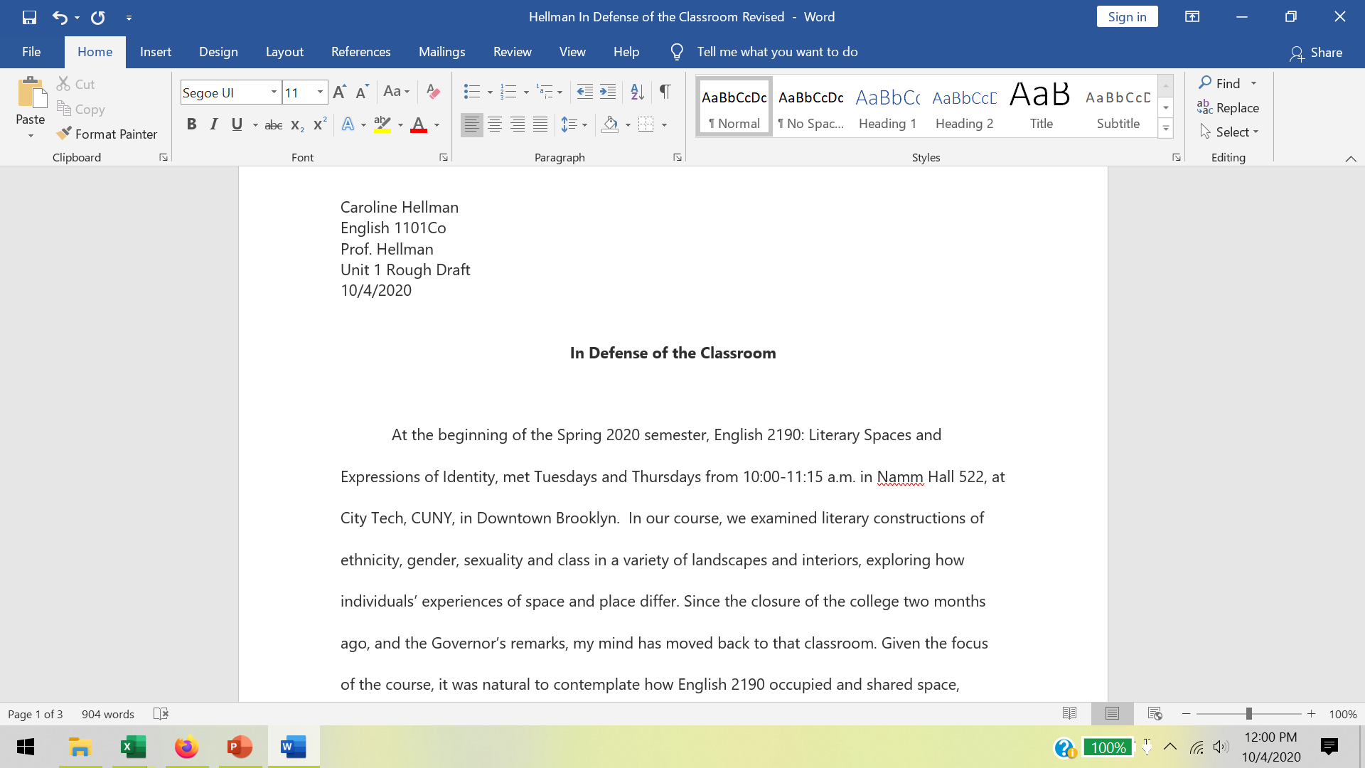
Name
Class
Professor
Assignment
Date
Center, Bold Title
Aim for creative!
Drop down essay text; use Tab to indent each paragraph; double space (under Paragraph)12 font; no extra space between BPs

Slide 10

The Quote Sandwich: Your New Friend
1. Bread: Set up and introduce quote. Include the author, text title (capitalized), and publication
year. Summarize the text fully (this will take several sentences!)
  Example: In “Maybe I Could Save Myself by Writing” (2017), Jose Olivarez writes about the challenge of navigating different aspects of his identity in school settings. (continued in other summary sentences)
2. Veggies/ meat/ tofu: The quote itself, with a page citation if possible (if no page, cite
paragraph #), or line number citation if a poem
    Ex: Olivarez writes, “I’m telling you this because I wrote a book of poems with one foot in the past, one hand in the present, and a nose on the future” (45).
  3. Bread: Analyze quote. Avoid repeating the quote or merely paraphrasing. Instead, say what the quote means, and then explain how it relates to your own writing.
  Ex: Here Olivarez emphasizes the importance of his family history in his writing, as well as who he is as an individual. His point relates to…

Slide 11
Rough Draft Checklist
Is my essay the right length? Is it properly formatted? (go back to assignment guidelines)
Does my writing fulfill the assignment expectations (re-read assignment guidelines to verify)
Does the introduction set the scene for the reader and fully introduce the topic and focus?
Is the thesis, or main idea I wish to propose, clear? Is there a way to clarify it further?
Does the BP order (sequence) make sense?
Do BP examples adequately support main ideas? Could some examples be more fully developed?
Are text connections well-integrated? (QUOTE SANDWICH)?
Does the conclusion wrap up the essay in a way that avoids repetition, and offers food for thought to the reader?

