Slide 1
The Linux Command Line Chapter 16
Networking
Prepared by Dr. Reyes, New York City College of Technology

Slide 2
Networking
ping – command used to determine if a remote location is reachable
Example:

Slide 3
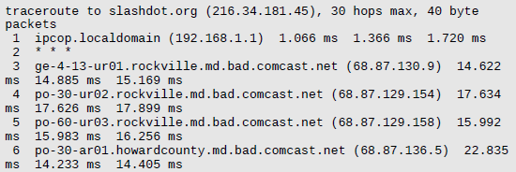
Networking
traceroute – command that displays a listing of all the “hops” network traffic takes to get from the local system to a specified host.
Example

Slide 4
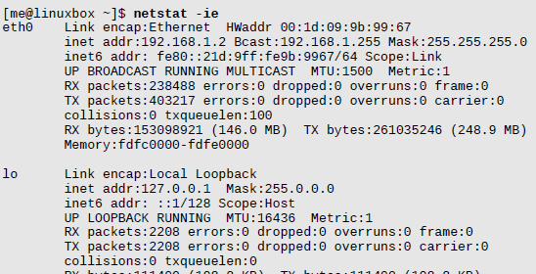
Networking
netstat – command used to examine various network settings and statistics.
Example:

Slide 5
Networking
ftp – command used for file transfer protocol
Example:

Slide 6
Networking
wget – command used to downloading files from the web and FTP sites
wget linuxcommand.com
ls
gedit index.html
Example:

Slide 7
Networking
ssh – command used to communicate securely with a remote host
Example:

