Slide 1
The Linux Command Line Chapter 9
Permissions
Prepared by Dr. Reyes, New York City College of Technology

Slide 2
Ownership
Files permissions are divided in three levels: owner, group, everybody
ls -l
id - command used to find out information about your identity

Slide 3
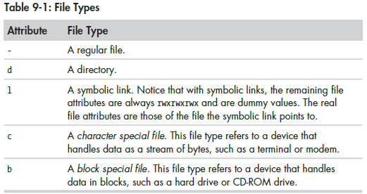
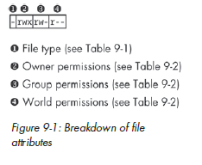
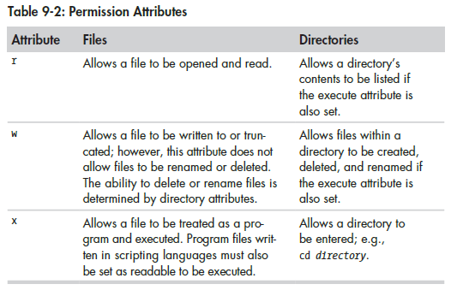

Slide 4
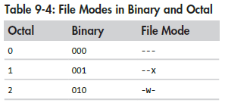
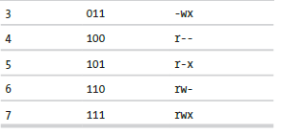
Change Mode
chmod – command to change the mode or permissions of a file or directory
Permissions represented using octal notation
> foo.txt
ls -l foo.txt
chmod 600 foo.txt
ls -l foo.txt
chmod 777 foo.txt
ls -l foo.txt

Slide 5
Changing Identities
su - command that allows you to log in as another user
su –
su – username
sudo - command that allows you to execute commands as a different user, usually a superuser in a controlled way
sudo
chown - command used to change the owner of a file
passwd - command used to change the password

