Slide 1
The Linux Command Line Chapter 18
Archiving And Backup
Prepared by Dr. Reyes, New York City College of Technology

Slide 2
gzip Command
gzip – command used to compress one or more files
Example:

Slide 3
gunzip Command
gunzip – command used to decompress files
Example:

Slide 4
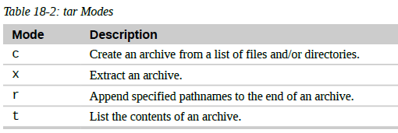
tar Command
tar – Command used for archiving files. It’s name is short for tape archive.
Modes:
Example:

Slide 5
zip Command
zip – command that is both a compression tool and an archiver
Usage: zip options zipfilename file1, file,2, ..., filen
Example:

Slide 6
unzip Command
unzip - command used to decompress a zip file
Usage: unzip options zipfilename
Example:

