Slide 1
The Linux Command Line Chapter 34
Strings and Numbers
Prepared by Dr. Reyes, New York City College of Technology

Slide 2
Basic String Parameters
Use $ in front of variables to retrieve its value
Syntax:
Surround a variable with { } to use it with other text
Example

Slide 3
Arithmetic Evaluation and Expression
To evaluate an arithmetic expression use
Examples

Slide 4
Arithmetic Operators

Slide 5
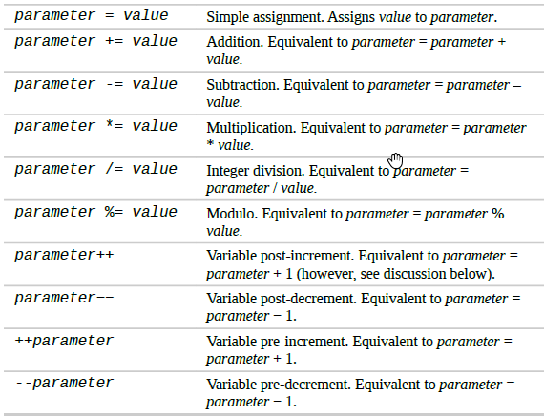
Assignment Operators

Slide 6
Comparison Operators

Slide 7
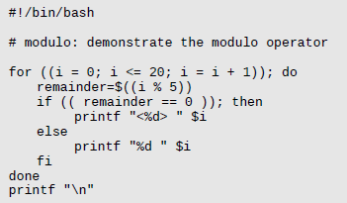
Sample Script

Slide 8
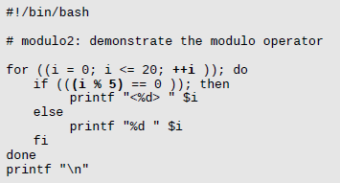
Sample Script #2

