Slide 1
The Linux Command Line Chapter 28
Reading Keyboard Input
Prepared by Dr. Reyes, New York City College of Technology

Slide 2
The read command
read - Command used to read a single line of standard input
Syntax:

Slide 3
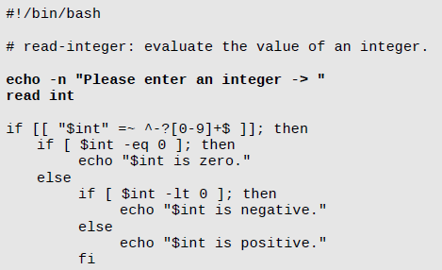
Example of the read command

Slide 4
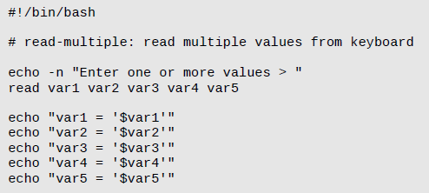
Reading Multiple Values
The read command can assign input to multiple variables, separated by spaces

Slide 5
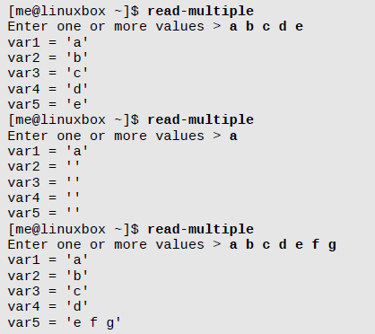
Be Careful Reading Multiple Variables

Slide 6
The REPLY shell variable
If no variable is given after a read command, the input will be stored in the REPLY shell variable

Slide 7
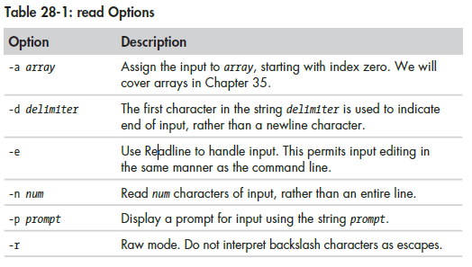
Read Options

