Slide 1
String and Lists
Dr. Benito Mendoza

Slide 2
Outline
What is a string
String operations
Traversing strings
String slices
What is a list
Traversing a list
List operations
Lists slices

Slide 3
Strings

Slide 4
A string is a sequence
A string is a sequence of characters.
You can access the characters one at a time with the bracket operator:
This statement selects character number 1 from fruit and assigns it to letter.
The expression in brackets is called an index. The index indicates which character in the sequence you want (hence the name).
But you might not get what you expect. Why? ➔

Slide 5
Indexes
In Python the index is an offset from the beginning of the string, and the offset of the first letter is zero.
You can use any expression, including variables and operators, as an index, but this value has to be an integer. Otherwise you get an error:
Notes:
So b is the 0th letter (“zero-eth”) of 'banana', a is the 1th letter (“one-eth”), and n is the 2th (“two-eth”) letter.

Slide 6
Strings have length
len is a built-in function that returns the number of characters in a string

Slide 7
Strings have methods
A method is another word for a function.
For example, the method upper takes a string and returns a new string with all uppercase letters

Slide 8
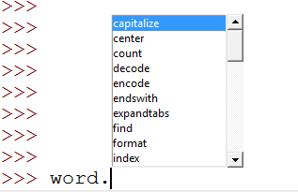
Many methods
http://pguides.net/python-tutorial/python-string-methods/

Slide 9
Strings have special operators
The word in is a Boolean operator that takes two strings and returns True if the first string is as a substring of the second one
You can concatenate strings using the + sign
You can repeatedly copy a string using the * sign

Slide 10
Strings Are Comparable
The relational operators work on strings.
To see if two strings are equal
Other relational operations are useful for putting words in alphabetical order:
Uppercase letters come before all the lowercase letters, so:

Slide 11
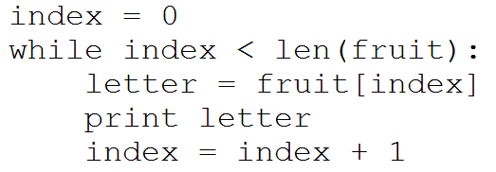
The Traversal Pattern
Notes:
A lot of computations involve processing a string one character at a time. Often they start at the beginning, select each character in turn, do something to it, and continue until the end. This pattern of processing is called a traversal. One way to write a traversal is with a while loop

Slide 12
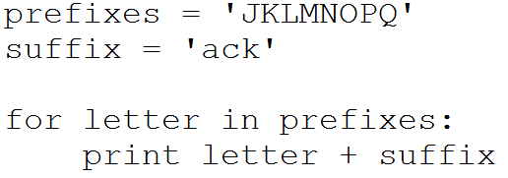
Traversal Example
What is the output of this program?

Slide 13
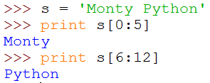
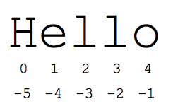
A segment of a string is called a slice
Selecting a slice is similar to selecting a character:
Careful!
It printed from 0 to 4-1

Slide 14
Strings are immutable
Immutable means you can’t change an existing string.
The best you can do is create a new string that is a variation on the original

Slide 15
Lists

Slide 16
A list is a sequence
Like a string, a list is a sequence of values.
In a string, the values are characters; in a list, they can be any type.
The values in a list are called elements or items.
There are several ways to create a new list; the simplest is to enclose the elements in square brackets [ ]
The elements do not have to be of the same type:
A list within another list is nested

Slide 17
More About Lists
A list that contains no elements is called an empty list.
You can create one with empty brackets[].
You can assign list values to variables:

Slide 18
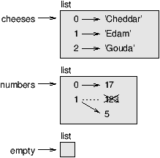
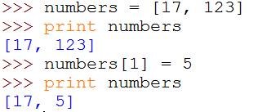
Lists are mutable
For accessing the elements of a list we also use the bracket operator.
The expression inside the brackets specifies the index.
Unlike strings, lists are mutable, which means that you can change the value of an element by using the bracket operator:

Slide 19
The in operator works with lists too

Slide 20
A for loop is good for traversing a list
If you want to write or update the elements, you need the indices. A common way to do that is to combine the functions range and len:
A for loop over an empty list never executes the body:
Nested list still counts as a single element.
(0)
(1)
(2)
(3)

Slide 21
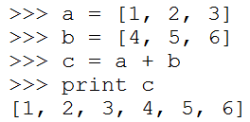
The + operator concatenates lists
List Operators
The * operator copies a list a given number of times

Slide 22
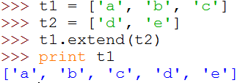
Built-in methods that operate on lists
append adds a new element to the end of a list
extend takes a list as an argument and appends all of the elements
sort arranges the elements of the list from low to high
List methods are all void; they modify the list and return None.
If you write t = t.sort(), you will be disappointed with the result.

Slide 23
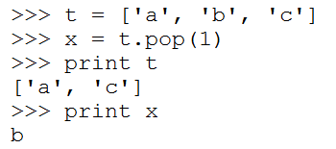
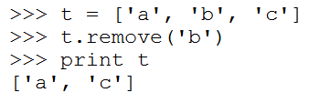
Deleting elements
If you know the index of the element you want, you can use pop
If you don’t need the removed value, you can use the del operator
If you know the element you want to remove (but not the index), you can use remove

Slide 24
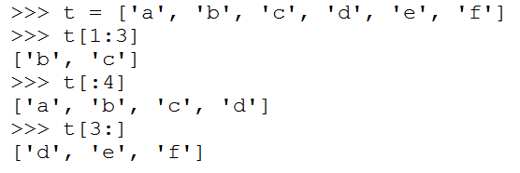
The slice operator also works on lists
If you omit the first index, the slice starts at the beginning.
If you omit the second, the slice goes to the end.
If you omit both, the slice is a copy of the whole list.

Slide 25
An assignment statement can update multiple elements

Slide 26
Assignments
Check the class website for any new lab
https://openlab.citytech.cuny.edu/emt1111/
Check Blackboard for any new quiz
https://cunyportal.cuny.edu
Study for midterm exam

