Slide 1
Control Flow (Python)
Dr. José M. Reyes Álamo

Slide 2
Control Flow
Sequential statements
Decision statements
Repetition statements (loops)

Slide 3
Sequential Statements
Statements are executed one after the other in descending order

Slide 4
Relational Operators
Less than: <
Greater than: >
Equal to: == (Not the same as = )
Not equal to: !=
Less than or equal to: <=
Greater than or equal to: >=

Slide 5
Logical Operator
AND – result is True if both conditions are true, False otherwise
  i.e. x > 0 and x < 10
OR – result is True if either condition is true, False otherwise
  i.e. n == ‘a’ or n == ‘b’
NOT – Negates a Boolean expression
  i.e. not (y < 5)

Slide 6

Selection Statements (Conditional)
Selection statements allows a program to make choices
Evaluate the Boolean condition (rendering True or False)
If Boolean expression is True, execute all statements in the body

Slide 7
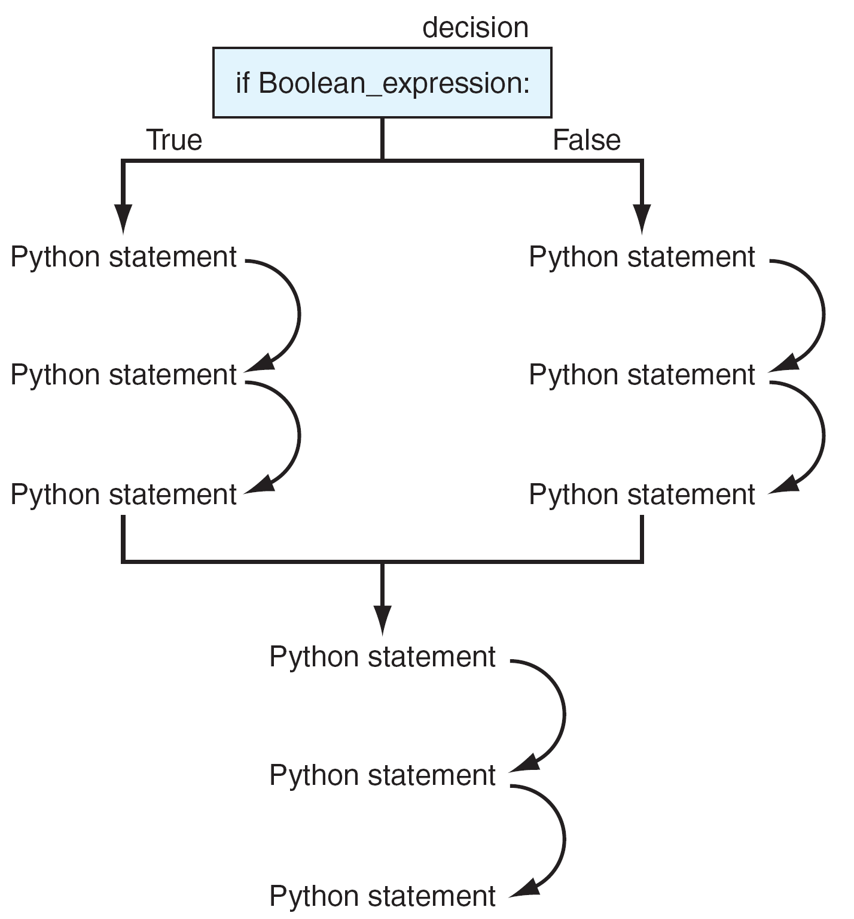

Slide 8
Warning About Indentation
Elements of the body must all be indented the same number of spaces or tabs
Python only recognizes the body when the lines of code are indented at the same level

Slide 9
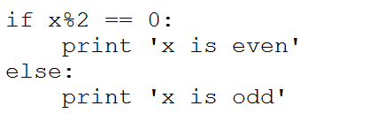
Python Selection, Round 2
Python evaluates the Boolean expression:
If expression is True, runs bodyTrue
If expression is False, runs bodyFalse
if Boolean expression:
bodyTrue
else:
bodyFalse

Slide 10
Python Selection, Chained Conditionals
Python evaluates the Boolean expression 1:
If expression 1 is True, runs body1
If expression 1 is False, checks expression 2
If expression 2 is True, runs body2
If expression2 is False, runs bodyFalse
if Boolean expression 1:
body1
elif Boolean expression 2 :
body2
else :
bodyFalse

Slide 11
Chained Conditionals Example
if x < y:
print 'x is less than y'
elif x > y:
print 'x is greater than y'
else:
print 'x and y are equal'

Slide 12
Python Selection, Nested Conditionals
Python evaluates the Boolean expression 1:
If expression 1 is True, it evaluates expression 2
If expression 2 is True, executes body2
If expression 2 is False, executes body2False
If expression1 is False, runs body1False
if Boolean expression 1:
if Boolean expression 2 :
body2
else :
body2False
else:
body1False

Slide 13
Nested Conditionals Example
if x == y:
print 'x and y are equal'
else:
if x < y:
print 'x is less than y'
else:
print 'x is greater than y'

Slide 14
Repetition: A Quick Overview

Slide 15
Repetition Statements (Loops)
Besides selecting which statements to execute, a fundamental need in a program is repetition
  repeat a set of statements under certain conditions
With sequential, selection, and repetition, we have the fundamental programming statements

Slide 16
While and For Statements
The while loop is the general repetition statement. It repeats a set of statements while the condition is True.
The for loop is useful for iterating through the elements of data structure, one at a time.
  We will study the for loop later on.

Slide 17
while Loop
Characteristics:
  test the Boolean expression before entering the loop
  test the Boolean expression before each iteration of the loop
Syntax:
while Boolean expression:
loop body

Slide 19
Repeat While the Boolean Expression is True
while loop will repeat the statements in the body while the Boolean expression is True
If the Boolean expression never changes during the course of the loop, the loop will continue forever.

Slide 20
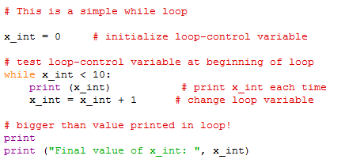
Example

Slide 21
General Approach to a while Loop
Outside the loop: initialize the Boolean expression
Inside the loop: perform some operations which changes the state of the program, eventually leading the Boolean expression to become False, exiting the loop
Need them both!

Slide 22
OpenLab and Blackboard
Check OpenLab for any new lab.
Check Blackboard for any new quiz.

