Slide 1
Functions, Procedures, and Abstraction
Dr. José M. Reyes Álamo

Slide 2
Outline
Functions
Built-in functions
User defined functions
Abstraction
Reusability
Parameters and arguments
Returning values
Variables Scope

Slide 3
Functions
From mathematics, a functions perform some operation and returns a result.
Functions hide the details of an operation, to make it easy to use by others
  e.g. sqrt() for computing the square root.

Slide 4
Function
In the context of programming, a function is a named sequence of statements that performs a computation.
When you define a function you specify the name and the sequence of statements.
Functions are invoked by their name.

Slide 5
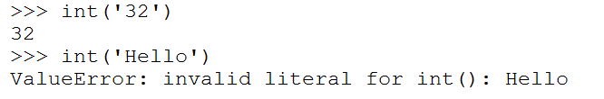
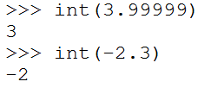
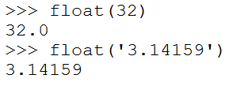
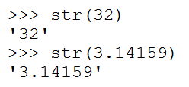
Python provides built-in functions
Type conversion functions

Slide 6
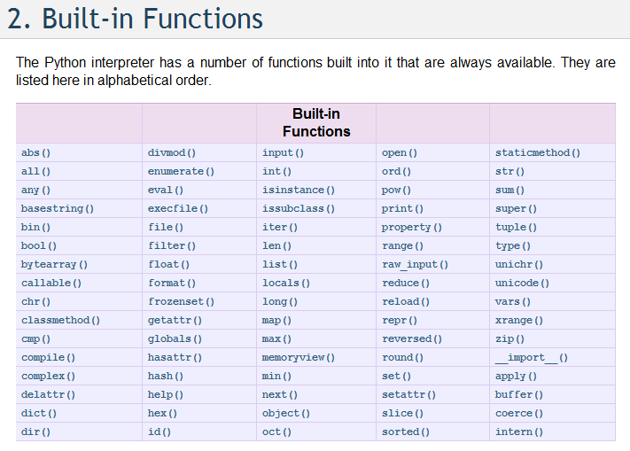
A big list of built-in functions
http://docs.python.org/library/functions.html

Slide 7
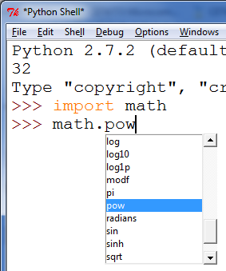
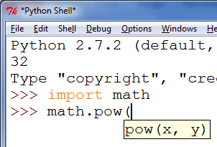

Functions in the Math module
Math functions

Slide 8
Lots of Python modules available
Built-in modules
  The Python Standard Library: http://docs.python.org/3.3/library/functions.html
Other modules
  PyPI - the Python Package Index http://pypi.python.org/pypi
  The Python Package Index is a repository of software for the Python programming language.
  There are thousands of packages there.

Slide 9
User defined functions

Slide 10
Mathematical notation
Consider a function that converts temperatures from Celsius to temperatures in Fahrenheit:
  Formula: F = 1.8*C + 32.0
  Functional notation: F = celsisus2Fahrenheit(C) where
  celsius2Fahrenheit(C) will compute 1.8*C + 32.0 and return the result.

Slide 11

Function definition
Math:
Python:
$$f\left(C\right)=1.8C+32$$
Terminology: parameter “C”

Slide 12
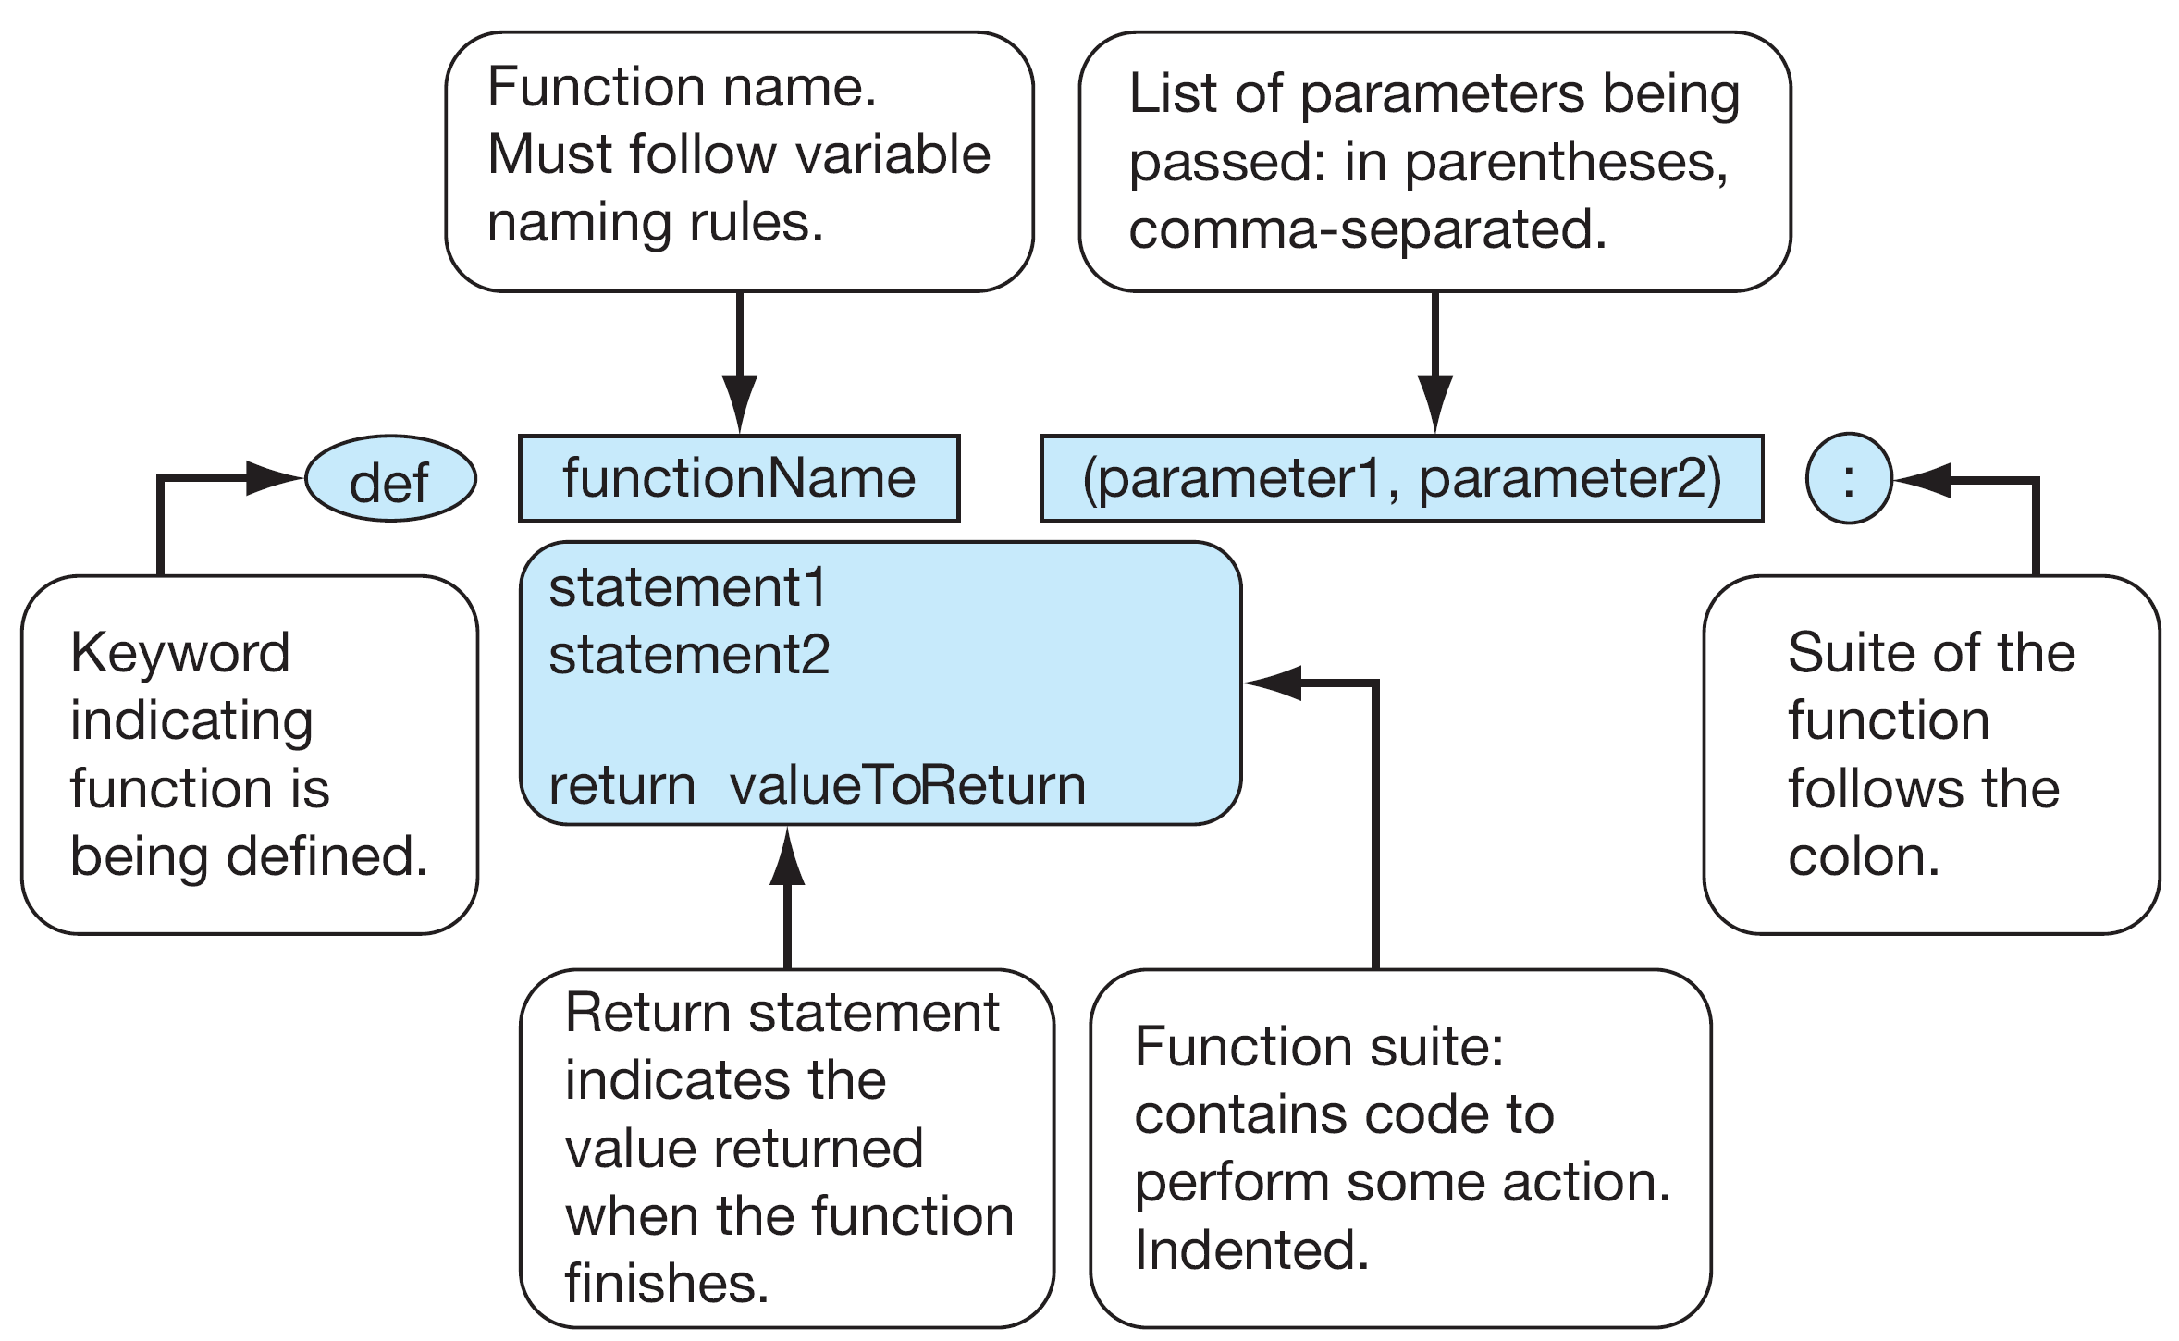

Slide 13
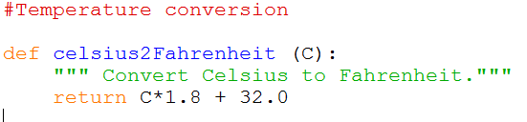

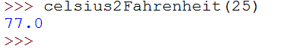
Definition and calling

Slide 14
Triple quoted string in function
A triple quoted string just after the definition is called a docstring
docstring is used for documentation of the function’s purpose. It is used to indicate to the user what the function does.

Slide 15
Abstraction

Slide 16



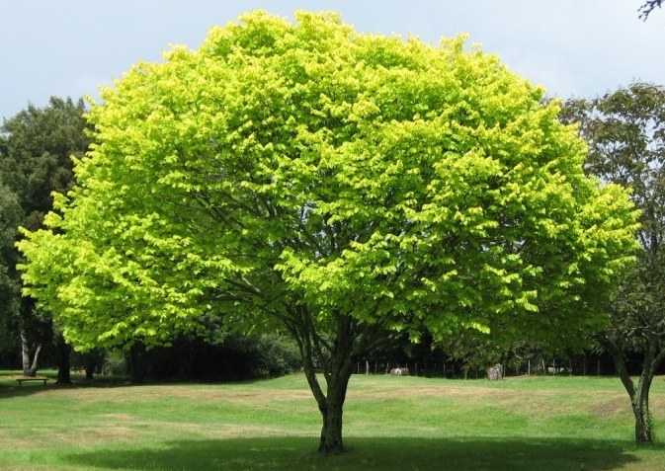




Abstraction

Slide 17
Abstraction
The ability of dealing with ideas rather than events.
Something that exists only as an idea.

Slide 18
Abstraction in computing
A programmer would use abstraction to define general purpose functions.
Abstraction is one of the most important techniques in software engineering as it is used to reduce complexity.

Slide 19
Reusability

Slide 20
Why have functions?
Support divide-and-conquer strategy
Abstraction of operations
Reuse: once written, use again
Sharing: others can use it
Security: if well tested, more secure for reuse
Simplify code: more readable

Slide 21
How to write a function
Does one thing. If it does too many things, it should be refactored into multiple functions.
Readable. You should be able to read it as well as others.
Reusable. If it performs its task well, you can reuse.
Complete. A function should check for all the cases where it might be invoked. Check for potential errors.
Not too long. As it does one thing, code is usually succinct.

Slide 22


Parameters and argument
A parameter is the variable which is part of the function's definition.
An argument is an expression, value, or literal used when calling the method.
When calling a function, the arguments must match the parameters

Slide 23
celsius=25
val=25* 1.8 + 32 = 77.0

Slide 24
Return Statement
The return statement indicates the value that is returned by the function.
The return statement is optional. If there is no return statement, the function is often called a procedure.
Procedures are often used to perform duties such as printing output or storing a file

Slide 25
Multiple returns in a function
A function can have multiple return statements, but only one will execute.
  The first return statement found executes and ends the function.
Multiple return statements can make your code confusing, therefore should be used carefully.

Slide 26
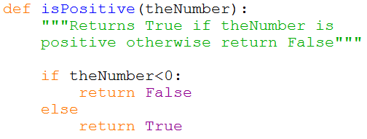
Multiple return statements

Slide 27

Local variables
When you create a variable inside a function, it is local (i.e. it only exists inside the function). For example:
When cat_twice terminates, the variables cat, part1, and part2 are destroyed. These cannot be used outside of the function.

