Slide 1
Benefits of an Electric Car
Judayne Bennett, Jamiel Reynolds, Abrar Mahin
ENG 2575

Slide 2
What is an Electric Car ?
Electric Cars are propelled by electric motors and they use electrical energy stored in batteries. Unlike ”ICE” vehicles with combustion engines, electric vehicles do not produce exhaust gases during operation. This alone makes electric vehicles more environmentally friendly than vehicles with conventional technology. However, the electrical energy for charging the vehicle does have to be produced from renewable sources, e.g. from wind, solar, hydroelectric or biogas power plants. By combining different drive types, the overall efficiency of the vehicle can be improved and fuel consumption can be reduced.

Slide 3
How Does It Work?

Slide 4
How Does It Work?
1. The controller gathers energy from the battery
2. Controller delivers the appropriate amount of electrical energy to the motor.
3. Electric energy transforms to mechanical energy.
4. Wheels turn, vehicle moves.
Simple, Easy, COOL & Efficient!

Slide 5
How Does It Work

Slide 6
The Main Components of An EV
High-voltage battery with control unit for battery regulation and charger
Electric motor/generator with electronic control (power electronics) and cooling system
Transmission including the differential
Brake system
High-voltage air conditioning for vehicle interior climate control
Electric motor/generator
Transmission with differential
Power electronics
High-voltage lines
High-voltage battery
Electronics box with control unit for battery regulation
Cooling system
Brake system
High-voltage air conditioner compressor
High-voltage heating
Battery charger
Charging contact for external charging
External charging source

Slide 7
History of EV’s

Slide 8
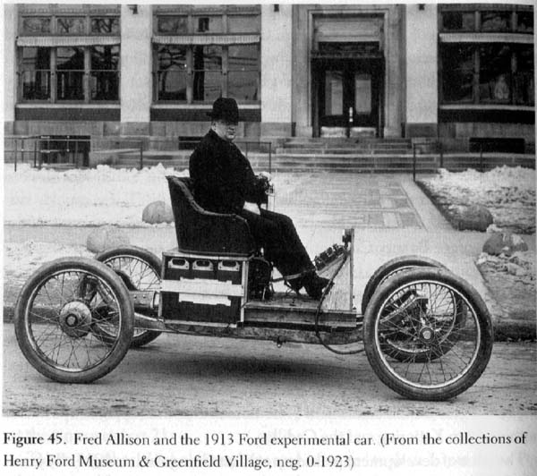
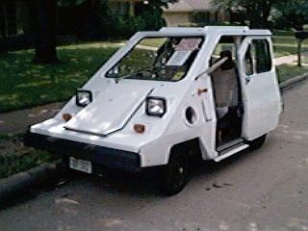
History of EV’s
- In the 1830’s first electric carriage was built
- 1891 the first electric automobile was build in the United States
- 1900 Heyday
- 1908 Henry Ford introduces Model T
- 1974 Vanguard-Sebring’s bring EV’s back into the spotlight

Slide 9
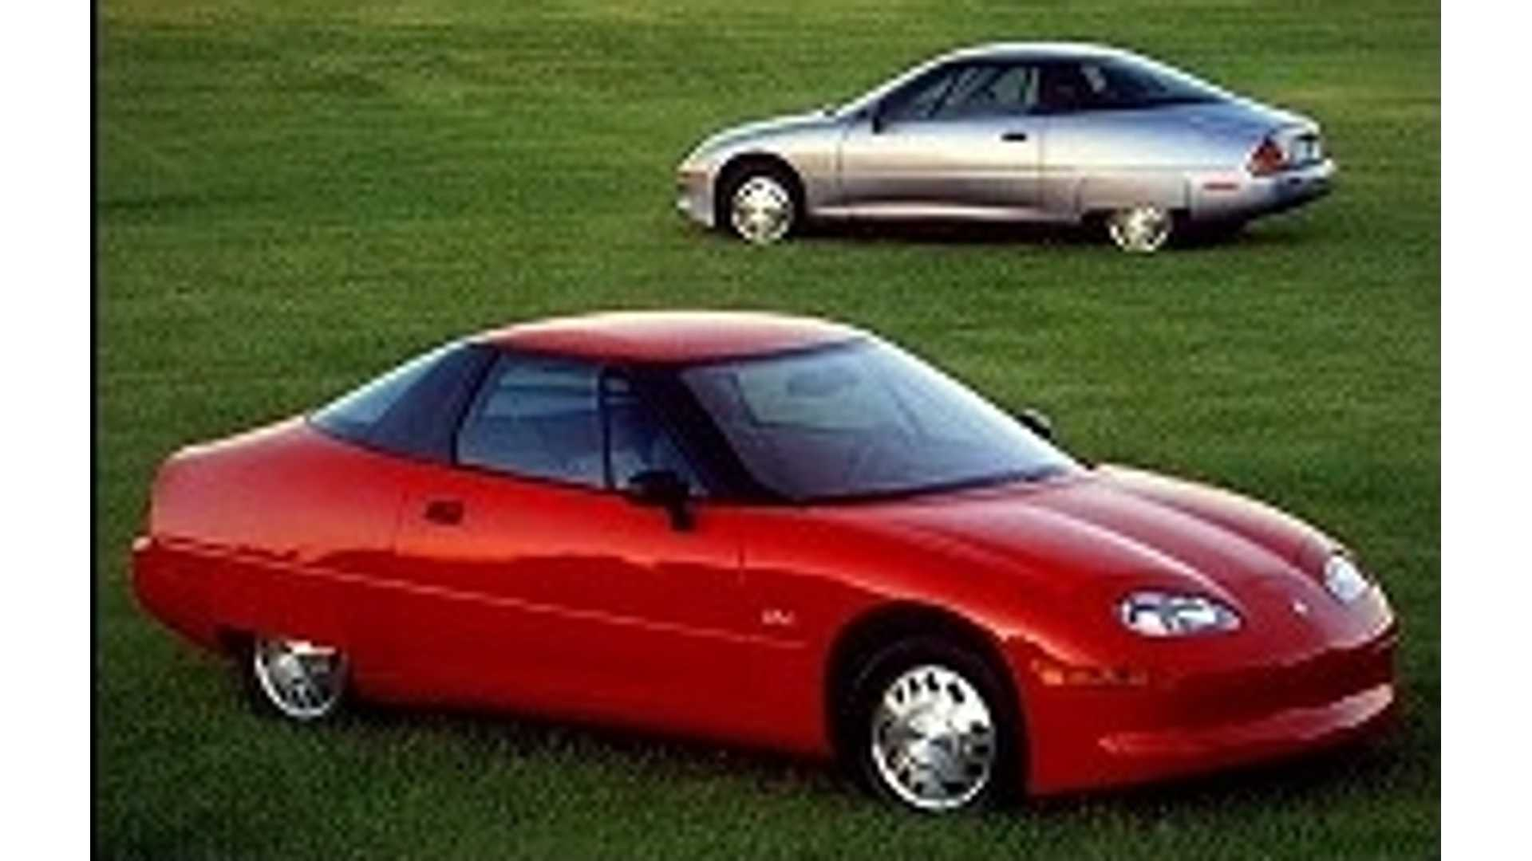
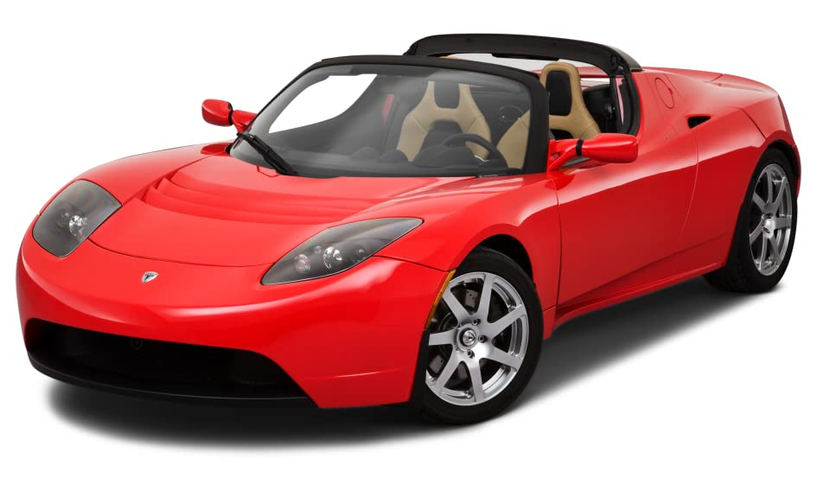
History of EV’s
- 1970s Governmental Acts
- 1988 GM EV1 (top image)
- 1997-2000 A few thousand electric cars were only available for lease.
- 2003 GM discontinued the EV1 and “killed the electric car”
- 2007 Tesla Roadster, an all electric vehicle. (bottom image)

Slide 10
Types of Electrical Vehicles On The Road Today
BEV: Battery Electric Vehicle
PHEV and HEVs: (Plug-In) Hybrid Electric Vehicle
FCEV: Fuel-Cell Electric Vehicle

Slide 11
BEV
A BEV runs entirely on a battery and electric drive train, without an internal combustion engine. It is powered by electricity from an external source, usually the public power grid. This electricity is stored in onboard batteries that turn the vehicle’s wheels using one or more electric motors. What you should know about BEVs:
•The initial purchase price is significantly higher than similar gas-powered vehicles, even with government incentives, if offered in your province.
•Demand for BEVs should result in lower purchase prices in future.
•You can save a lot of money on fuel and maintenance costs.
•They have a range between 100 and 160 km, compared with 500 km for most conventional cars, but for most consumers, that range is well within their current commute range.
•Batteries can recharge overnight plugged into a regular household outlet of 120 volts, or even faster using a 240 volt outlet, similar to the type of outlet used for domestic clothes dryers.
•Installing a 240V outlet for your BEV costs approximately $200-$400.
•Many BEV owners purchase a charging station for their home, which ranges in price from $600- $1200.
•400V rapid charging stations are now available in many locations, where BEVs equipped with a CHAdeMO or COMBO connector can be 80% charged in under 30 minutes.

Slide 12
Plug-in Hybrid Electric Vehicle (PHEV)
A PHEV runs mostly on a battery that is recharged by plugging into the power grid. It is also equipped with an internal combustion engine, running on gasoline or diesel fuel, that can recharge the battery and/or to replace the electric drive train when the battery is low and more power is required. What you should know about PHEVs:
•The original purchase price is comparable to similar vehicles operating on internal combustion alone.
•PHEVs have an advantage over BEVs because consumers are already comfortable with gas or diesel fueled vehicles.
•PHEVs offer readily-available fuel for long distance driving and have a significantly increased range compared to BEVs.
• PHEVs can be recharged on the public network, as opposed to HEVs (covered next), they are often cheaper to run than HEVs, though the amount of savings depends on the distance driven on the electric motor alone.
•If the distance traveled before recharging is always less than the vehicle’s range in electric-only mode, the car never has to be refueled with conventional fuel. •Autonomy of a PHEV can vary between 10 and 35 km in electric mode.
•Since PHEV batteries are smaller than BEV batteries, charging time is less.

Slide 13
Hybrid Electric Vehicle (HEV)
An HEV has two complementary drive systems - a gasoline engine and fuel tank, and an electric motor, battery and controls. The engine and the motor can simultaneously turn the transmission, which powers the wheels. Where the HEV differs from the above two types of electric vehicles (BEV and PHEV) is that HEVs cannot be recharged from the power grid. Their energy comes entirely from gasoline and regenerative braking. What you should know about HEVs:
•The original purchase price is comparable to similar vehicles operating on internal combustion alone.
•HEVs have an advantage over BEVs because consumers are already comfortable with gas or diesel-fueled vehicles.
•HEVs offer readily-available fuel for long distance driving and have a significantly increased range compared to BEVs.
•As soon as the driver accelerates moderately, running entirely on the electric motor lasts rarely more than 5-10 km.
•Typically, the electric motor can also function as a generator, driven by the engine, to help recharge the batteries when electric power is not needed for driving the vehicle.
•They are more expensive to run than PHEVs, because they cannot be recharged on the public network.

Slide 14
Fuel-cell Electric Vehicle (FCEV)
A FCEV creates electricity from hydrogen and oxygen, instead of storing and releasing energy like a battery. Because of these vehicles’ efficiency and water-only emissions, some experts consider these cars to be the best electric vehicles, even though they are still in development phases and provide many challenges. What you should know about FCEVs:
•Purchase price is high because the cost of a fuel cell is several times more expensive than the cost of an internal combustion engine.
•Extracting hydrogen from a water molecule is an energy-intensive process that generates greenhouse gas emissions if renewable energies are not used.
•FCEVs are expected to be widespread on the market in the next few years.
•Since February 12, 2015, the fuel-cell Tucson has been for sale in the Vancouver area, making Hyundai the first original equipment manufacturer to market a fuel-cell vehicle.
•The Toyota Mirai was slated to follow suit, but was stalled due to lack of infrastructure.
•The transportation and infrastructure required to bring this fuel to stations is a challenge.

Slide 15
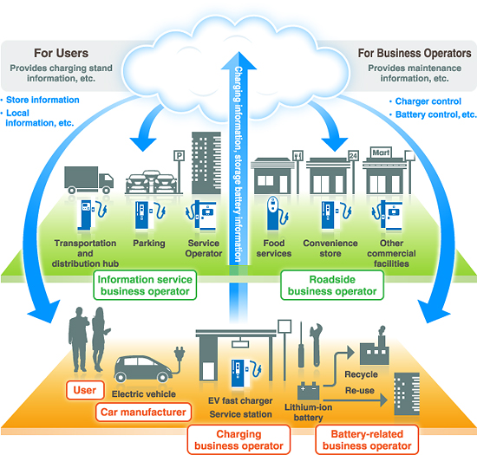
Infrastructure of EV’s

Slide 16
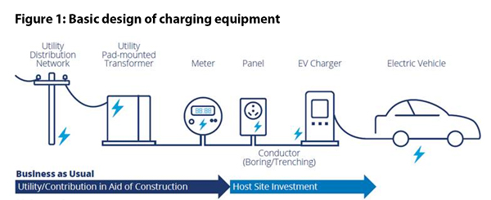
Charging Station Infrastructure

Slide 17
Confusion Regarding Speed
There is a misconception regarding EV’s and speed, if your customer whom likes going fast and furious like they do in the films, electric cars are the perfect choice for that!
One huge reason for that being they instantaneous torque, once you hit the accelerator you’ll be flying like a hawk down the freeway.
Batteries due to contrary belief last long too even when pushed to its limits
Guaranteed for up to 200,000 miles

Slide 18
Speeds

Slide 19
Future of EV’s
Most to ALL car manufactures are going electric
Matter of fact most or ALL cars by 2035 will be fully electric
To combat Global Warming and Greenhouse Gasses manufacturers have accelerated
EV companies want to make people believe in Electric Cars, ending the gas era!

Slide 20
Thank You for listening! Purchase Your Electrical Vehicle Today!

