Slide 1
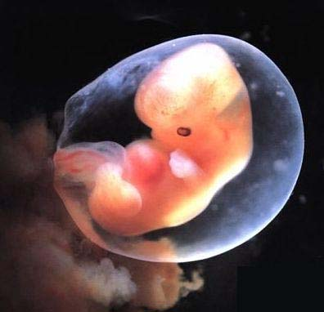
Ectodermal Dysplasia
Emelisa Gonzalez
Den 1114

Slide 2
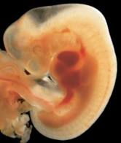
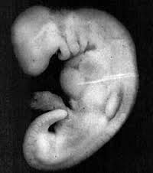
What is Ectodermal dysplasia?
In the critical period of prenatal development, a disturbance occurs and can develop to a congenital malformation.
It is a hereditary syndrome from an abnormal development of one and more structures from the ectoderm.

Slide 3
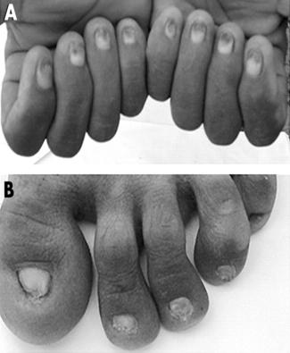
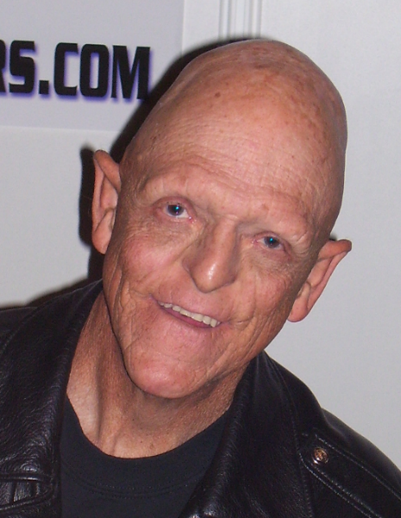
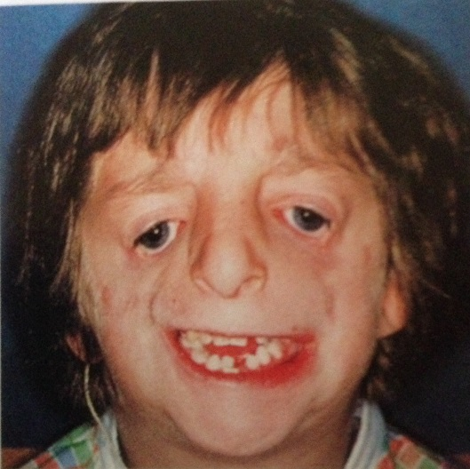
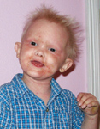
What does it effect?
It can effect the abnormalities of the teeth, skin, hair, nails, eye, facial structures and glands.

Slide 4
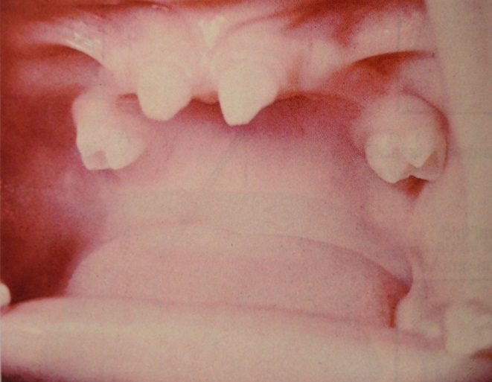
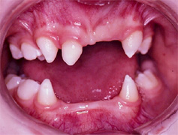
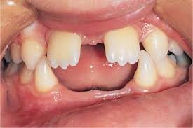
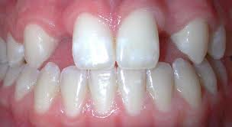
Dental Association
Since the teeth are produced by ectoderm, there may be partial or complete ANODONTIA. (Absent of teeth)

Slide 5
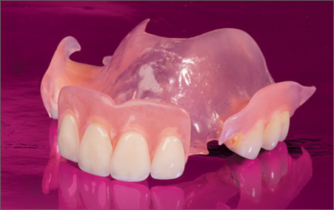
Dental Treatments Options
Partial or full denture
Advantage: esthetic purpose & function
Disadvantage: dentures need to be remade
periodically because the jaw continues to
grow.
Implants may be considered when the jaw growth stops.

Slide 6
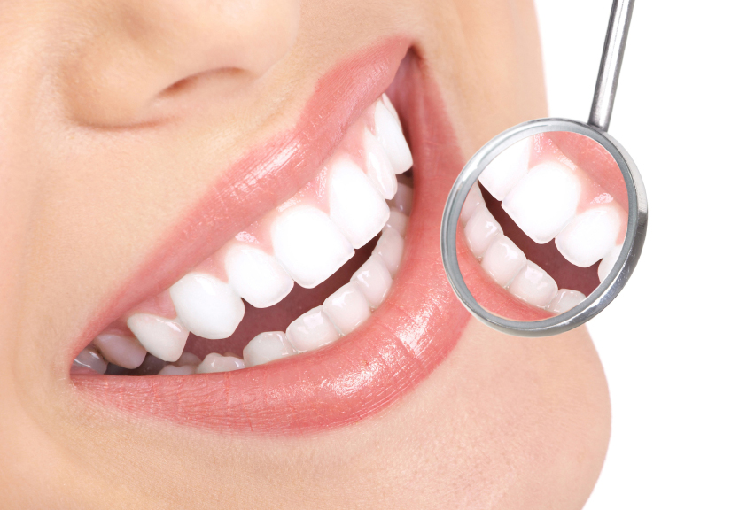
Role of the Dental Hygienist
To assist in identifying & diagnosing this condition.
To offer the best treatment option available for the patient.

