Slide 1
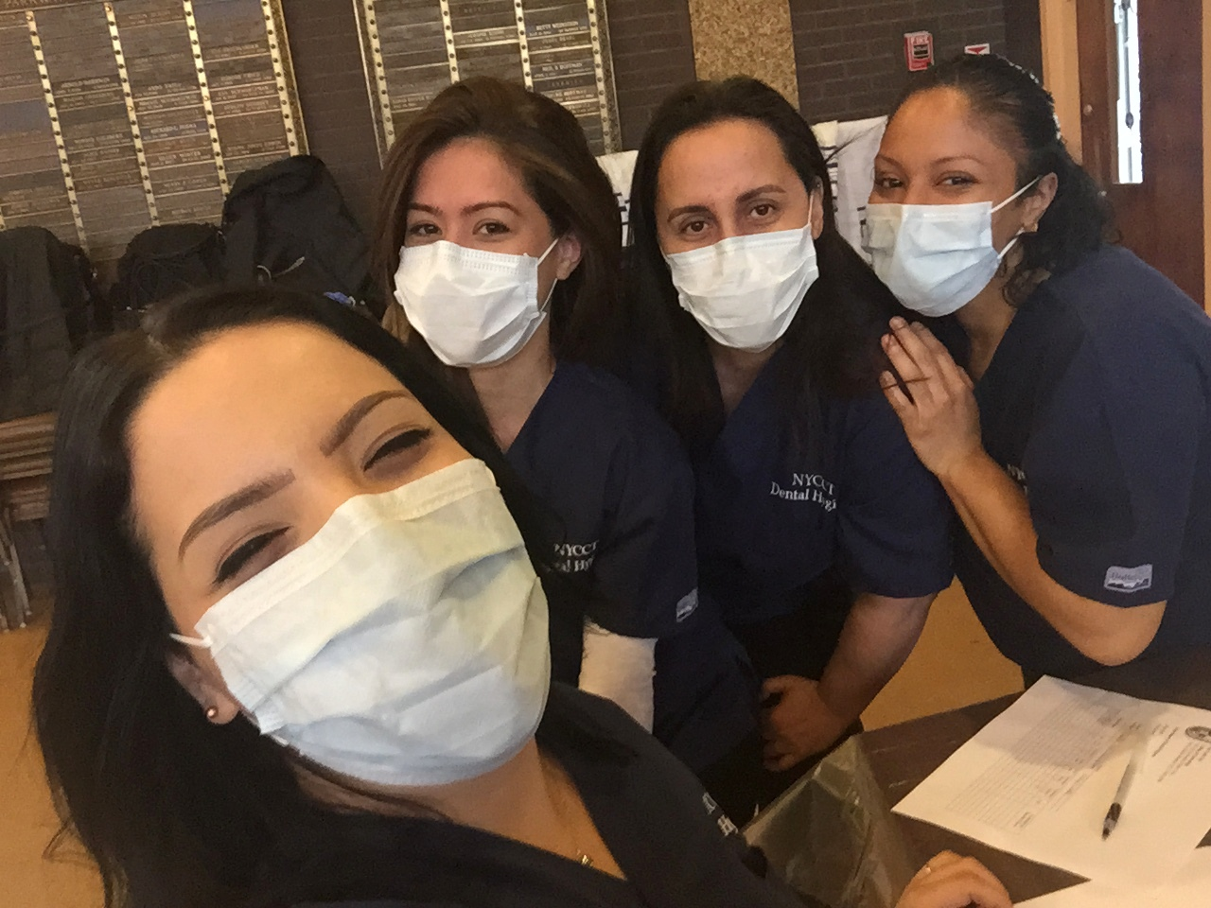
Presented by: Natalie Agudelo, Jessica Machado, Wendy Moran, Dorothy Joy Rodriguez & Emelisa Gonzalez
HEALTHY MOUTH, HEALTHY YOU!

Slide 2
WHO…

Slide 3
HAS ANYONE…
EVER FORGOTTEN TO BRUSH THEIR TEETH?

Slide 4
ARE THESE TEETH CLEAN?

Slide 5
ARE THESE TEETH CLEAN?

Slide 6
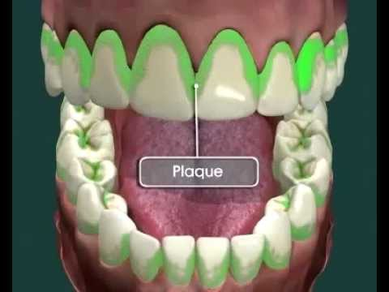
The sticky, slimy and grimy stuff on your teeth is called PLAQUE.
Plaque is made up of a mixture of millions of germs, food and saliva.

Slide 7
The bacteria in your mouth make acids and when plaque sticks to your teeth, the acids can eat away at the outside layer of the tooth, called the ENAMEL.

Slide 8
When the ENAMEL of a tooth starts to get weak and break down… you get a CAVITY.
A cavity is a hole that can grow bigger and deeper over time. Once you have a cavity it’s important to get to repaired!

Slide 10
YOU HAVE THE POWER TO PREVENT CAVITIES BY BRUSHING AND FLOSSING!

Slide 11
SO WHY DO WE HAVE TO BRUSH???

Slide 13
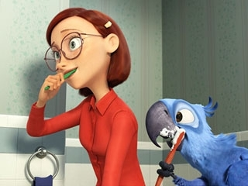
HOW DO WE BRUSH OUR TEETH???

Slide 14
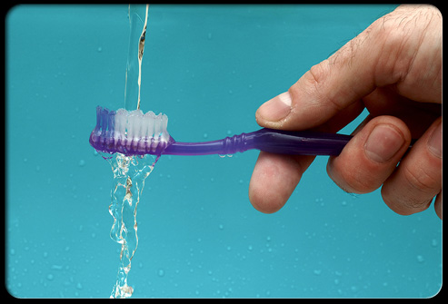
STEP 1: WET YOUR TOOTHBRUSH

Slide 15
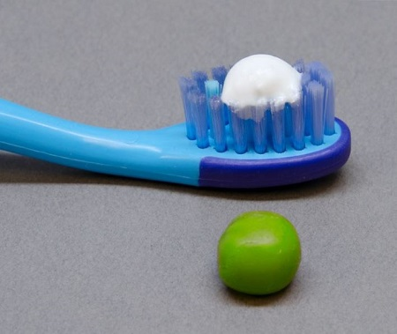
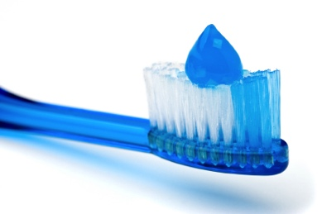
STEP 2: PUT A PEA SIZE AMOUNT OF FLUORIDE TOOTHPASTE ON YOUR TOOTHBRUSH

Slide 16
STEP 3:
BRUSH ALL YOUR TEETH FROM THE FRONT TO THE BACK, THE TOP AND THE BOTTOM

Slide 17
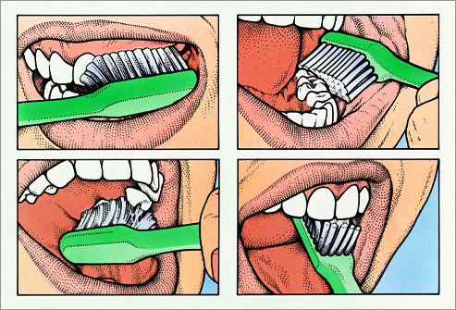
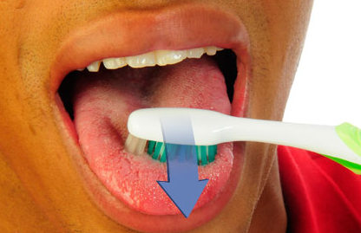
STEP 4:
BRUSH BACK AND FORTH, ROUND AND ROUND AND DON’T FORGET YOUR TONGUE!

Slide 18
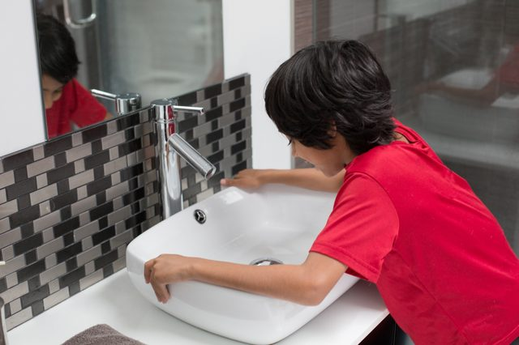
STEP 5:
SPIT TOOTHPASTE IN SINK

Slide 19
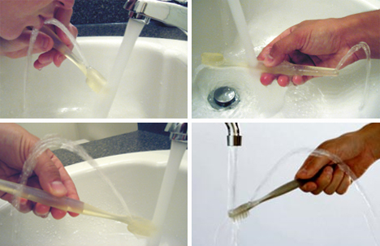
STEP 6:
RINSE TOOTHBRUSH

Slide 20
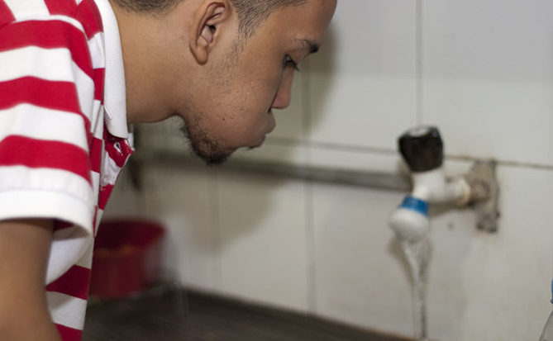
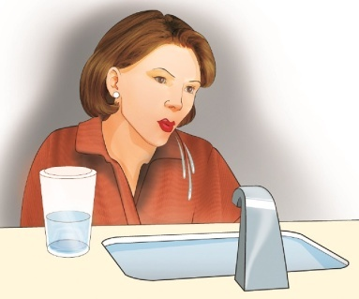
STEP 7:
RINSE YOUR MOUTH WITH WATER

Slide 21
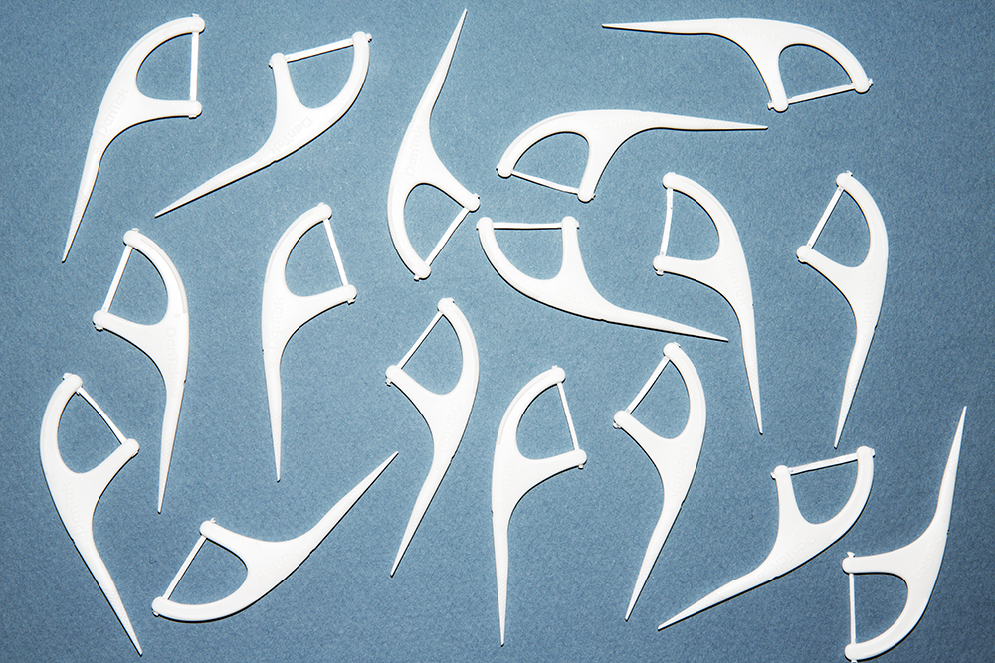
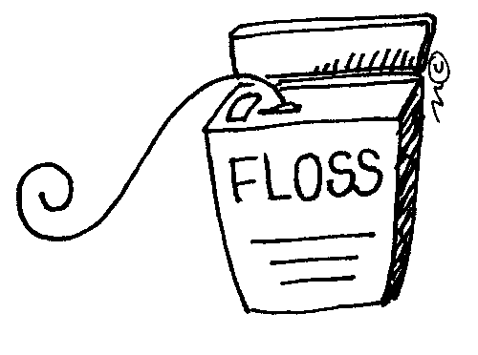
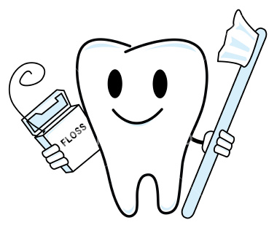
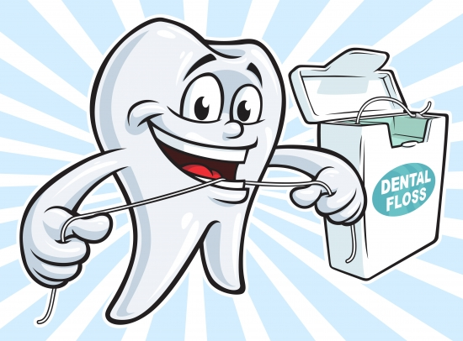
BRUSHING YOUR TEETH ISN’T THE ONLY STEP IN KEEPING YOUR TEETH CLEAN!
YOU NEED TO FLOSS!

Slide 22
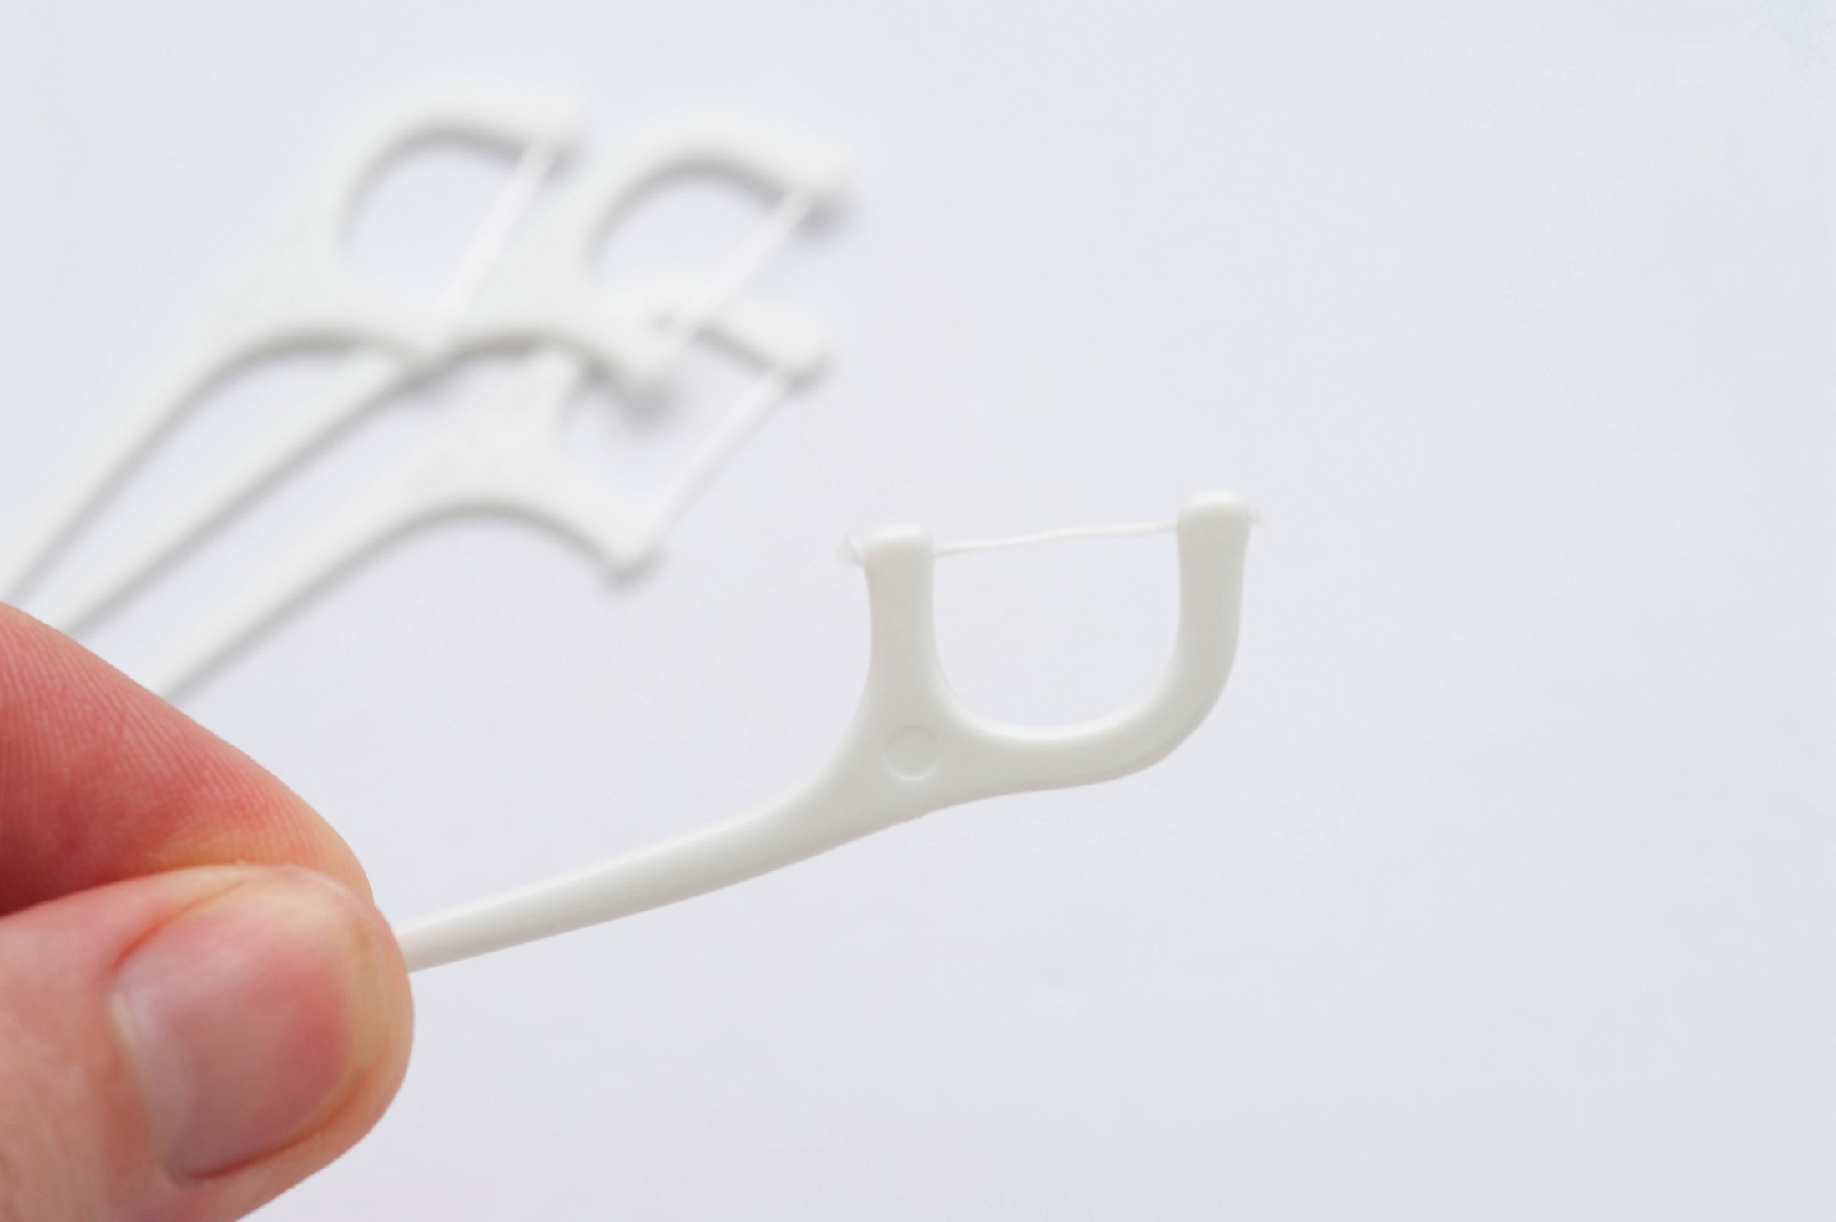
HOW TO FLOSS
STEP 1:
HOLD THE FLOSSER FIRMLY BETWEEN YOUR THUMB AND INDEX FINGER

Slide 23
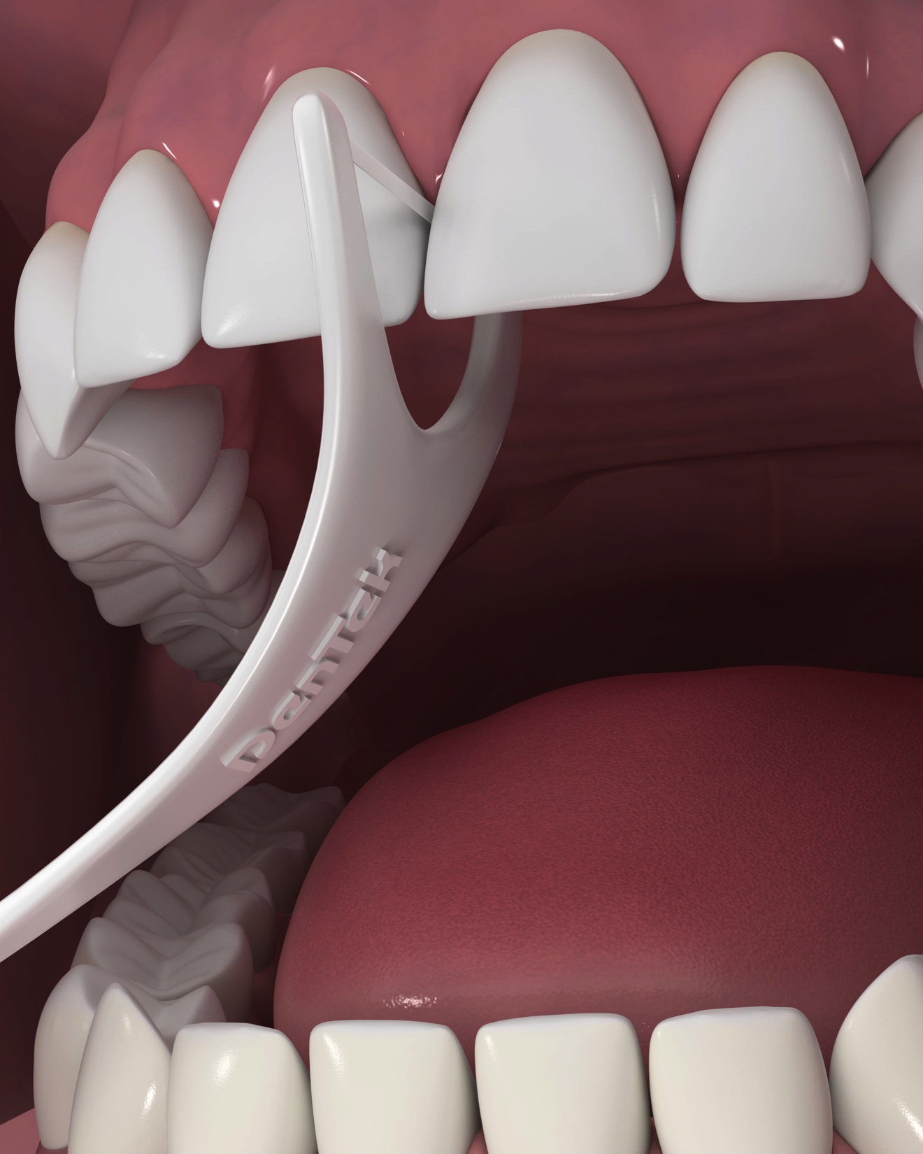
STEP 2:
Use a gentle back-and-forth wiggling motion and slide floss between teeth

Slide 24
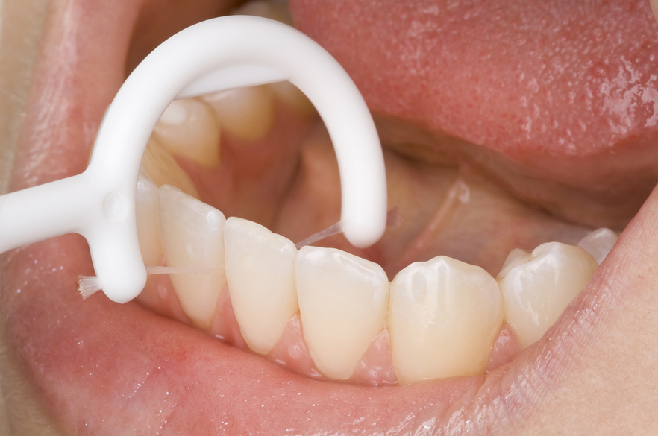
STEP 3:
Move up and down against each side of the tooth in a “C” shape to clean above and below your gum line

Slide 25
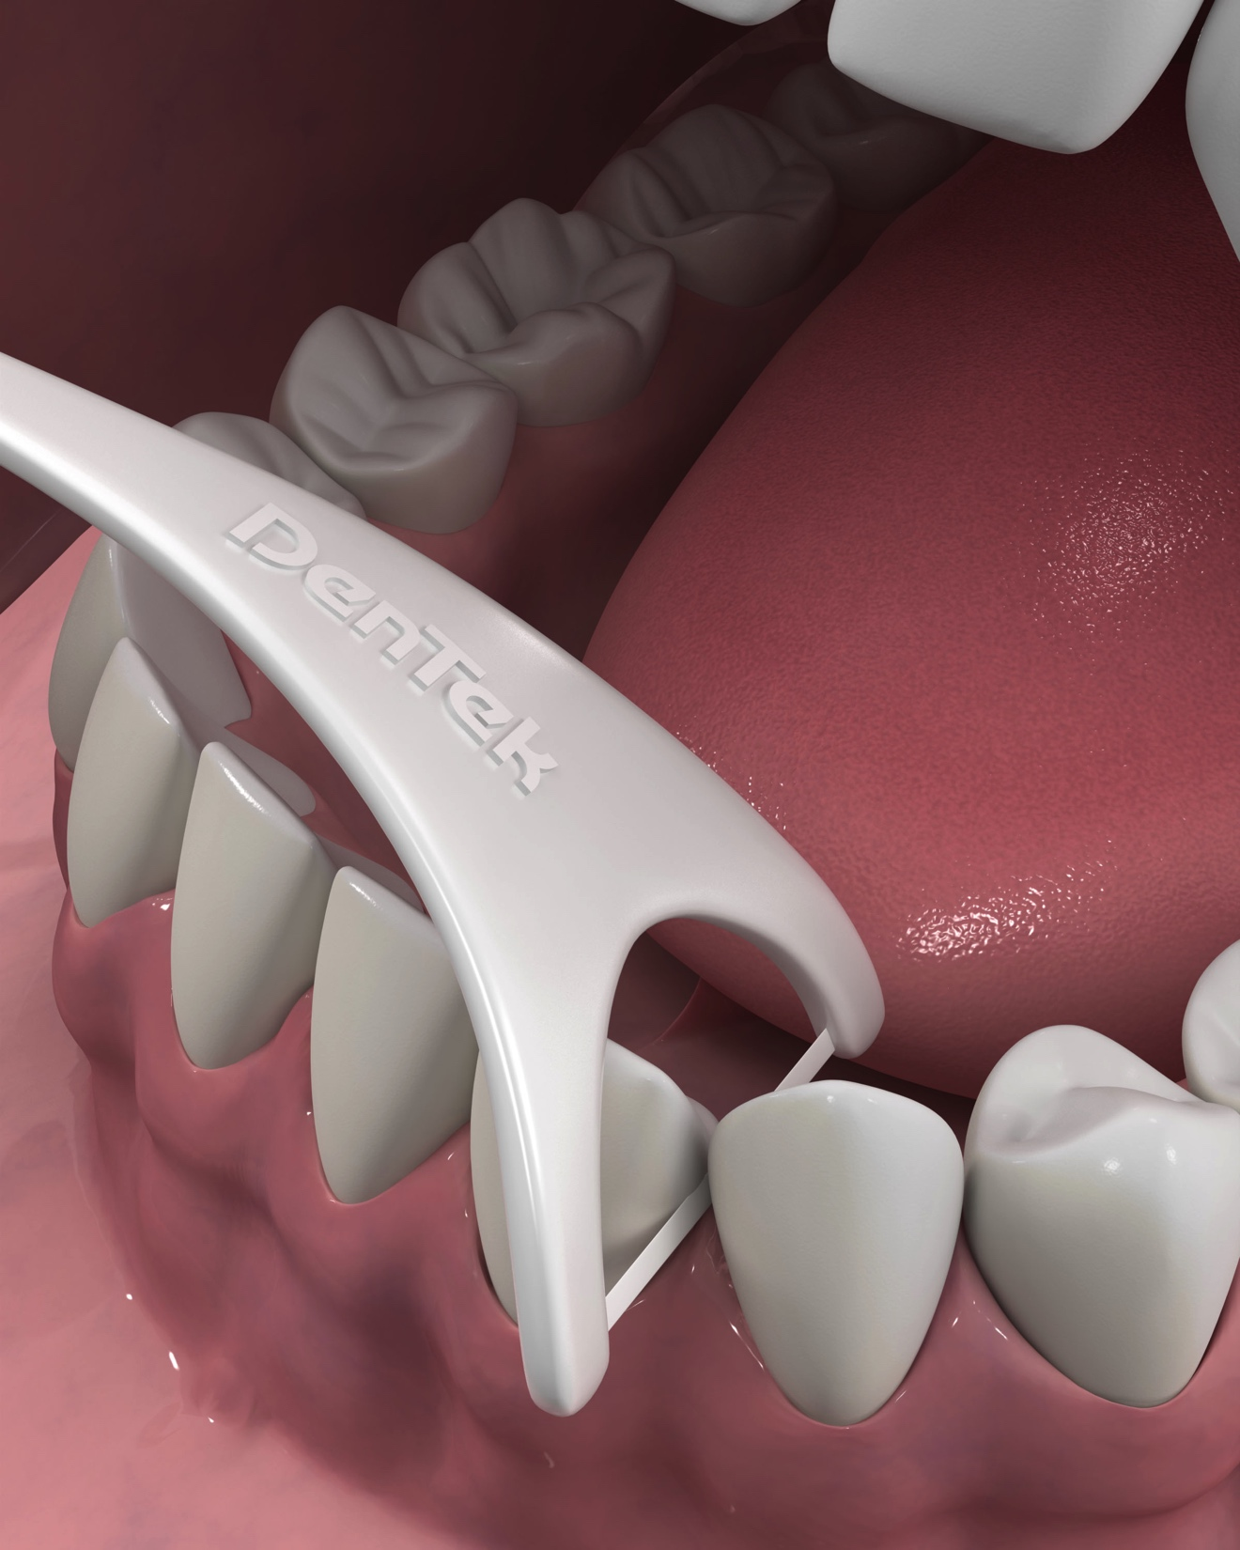
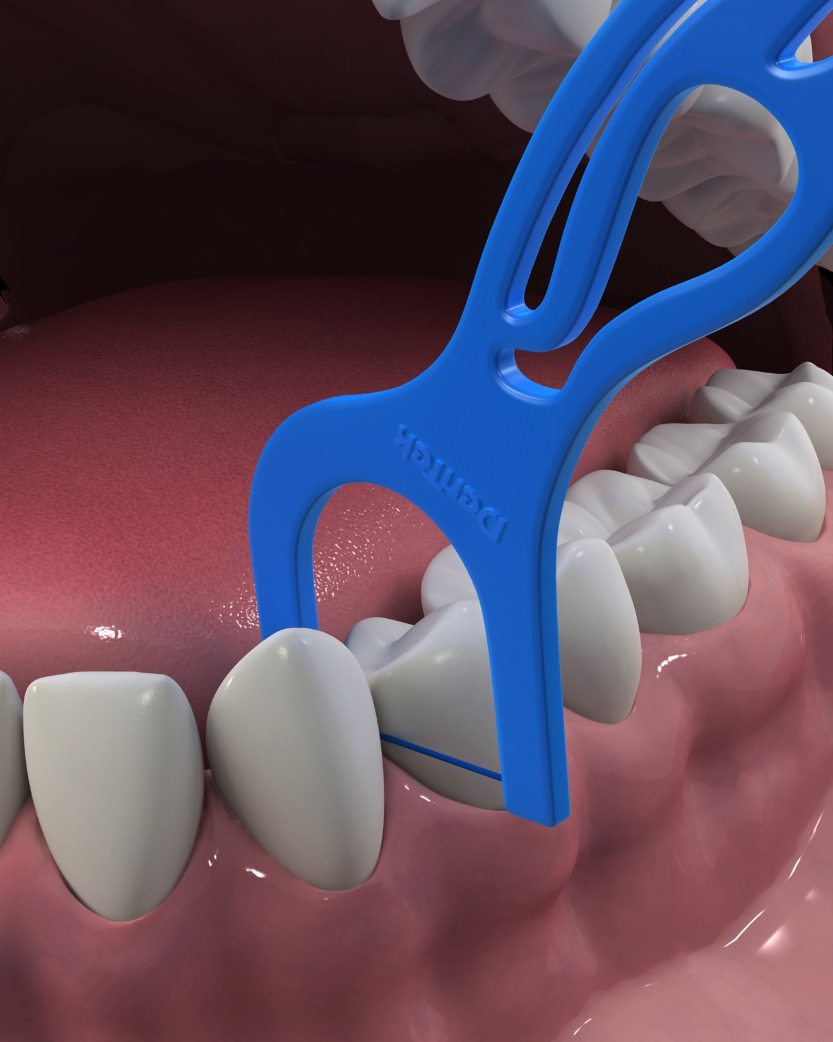
STEP 4:
Repeat for each tooth

Slide 26
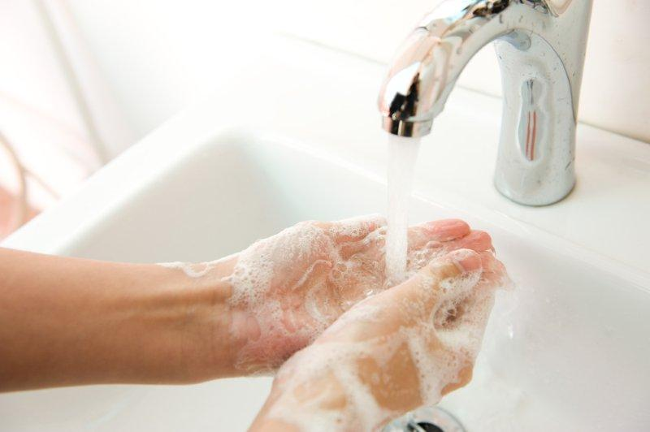
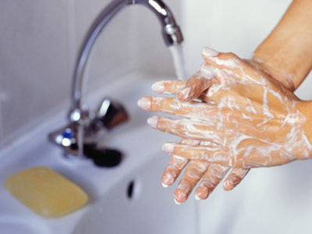
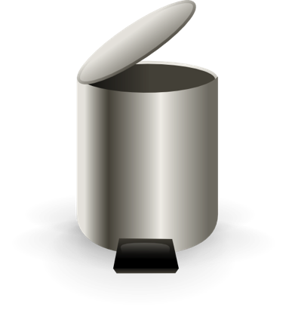
STEP 5:
Throw away and wash hands

Slide 27
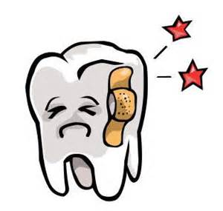
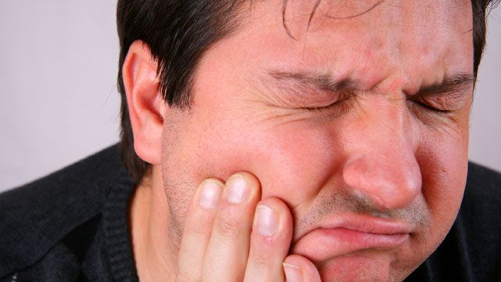

Slide 28
OR

Slide 29
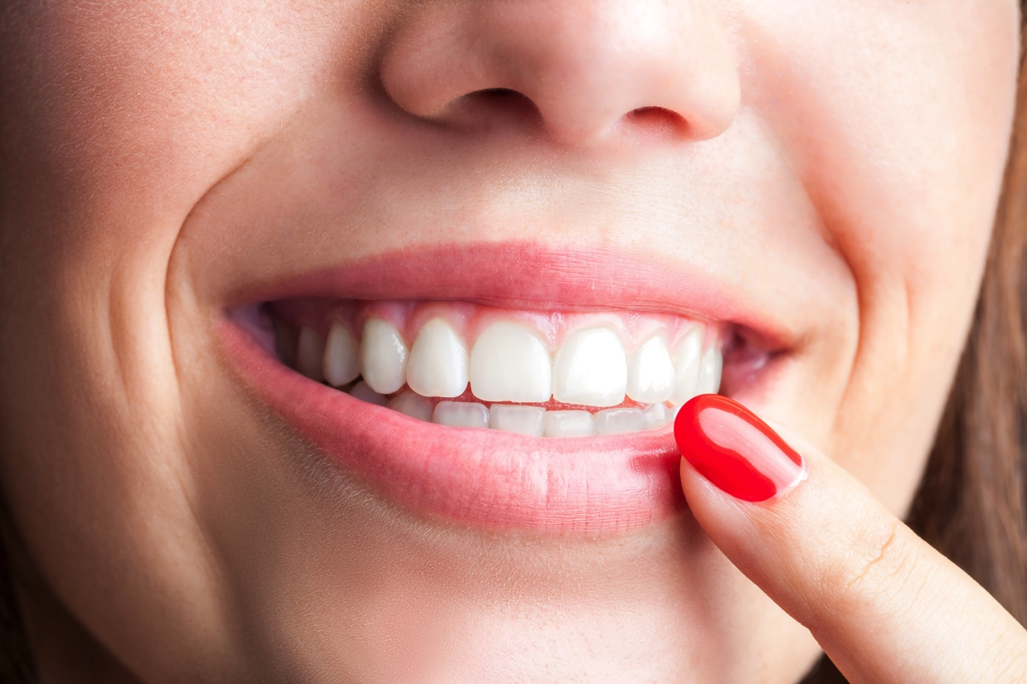
TELL SOMEONE
TELL SOMEONE

Slide 30
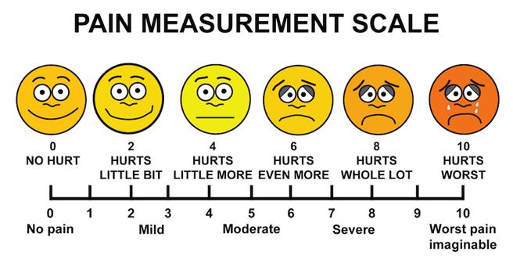

Slide 31
DON’T FORGET TO VISIT THE DENTIST!

Slide 32
THE END!!!!!

