Slide 1
WHO: Age Group 55-64
WHAT: People in This Age Group Who Do Not Qualify or Cannot Afford Insurance WHY: Unemployment or Underemployment
Aralfa Rosario, Sagine Alexandre, Eliran Gluzman, Kevin Maddix & Connie Koo

Slide 2
What is unemployment? Unemployment is defined by the U.S. Bureau of Labor Statistics as people who do not have a job, have actively looked for work in the past four weeks, and currently are available for work. Also, people who were temporarily laid off and were waiting to be called back to that job are included in unemployment statistics.
Consequences of Unemployment and Underemployment The consequences of unemployment and underemployment for individuals are financially and often emotionally destructive. When people are out of work for a long period of time,, their job skills may no longer match the requirements of the new jobs being offered. Many of these individuals are 55 or older. They may not be able to get a good job again, despite laws prohibiting age discrimination. They may get part time or low paying entry jobs to make ends meet. When money is limited it becomes a problem and seeking healthcare needs become a secondary priority.

Slide 3
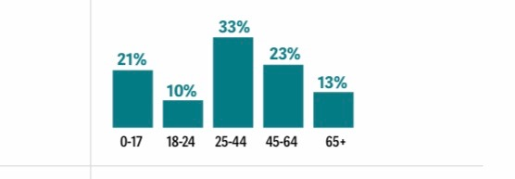
Target Population : Age 55-64

Slide 4
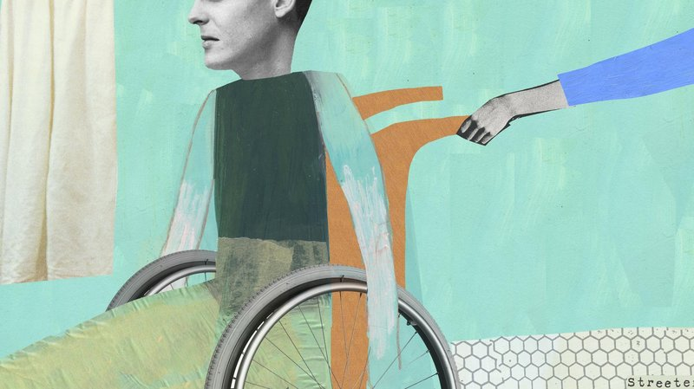
Barriers/Challenges to Delivering Healthcare
Limited education about health management
Language barrier
Access to healthcare services
Financial constraints Gender
Race
Education level
Income
Uninsured
Sexual orientation
Medical condition
Employment status
Not knowing the options available

Slide 5
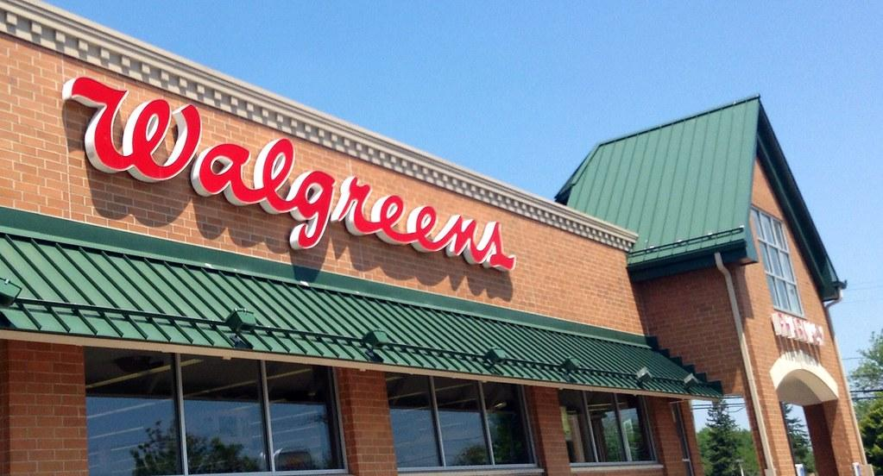
Interventions
AARP helps adults 50 years old and older
Costs only $12 a month to join
Connects elderly job seekers with employers
Advocates for older Americans, particularly the low income and vulnerable
Prescription discounts at major pharmacy retailers
Job and skills development

Slide 6
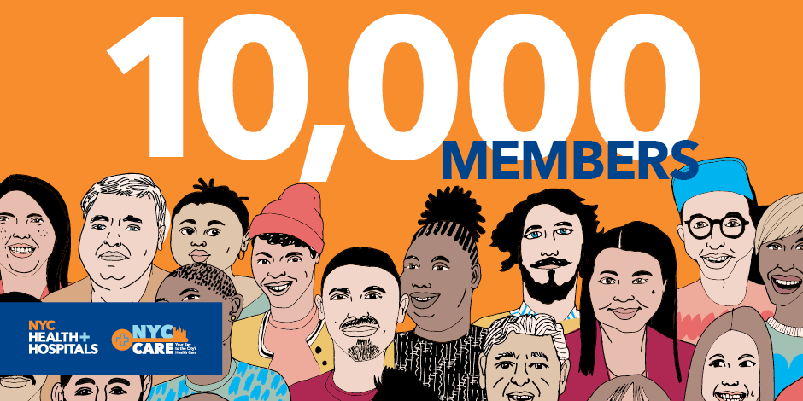
NYC Care is a health care access program that guarantees low cost and no cost services to New Yorkers who do not qualify for or cannot afford health insurance. All NYC Care services are provided through NYC Health + Hospitals.
With NYC Care, you can get a unique membership card to access health services, choose your own doctor, and get affordable medications.
With the launch of NYC Care, avoidable hospitalizations will decrease.
Services Provided:
Primary and Preventive Care
Speciality Care
Behavioral Health and Substance Use
Women’s Health
Affordable Medications
Eye Care

Slide 7
Senior Community Service Employment Program (SCSEP)
Helps low-Income, unemployed persons 55 and up find work.
Given an opportunity to be of service to the community through non-profit organizations.
Builds skills and self confidence.

Slide 8
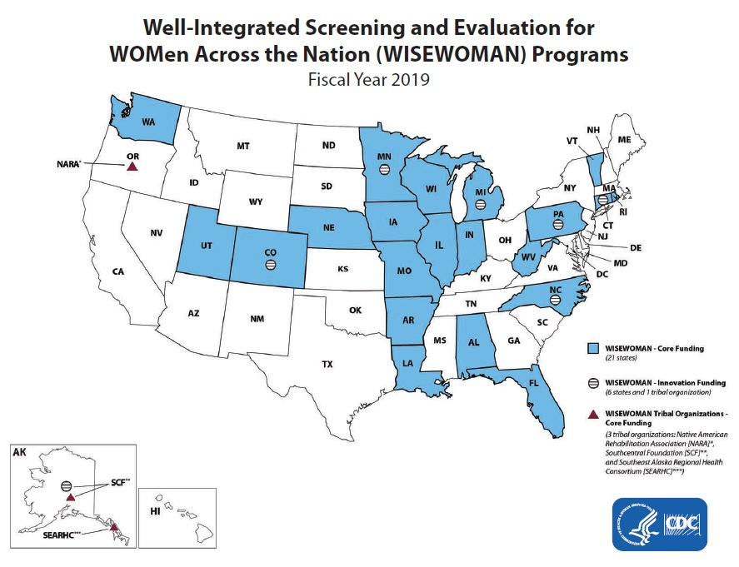
WISEWOMAN services include:
BMI
Weight
Blood pressure
Cholesterol
Blood glucose testing
Lifestyle programs
All WISEWOMAN programs collaborate with health care providers to provide qualifying women free screenings and counseling about their risk for heart disease and stroke.
WISEWOMAN (Well-Integrated Screening and Evaluation for Women Across the Nation) Program is a Centers for Disease Control and Prevention (CDC)-sponsored program designed to help 40-64 year-old women reduce their risk for heart disease and promote a heart-healthy lifestyle.

Slide 9
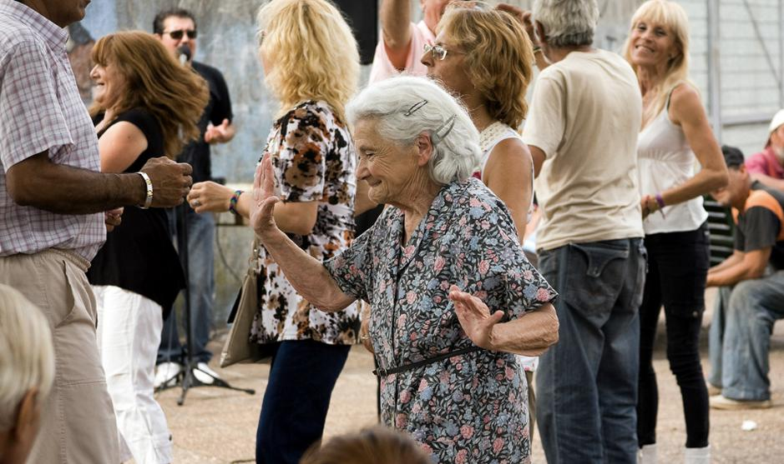
Shared Values The need for accessible health care among adults between the age of 55-64. Problem
Unemployment and underemployment results in people not seeking healthcare
Solutions
NYC Care
Evaluation Within just four months after its launch, NYC Care is ahead of its enrollment goal schedule in the Bronx with all members receiving primary care appointments within the first two weeks of enrollment.

Slide 10
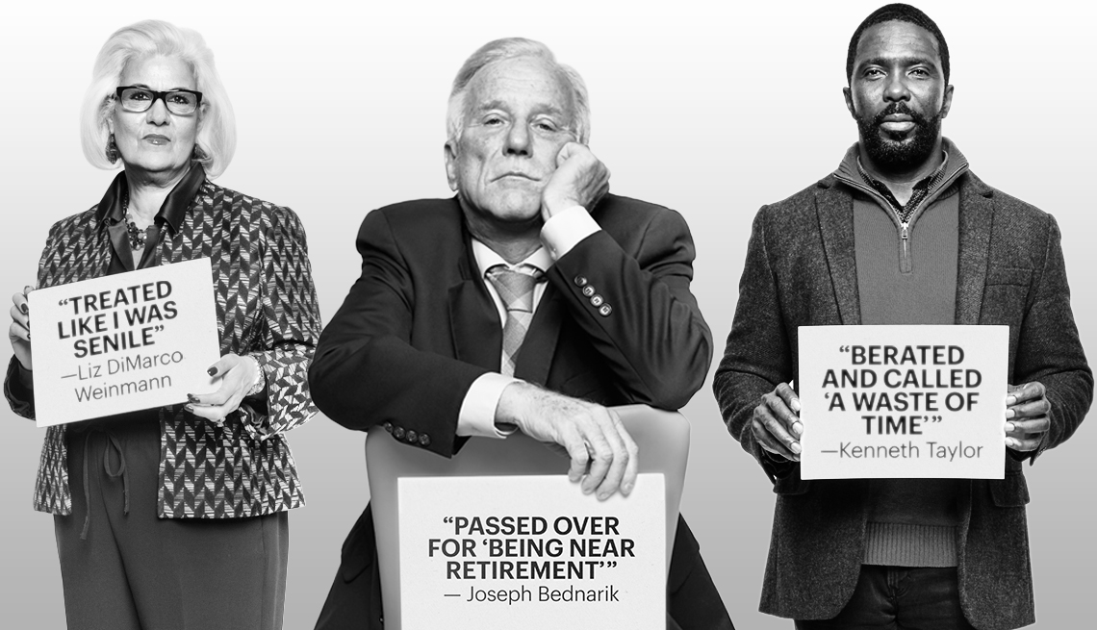
“Take Away” From Our Experience
un/underemployment due to age discrimination
Difficulty in qualifying for insurance due to age and socioeconomic status
AARP helps this age group with costs and resources
NYC CARE provides insurance to those who do not qualify for ACA or Medicaid

Slide 11
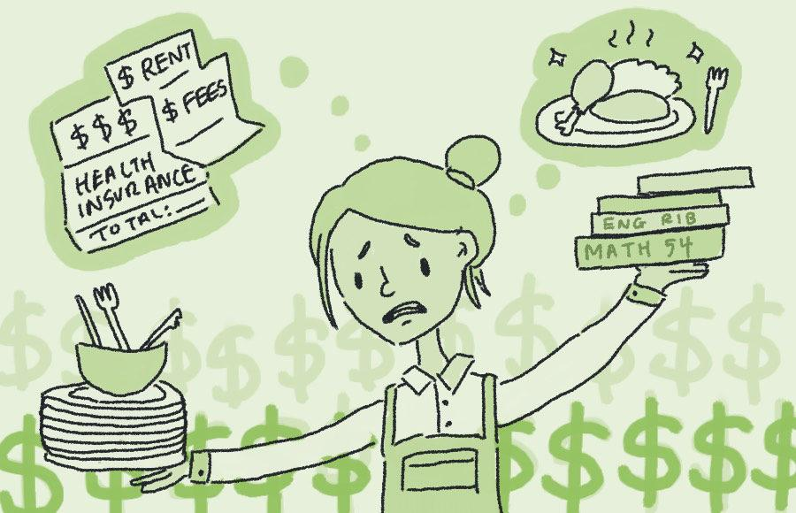
“Take Away” Continue..
From our time working at the community center we realized that many people do not follow up with their primary care physician (PCP)
We also learned that many people do not know how to properly take their medications.
Many people live without insurance due to lack of income.

Slide 12
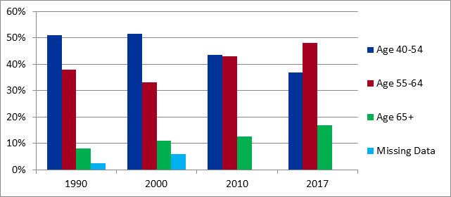
Whats Next?
Percentage of discrimination based on age
Increase awareness of age discrimination
Healthcare Reform
Government programs to aid this specific age group with employment opportunities
Expanding NYC Care throughout the entire country.
Lipnic, V. A. (2008). The State of Age Discrimination and Older Workers in the U.S. 50 Years After the Age Discrimination in Employment Act (ADEA). Retrieved from https://www.eeoc.gov/eeoc/history/adea50th/report.cfm

Slide 13
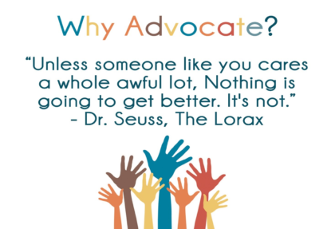
Being an Advocate
Support and recommend our patients.
Collaborating with interdisciplinary team, social workers and case managers in order to provide quality care and prevent health disparities.
Assist people in finding employment
Create follow up programs to manage health

Slide 14
References
5 Tips for Treating Patients with a Language Barrier. (n.d.). Retrieved May 1, 2020, from http://www.jonestherapyservices.com/blog/5-tips-for-treating-patients-with-a-language-barrier/ AARP's Mission, Vision, Advocacy, Community Service & Products. (n.d.). Retrieved from https://www.aarp.org/about-aarp/
About NYC Care. (2020). Retrieved from https://www.nyccare.nyc/about/
Amadeo, K. (2020, April 13). Not Everyone Who Is Jobless Is Unemployed. Retrieved April 28, 2020, from https://www.thebalance.com/what-is-unemployment-3306222
Lancaster, A. (2016, December 15). How to beat language barriers. Retrieved April 27, 2020, from https://www.restaurantbusinessonline.com/workforce/how-beat-language-barriers
Lipnic, V. A. (2008). The State of Age Discrimination and Older Workers in the U.S. 50 Years After the Age Discrimination in Employment Act(ADEA). Retrieved from https://www.eeoc.gov/eeoc/history/adea50th/report.cfm
National Council on Aging (NCOA). (2016, December 20). Facts About Older Workers. Retrieved from https://www.ncoa.org/news/resources-for-reporters/get-the-facts/mature-workers-facts/

Slide 15
References
Nmac (n.d.). advocacy. Retrieved May 1, 2020, from http://www.nmac.org/nmac-welcomes-the-2019-reclaiming-our-place-at-the-table-advocates/advocacy/
Poor health images. (n.d.). Retrieved April 26, 2020, from https://www.shutterstock.com/search/poor health
Unemployment issues and concepts word cloud illustration. Word.. (n.d.). Retrieved April 29, 2020, from https://www.123rf.com/photo_41306441_stock-illustration-unemployment-issues-and-concepts-word-cloud-illustration-word-collage-concept-.htm UUSJ Advocacy: Capitol Hill Advocacy Corps, WHWN Handouts & Action Alerts, and Advocacy Resources. (n.d.). Retrieved April 26, 2020, from http://uusj.net/wp1/advocacy/uusj-capitol-hill-advocacy-corps/ Ward, L. (2018, May 16). SENIOR COMMUNITY SERVICE EMPLOYMENT PROGRAM (SCSEP). Retrieved April 25, 2020, from https://phoenixhomesaz.com/senior-community-service-employment-program-scsep/ WISEWOMAN Locations. (2020, February 10). Retrieved May 1, 2020, from https://www.cdc.gov/wisewoman/locations/index.htm

