Slide 1
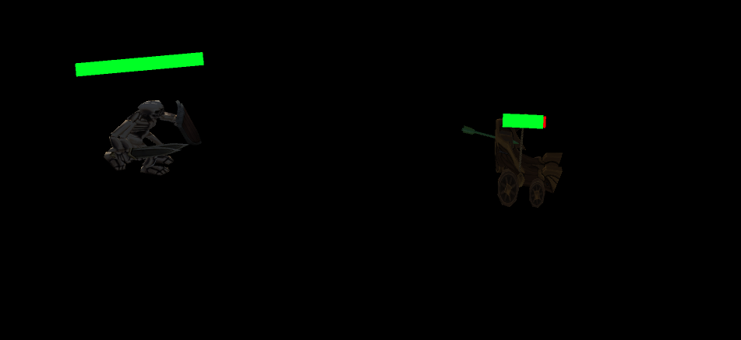
Kite Away
The perfect game to improve your skills how long can you last

Slide 2
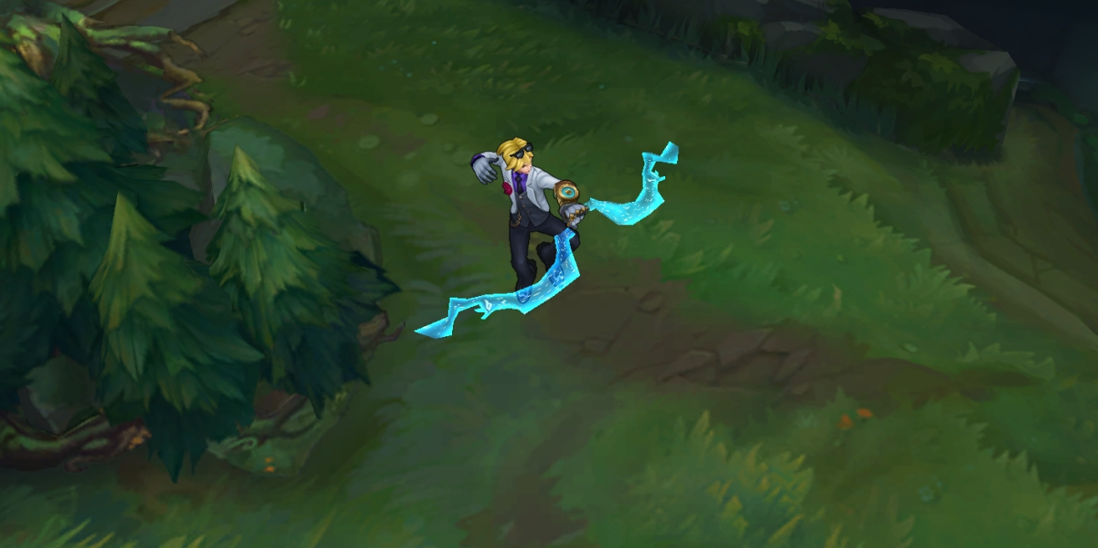
Inspiration

Slide 3
Budget
Budget Then
Budget Now
Sketch Pad $ 10.00
Writing Utensils
Computer
Unity Game Engine
Art Assets Budget $200.00
Music Effects Budget $100.00
Total: $ 310.00
Assets Purchased $ 25.00
Total: $25.00

Slide 4
Resources Used
Resources Planned Then
Resources Used Actual
Computer
Sketch Pad
Writing Utensils
White Board
Dinosaur Plush to Help me
Unity Engine
Assets for the game
VSCode
Computer
Various Udemy Courses
Tablet replaced White Board and Sketch Pad
Dinosaur Plush and Dinosaur Plush friends to Help me
VSCode

Slide 5
Calendar
Description
Time Frame Plan
Time Frame Actual
Planning & Outlining
Programming
Searching & Picking Assets
Finishing Touches
9/21/21 -> 9/30/21
9/24/21 -> 11/28/21
10/01/21 -> 11/12/21
11/26/21 -> 12/13/21
9/21/21 -> Still Ongoing
9/25/21 -> 12.07.21
11/15/21 -> 11/26/21
12/01/21 -> Still Ongoing

Slide 6
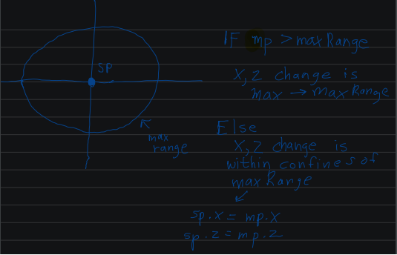
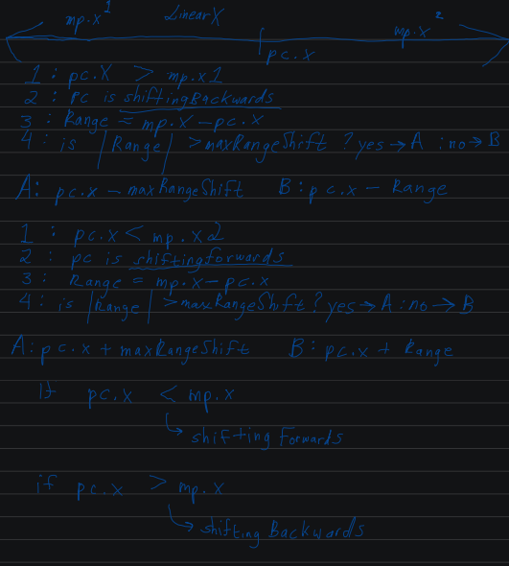
Creating the Teleportation System

Slide 7
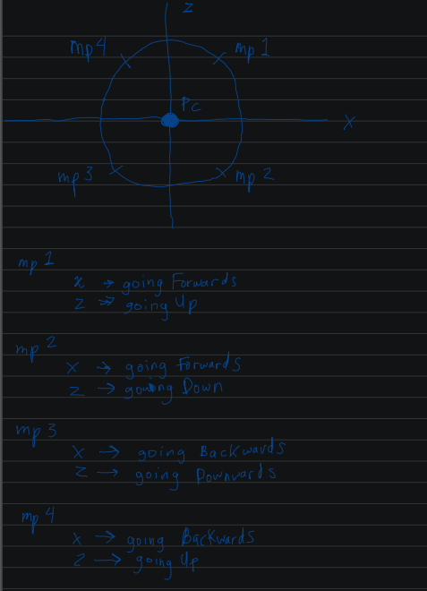
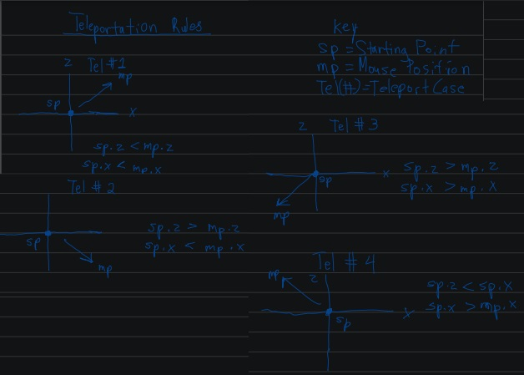
Testing the Logic

Slide 8
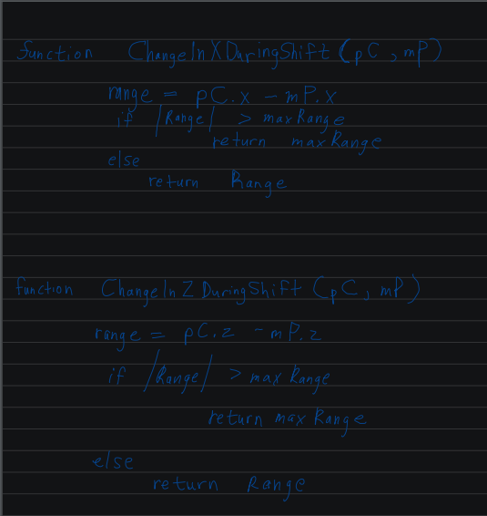
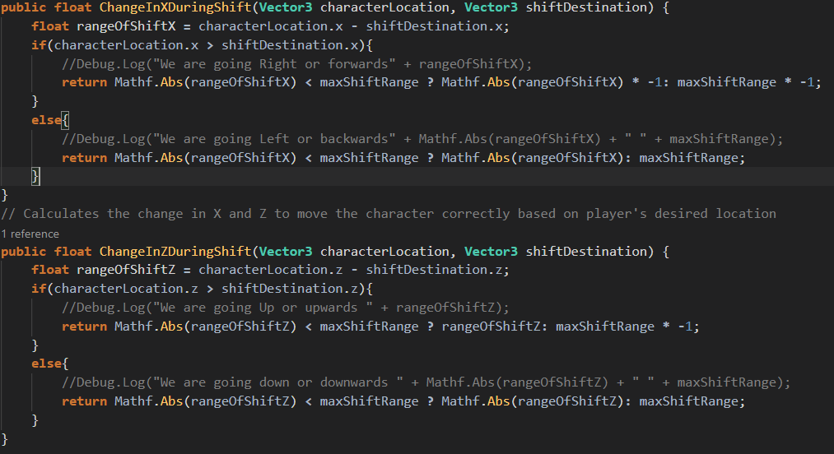
Creating the Teleportation System
Pseudo Code
Code

Slide 9
Conclusion
Future of the project
I plan on continuing to work on it. I learned a lot about C# and game development while working on this project. I also learned a lot about best practices with regards to programming and development.

