Slide 1
EDU3640 COMPUTERS IN EDUCATION NYC College of Technology
Dr. Hon Teo

Slide 2
Introductions

Slide 3
Contact & Office Hours
Email: hteo@citytech.cuny.edu
Office phone: 718-260-5373
Office hours: Fri 2-4 pm
Office is located at 510 at Pearl Building

Slide 4
Course Outline
Refer to Handout

Slide 5
Academic Calendar and Class Meeting Grids
See Handout

Slide 6
Setting Up your Email on Your Mobile Device
http://cis.citytech.cuny.edu/Student/it_student_email_faq.aspx

Slide 7
HYBRID?

Slide 8
Basic Info on Hybrid Classes
At least 50% of classes are online
Frequent use of Blackboard and Emails
Set notifications on your Blackboard
Check your email frequently
You will need ready access to a computer with internet connectivity

Slide 9
Attendance for IN-PERSON Meetings
Follows college/departmental policy for absence/lateness
http://www.citytech.cuny.edu/catalog/docs/catalog.pdf
If you foresee difficulties in schedule due to work, please speak to your supervisor

Slide 10
BLACKBOARD

Slide 11
Editing your NOTIFICATION settings

Slide 12
Blackboard

Slide 13
OER PAGE

Slide 14
OER SITE http://openlab.citytech.cuny.edu/edu3640/

Slide 15
OER SITE http://openlab.citytech.cuny.edu/edu3640/
“The US Department of Education's Office of Education Technology defines open educational resources (OER) as teaching, learning, and research resources that reside in the public domain or have been released under a license that permits their free use, reuse, modification, and sharing with others. Digital openly licensed resources can include complete online courses, modular digital textbooks as well as more granular resources such as images, videos, and assessment items. ”
https://www.open-nys.org/

Slide 16
Academic Schedules
http://www.citytech.cuny.edu/registrar/academic-calendar.aspx

Slide 17
Importance of Computers in EDUCATION

Slide 18
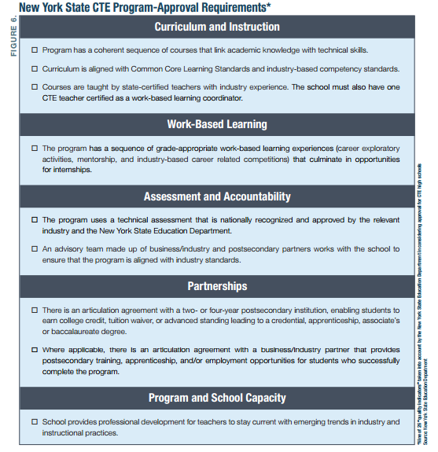
Notes:
And those enrolled in CTE programs face an additional set of requirements: mandated “work-based learning” and technical assessments of the occupational skills that they have acquired in high school.
career training without a deep engagement with business and industry
students need exposure to the workplace and work experience
a “spectrum” of experiences. Among the possible stops along the spectrum: a guest lecture by someone from a company, a walk-through at a firm, job shadowing, field trips, and mentoring. T

