Slide 1
Wage trends and the economy

Slide 2
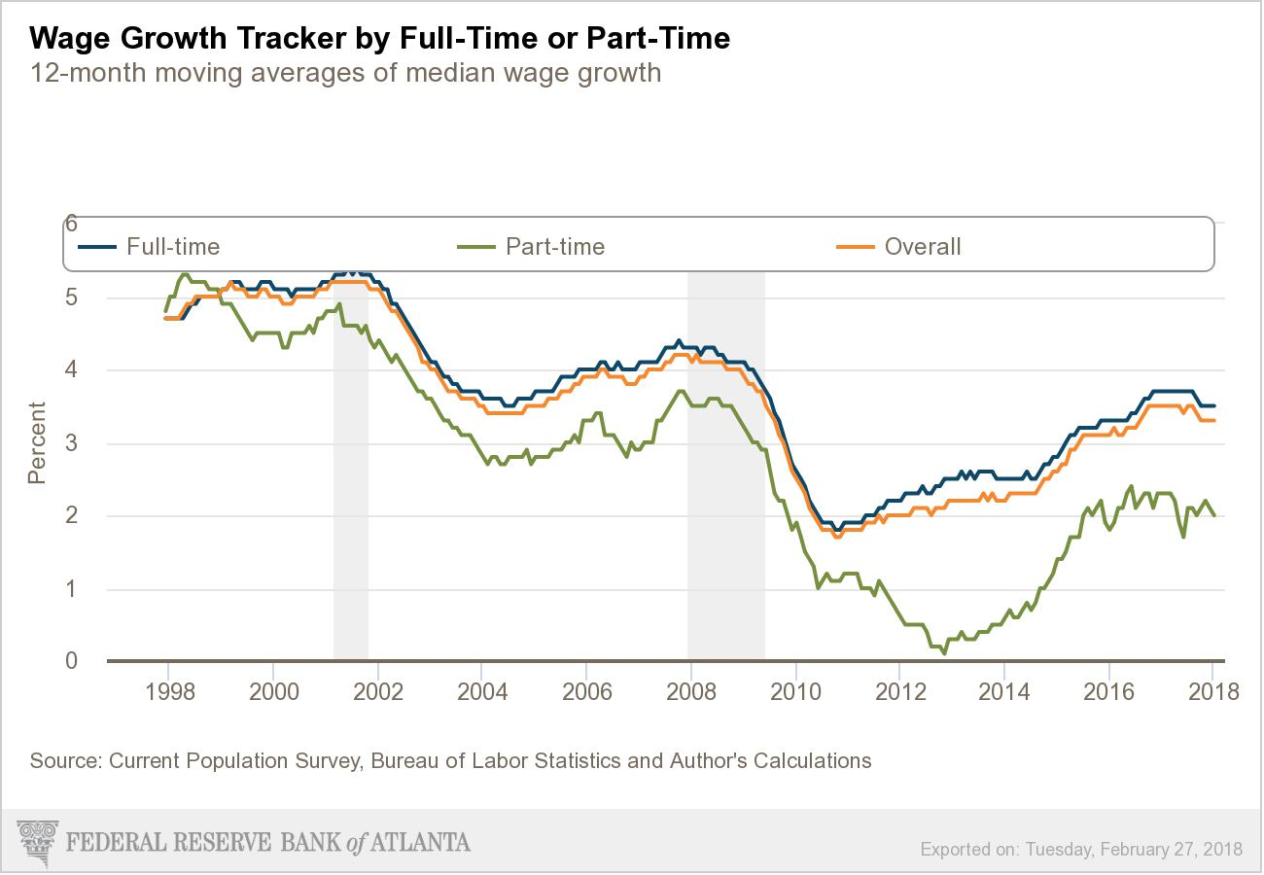
On average, wages grew by 3% in January over the previous month.

Slide 3
However, the overall wage growth trend is far below where it should be at this stage of the economic recovery. Month-to-month percentage changes have not yet matched the rates seen just before the recession began in 2008.

Slide 4
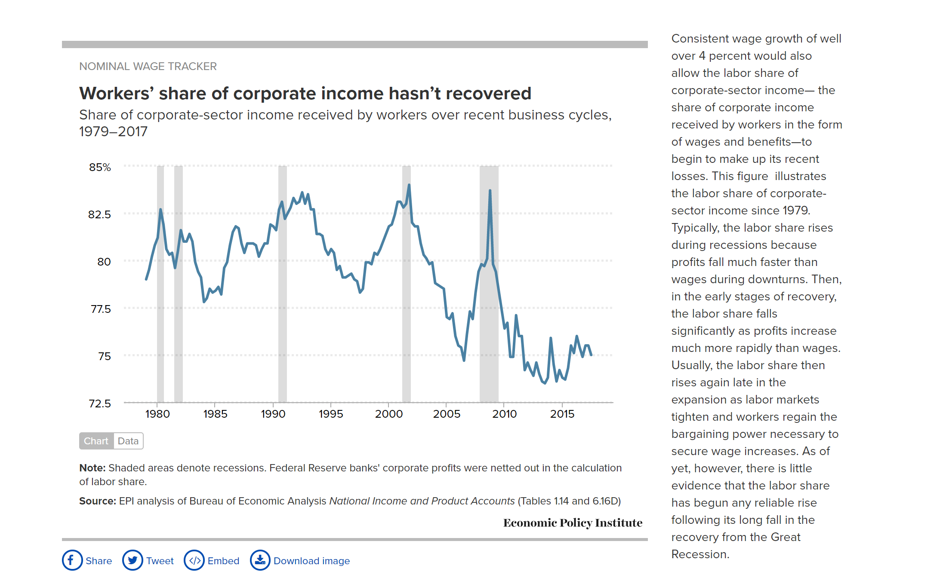
At the same time, employees’ share of corporate income, which plummeted during the last recession, has not recovered, a notable contrast with its rebound during earlier recoveries.
Source: Economic Policy Institute, https://www.epi.org/nominal-wage-tracker/#chart-unemployment-rate

Slide 5
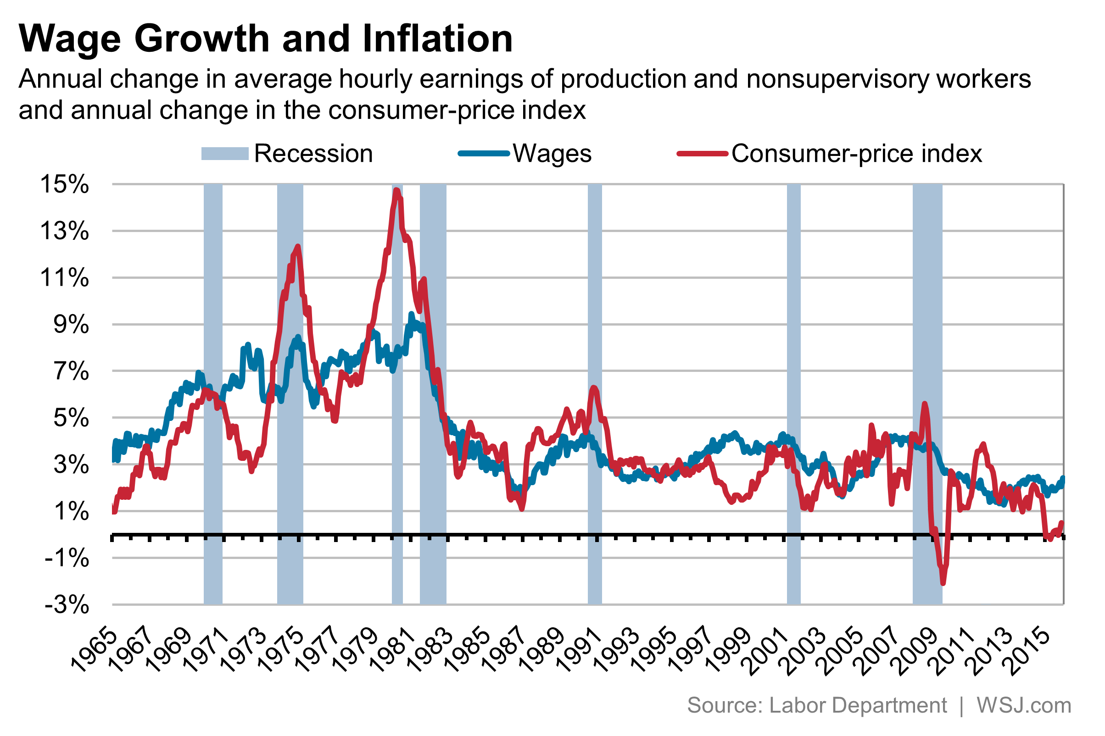
Since the mid-1970’s wage growth has lagged inflation growth during most years. The late 1990’s- wage gains moved ahead of prices.
What does this suggest about the purchasing power of earnings?
Source: Wall Street Journal; www.wsj.com

