Slide 1
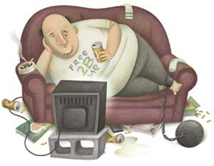
By: Edgardo J Bouret
THE CORRELATIONS BETWEEN OBESITY AND WATCHING TELEVISION

Slide 2
Introduction
Obesity is the number one killer in the world.
Is watching to much television contributing to you becoming overweight

Slide 3
Review of Literature
Role of Television in childhood obesity prevention.(Caroli,M., Argentieri, L.,Cardone,M.,& Masi, A.2004)
Study suggest that watching TV influences children's food choices and TV replaces Physical activity becoming a major role in obesity.

Slide 4
Review of Literature
Watching television is associated with childhood obesity:but is it clinically important? (Hancox,R.J.,& Poulton,R. 2006)
Study proved that children who watch more than 2 hours had higher BMIs and girls were at higher risk than boys were.

Slide 5
Review of Literature
The Worldwide Association between Television viewing and obesity in Children and Adolescents: Cross Sectional Study.(Braithwaite,I.,Stewart,A.W., Hancox, R.J., Beasley, R., Murphy, R., Mitchelle, E.A. 2013)
Proved that longer periods of time watching TV contributed to obesity especially in females even more so than males.

Slide 6
Review of Literature
Television viewing time in Hong Kong Adult Population: Associations with Body Mass Index and Obesity. (Xie,Y.J.,Stewart,S.M.,Lam,T.H.,Viswanath,K.,& Chan,S.S. 2014)
Survey proved that watching more than 2 hours of TV contributed to higher BMIs especially in females ages 18-34.

Slide 7
Review of Literature
Priming effects of television food advertising eating behavior. (Harris,J.L.,Bargh,J.A.,&Brownell, K.D. 2009)
The survey proved that watching television affected the eating habits of both children and adults.

Slide 8
Review of Literature
Do we fatten our children at the television set?Obesity and Television viewing in children and adolescents. (Dietz Jr.,W.H.,& Gortmaker,S.L. 1985)
The survey proved that watching television affected the BMIs in children and that obesity can be reversed by replacing TV with Physical activity.

Slide 9
Methodology
Researched articles
Gathered information
Made survey questions
Questions were evaluated for content, grammar and spelling
Questions were finalized on Survey Monkey
Launched on facebook and email
Collected data

Slide 10
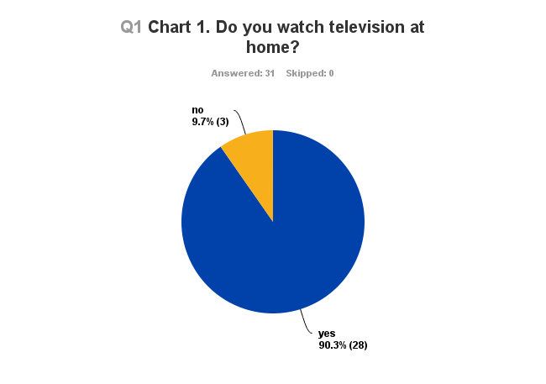
Results

Slide 11
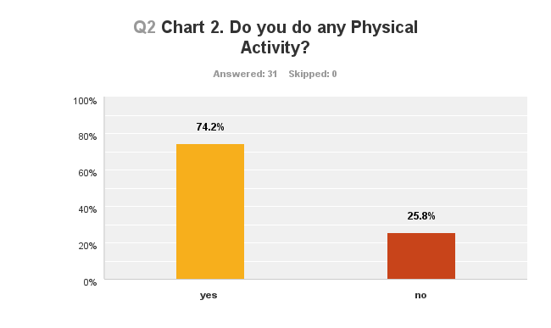
Results

Slide 12
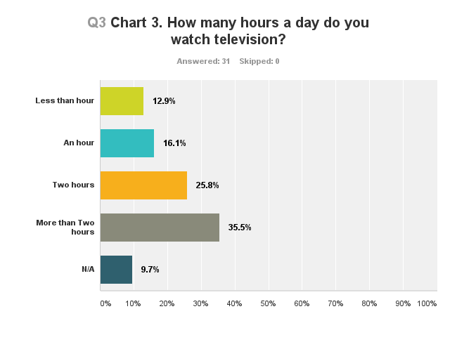
Results

Slide 13
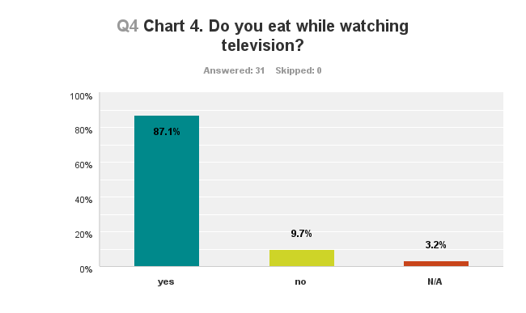
Results

Slide 14
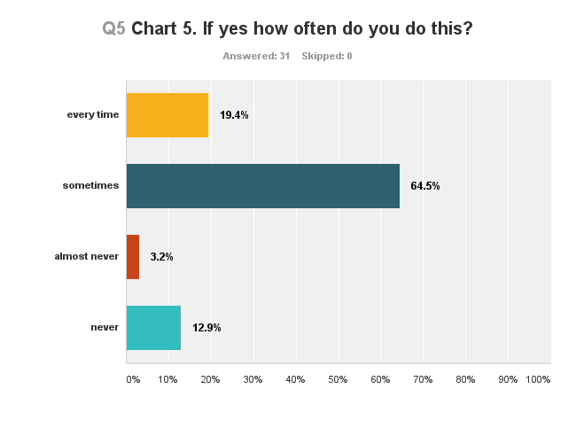
Results

Slide 15
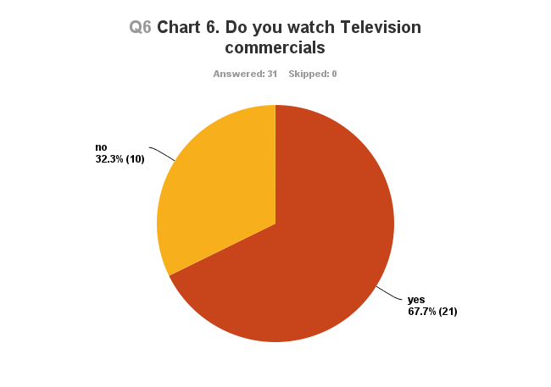
Results

Slide 16
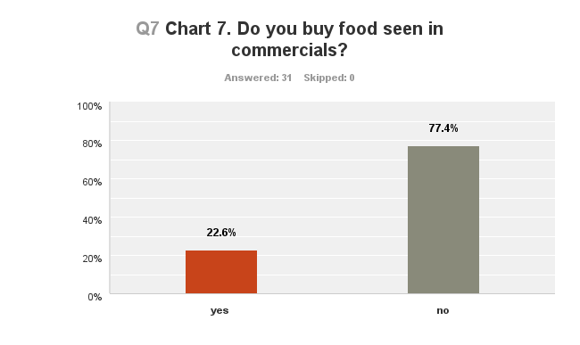
Results

Slide 17
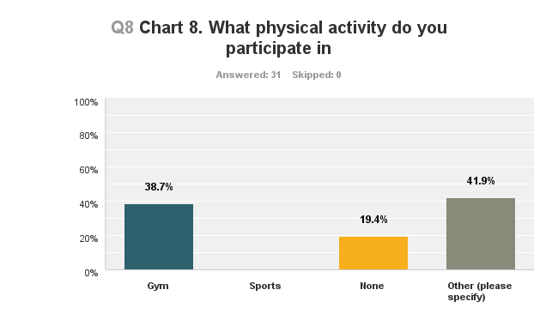
Results

Slide 18
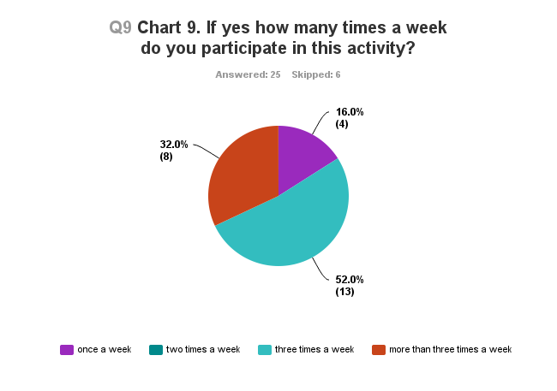
Results

Slide 19
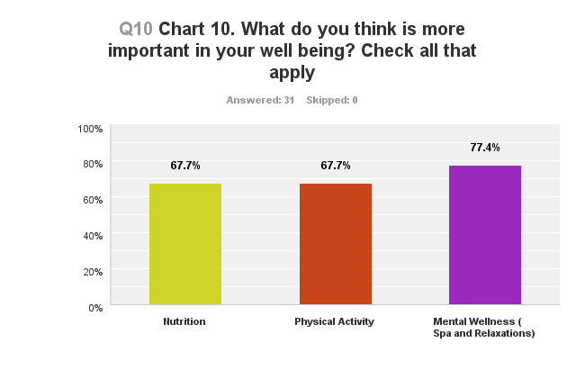
Results

Slide 20
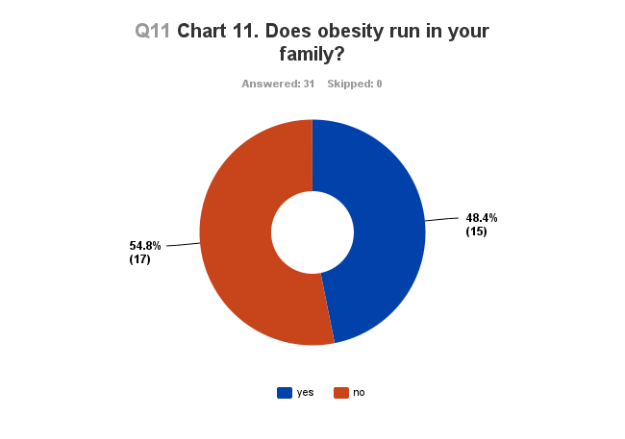
Results

Slide 21
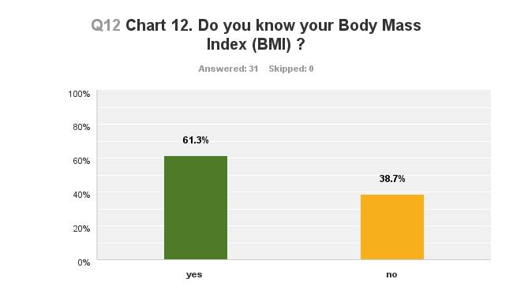
Results

Slide 22
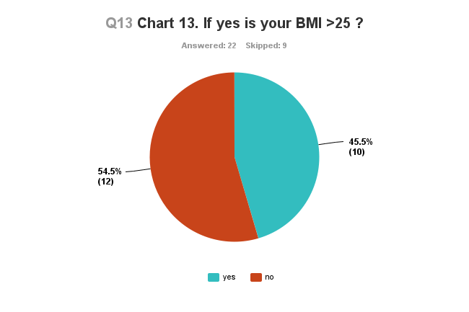
Results

Slide 23
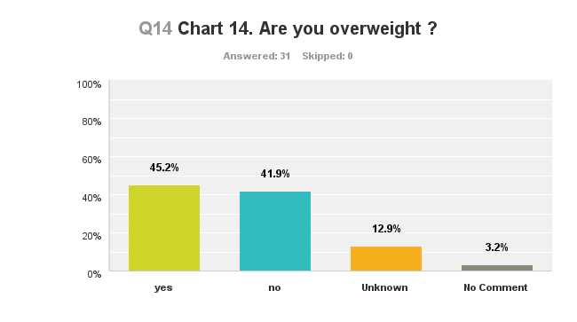
Results

Slide 24
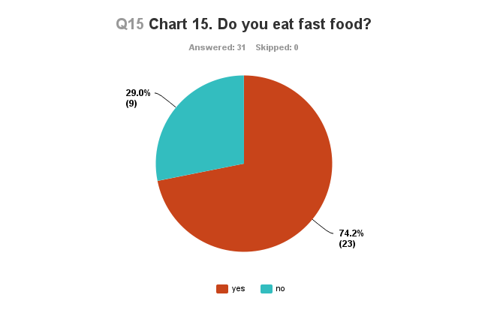
Results

Slide 25
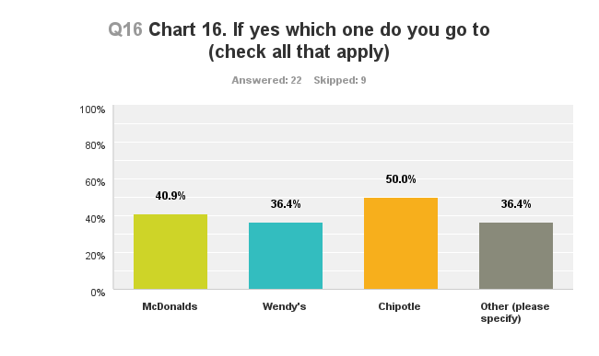
Results

Slide 26
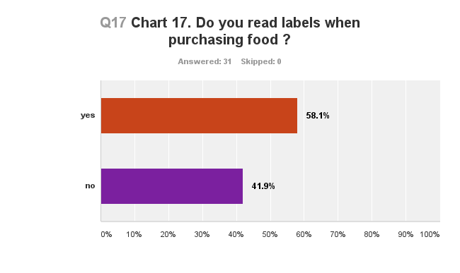
Results

Slide 27
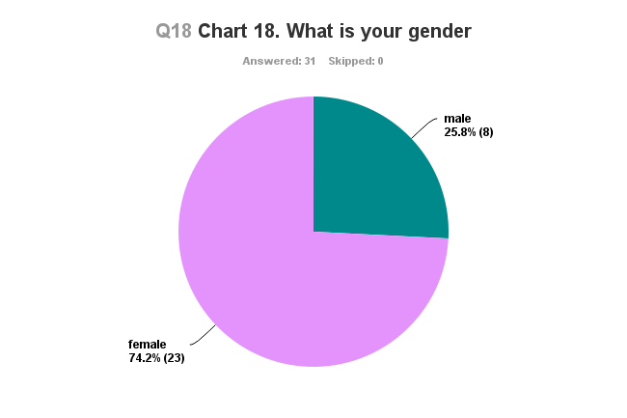
Results

Slide 28
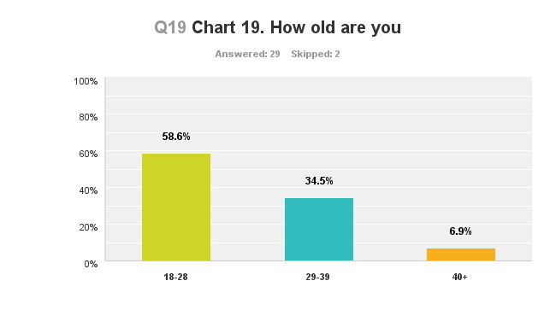
Results

Slide 29
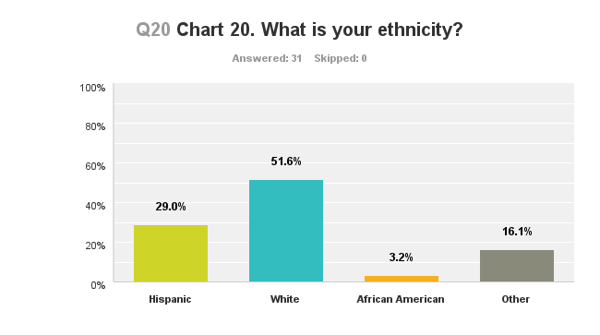
Results

Slide 30
Conclusions
People watch TV at home over 2 hours a day. They also tend to eat while watching TV.
People watch the commercials but don’t buy the food based on the commercials.
People surveyed are physically active and do the activity 3 times a week.
People knew their BMIs. Out of the ones that knew their BMIs most were overweight.
More than ¾ of the people eat fast food and the most popular restaurants were Chipotle and McDonalds. And most people read the labels of their food before purchasing.

Slide 31
Recommendations
Watch less than 2 hours of TV a day.
Educate your children about their eating habits and obesity.
Don’t eat and watch TV.
Replace TV with physical activity.
Limit the amount of time children watch TV.

Slide 32
Bibliography
Braithwaite, I., Stewart, A. W., Hancox, R. J., Beasley, R., Murphy, R., & Mitchell, E. A. (2013). The Worldwide Association between Television Viewing and Obesity in Children and Adolescents: Cross Sectional Study.
Caroli, M., Argentieri, L., Cardone, M., & Masi, A. (2004). Role of television in childhood obesity prevention. International Journal of Obesity and Related Metabolic Disorders: Journal of The International Association For The Study of Obesity.

Slide 33
Bibliography
Dietz Jr., W. H., & Gortmaker, S. L. (1985). Do We Fatten Our Children at the Television Set? Obesity and Television Viewing in Children and Adolescents. Pediatrics
Hancox, R. J., & Poulton, R. (2006). Watching television is associated with childhood obesity: but is it clinically important? International Journal of Obesity
Harris, J. L., Bargh, J. A., & Brownell, K. D. (2009). Priming effects of television food advertising eating behavior. Health Psychology

Slide 34
Bibliography
Xie, Y. J., Stewart, S. M., Lam, T. H., Viswanath, K., & Chan, S. S. (2014). Television Viewing Time in Hong Kong Adult Population: Associations with Body Mass Index and Obesity

