Slide 1
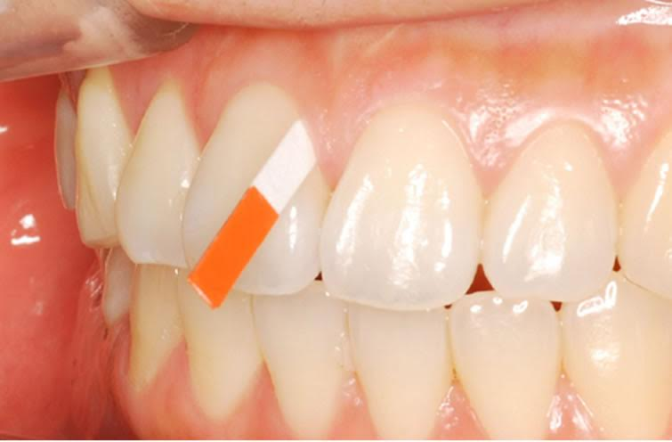
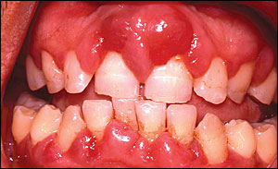
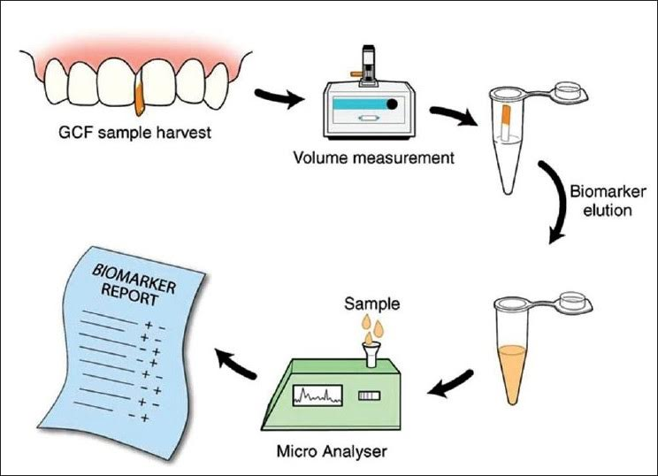
The Link Between Diabetes Mellitus, Periodontal Disease, and Gingival Crevicular Fluid
What is Type 2 Diabetes Mellitus?
What is the relationship?
The role of Gingival Crevicular Fluid
What is Periodontal Disease?
Type 2 diabetes is a chronic condition that effects the way your body metabolizes glucose; which is one of your body’s main sources of fuel.
With type 2 diabetes, your body either:
resists the effects of insulin — a hormone that regulates the movement of sugar into your cells.
doesn't produce enough insulin to maintain a normal glucose level.
Risk factors for Type 2 diabetes:
Age, risks increase with age; especially after 45yrs old.
Overweight
High blood pressure
Lack of physical activity
Unhealthy diet
Familial history of diabetes
Race, ethnicity
There is no cure for diabetes mellitus, but it can be controlled through medication, a healthy diet, and exercise; failure to do so may lead to unbalanced glucose levels causing health issues such as:
nerve, kidney, and eye damage
cardiovascular problems
periodontal disease
Type 2 Diabetes Mellitus and Periodontal disease have a bidirectional relationship:
Diabetes increases the risk for Periodontitis and the severity of it.
while Periodontal inflammation negatively effects glycemic control and can exacerbate the effects of diabetes.
high levels of the following inflammatory mediators are found in the GFC both of patients with Diabetes and/or Periodontal Disease:
Interleukin1b – Causes bone resorption, induces insulin resistance while decreasing insulin action.
Prostaglandin E2 – Causes bone resorption.
Tumor Necrosis Factor – Induces insulin resistance, decreases insulin action; mimics Interleukin & Prostaglandin.
periodontal disease is a bacterial infection of the gums, ligaments, and bones which support your teeth and keep them in your jaw.
Gingivitis, which is an inflammation of the gums, is the first sign of periodontal disease. If left untreated it can progress to Periodontitis, which causes the destruction of alveolar bone, and can result in tooth loss.
Periodontal disease symptoms include:
Red swollen gums, tender to touch, that bleed while brushing or flossing
Gums that have pulled away from the tooth surface, exposing the roots
Milky white/yellow plaque deposits; usually heaviest between the teeth
Pus between the teeth or gums
A consistent foul odor from the mouth
Risk factors for Periodontal Disease:
Tobacco use (20x more likely)
Drugs/medications
Diabetes (3x more likely)
Hormonal changes
Nutritional deficiencies
The Role of the Dental Hygienist
If the patient is a Type 2 Diabetic, the following signs may be found during an intra-oral exam:
Dry mouth
Severe inflammation
Poor healing of the oral tissues
Fungal infections (due to medication)
Burning sensation in the mouth/tongue
When going over medical history with a Type 2 Diabetic patient the following information is vital:
What medication are they taking, the frequency and dosage.
Hemoglobin A2C level – 7% or less is considered good glycemic control, individuals who have fair-poor control have a 50-200% greater risk for Periodontal Disease.
Diabetic complications that can impair oral self-care and require treatment modifications:
Neuropathy- nerve damage that can cause numbness in the hands
Retinopathy-Blindness
How Type 2 Diabetes Effects the Oral Cavity & Periodontal Disease
How Periodontal Disease Effects Type 2 Diabetes Mellitus
Diabetic patients with poorly controlled glucose levels exhibit an exaggerated host response to bacteria and microbes, as well as:
Decrease in levels of Polymorphonuclear leukocytes (PMN), which are the first line of defense in the gingiva.
High levels of inflammatory markers in Gingival Crevicular Fluid (which cleanses the surface between the tooth and gingiva)
Increase/decrease of vascularity in Gingival tissues.
Decrease of collagen in the connective tissues, which impair the gingiva’s ability to heal.
Xerostomia (dry mouth syndrome)
Periodontal Disease causes acute bacterial, viral, and chronic gram-positive infections, which increase insulin resistance and poor glycemic control.
This fluctuation in insulin resistance may cause further diabetic complications.
Treatment of periodontal disease decreases inflammation, and has a positive effect on the patient’s glycemic control.
How to avoid Hyperglycemic emergencies:
How Dental Hygienist screen for Diabetes Mellitus:
Hyperglycemic emergencies, in which a diabetic patient faints due to low blood sugar, is best avoided by:
Medical History review, and Blood sugar level check.
Schedule morning appointments, Hyperglycemia risk is greater in the afternoon.
Use anxiety reduction protocol, stress may hinder the condition.
Keep a glucose gel tablet in your office emergency kit.
Dental Hygienists can screen blood or GCF to detect diabetes mellitus and periodontal disease:
Only a small volume of sample is needed. Nearly all patients will have some suitable sites for collecting gingival blood or fluid.
The fluid is then tested on a Glucose monitoring device, to screen the blood sample.
If Crevicular fluid samples are taken, they need to be tested in the laboratory.
Eftyhia Argyros
Mariluz Morales
Evelina Simuleviciene
References
Chi, A. C., Neville, B. W., Krayer, J. W., DDS, & Gonsalves, W. C., MD. (2010, December 01). Oral Manifestations of Systemic Disease. Retrieved March 23, 2017, from http://www.aafp.org/afp/2010/1201/p1381.html
Johnson, G., RDH. (2015, July 10). Retrieved March 21, 2017, from http://www.rdhmag.com/articles/print/volume-35/issue- 7/features/help-in-explaining-diabetes.html
Lyle, D. M., RDH, MS. (n.d.). Diabetes Mellitus. Retrieved March 21, 2017, from http://www.rdhmag.com/articles/print/volume-23/issue-3/feature/diabetes-mellitus.htmll
Ortiz, M., RDH, BA. (n.d.). Systemic diabetes. Retrieved March 23, 2017, from http://www.rdhmag.com/articles/print/volume-31/issue-6/features/systemic-diabetes.html
Negrato, C. A., Tarzia, O., JovanoviäŒ, L., & Chinellato, L. E. (2013). Periodontal disease and diabetes mellitus. Journal of Applied Oral Science, 21(1), 1-12. doi:10.1590/1678-7757201302106
Preshaw, P. M., Alba, A. L., Herrera, D., Jepsen, S., Konstantinidis, A., Makrilakis, K., & Taylor, R. (2011). Periodontitis and diabetes: a two-way relationship. Diabetologia, 55(1), 21-31. doi:10.1007/s00125-011-2342-y
Penmetsa GS, Devi JB, Dwarakanath CD. (2016) Assessment of blood glucose levels in diabetic patients with periodontitis: A three-way method using gingival crevicular, capillary
and venous blood. Int Dent Med J Advanced Research ;2:1-4.
M. Meti. (2010, December) Screening for Diabetes Mellitus Using Gingival Crevicular Blood. Journal of Oral Health Research. 1 (4). 160 – 164.

