Slide 1
Steps To creating a club
College edition

Slide 2

Step 1
GATHERING MEMBER
Step 1. Gathering member
The club should gathering a group of people that have common interest to share ideas and to decide type of club. determine the club’s purpose and needs. Also collecting people’s contact information, such as e-mails and contact number.

Slide 3

Step 2
HOLD A MEETING
Club president will likely to set up a date (How often should the club meet?)and location for club meeting. Be sure that the club acquires space where they can have effective meetings. The date and location should be convenience for every club member to attend. A club member should be in charge for mapping out thing will do during the meeting.

Slide 4
Step 3
RECRUIT MEMBERS
The first meeting is very essential when starting a new club. Just like a first impression, you want your club to appear its best. This is where the club members first meet one another. The meeting should be welcoming, with snacks and drinks provided. It should be relatively interesting, so there should be some sort of games involved to keep members interested and anticipated to stay.
During the first club meeting, members should introduce themselves through the “ice breaker”, a common activity in which members introduce themselves and share an interesting facts about themselves. This is the part where members get to know one another, where they come from, what their majoring, and etc. After going around the circle and learning a bit about each other, it is time to present the ‘constitution’ to the group, and be sure to ask for questions and feedback. Every member should receive a copy. Together, they will talk about the club’s purpose, its leadership structure and voting method. When you’re done going over it, ask if anyone has any changes they would like to suggest. After you have addressed any concerns, ask the group to adopt the constitution. Finally, club members will go over upcoming events.

Slide 5
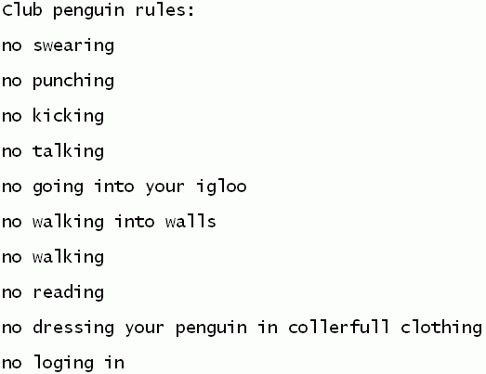
Step 5
Rules and Procedures
The "rules and procedures" of a club, is what keeps a club within stability. It's the foundation of any club, striving for a great future. Things such as who speaks when, or who decides what, can keep a club in forward motion. Communication should be a prime factor for any club, because with it, a club's teamwork and chemistry will grow. Creating rules can be tedious, because every club is unique, and some rules might not work well with other clubs. It's your job to explore what rules work well with your group, and make sure everyone is notified about rule changes that are sudden. If everyone follows the procedures, then even your club can prosper.

Slide 6
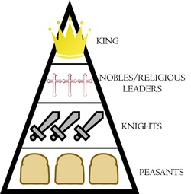
Step 6
Positions/Roles!
Everyone within the club should have a certain position or Role that he/she is dedicated to. Assigning roles such as leader, treasurer, secretary, Historian, and even advertiser are all critical in making a strong club.
Leader (president). This person should run the club, meetings, and enforce the rules.
Deputy leader (vice president). This is the person who is in charge when the leader cannot make it.
Treasurer. This person handles the club's money, and keeps track of dues for memberships, pays the bills for the club's operations and activities. He/She also keep records of all debits and credits for accounting purposes.
Secretary. The secretary keeps minutes of every meeting and reads them for correction or addition at each following meeting. He/She can assist with the activities of the club, such as events that are hosted, and give a report of the event at meetings following these events.
Historian. This person keeps a record of activities that the club hosts, etc.
Head of Events. This person delegates club members to help in planning and organizing activities.
Advertising team. They should be responsible for creating flyers, etc. (http://www.wikihow.com/Start-a-Successful-Club)

Slide 7
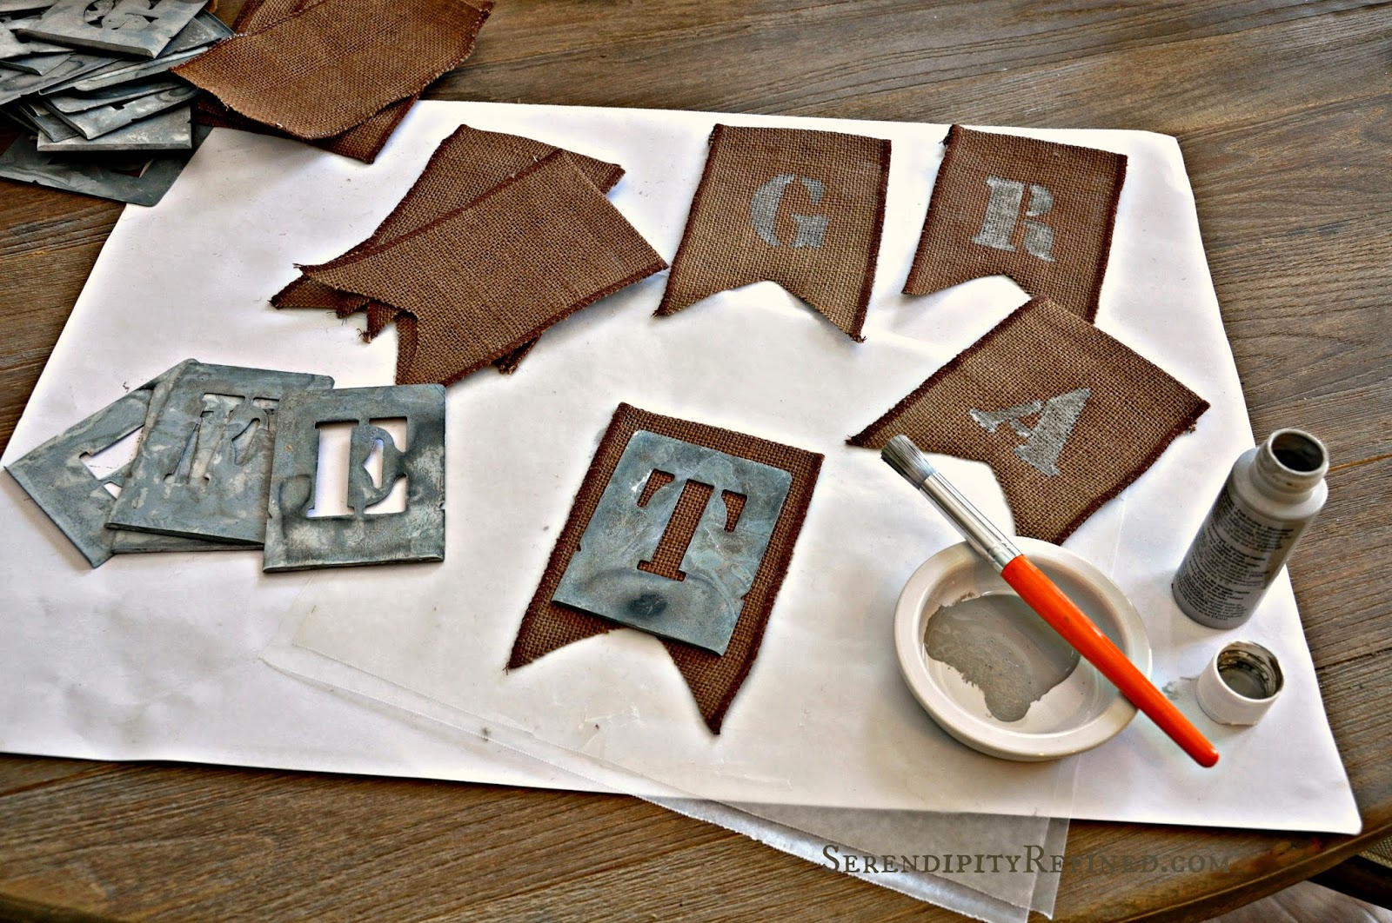
Step 7
Clubs Symbol a.k.a LOGO/BANNER
The best way for a club to be recognized throughout campus or universities is to create a distinguish logo/banner . A logo/banner that everybody can associate to your club and maybe have interest to join. You can use any type of material to make the logo/banner from art supplies or online using software programs in computer labs located at your schools. If your creating a logo/banner from scratch, that is always the best way to go. The biggest and many mistakes student do is copy and paste pre done logos/banners. The reason why copy and paste pre-existing logos is wrong because of copyright problems. To make things more fun, why not have everybody create a logo/banner even if the peoples drawing skills might not be the best and have everybody vote on which is going to stand out more. Remember once the logo/banner is done, you must have it approved. If the first one did not go through have the runner up as plan b. If nothing works re-create the logo until approved and ready for everyone to see.Voilà! Are logo is up and located on the header of this website!

Slide 8

Step 8
Club Records!
Club records are important for many reasons. Before we get to that, the persons job in charge of that is either the Secretary or VIP. The VIP can either do it themselves or can appoint someone else in charge. This is all up to who agrees to do the job or not and by votes to keep everything respectfully fair upon responsibility. The person in charge of recording everything down must do the following : write down all the information that has been going on throughout the day, have everyone's name, email, phone, school id and maybe address, contact information for the club, time (attendance) and club location (All college require that you let them know where your meeting are going to be located, just in case that room or location is already occupied) . The reason why this is really important is to keep everything organize, is to keep everyone informed and respectfully up to date. The students need to know who is president, vice, and more in order to have students come up (like questions) to the right appropriate member about any concerns or actions.

Slide 9

Step 9
Looking into the future!
One of the hardest and last things to do is to maintain the clubs moral. Yes, it will become the boring broken record that no one wants to hear and there will be times that things will get slow. The most important thing is to keep the club interested by creating new projects, productive activities and future events. The biggest advantage of having a club is to help you and everyone else move into the future!

