Slide 1
City Tech 101
Fall 2024
Adin Dobkin
adin.dobkin14@citytech.cuny.edu
City Tech 101 by Karen Goodlad and Sarah Paruolo is licensed under a Creative Commons Attribution-NonCommercial-ShareAlike 4.0 International License.

Slide 2
SESSION THREE:
You Paid for It; Use It
+
The Buzz on Getting Involved
Session 3
September 20, 2024
Adin Dobkin
City Tech 101 by Karen Goodlad and Sarah Paruolo is licensed under a Creative Commons Attribution-NonCommercial-ShareAlike 4.0 International License.

Slide 3
Today’s Topics
Part A:
Where College Happens, Pt. 3
Taking Notes
Overview of Resources + Services
Asking for Help
Part B:
Where College Happens, pt. 5
Why Participate?
Co-curriculars @City Tech
Extracurriculars @City Tech
Asking Effective Questions
Effective Communication

Slide 4
Part A: You Paid for it; Use It
Resources and Services at City Tech

Slide 5
Where does
college happen?
Notes:
We want students to understand that college isn’t just going to class and leaving. Getting a full college experience means that learning and growth happen in many different spaces and in different ways. Variations on these slides will appear in each presentation from Session 2 to Session 6.

Slide 6

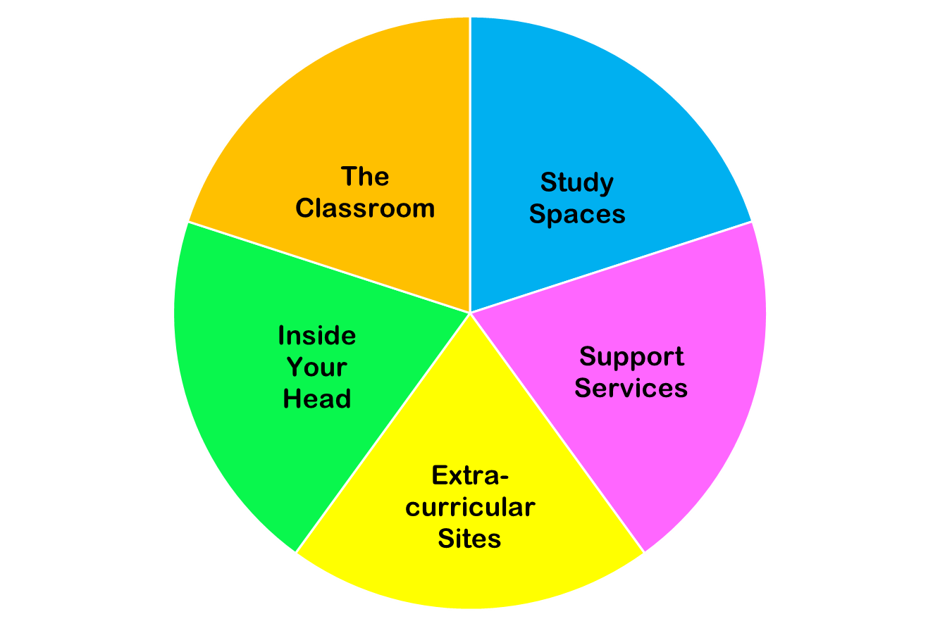
College happens in lots of places
These
are all necessary parts of college!
Notes:
You do NOT need to discuss each piece of this pie in detail. Just discuss the “pie wedge” for the current session and let students know that we will go over each of these pieces in subsequent sessions.

Slide 7
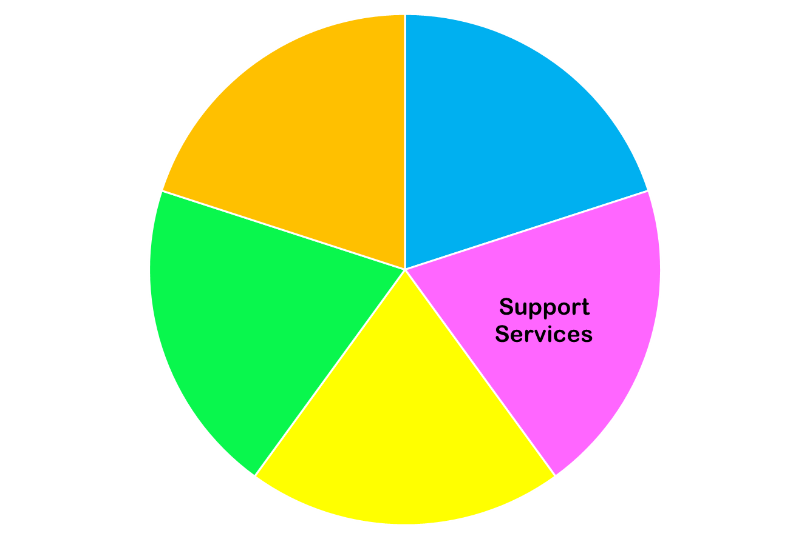
Today we are focused on…

Slide 8
Taking Notes

Slide 9
Effective Note-Taking Strategies
Studies have shown taking notes by hand is most effective!
Note-taking is not just a way to record material for later review–it is also a first step in learning the material
Don’t try to write down everything the professor says. Instead, identify main ideas and crucial information
Add your own questions, ideas, and connections to other course materials. For example, if an idea discussed in lecture relates to a reading you’ve done, mention that in your notes.
Consider using the Cornell Notes method.
Notes:
Use this time to help students consider how they learn and absorb information. Whether or not you (or the students) favor the Cornell method, it’s useful to brainstorm methods of active learning and listening. How do we learn something? How do we make it our own? The peer mentors can be helpful here in sharing their methods.

Slide 10
Let’s test out our note- taking skills today!
Today you will be given a lot of information about resources available at City Tech. There is more information here than you can remember all at once.
As you listen, try taking notes using the Cornell Method or another preferred technique. What do you need to write down to get to the information you need later?
We’ll check in at the end to see how we did.
Notes:
It may be helpful to ask students what they’re listening for and what they expect to hear. You may also wish to use the optional exercise (on the slides at the end of this presentation) as a focusing activity. Help students consider how they will help themselves stay interested and pay attention. (You can get paper and writing utensils for this activity from the FYP Office!)

Slide 11
Think of two activities, resources, or support services you would like to access during your time at City Tech.
Take a minute to write them down.
As we go through the presentation, look for information on those items!
Notes:
This is an optional activity. Feel free to use it as a way to supplement/direct the note-taking exercise. The next slide also pertains to this activity.

Slide 12
Resources
+ Services
@City Tech

Slide 13
Academic
Resources + Services

Slide 14
Tutoring
Atrium Learning Center
Writing Center
Tutor.com (in Brightspace)
Department-Specific Tutoring (See Dept. Sites)
Self-Paced Department Resources

Slide 15
Student Success Center
Student Hub for questions, issues, confusion, guidance– any kind of help you need!
Connections to Emergency Resources + Funds
Coaching and Workshops
May contact you during the semester if you are struggling in your classes– but you can always contact them first!
Room: Library G-18R [ground floor of the Library Building, across from the rear elevators] Just walk in!
StudentSuccessCenter@citytech.cuny.edu or their website

Slide 16
Professor Office Hours
Questions from class
Questions about careers
Questions about majors or tracks
Questions about advisement
Questions about college or City Tech

Slide 17
Peer Leaders
First Year Programs Peer Mentors
Math Peer Leaders
Perkins Peer Advisement
Student Success Coaches
SLD Peer Navigators

Slide 18
City Tech Library
Reference Desk
Ask A Librarian
Research Guides
Subject Resources
Technology Loans
Reserve Materials
Scanning + Photocopies
LGBTQ+ Resources
Website

Slide 19
Center For
Student Accessibility
If you had an IEP in high school
If you have any type of disability
If you are sick or unable to attend classes for more than a day or two
Website
City Tech is committed to supporting the educational goals of enrolled students with disabilities in the areas of enrollment, academic advisement, tutoring, assistive technologies, and testing accommodations. If you have or think you may have a disability, you may be eligible for reasonable accommodations or academic adjustments as provided under applicable federal, state and city laws. You may also request services for temporary conditions or medical issues under certain circumstances. If you have questions about your eligibility or would like to seek accommodation services or academic adjustments, you can leave a voicemail at 718-260-5143, send an email to: Accessibility@citytech.cuny.edu, or visit the Center’s website at http://www.citytech.cuny.edu/accessibility/ for more information.

Slide 20
Comprehensive Programs

Slide 21
Full Service
ASAP
ACE
SEEK
CUNY EDGE
Notes:
ASAP is a full-service support program for qualifying students pursuing an associate degree, while ACE is the ASAP extension program for bachelor’s students. CUNY EDGE is a similar program with different standards to qualify. Students should be encouraged to apply for ASAP and CUNY EDGE. SEEK is a similar program that students must apply for while they are seeking admission to the college. Please encourage current SEEK, ASAP, and CUNY EDGE students to take full advantage of the resources offered by their programs, which include counseling, academic support and extra financial aid support. (This may include dedicated advisors and tutors!)

Slide 22
Administrative
Resources + Services

Slide 23
College Administration
Registrar
Bursar
Financial Aid
Scholarship & Residency Services
International Student Services

Slide 24
Student-Centered
Resources + Services

Slide 25
First Year Students
First Year Programs
FYP Peer Mentors

Slide 26
Student Leaders
Student Government Association (SGA)
NYPIRG

Slide 27
Student Clubs + Events
Student Life + Development (SLD)
Yellow Jacket Journey (Presence)
Notes:
You can just touch on this lightly–you’ll spend a lot more time on this in Part B!

Slide 28
Professional
Development Center
Exploring majors, interests, and values
Resume and Cover letter critiques
Interview preparation & Mock interviews
Graduate School Exploration
Virtual Workshops & Seminars
Virtual Informational Sessions with Employers
Virtual Networking Events
Website
The PDC encourages students to make an appointment in their first year of coursework to plot a successful course of study!

Slide 29
Workshops and Speakers
Targeted topics
Experts in different areas
Department specific
Notes:
You can mention specific examples like the speakers brought in by Communications and Design, the Literary Arts Festival, the Mother Language Day event, etc. hosted by the English Dept., the Af Am studies events for Black History month, etc.

Slide 30
Technology
Resources + Services

Slide 31
Computer Labs
Atrium Learning Center, Library Building, ground floor
Library, 4th floor
General Building, 6th floor (G600)
Vorhees, 2nd floor
Virtual Computer Lab

Slide 32
Student Help Desk
CUNYFirst
CT email + Email Lookup
One Drive + Microsoft Office
Brightspace
OpenLab
Zoom
Specialized Programs + Tools
Student Help Desk StudentHelpDesk@citytech.cuny.edu
Room L114 718-260-4900

Slide 33
Targeted Resources + Services

Slide 34
Student Health + Well-Being
Counseling Services
Community Standards
Wellness Center
Public Safety
Petrie Fund (via Student Success Center)
Recreation and Intramural Sports
Fitness Center

Slide 35
Student Health + Well-Being
Nutrition for Education & Student Achievement (N.E.S.T.)
The N.E.S.T. is City Tech’s Food Pantry
Don’t miss the chance to grab free groceries! Perishable and non-perishable items, such as fruits, vegetables, canned foods, and dry goods are available.
Located in the General Building, Room 414
Open to all current students
Need to schedule an appointment to pick up food: https://citytech-cuny.presence.io/event/food-pantry

Slide 36
Affinity Support
Black Male Initiative (BMI)
Veteran Support Services
Childcare Center
CREAR Futuros
Identity-Based Clubs

Slide 37
LGBTQIA+ Support
Pride Club
Contact: lwestengard@citytech.cuny.edu
Pride Lounge (LG29B)
M and W, 2:30-4:30pm
T and Th, 5:30-7:30
Supervisor Daniel Ryan: DRyan@citytech.cuny.edu
Minor in Gender and Sexuality Studies
Counseling Contact
Jennifer Cruz
JCruz@citytech.cuny.edu
CUNY LGBTQ Hub
Instagram account: @citytechpride
Notes:
Pride Club meets during club hour, Thursdays 12:45-2:15. Students can get up-to-date info on club meetings, pride lounge hours, and more by following the instagram account.

Slide 38
How did your note taking go?
Look back at your notes. How do you think you did?
Take a minute to go back and fill in where anything seems to be missing.
What seems most important? If you were going to study your notes for an exam, what strategies would you use?

Slide 39
Look through your notes.
Did you hear about any resource or service at City Tech that matches up with what you wrote before the presentation?
Which service did you hear about? How do you think it might help you?

Slide 40
Some questions on finding resources:
If you’re interested in accessing any of the resources or services we discussed, where will you find them later?
What are the best ways to track down information about City Tech?
If you have time, try the City Tech website scavenger hunt!

Slide 41
Asking for Help!

Slide 42
What are some factors that might make a student less likely to ask for help?
Brainstorm ideas and let’s make a list together…

Slide 43
Asking for help is...
Responsible
Healthy
Proactive
Normal

Slide 44
Asking for help is NOT...
A sign of weakness
A sign of failure
A sign that you don’t belong in college

Slide 45
“Be strong enough to stand alone,
smart enough to know when you need help,
and brave enough to ask for it.”

Slide 46
Part B: #YellowJacketLife
The Buzz on Getting Involved

Slide 47
Where does
college happen?
Notes:
We want students to understand that college isn’t just going to class and leaving. Getting a full college experience means that learning and growth happen in many different spaces and in different ways. Variations on these slides will appear in each presentation from Session 2 to Session 6.

Slide 48
College happens in lots of places
These
are all necessary parts of college!
Notes:
You do NOT need to discuss each piece of this pie in detail. Just discuss the “pie wedge” for the current session and let students know that we will go over each of these pieces in subsequent sessions.

Slide 49
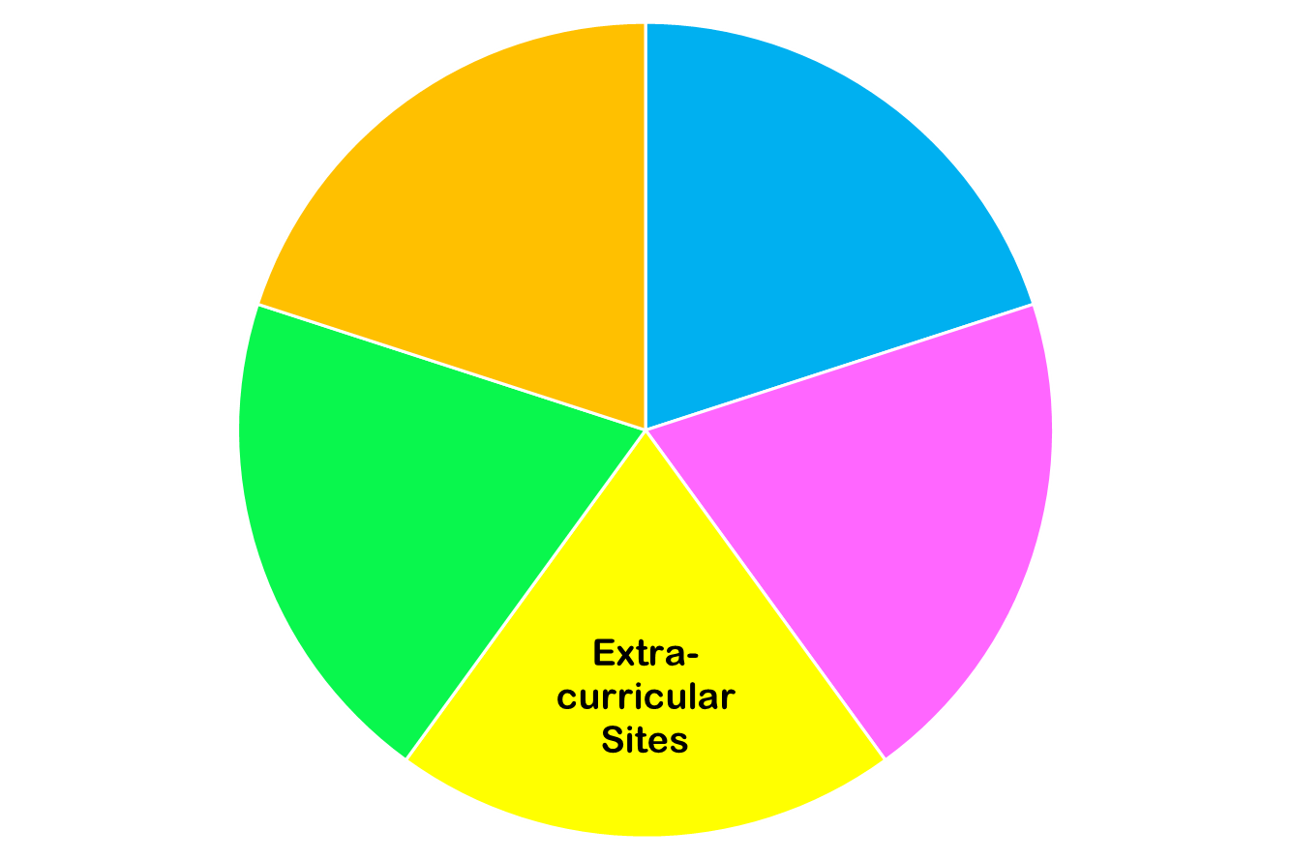
Today we are focused on…

Slide 50
Why Participate?

Slide 51
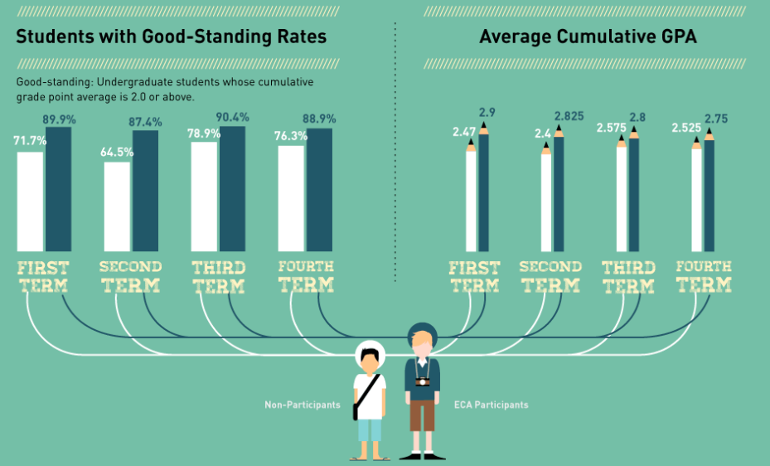

Slide 52
Building Skills Through Participation
Decision-Making Skills
Interpersonal Skills
Managerial Skills
General Workplace Knowledge

Slide 53


Slide 54
Sources
Boston University
California State University, Sacramento
Careerbuilder.com
The College Board
Collegiate Assessment
Elearninginfographics.com
Graduate Management Admissions Council
Harris Interactive
National Association of Colleges and Employers
National Center for Education Statistics
Stanford University

Slide 55
Co-curriculars
@City Tech

Slide 56
Co-curricular
Extracurricular
Programs, clubs, + activities directly related to what you are studying in college
Programs, clubs, + activities NOT directly related to what you are studying in college, but still relevant to your growth as a student

Slide 57
Co-curricular Examples
Honors Scholars Program Internships/Externships
Emerging Scholars Program Clubs related to a major or department
Undergraduate Research Events related to a major or department
Academic Competitions Study Abroad Programs
Place-based Learning
More information: http://citytech.cuny.edu/research/
http://www.citytech.cuny.edu/pdc/
https://www.citytech.cuny.edu/student-life/

Slide 58
Extracurriculars
@City Tech

Slide 59
Co-curricular
Extracurricular
Programs, clubs, + activities directly related to what you are studying in college
Programs, clubs, + activities NOT directly related to what you are studying in college, but still relevant to your growth as a student

Slide 60
Extracurricular Examples
Affinity Clubs (ex. Bengali Students Club, Chinese Christian Fellowship)
Social Clubs (ex. E-sports Club, Step Team)
Student Government
Peer Mentoring (ex. FYP Peer Mentors, Perkins Peer Advisement)
Social Events (ex. Welcome Back Bash, De-Stress Week)
Community Events (ex. PLAN Week, Literary Arts Festival)
Volunteering (ex. Spoons Across America)
More information: https://www.citytech.cuny.edu/student-life/
https://www.citytech.cuny.edu/sga/

Slide 61
If you can’t find what you are looking for...
Start your own club!

Slide 62
How To Get Involved
SLD website
OpenLab
Instagram
Facebook
Presence
Flyers on campus
Club + Activities Fair
Email Announcements
Weekly PM Newsletter

Slide 63
Asking Effective Questions

Slide 64

“Asking Questions is a good way to find things out.”
--Big Bird
Notes:
What makes a question a good question?
Break 11:10

Slide 65
Ask “Effective Questions”...
What does that mean?
Notes:
11:10-11:20
Be specific
Be brief
Be thorough
Be appreciative

Slide 66
Ask “Effective Questions”...
What does that mean?
Be specific
  What do you want as an outcome?
Be brief
  Include only relevant information
Be thorough
  But don’t leave out supporting information
Be appreciative
  You will gain an ally!
Notes:
Supporting Material:
https://www.edutopia.org/article/teaching-students-how-ask-productive-questions
https://www.edweek.org/teaching-learning/opinion-10-strategies-for-encouraging-students-to-ask-questions/2021/05
https://teaching.uchicago.edu/resources/teaching-strategies/asking-effective-questions/

Slide 67
Here are some situations in which you might need to ask effective questions. Let’s think about the best ways to do that!
You read a prompt for an assignment in your Biology class. One part of the instructions isn’t clear to you. You want to email your professor to ask for help. What do you say?
You get feedback on an essay for a Composition class, and you need to revise the paper. You’re not sure how to begin, so you go to the Writing Center. How will you ask for what you need?
You try to register for classes, and you see there is a hold on your record. You need to speak to the Registrar’s Office. What will you say when you meet with someone there?

Slide 68
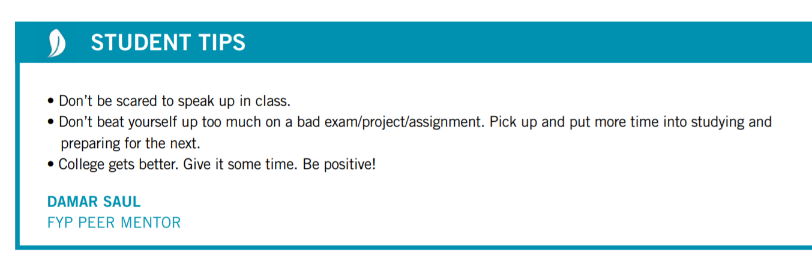
Asking For Help Is…
A Habit of Successful College Students!

Slide 69
Effective Written Communication

Slide 70
Emailing with Professors
https://www.youtube.com/watch?v=nqaRp8MyLOg&t=1s

Slide 71
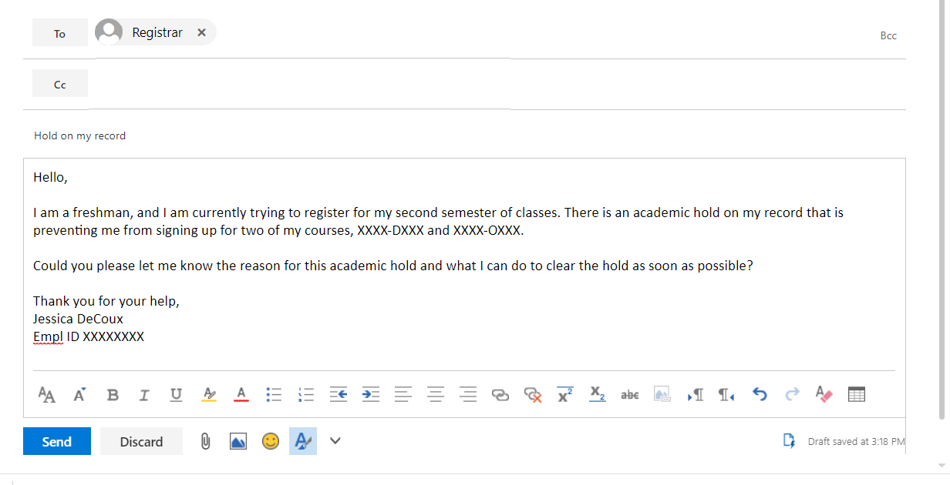
Emails should include…
a subject line
A clear statement of the information or request you are communicating
a greeting
any necessary background info
Be polite—especially if making a request!
A sign-off that includes your name
Remember, an email is NOT a text!

Slide 72
You don’t have to do it alone! One way of asking for what you need is to ask for help and support.
A few options when you need help:
Advisors
Trusted Professors/Office Hours
The Counseling Center
The Student Success Center

Slide 73
Recap
Part A:
Where College Happens, Pt. 3
Taking Notes
Overview of Resources + Services
Asking for Help
Part B:
Where College Happens, pt. 5
Why Participate?
Co-curriculars @City Tech
Extracurriculars @City Tech
Asking Effective Questions
Effective Communication

Slide 74
Before Session 4…
Download a copy of “My Academic Career Planner” before our next class.
Complete Reflection on OpenLab by replying to Reflection #3 Post.
Reflection #3
Think about a time when you joined a new group activity (maybe a team, religious retreat, club, or workplace).
How did you feel when you first joined?
Do you recall a moment when you felt like you were part of the group?
What benefits did you get from participation in the group?
What can you do to help yourself feel like part of a group at City Tech?
We invite you to tell a story about becoming a City Tech student.

