Slide 1
City Tech 101
Fall 2024
Adin Dobkin
adin.dobkin14@citytech.cuny.edu
City Tech 101 by Karen Goodlad and Sarah Paruolo is licensed under a Creative Commons Attribution-NonCommercial-ShareAlike 4.0 International License.

Slide 2
SESSION TWO:
#RiseandGrind
+
Mindset
Session 2
September 13
Adin Dobkin
City Tech 101 by Karen Goodlad and Sarah Paruolo is licensed under a Creative Commons Attribution-NonCommercial-ShareAlike 4.0 International License.

Slide 3
Today’s Topics
Part A
Where College Happens, Pt. 2
Where We Learn
When We Learn
How We Learn
Your Study/Learning Plan
Part B
Where College Happens, Pt. 3
What is a Growth Mindset?
Fixed Mindset Habits
Growth Mindset Habits
Skills-Based Learning

Slide 4
Part A: Studying and Scheduling
#RiseandGrind

Slide 5
Where does
college happen?
Notes:
We want students to understand that college isn’t just going to class and leaving. Getting a full college experience means that learning and growth happen in many different spaces and in different ways. Variations on these slides will appear in each of the next several units.

Slide 6
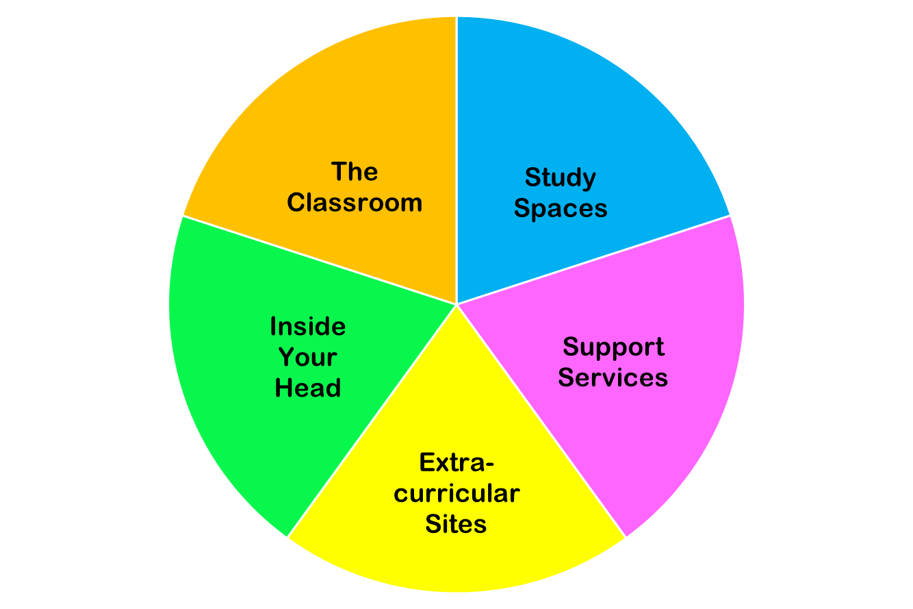
College happens in lots of places
These
are all necessary parts of college!
Notes:
You do NOT need to discuss each piece of this pie in detail. Just discuss the “pie wedge” for the current session and let students know that we will go over each of these pieces in subsequent sessions.

Slide 7
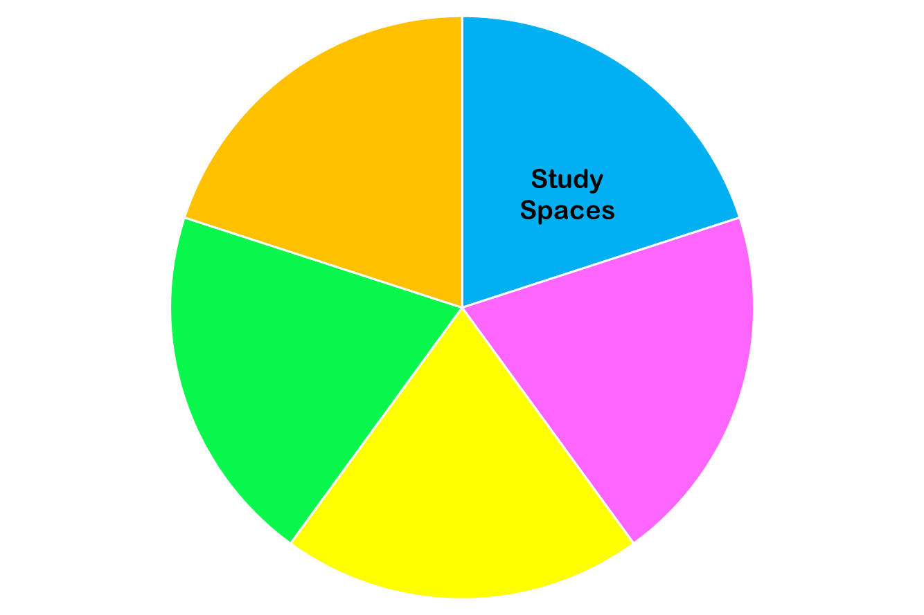
Now we are focused on…

Slide 8
Increased Personal Responsibility
Taking Control of Your Own Learning
=
Notes:
Q: What does it mean to take control of your own learning?
Q: Why is this important?
Q: How does this present as being different from how you learned in high school?

Slide 9
When do I learn?

Slide 10
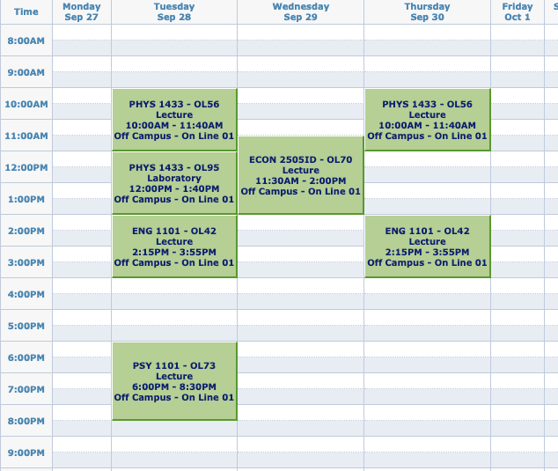
A Typical FY College Schedule
What does this schedule look like compared to your HS schedule?
What assumptions might you make based on those differences?
IMAGE

Slide 11
Do you really have all that free time now??
One of the hardest parts of college is BALANCING everything—your courses,your assignments, and the rest of your life.

Slide 12
Question
How many hours will you spend
in class and doing work for class in one semester?
Notes:
Have them guess

Slide 13
Answer:
Over 600 hours!
That’s a lot of hours!
Let’s break it down week by week.

Slide 14
The Breakdown
15 credits = roughly 15 hours in class each week
for each hour in class, budget 2 hours for homework and studying
15 credits = roughly 30 hours of work outside of class each week
so when taking 15 credits, you should expect to spend about 45 hours each week just on school
15 credits each semester
many classes are 3 credits
often, 15 credits means
5 courses (but not always)
1 credit = approximately 1 hour in class each week

Slide 15
Math Time!
How many hours a week do you spend doing…
https://drive.google.com/file/d/1pYeH6IbtC0dVyiui22f40_uOQVlCn59w/view?usp=drive_link
(But don’t worry, you can use your calculator for this.)
Notes:
Not all hours are created equal. Open Google Doc or Zoom Whiteboard to DEMO math.

Slide 16
What times of the day are the best times for you to study? What can you do to make sure you’re available during those times?

Slide 17
Take time to fill out your weekly schedule. How will you fill each hour?
Don’t forget to include:
Commute time
Time for eating
Time for rest and self care
Time to sleep!

Slide 18
Learning Spaces: Where do I learn?
Notes:
Q: Where do you do your homework and study? Why? Do you think that is the best place to do it? Why/Why not?

Slide 19
Questions…
Do I like to study alone or with others?
Do I like to have background noise? (voices? music?)
What kind of chair is most comfortable?
What do I like to have around me?
Notes:
Pros and cons
Online/Remote Learning-- difficulties and advantages
Armed with the knowledge of past 2.5 years
Even if in person, will all your work be done at school? Do you need a space at home to work?

Slide 20
Working Remotely
In your home
In your own space
In your personal classroom
In a suitable place in your neighborhood (library, coffee shop, park, or a different CUNY campus)
Notes:
Pros and cons
Online/Remote Learning-- difficulties and advantages
Armed with the knowledge of past 2.5 years
Even if in person, will all your work be done at school? Do you need a space at home to work?

Slide 21
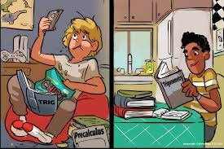
Which student is an engaged learner?

Slide 22
Create Your Own Workspace at Home
Limit distractions and unwanted noise
Set up computer/tablet on a desk or table, not your lap
Sit in a chair, rather than a couch or bed
Have a notebook and pens/pencils nearby
Make sure there is plenty of light
Hang a calendar or weekly schedule
Post a To Do list
Post pictures, images, and/or motivational quotes
Add a plant for increased oxygen
Notes:
Importance of making space, Creating the right atmosphere and routine
Train your brain to know that this is a space for work

Slide 23
On City Tech Campus
In the classroom
In the lab
In the library
In the computer lab
In other spaces
How will you find a place on campus to study that works for you?
A place to hang out?
Notes:
Pros and cons:
Quiet v. Noise
Distractions
Comfort-- but not too much
Specific spaces
What kind of access will you have this/next semester?

Slide 24
Find Your Own Workspace on Campus
Which spaces have the optimal amount of quiet or noise for you?
Alone or with friends/classmates?
Find a place where you can work in a comfortable position
Carry your supplies with you
Where are the places you can get help on campus when you need it?
Notes:
Importance of making space
Creating the right atmosphere and routine
Train your brain to know that this is a space for work

Slide 25
What other places are workspaces?

Slide 26
What other places are workspaces?
Coffee shop or restaurant
Park or other outdoor area
Public Library
Library at a different CUNY campus

Slide 27
What spaces will help you study most productively? Where can you find those spaces?
Take a few minutes to draw or diagram a study space you plan to use. What will be the best layout for this space? What will this space include?
Notes:
You can direct students to the activity sheet (in their course packet) and give them a few minutes to draw or sketch an ideal study space for themselves.

Slide 28
How do I learn?

Slide 29
How do you learn something new?
How do you practice a new skill?
What are the best practices and habits to help you learn?
How can you take charge of your own learning?
Take time to discuss these questions as a class or in small groups.
Notes:
Open students up to the idea that they don’t actually know HOW they learn things. Invite students to consider what methods best help them memorize and retain information and what kinds of habits or goals help motivate them to learn.
I usually say something like… “At this point in your lives most of you have been professional students for at least 12 years. We expect professionals in most fields to be experts at their craft. Examples like a carpenter, a plumber, a pilot, etc. Are you an expert at learning? How could you not be? Is it possible you learned how to learn but have no idea that you did?”
This leads into why we need to understand how our brains work, and how we actually learn-- especially since it is now in their hands.

Slide 30
What is my Learning Plan?

Slide 31
Based on all you have learned today, take time to write down three practices or habits you will incorporate into your study routine.
Why did you choose them? Why do you think they will help you?

Slide 32
To get a better handle on your study needs, answer the Learning Plan Questions
in your course packet!
PDF of Questionnaire
Notes:
Introduce the idea that people learn in different ways, know how you learn makes a huge difference in how easy you find school/studying.
Give them 10 minutes to take the quiz.

Slide 33
BE OPEN TO LEARNING HOW TO LEARN
The definition of futility is doing them same thing over and over, but expecting different results.
Successful learners adjust their practices to improve their outcomes.
Notes:
Prompt students to understand that do get new results, they have to be willing to try new things.
I like to share this example: When introducing new food to a child, you have to make them try it 20 times before accepting that they really don’t like the food. Not to torture them, but because our bodies are trained to be suspicious of new things. Translate this to learning.
Trying to integrate new study methods and routines will not be simple. You are going to have to push yourself for a while before it feels natural/right/comfortable.

Slide 34
Part B: Get Your Head in the Game
Mindset

Slide 35
Where does
college happen?
Notes:
We want students to understand that college isn’t just going to class and leaving. Getting a full college experience means that learning and growth happen in many different spaces and in different ways. Variations on these slides will appear in each presentation from Session 2 to Session 6.

Slide 36
College happens in lots of places
These
are all necessary parts of college!
Notes:
You do NOT need to discuss each piece of this pie in detail. Just discuss the “pie wedge” for the current session and let students know that we will go over each of these pieces in subsequent sessions.

Slide 37
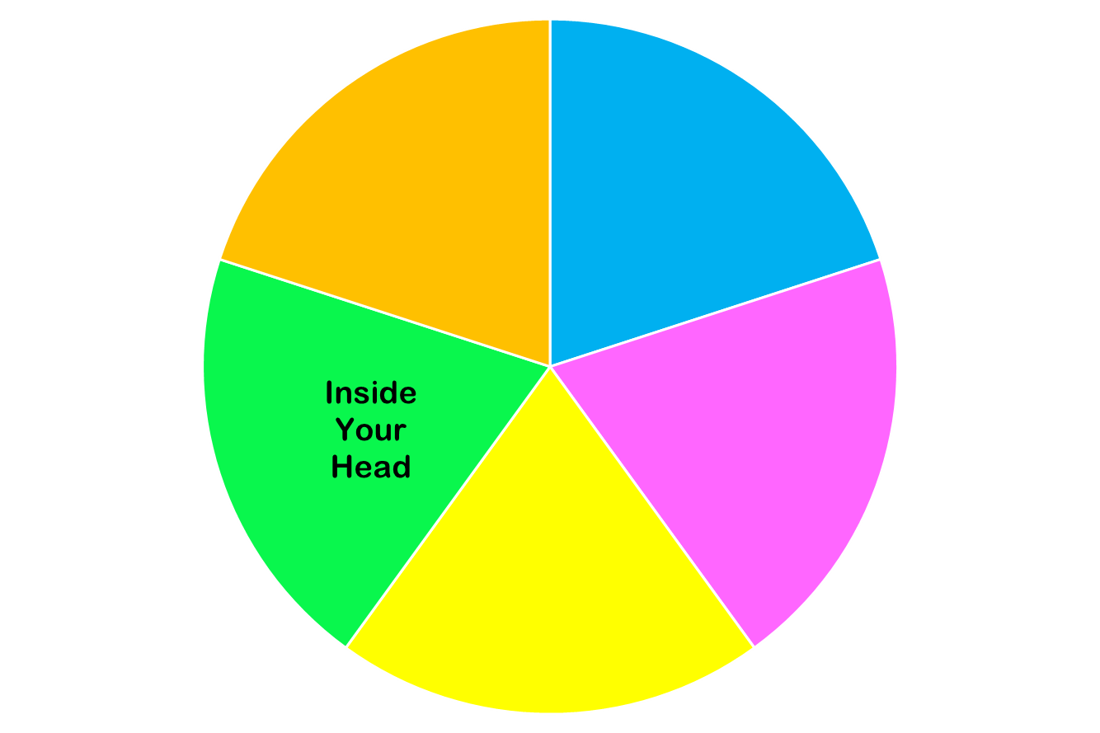
Now we are focused on…

Slide 38
Notes:
I remember a number of people stated they wanted to meet new people at CT, well that is hard and everyone starts as a stranger until they are your best friend

Slide 39
Growth Mindset

Slide 40
Have you ever said any of these things?
“I’m just not good at math.”
“Writing papers just isn’t my thing.”
“Some people have a talent for languages.”
“People are who they are; they can’t really change.”
Notes:
Take a few minutes to talk about these sentences with students, and think of variations on these sentiments that they may have said or believed. You may take an informal poll of how many think some people are just “math people” or “English people” and some aren’t.

Slide 41
Here are some explanations of mindset:
Video option 1
Video option 2
This Photo by Unknown Author is licensed under CC BY-SA
Article on Mindset
Do you want to know more about creating a growth mindset? Here are more resources:
Mindset, Talks at Google
Assess your Mindset (alternate quiz—requires registration)
A Summary of Growth and Fixed Mindset

Slide 42
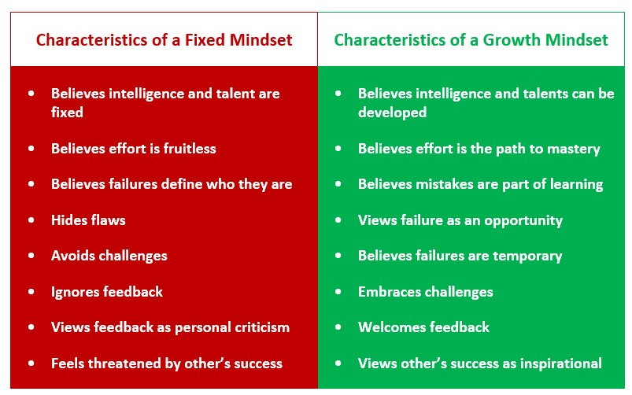
Attribution: https://thepeakperformancecenter.com/development-series/mental-conditioning/mindsets/fixed-mindset-vs-growth-mindset/

Slide 43
Habits of Fixed Mindset
College Students

Slide 44
What kinds of habits and practices do Fixed Mindset students have?

Slide 45
Fixed Mindset Behaviors:
Resistance
Procrastination

Slide 46
Resistance:
Pushing back
Refusing to engage or care about learning
Seeing anything challenging or hard to understand as “dumb” or “pointless.”
You do your work, but in a “mechanical”way–you follow directions and get the work done as quickly as possible, without caring about what you learn. Things that require intense effort or thought irritate you.

Slide 47
Procrastination
Voluntarily delaying a task or act unnecessarily and seemingly “irrationally,” even though this delay brings negative consequences
Often accompanied by negative feelings and possibly emotional dysregulation

Slide 48
What are some causes of procrastination?

Slide 49
Which of these causes of procrastination are related to having a fixed mindset?
Anxiety/anxious feelings
Ego-identity protection
Fatigue/Burnout
Lack of motivation
Low self-esteem
Pessimism
“Self-sabotage”
Time management/executive functioning issues
Notes:
10:40-10:45
Activate the poll

Slide 50
Which of these causes of procrastination are related to having a fixed mindset?
Anxiety/Anxious feelings
Ego-identity protection
Fatigue/Burnout
Lack of motivation*
Low self-esteem
Pessimism
“Self-sabotage”
Time management/executive functioning issues
Notes:
10:40-10:45
Activate the poll

Slide 51
For some tips to help you manage procrastination, visit the Procrastination Station Site.
For procrastination habits that persist or are overwhelming, visit the Counseling Center.
Notes:
https://procrastination.squarespace.com/

Slide 52
Habits of Growth Mindset
College Students

Slide 53
What kinds of habits and practices do Growth Mindset students have?

Slide 54
Growth Mindset Behaviors:
Value learning as a process
Focus on building skills
Work with patience and engagement
Ask for what you need
Care for yourself
Notes:
10:40-10:45
Activate the poll

Slide 55
Building Skills (with Patience)

Slide 56
Skill-Building Activity: Understanding the Learning Beneath the Assignment
Identify a group scribe and a speaker.
Read the assignment prompt on the next slide. This is a typical assignment that a first year student might see.
As you read, try to identify the tasks that the assignment is asking you to accomplish. What does the assignment want you to do?
Next, look at the list of skills that is provided.
What SKILLS will you need to accomplish the tasks in the assignment?
When we come back together as a full group, we will compare our results.
Notes:
10 minutes

Slide 57
SAMPLE PROMPT
UNIT 1: EDUCATION NARRATIVE
Now that we have read and thought about several different education narrative essays, it is time for you to create an education narrative of your own. In the education narratives we read, the writers discuss educational journeys and use their experiences as a way to draw conclusions about themselves, about education, or about the world in general. You will do the same! You may write about a single event in your educational life that transformed you or changed your way of thinking, or you may write about a series of events that all tie together to make a single point. In writing about your education, you want your reader to understand your interpretation of the events you describe and agree with your overall point (thesis).
Use the readings you have done as models to help you with this task. You may choose to use elements of several different pieces, or you may choose to use one of the pieces as a “mentor text” to help you structure your own work.
Your essay should do or have the following things:
Describe your own personal education experiences (a kind of “personal essay”) and be written in the first person (I/me pronouns)
Describe a single event/experience OR a series of different connected events/experiences
Be thoughtful—analyze your situation and its effect on you
Use specific details and precise language to convey the events and your feelings to the reader
Information should be divided into distinct, organized paragraphs
Should have a point of view and make an overall point about the events you describe and why they are significant
Should be approximately three pages or ~1000 words long

Slide 58
Questions for Discussion:
What did the assignment ask you to do?
What skills do you think you need to complete the assignment?
What was most challenging about reading the prompt and the list of skills?
Of the skills we discussed, which ones do you think you already have mastery of? Which ones have you partly mastered? Which ones do you still have to learn?
If you try to do the assignment without having mastery of all of those skills, what do you think will happen?
Why might a teacher give an assignment knowing that students might not yet have mastery of the skills needed to complete it?
How long to you think it might take to get full mastery of all of those skills? What can you do to have patience with yourself while you learn them?
How can having a Growth Mindset help you as you build skills?

Slide 59
Optional Small Group Discussion: Growth Mindset Habits of Successful College Students
Review the “Track your Learning Process” checklist.
Share which of the practices you did not know successful college students used.
Which of the practices seem most consistent with Growth Mindset behavior? How can having a Growth Mindset help you do some of these tasks?
Which tasks would you like to incorporate into your own study routine?
When you return to the larger group, the speaker from your small group will summarize your discussion
Notes:
10 minutes

Slide 60
What Questions Do you Have?
Now that we are halfway through our workshop, take a moment to think about things you would still like to know.
Please write down three questions that you would like answered, and give them to your professor.
They will answer your questions over the next few sessions.

Slide 61
Before Session 3…
Complete Reflection on OpenLab by replying to Reflection #2 Post.
Read the following quote by Dr. Pamela Brown, Provost and Vice President for Academic Affairs:
“Learning is a source of hope for a better future. It requires hard work and sacrifice which can be even more difficult in challenging times. Your time in college is also your opportunity to connect with others, lift your spirit, enrich your life, and develop the skills and knowledge to make a difference in your community.”
Choose a question below and write a reflection in the comment box below this post.
What life experiences have prepared me for college?
When I have been faced with a difficult situation, what strategies did I use to find a solution?
How will I create positive academic habits for myself?
Read and comment on another student’s post. These are your classmates, encourage them to work towards their goals.

Slide 62
Recap
Part A
Where College Happens, Pt. 2
Where We Learn
When We Learn
How We Learn
Your Study/Learning Plan
Part B
Where College Happens, Pt. 3
What is a Growth Mindset?
Fixed Mindset Habits
Growth Mindset Habits
Skills-Based Learning

Slide 63
SESSION TWO:
#RiseandGrind
+
Mindset
Session 1
Date
Professor
City Tech 101 by Karen Goodlad and Sarah Paruolo is licensed under a Creative Commons Attribution-NonCommercial-ShareAlike 4.0 International License.

