Slide 1
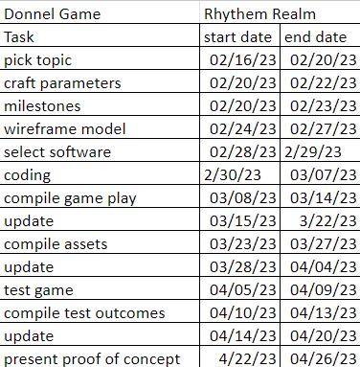
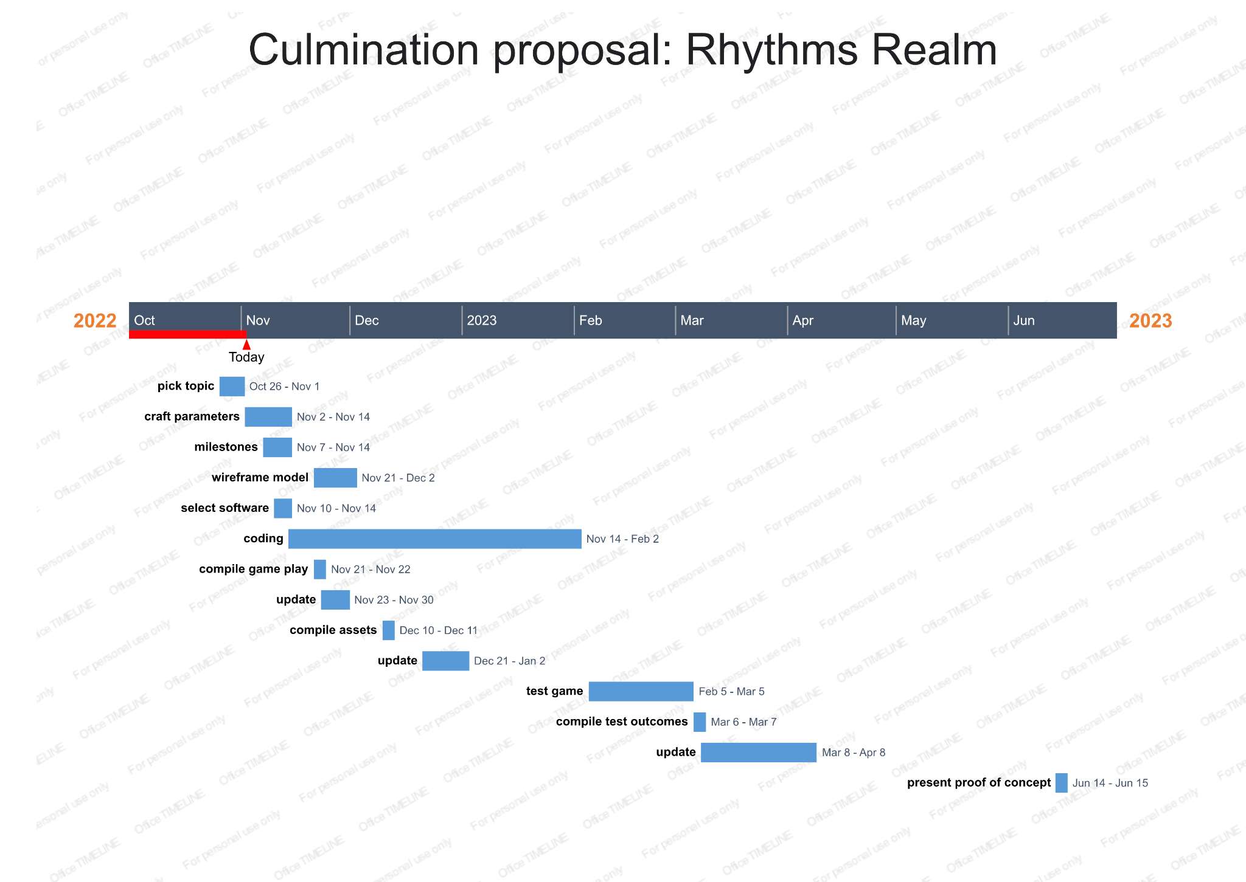
Culmination proposal: Rhythms Realm
By: Donnell Maylor
Summary
An adventure game about shapes that fight and defend to rhythms and songs. On a quest to make music for their kingdom. Came up with this idea when I played the game “Just some Shapes and Beats” and “Metal Hellsinger” for the first time. Inspired by how integral music was to game play and vice versa. I will be working alone to create this project using Unity, the game maker engine. There will be 5 elements to the game: the player character, enemies, setting, music and combat. This project is going to have 3 levels each with an item at the end that will give the player character a new ability for combat and/or traversal. In finishing this project, I will be able to create more levels and have more intricate level design.
Description
For my project I want to create an action adventure game about shapes that interact with each other to the rhyme of music in some way.
Methods
Coding
Art
Results
A playable build of the game with enemies and combat mechanics.
Conclusion
What I expect from this project is a working build and a solid foundation to build off of. I want to get a better grasp of the mechanics of comdat in combination of the music.
Schedule
Deliverables
5 min presentation
Playable build
1 level
Enemies
Fight mechanics
Required Resources
Unity software
Literature cited
https://store.steampowered.com/app/1061910/Metal_Hellsinger/
https://www.justshapesandbeats.com/
https://ninja-muffin24.itch.io/funkin
The Process
I will be designing the game in unity first to make sure the combat works and then implement the music after.
Budget
Unite is a free game making software but if I were to further work on this game I will need to hire a artist to make more sprites. A musician to for more soundtracks and a coder to help create more levels.

Slide 2
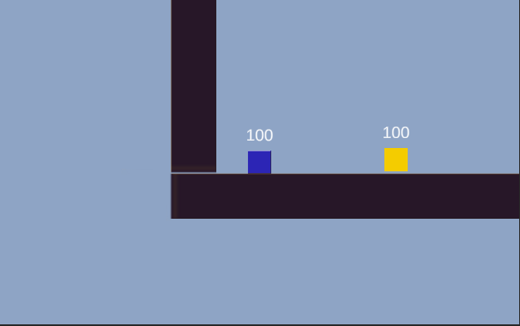
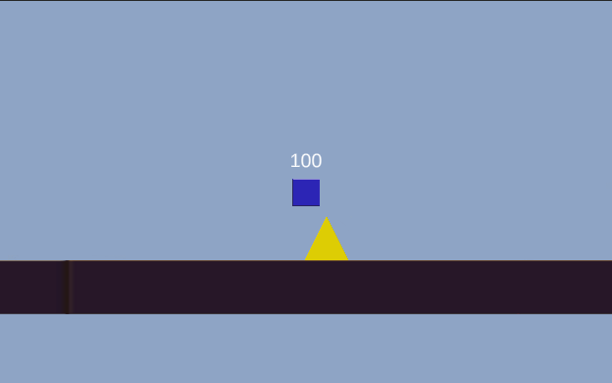
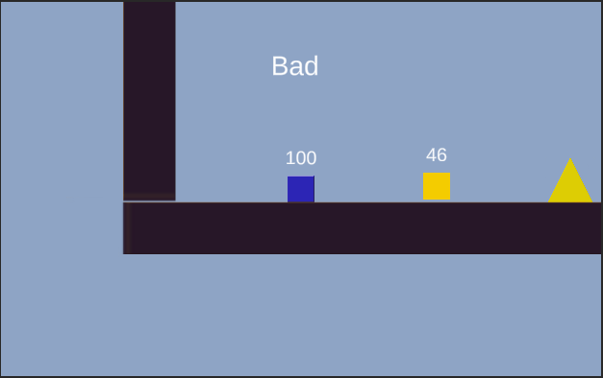
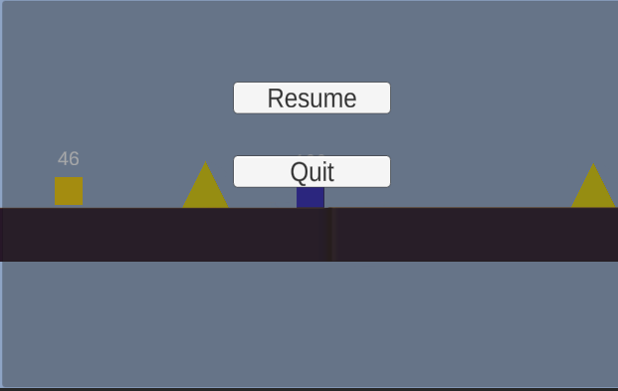
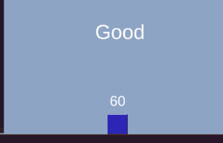
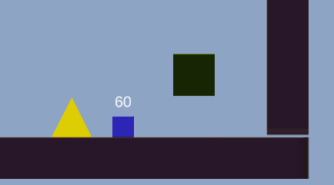
Culmination proposal: Rhythms Realm
By: Donnell Maylor
Summary
An adventure game about shapes that fight and defend to rhythms and songs. On a quest to make music for their kingdom.
Description
For my project I created an action adventure game about shapes that interact with each other to the rhyme of music in some way.
Screenshots
Schedule
Enemy
Obstacle
Missing a beat
Pause menu
Hitting a beat
Finish line
Results
A playable build of the game with enemies and combat mechanics.
Conclusion
What I expect from this project is a working build and a solid foundation to build off of. I want to get a better grasp of the mechanics of comdat in combination of the music.
Deliverables
Playable build
1 level
Enemies
Fight mechanics
Required Resources
Unity software
The Process
I designed the game in unity with a timer that was insync with the beats.

