Slide 1
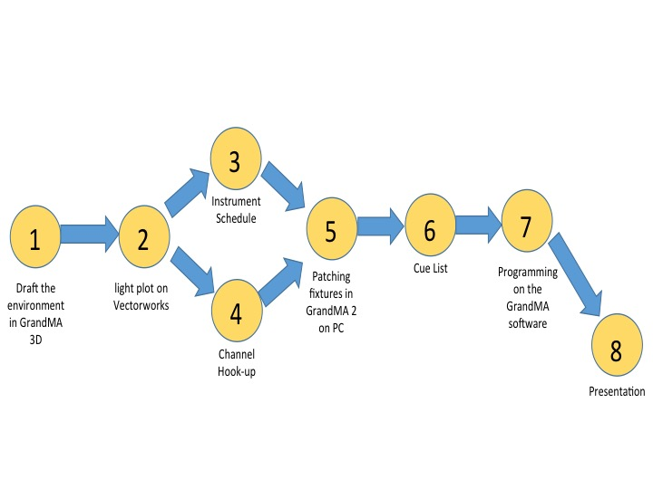
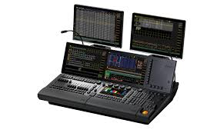
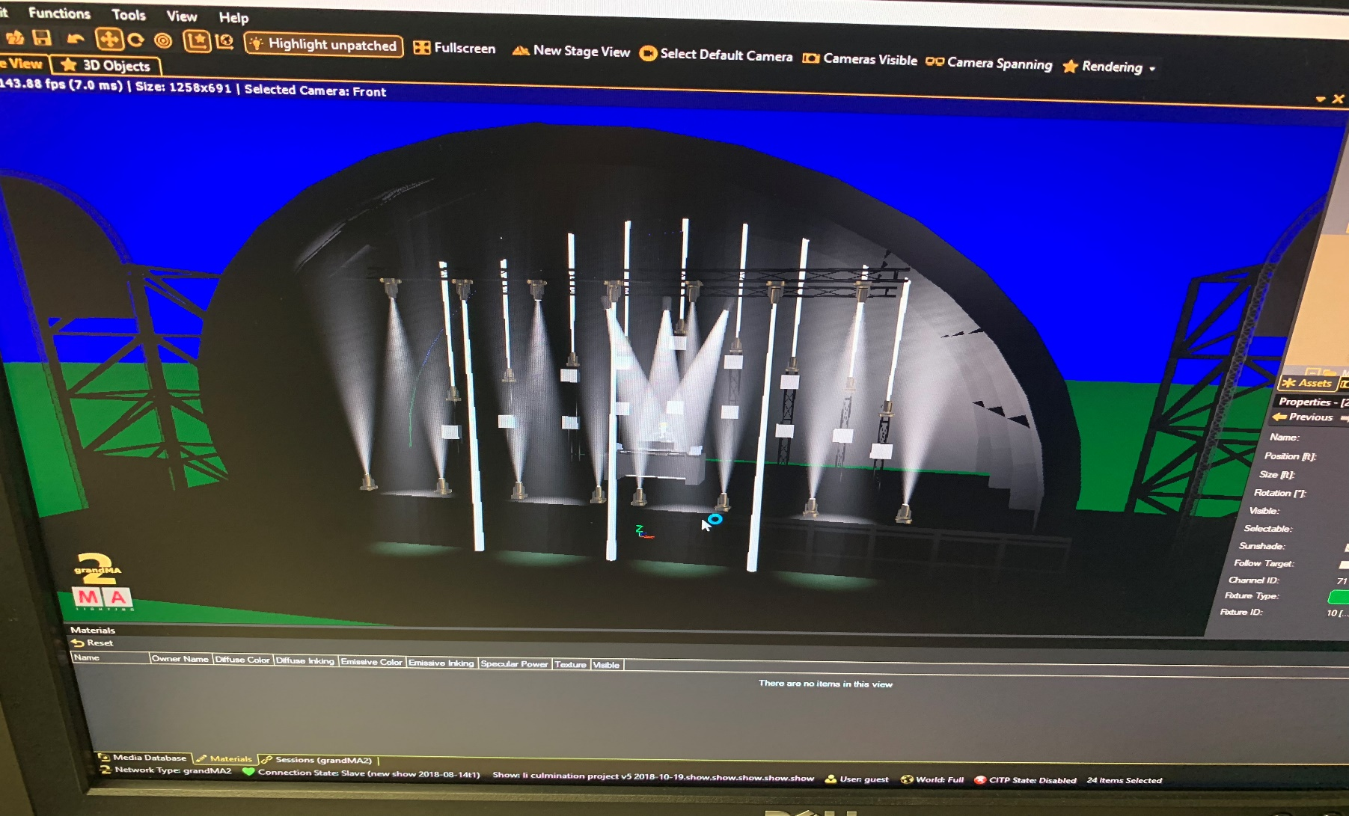
Lightshow on GrandMA 3D David Li New York City College of Technology, Brooklyn, New York 11201
Introduction
The GrandMA is a device that controls lighting fixtures. This kind of device is called a console or in industry terms a desk. A lighting console has the ability to control all different kinds of lighting fixtures. Lighting fixtures such as conventional, Moving lights and LEDs. For the GrandMA 2 consoles, it contains 4,096 parameters and 15 motorized executor faders along with the feature to control video and media. The GrandMA company also has the GrandMA 3D software. According to actlighting.com, this software is a, “free state of the art visualization program for PC”. 3-D environments can be constructed in the software to enhance the visual ideas of the designer and aid the presentation of the designer.
The skills include:
1. Drafting in a 2D and 3D Space.
Operating on the lighting console.
The Process
Decide the environment of the venue.
Draft the venue in Vectorworks and place fixtures in the virtual venue.
This allows the production of both the instrument schedule and channel hook-up.
Start drafting the environment in GrandMA 3D.
With the instrument schedule and channel hook-up, start patching light fixtures into GrandMA 2 GrandMA 3D.
At the same time this is happening, production of the cue list can be done.
After the above procedures are complete, programming of the cue list can begin.
The last and final step of this project is to present the completed product.
Method:
1. Schedule; timeline
Week 1: Light Plot and GrandMA 3D drafting.
Week 2: Patching Fixtures in GrandMA software.
Week 3: Construction of cue list.
Week 4-9: Programming effects into GrandMA software.
Week 10: Presentation
2. Procedural system of communication
and documentation
Face to face meeting with technical advisor
Email
YouTube Videos
PERT Chart Planning
Conclusion
This project is a success in creating a lightshow. While creating the lightshow, there were a lot of obstacles I had to face in terms of programming on the GrandMA console making it hard to fit the same number of cues from my cue list onto my executor. So, I needed more cues then I had on my cue list. I also ran into problems where I had to meet deadlines spontaneously. I think planning ahead is a key part of this project. In this project, I applied most of my knowledge on the GrandMA 2 console, drafting skills, and my knowledge of lighting. I got to express my creativity in creating this light show. I got to learn more about the GrandMA 2 lighting console. I am more comfortable programming on the console and am comfortable drafting in the GrandMA 3D software.
Task | Description | Estimated Duration (hrs) | Dependency
1 | Draft the environment in GrandMA 3D | 3 | -
2 | Draft the light plot in Vectorworks | 3 | 1
3 | Produce Instrument Schedule | 1 | 2
4 | Produce Channel Hook-Up | 1 | 2
5 | Patch Fixtures in GrandMA2 on PC | 1 | 3,4
6 | Cue List | 2 | 5
7 | Start Programming on the GrandMA2 software | 24 | 6
8 | Presentation | 1 | 7
Literature cited
“grandMA2 User Manual.” grandMA2 User Manual - grandMA2 User Manual - Help Pages of MA Lighting International GmbH, help2.malighting.com/Page/grandMA2/grandma2/en/3.4.
“MA 3D User Manual.” MA 3D User Manual - MA 3D - Help Pages of MA Lighting International GmbH, help2.malighting.com/Page/grandMA2/MA_3D/en/3.3.
Budget:
Product | Price
GrandMA2 on PC | FREE
GrandMA 3D | FREE
Vectorworks | $3,045
Lightwright | $586.50
Google Spreadsheets | FREE
Total: | $3,631.50
Acknowledgements
Special thanks to Professor Robinson for guidance and Professor Scott for being available for questions about the GrandMA2 console and GrandMA 3D software.
Deliverables:
Culmination Poster
OpenLab Portfolio
Production Meeting Notes
Image of Progress
Light Plot
Channel hook-up/Instrument Schedule
Presentation of the programming in GrandMA 3D
Hypothesis
I predict that the cue list would dictate the number of cues I would have on the executor.
Results
A successful lightshow is created on GrandMA 3D.

