Slide 1
Steve Jobs 1955-2011 “I want to put a ding in the universe.”
One of the most influential and inspirational people of a generation. Jobs definitely puts a ding in the universe.
Daniel Lee

Slide 2
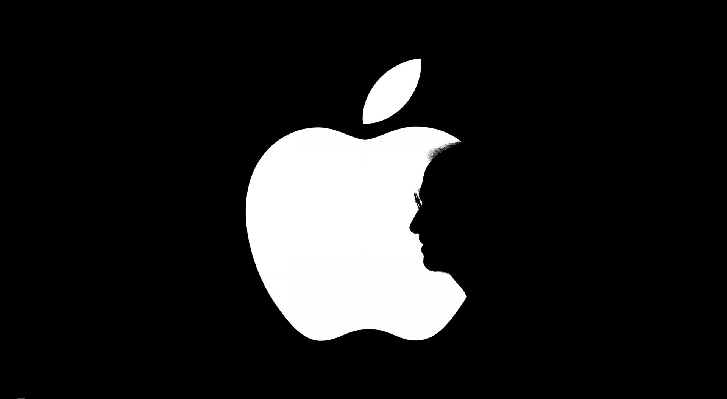
Why Steve Jobs?
In the age of technology there are a select few names that will never be forgotten. One of these names is Steve Jobs. Many people ask, “Why Steve Jobs?” Some know him as the inventor of the iPod, iPhone, and iPad, but what they don’t know is Job’s rise to success was anything but at the click of a button.

Slide 3
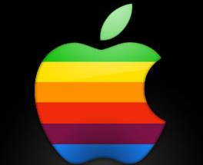
The Macintosh Revolution
Steve Jobs revolutionized the way the world operates on a daily basis. He changed the way we all communicate, entertain, and connect with one another.
Under the brilliant guidance from Steve Jobs Apple came to dominate the digital age. After the invention of the first Macintosh computer Jobs stopped at nothing to push the boundaries of technology that none of us thought possible.

Slide 4
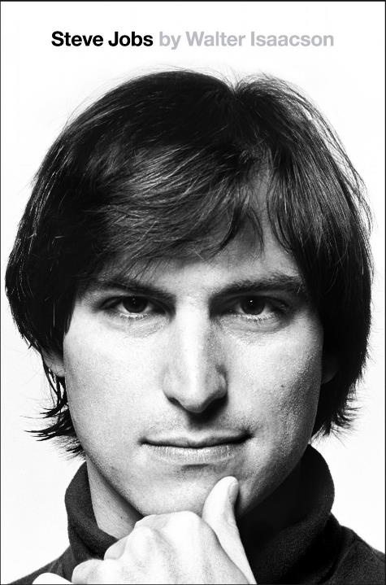
Early Life
Steve Jobs was a long haired college dropout who started a computer company in his parents’ garage on April Fools’ Day. He saw past what most people did when looking at computers, and realized that these machines can be indispensible tools. He saw computers as the work horse for a new generation. He often thought of a computer as a “bicycle for the mind.” In 1976 Jobs and Steve Wozniak invented the Apple Computer.

Slide 5
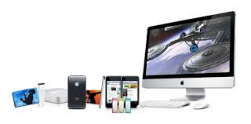
Accomplishments
Without a doubt most of us own at least one of these products. And if we do they have become so much a part of our lives that they are extensions of our body. This is the legacy that is Steve Jobs. Jobs was one who dared to dream and his innovative thinking is why he will be missed dearly.

Slide 6
Accomplishments(cont.)
Along with being the co-founder of Apple Computers, Jobs was also involved in many other business ventures over the course of his lifetime.
In 1985 Jobs founded the NeXT Computer company. In 1986 Jobs bought the company now known as Pixar. Jobs was credited as the executive producer of the company’s first film “Toy Story”.
In 1996 Apple purchased NeXT Computer company from Jobs. This would later evolved into the App Store and iTunes. Soon after this big switch the release of the iPod and iPhone were upon the world. Changing the way we think about what is capable.

Slide 7
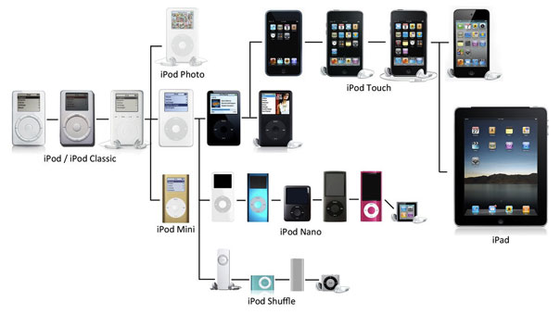
An i Generation
Since their release every iProduct Apple releases evolves into an ever growing timeline of technology. The invention of the iPhone and iPad have changed the way we look at a computer. With such a high demand for an instant connection with the world the iDevices create a way for us to always be integrated with technology. With unlimited access to the internet at the tips of our fingers we now start to view the way we go about our lives differently. With these inventions we are now able to stay connected to the rest of the world at any time.

Slide 8
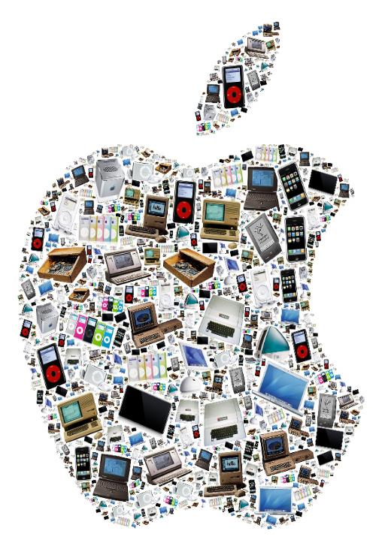
Job’s Influence
Steve Jobs inventions and outside the box thinking paved a new path for the field of Graphic Design. With the invention of the iPhone and iPad the industry now calls on more designers than ever. This is due to the high demand of people wanting unlimited access to information at all times. In congruence with this high demand, many new file formats had to be created in order to accommodate this new way of accessing the world.

Slide 9
The Death of a Generation
In August 2011 Jobs resigned as CEO of Apple but stayed on as the chairman of the company’s board. On October 5, 2011 at his home in California, Jobs died. Jobs had a history of medical problems which would later result in the relapse of his pancreatic cancer. This was ultimately the death of Jobs who not only left behind a family but a legacy as well. Apple released this obituary on their corporate page for the next two weeks. “Apple has lost a visionary and creative genius, and the world has lost an amazing human being. Those of us who have been fortunate enough to know and work with Steve have lost a dear friend and an inspiring mentor. Steve leaves behind a company that only he could have built, and his spirit will forever be the foundation of Apple.”

Slide 10
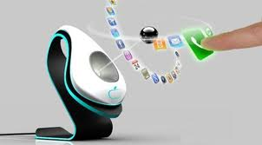
The Next Generation
With Steve Jobs taken from us so suddenly who knows what Apple has in store for us in the future. Technology has been growing at an extremely fast rate over the past 5-10 years which makes me think anything is possible in the not so distant future.
I think that Apple will be fully integrated into every aspect of our lives soon. With the invention of Cloud Storage we will soon have all parts of our technology based lives on one central server keeping us forever linked to one another.

Slide 11
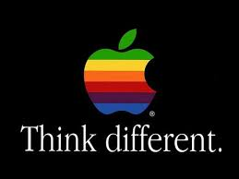
Conclusion
Like all great people through time Jobs will be remembered for what he bestowed upon the world. He will forever be remembered as an outside thinker, someone who never looked at the world from a typical viewpoint. Without people like Steve Jobs in the world we would never progress, we would never dare to ..

Slide 12
Bibliography
http://en.wikipedia.org/wiki/Steve_Jobs
http://www.google.com/#hl=en&sugexp=pfwe&cp=22&gs_id=3n&xhr=t&q=Why+is+Steve+Jobs+so+important&pf=p&sclient=psy-ab&rlz=1W1RNTN_en&source=hp&pbx=1&oq=Why+is+Steve+Jobs+so+i&aq=0&aqi=g1&aql=f&gs_sm=&gs_upl=&bav=on.2,or.r_gc.r_pw.,cf.osb&fp=a9bfab63d9bb937&biw=1024&bih=529
http://adage.com/article/news/apple-s-steve-jobs-dies-56/230232/?utm_source=daily_email&utm_medium=newsletter&utm_campaign=adage
http://creativity-online.com/news/steve-jobs-a-rogue-grounded-in-tradition/230315
http://creativity-online.com/news/creativity-top-5-october-10-2011/230324
http://creativity-online.com/news/apples-postjobs-legacy-is-in-the-hands-of-tbwamedia-arts-lab/230316
http://adage.com/article/agency-news/book-jobs-a-student-advertising/230612/?utm_source=daily_email&utm_medium=newsletter&utm_campaign=adage
http://www.cbsnews.com/8301-18560_162-20124391/steve-jobs-revelations-from-a-tech-giant/?tag=contentMain;cbsCarousel

