Slide 1
PRIVATE BUILDING
By :Diego Lasluisa

Slide 2
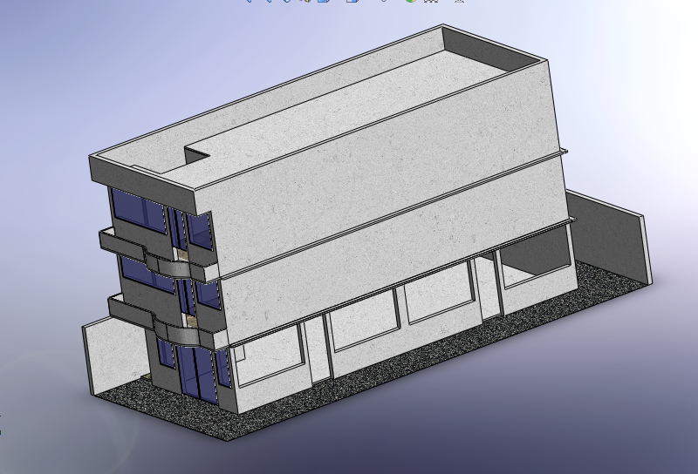

Slide 3
Isometric view

Slide 4
Top view wireframe

Slide 5
Isometric and lateral wireframe view

Slide 6
Front wireframe view

Slide 7
Front view

Slide 8
Lateral section view

Slide 10
Top section view

Slide 11
Top section view

