Slide 1
Torus Mandibular/ Palatine
Danielle Kim

Slide 2
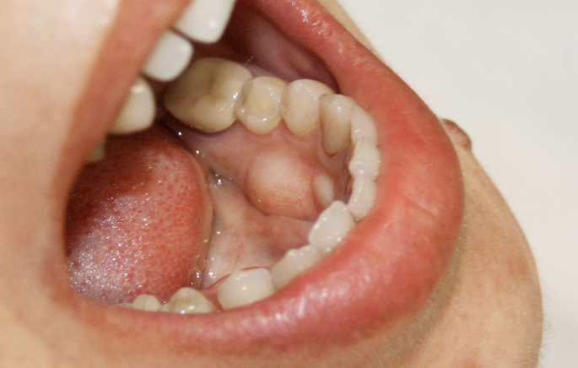
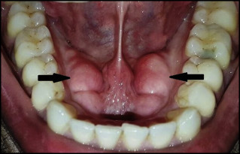
Torus Mandibular
Torus Mandibularis: A bony growth that develops on the lower jaw, beneath, and on the side of the tongue

Slide 3
Torus Mandibular: Etiology and Impacts
According to the National Institutes of Health (NIH), Torus Mandibularis development is thought to be mostly driven by genetics.
These bony growths generally don’t pose a problem on a patient; however, sometimes it can interfere with the fit of a patient’s lower denture.
Soft tissues that cover the growth can also become ulcerated in some cases.

Slide 4
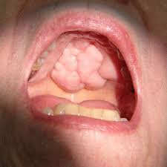
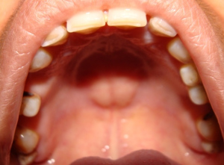
Torus Palatine
Torus Palatinus: A bony growth that develops on the roof of the mouth
Single or multiple nodules in a range of shapes may appear
Growths can be regular or irregular, flat, spindle-shaped or nodular

Slide 5
Torus Palatine: Etiology and Impacts
Torus Palatine causes are unclear, but heredity and trauma seem to play a role.
According to Colgate, research suggests diet has an influence, such as vitamin deficiencies, fish consumption, and a calcium-rich diet.
These growths generally don’t cause any complications for a patient.

Slide 6
Role of dental team
Dental professionals should generally monitor the size and shape of the tori.
The team does not need to recommend treatment of area, unless the tori begin to interfere with the patients routine oral home care, or basic daily functions.

