Slide 1
New York City College of Technology Department of Dental Hygiene DEN 2300 Case Presentation
Danielle Kim
Fall 2019

Slide 2
Patient Profile
Ms. P is a 24 year old Korean Female.
Marital status: Single
She is a college student that lives in the suburbs with her parents and siblings.
She currently has Medicaid insurance.
Patient reports avoiding going to the dentist due to dental phobia. Patient recalls her last dental visit was over 6 years ago, she could not recall the month or year. Last radiographic history was over 6 years.
Patient’s oral hygiene regimen included using a manual medium bristled toothbrush 2x a day using Colgate Sodium fluoride toothpaste, and Listerine antiseptic oral rinse 1x a day. Patient reported no usage of any type of interdental aid, or tongue cleaner.

Slide 3
Chief complaints:
CC: Patient states she’s “Here for a cleaning.”
Ms. P reported feeling “a little under the weather starting two nights ago” during her initial visit.
Patient complained about having “sensitive gums that are tender to the touch”.
Patient also complained about bleeding every other day when brushing her teeth.

Slide 4
Health History Overview:
Blood Pressure: 103/73
Pulse:77
ASA: II
Health Conditions: Patient is a non-smoker and non-drinker.
Systemic Conditions: Patient has Asthma.
Allergies: Patient is allergic to Peaches, Apples which cause her to break out in hives. Ms. P is allergic to dust and pet dander which causes her Asthma to flare up.
Current Medications: Patient takes Albuterol sulfate 90mcg during acute attacks, and Fluticasone 110mcg 2x a day. Last severe Asthma flare up was over two years ago. Patient has been on Albuterol sulfate for 9 years, and Fluticasone for 1 year.

Slide 5
Asthma
What is Asthma: Asthma is a chronic condition that inflames and narrows the airways in the lungs. This systemic condition can have symptoms that range from mild to severe. When symptoms get worse, it is called an asthma attack. Asthma affects people of all ages and often starts during childhood.
Etiology: Varies person to person. Common triggers include: Dust, grass, weed pollen, animal dander, smoke, chemical fumes, and heavy perfume.
Signs: Wheezing, shortness of breath, and coughing.
Symptoms: Chest tightness, anxiety, fast heart rate, and throat irritation.
References:
https://www.lung.org/lung-health-and-diseases/lung-disease-lookup/asthma/asthma-symptoms-causes-risk-factors/what-causes-asthma.html
https://www.nhlbi.nih.gov/health-topics/asthma

Slide 6
Management of Asthma:
Suggested treatment for the management of Asthma: Working closely with a healthcare provider to find the appropriate medication that works quickly and efficiently to help reduce flare ups.
Types of Asthma medications include:
Inhaled short-acting beta2-agonists (SABAs)
Oral and intravenous (IV) corticosteroids
Short-acting anticholinergics
Patient reports managing her Asthma by using her Albuterol sulfate for acute Asthma attacks and Fluticasone 2x a day.
References:
https://www.lung.org/lung-health-and-diseases/lung-disease-lookup/asthma/asthma-symptoms-causes-risk-factors/what-causes-asthma.html
https://www.nhlbi.nih.gov/health-topics/asthma

Slide 7
DH management of Asthma:
Contraindications for Albuterol: Xerostomia
Contraindications for Fluticasone: Candida albicans and aspergillus niger in the oral cavity
Patient management: Discuss alcohol free oral rinses and oral gels with patient, ask about frequency in water consumption, and exposure to fluoride since xerostomia increases the patient’s risk in caries.
Introduce patient to xylitol gum products to increase salivary production.
If the patient has Candida albicans refer them to a HCP for evaluation for possible antifungal medication.
Maintain proper upkeep of dental facility free of dust.
Abstain from wearing any heavy perfume of any sort.
Make sure patient has their inhaler with them, if not, be aware of the location of the emergency rescue inhaler.
References:
Claramunt Lozano, Ariadna, María Gracia Sarrión Pérez, and Carmen Gavaldá Esteve. "Dental considerations in patients with respiratory problems." (2011).
Little, James W., et al. Dental Management of the Medically Compromised Patient-E-Book. Elsevier Health Sciences, 2017.

Slide 8
Comprehensive Assessments: Radiographs

Slide 9
Clinical/Radiographic Findings:
Radiographs indicate localized minimal horizontal bone loss present on lower anteriors #22-27
No caries or PAP noted
Generalized heavy subgingival calculus
Localized heavy supragingival calculus on facial and lingual surfaces of anterior teeth

Slide 10
Summary of Clinical Findings:
EO: Asymptomatic, movable, swollen, bilateral submandibular lymph nodes
IO: Coated tongue, slight erythema and enlargement of tonsils. Slight fluorosis on anterior teeth numbers 7-10, 23-26, and mild anterior crowding.
Class of Occlusion: I Bilaterally
Overjet: 3mm
Overbite: 40%
Attrition: Slight attrition present on teeth #6-11 and 22-27

Slide 11
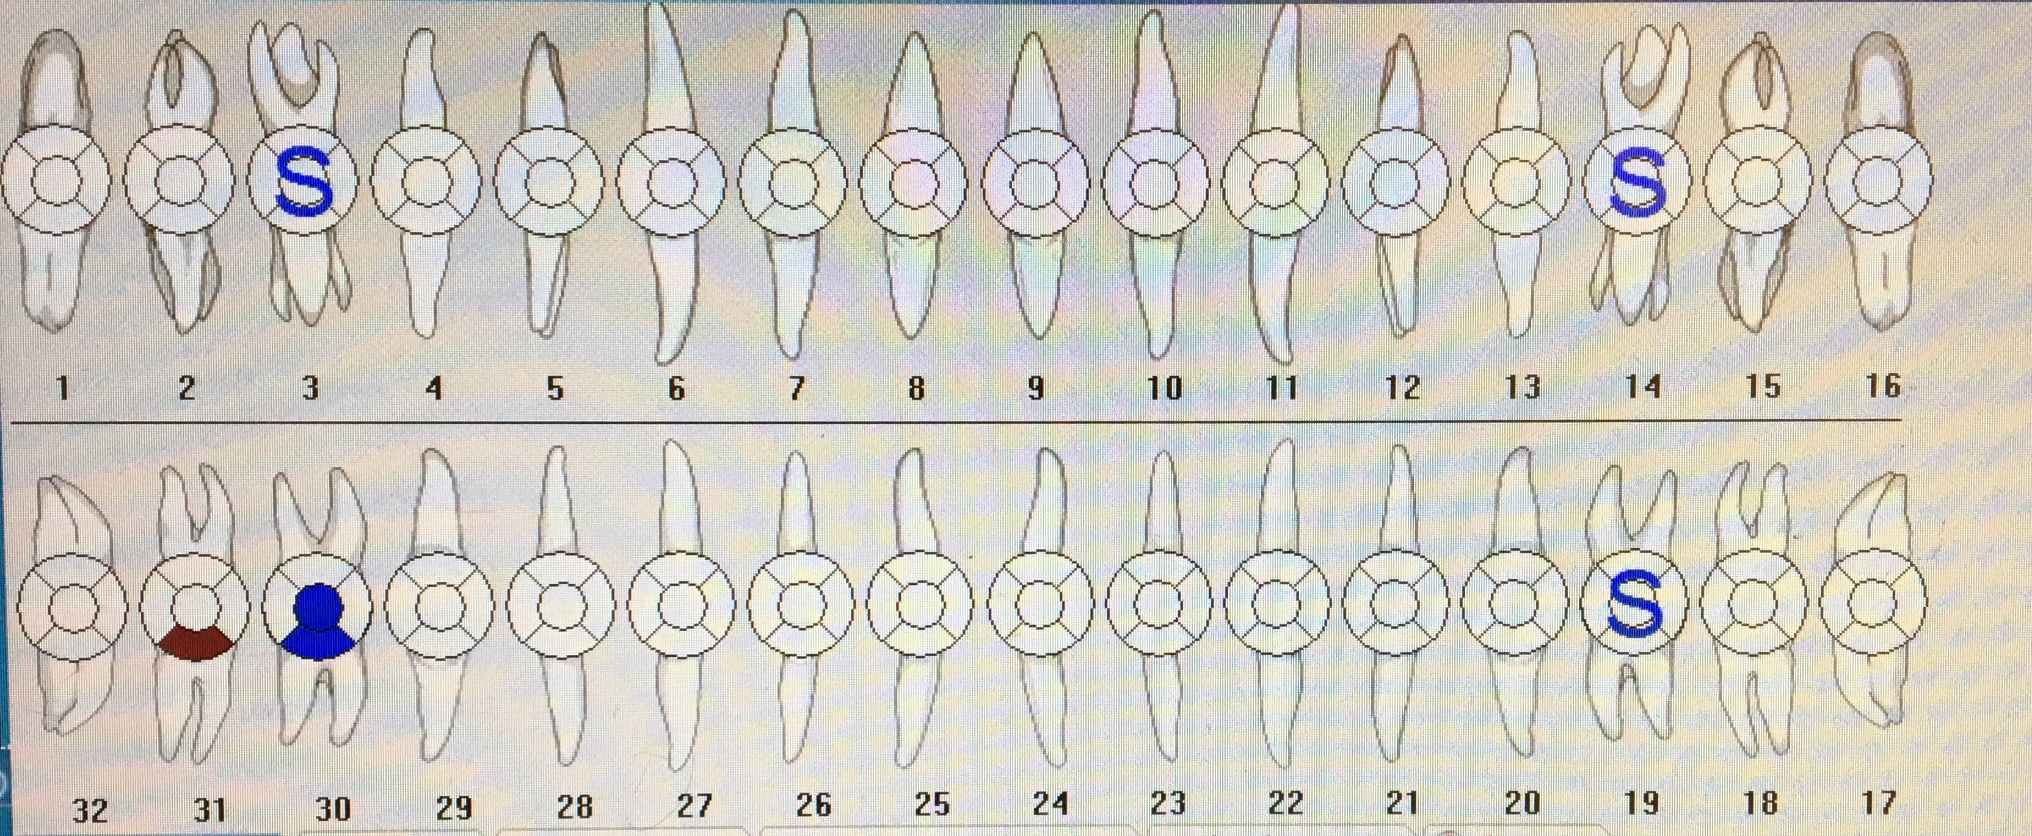
Dental Charting
Sealants: #3,14,19
Amalgams: #30(OB)
Missing restoration: #31(B)
No caries found

Slide 12
Caries Risk Assessment:
Patient had no active caries radiographically or clinically
No CAMBRA assessment was done.

Slide 13
Gingival Description & Periodontal Status:
Gingival assessment: Generalized moderate marginal gingival inflammation with bulbous red papillae. Patient had moderate bleeding upon probing and exploring.
Periodontal Status: H/I active gingivitis. Radiographs revealed bone levels consistent with periodontal classification I. Localized slight horizontal bone loss (>10%) on lower anterior teeth. No furcation involvement, mobility, or gingival recession were present.

Slide 14
Periodontal Charting:

Slide 15
Dental Hygiene Diagnosis:
Patient has minimal risk for caries due to no evidence decay.
Patient has no signs of oral candidiasis.
Patient had heavy supra and sub-gingival calculus deposits which contributed to gingival irritation.
Biofilm build up was present sub-gingivally contributing to inflammation of tissue. Patient had no preventative measures such as flossing.
Periodontal diagnosis: Type I – Gingivitis, active due to generalized moderate marginal and papillary inflammation and localized severe inflammation on all anteriors. Moderate BOP, and minimal bone loss supported by radiographs.

Slide 16
Dental Hygiene Care Plan:
Visit 1: Review treatment plan with patient and obtain consent. Expose FMS. OHI: Modified Bass toothbrushing method. Begin scaling Quadrant I using hand and ultra sonic instruments.
Visit 2: Re-evaluate quadrant I. Take impressions. OHI: Introduce floss. Continue scaling quadrant I and IV using hand and ultra sonic instruments.
Visit 3: Re-evaluate quadrants I and IV. OHI: Review toothbrushing with patient and discuss oral rinses. Scale quadrants II and III using hand an ultra sonic instrument. Engine polish with fine grit. 2% Neutral Sodium Fluoride trays.
Local anesthesia was discussed with patient due to discomfort during probing and calculus detection.

Slide 17
Consent for Treatment:

Slide 18
Implementation:
Visit 1:
Since Ms. P’s last dental radiographs were over 6 years ago, an FMS was recommended and taken during the first visit. However, due to the patients gag reflex, the posterior periapical radiographs had placement errors.
Plaque score: 0.7 (Poor) Patient mostly had staining on facial and lingual anterior aspects of the cervical 3rd region
OHI: Modified bass toothbrushing method was shown on the typodont. Patient reciprocated technique in her mouth successfully.
Due to shortage of time, treatment plan was modified, and no scaling was done at this visit.

Slide 19
Implementation:
Visit 2:
Asked patient about OHI implementation for toothbrushing, and patient reported using the technique daily and found it less intrusive on her gingiva.
Plaque score: 0.5 (Fair) There was slightly less biofilm on the anteriors compared to previous visit, however there was no visible change in gingival tissue. OHI: Introduced “C” shape flossing technique to patient. Patient initially snapped floss into the embrasures, but then was able to reciprocate technique successfully on the 2nd try.
Topical Benzocaine 20% was applied, and 1 carpule Lidocaine 2% w/Epi. 1:100,000, IAB was administered in the LRQ by a dentist.
Scaled quadrant IV to completion using hand and ultra sonic instruments. Post anesthesia instructions were given to patient, instructed patient to not eat until the anesthesia wore off. Treatment plan was modified, impressions were moved to next visit, and an additional visit was added to complete the patient’s treatment.

Slide 20
Implementation:
Visit 3:
There was a significant difference in previously scaled tissue. The gingiva in quadrant IV looked healthier, pinker in color, with reduced inflammation and bleeding. No residual calculus was found.
Patient was compliant with flossing daily initially; however, reduced frequency a few days after.
Patient still agreed to taking impressions, so maxillary and mandibular impressions were taken.
Plaque score: 0.4 (Fair) OHI: Reviewed toothbrushing with patient again and discussed alcohol free rinses by Colgate.
Topical Benzocaine 20%, 1.8cc Lidocaine 2% w/Epi. 1:100,000 was administered in the URQ by a dentist.
Scaled quadrant I to completion using hand and ultra sonic instruments.

Slide 21
Implementation:
Visit 4:
UR quadrant had reduced inflammation and bleeding. Gingiva was more tapered to the teeth, and less erythematous.
Patient reported getting an electric toothbrush to help with brushing.
Plaque score: 0.4 (Fair) OHI: Review flossing with patient, and asked if patient had any questions regarding any of the OHI or electric toothbrush.
Topical Benzocaine 20%, 1.7cc Lidocaine 2% w/Epi. 1:100,000 was administered in the ULQ and 1.7 cc 3% Carbocaine was administered to the LLQ by a dentist.
Scaled Quadrants II and III using hand and ultra sonic instruments. Engine polished with fine grit. No fluoride treatment was done as per patient since she wanted to eat immediately after.
A 6 month recare was given to the patient since the patient had no active caries or periodontitis.

Slide 22
Evaluation of Care:
Patient outcome: Patient was on top of her oral hygiene regimen with brushing, and her plaque score seemed to steadily decrease with each visit. Ms. P needs to still work on her usage of interdental aids, however the patient seemed driven and excited to notably see the changes in her tissue. If the patient continues to be on top of her home care, and makes sure to follow up with regular check ups, I can see the patient having her Type I gingivitis state slowly revert back to being healthy.

Slide 23
Referral:
No referral was given to the patient since there was no evidence of intra-oral pathology or caries.

Slide 24
Continued Care Recommendations:
Patient was determined to having a recall of 6 months due to having no active caries, or PAP. Patient also had minimal bone loss, No active periodontitis was diagnosed, and given that the patient had not gotten a cleaning in over 6 years, it supports the heavy build up of sub and supra-gingival calculus.

Slide 25
Final Reflection:
Overall, Ms. P was quite tolerant throughout all the procedures. Each day before the treatment I would explain to her in detail what I was going to do for that session, and it seemed to ease her mind, reassuring her that there was nothing to be nervous about. When I asked Ms. P what her past experiences were like at a dental office, she said she recalled getting a cleaning done without any kind of topical or anesthesia, and distinctively remembering the dentist just reprimanding her for her poor oral hygiene upkeep. When she expressed discomfort during the dental procedure, the dentist shrugged it off. Due to the severe pain and her over all experience she was reluctant of going to dental offices at all.
I enjoyed working with Ms. P, her experience with dental offices is a striking reminder that as a clinician, I have to be mindful of how I express my words with patients, and how things shouldn’t not be rushed especially when it comes to patient discomfort. Ms. P was one of the few patients that I had that had easily detectable/ removable calculus. I had a pleasant experience with her.
One thing I would changed is increasing the recare frequency to 3 months, until the patients home care improves. Additionally, I should have given this patient a referral to see a dentist for a comprehensive exam, so she can establish a dental home.

