Slide 1

Digital Scrap Book
City College of Technology
By Ashley Varon
COMD1100

Slide 2
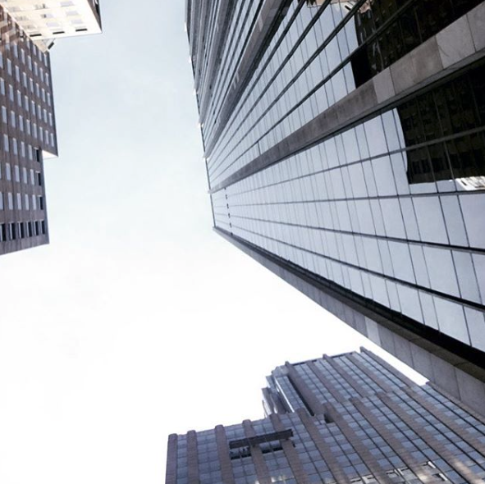
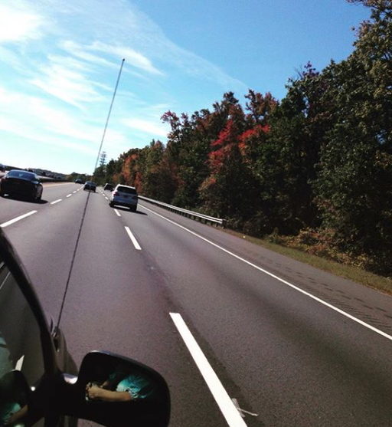
LINE
Line vary in width, length, direction, color and degree of curve.

Slide 3
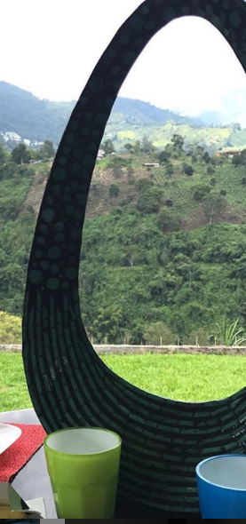
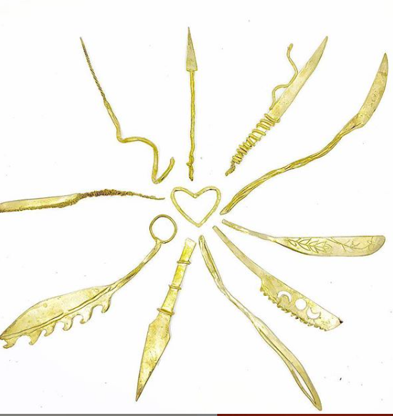
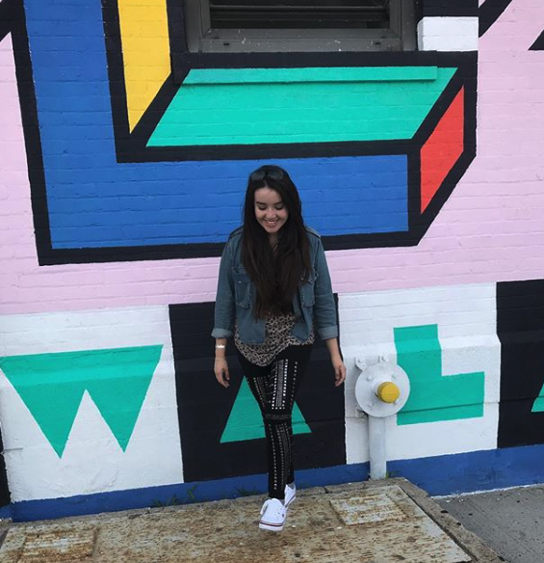
SHAPE
A shape can be geometric. A two dimentional figure created by connecting actual or implied lines.

Slide 4
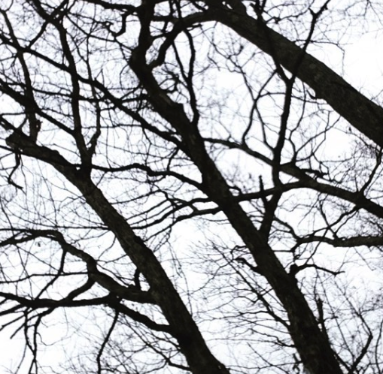
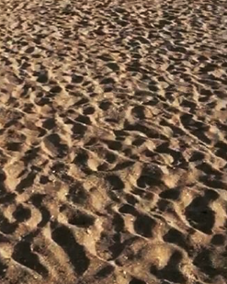
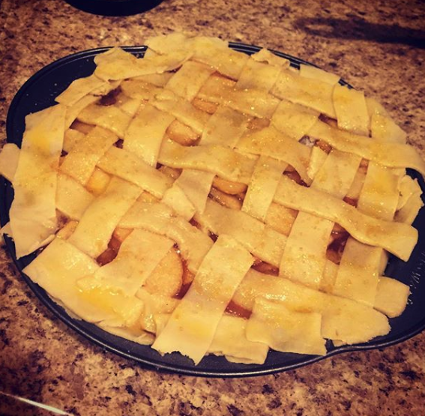
TEXTURE
The way a surface feels; rough, smooth, shiny

Slide 5
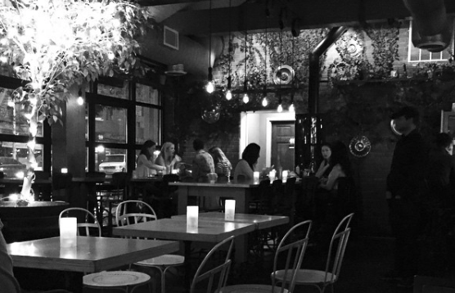
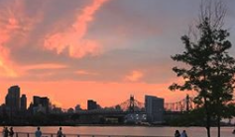
VALUE
The darkness of lightness of a color. Greyscale & Chromatic tints

Slide 6
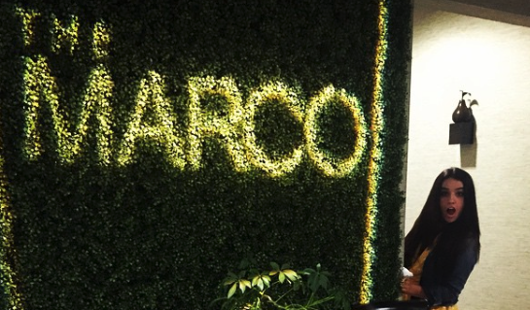
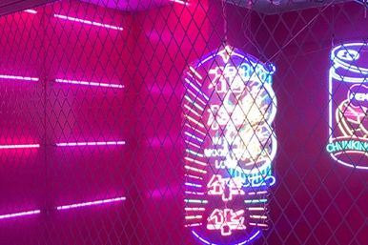
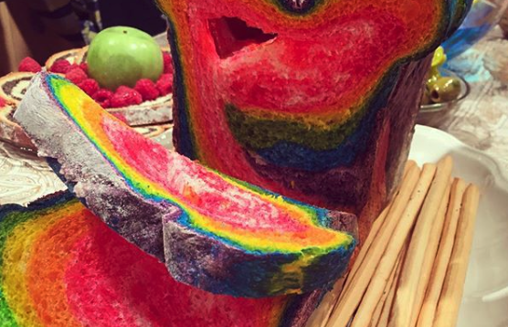
COLOR
Color is the appearance of an object. The following images are examples of Monochrome, analogous, & complimentary.

Slide 7
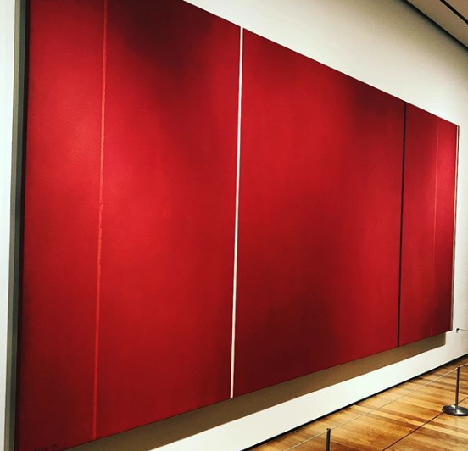
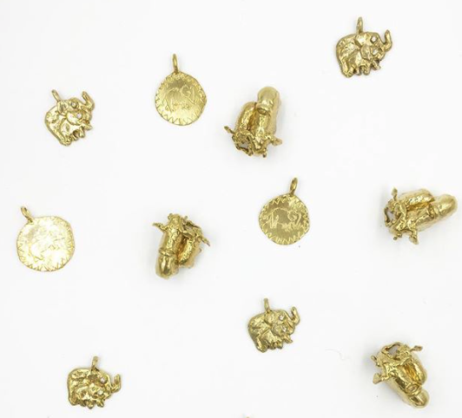
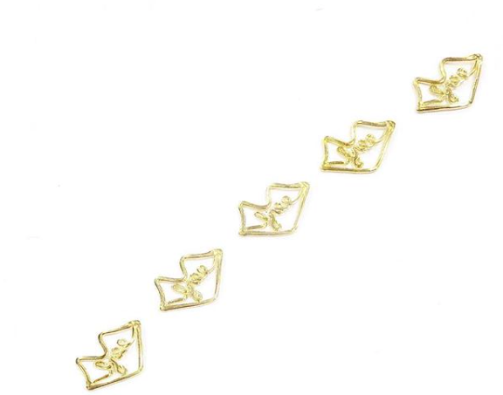
SPACE
An open or empty area above or between objects.

Slide 8
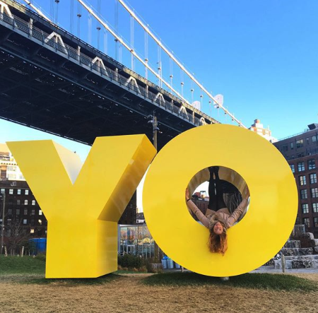
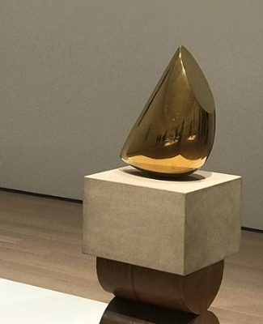
FORM
FORM
3-DIMENTIONAL OBJECT

