Slide 1
Gemination, Fusion, & Concrescence
By: Denise Ferreira & Tatsiana Maloila
Section: D230

Slide 2
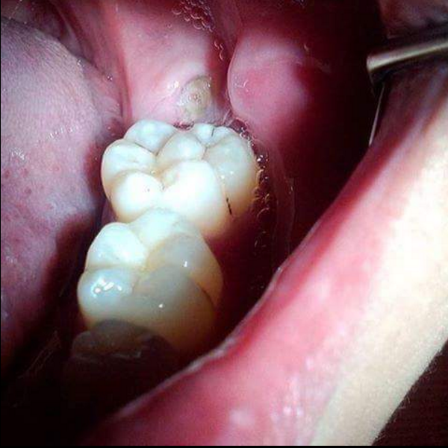
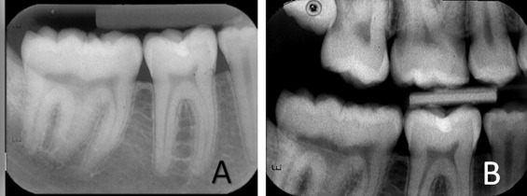
Gemination
Gemination: a dental abnormality describing a tooth that has one tooth bud which divides into two teeth at the crown with one root.

Slide 3
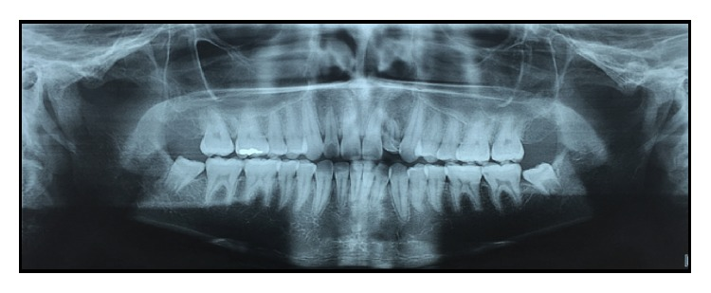
Gemination
Gemination occurs when a single bud splits and forms two teeth.
The tooth count remains normal when the anomalous tooth is considered as one.
If the tooth is small, a dentist may recommend leaving it alone. If the geminated tooth is so large that it causes problems in the mouth, it may need to be extracted.
Gemination in a maxillary lateral incisor

Slide 4
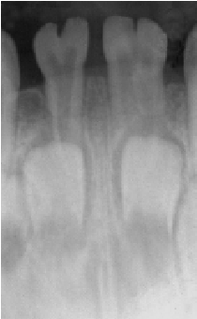
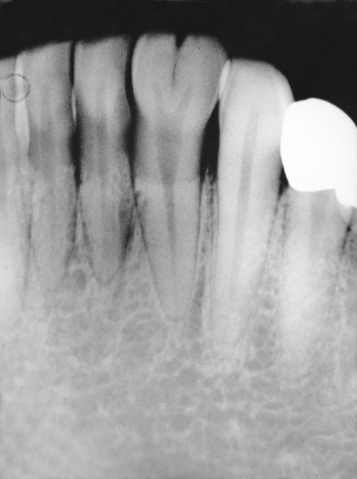
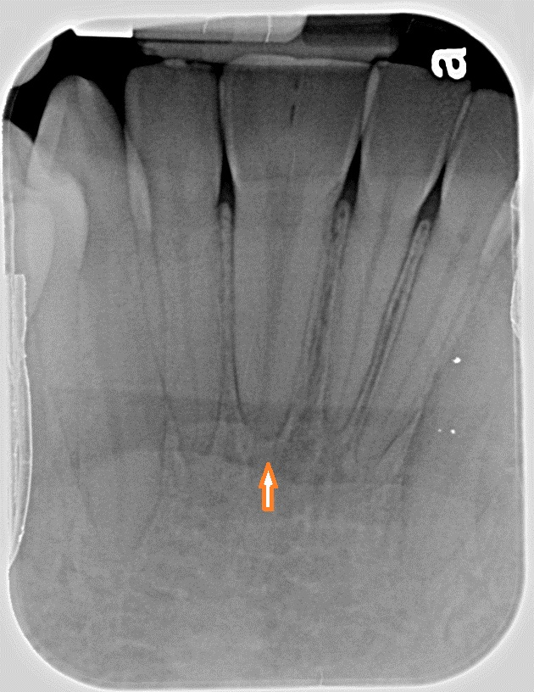
Gemination
Occurs mainly in the maxillary and mandibular incisors.
Seen in both primary and permanent dentitions.

Slide 5
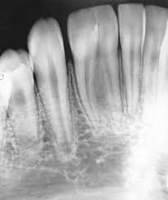
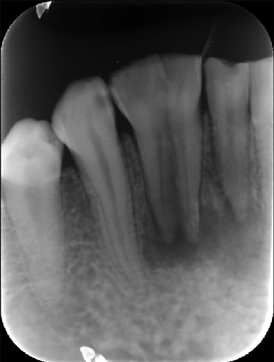
Fusion
Fusion: a dental abnormality describing a tooth that consist of a bond of two normally separated tooth germs.

Slide 6
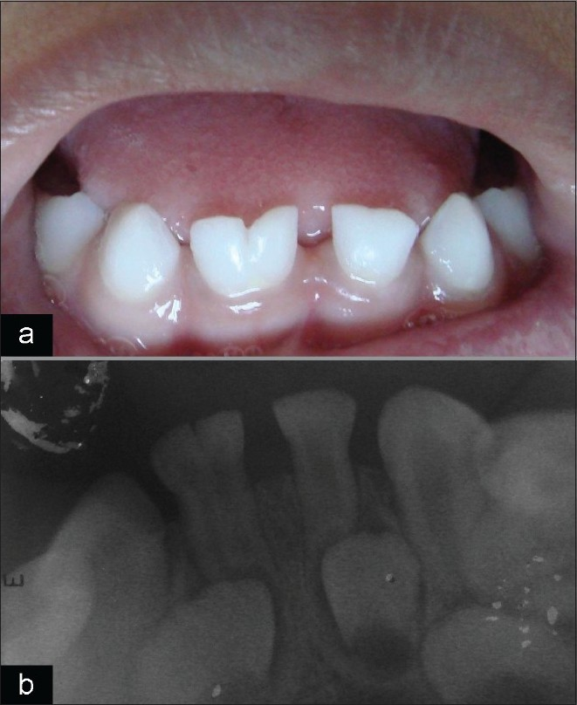
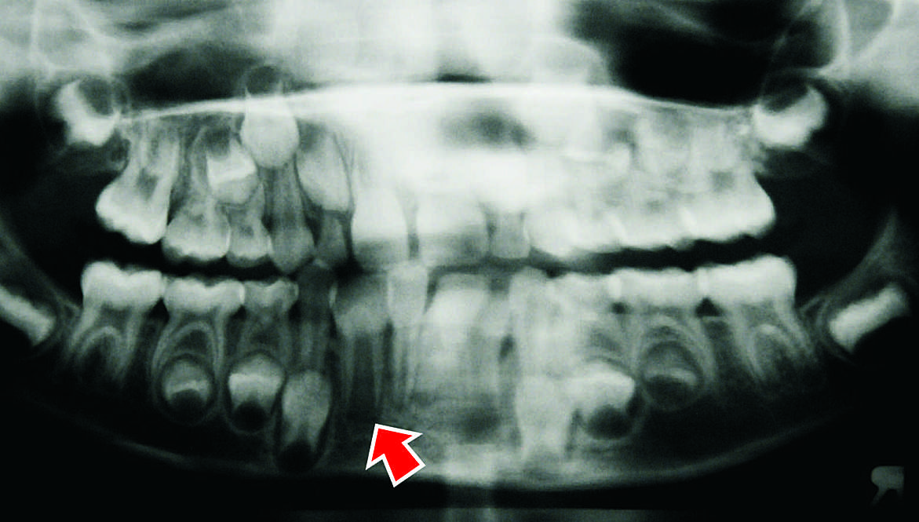
Fusion
Occurs in either dentition but mainly the primary dentition

Slide 7
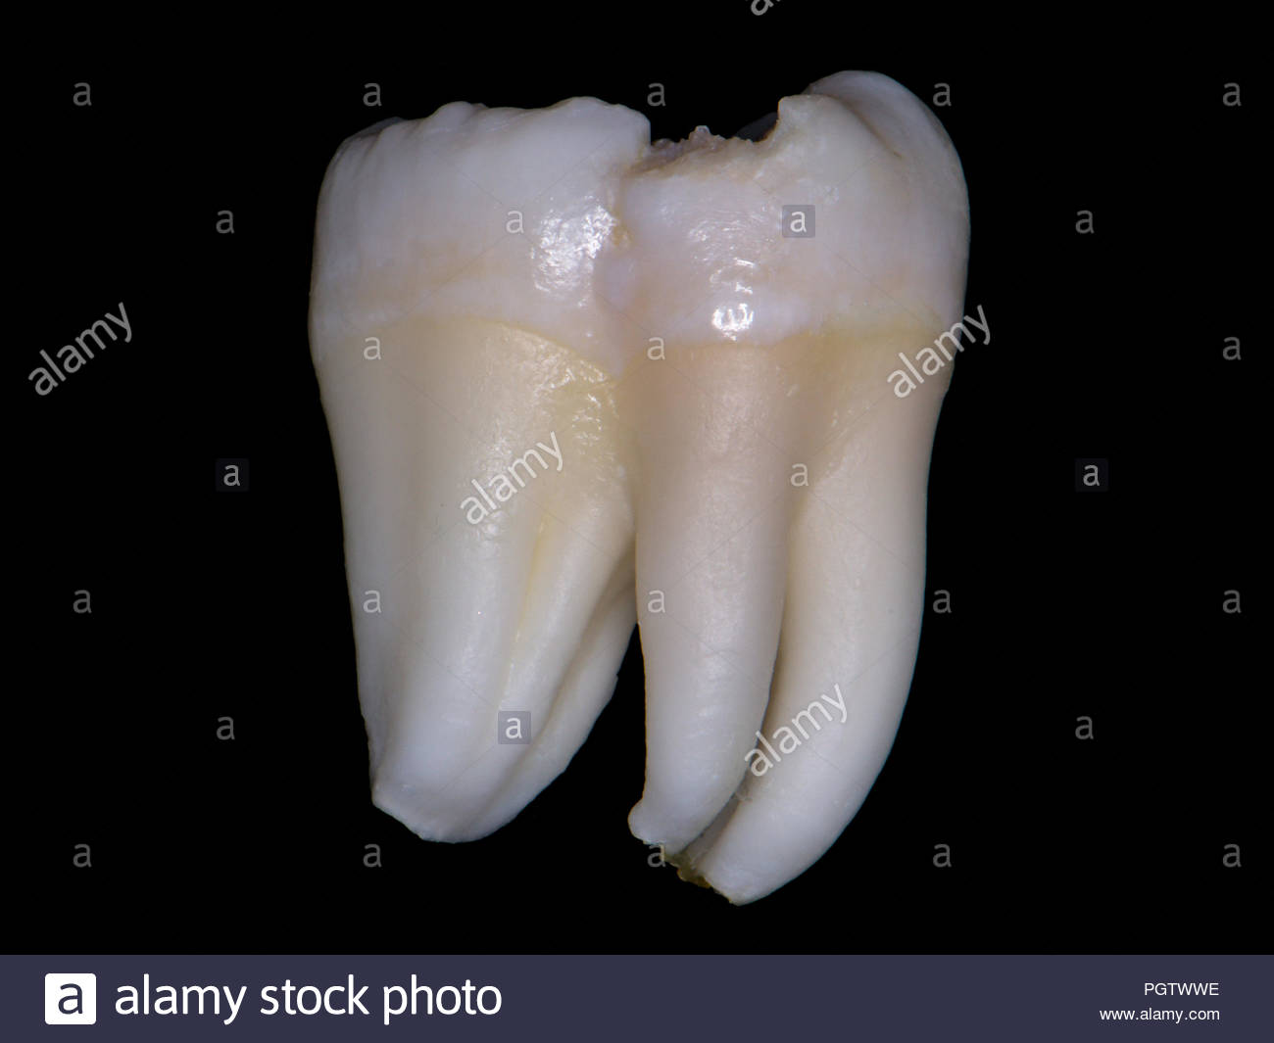
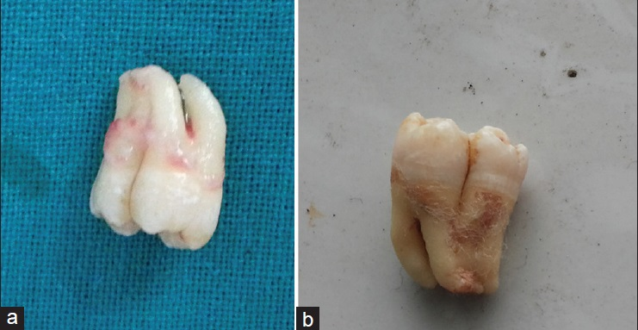
Fusion
Fusion causes a rare developmental anomaly shape of tooth

Slide 8
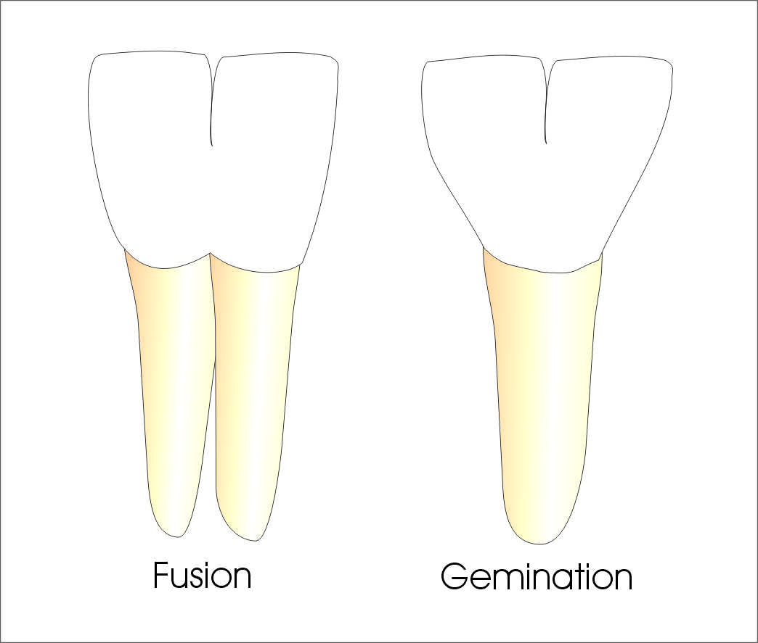
Fusion vs. Gemination
These are the most commonly encountered anomalies in dental practice, and distinction between the two is always challenging. Knowledge of the existence and morphology of the tooth will help the dentist in proper treatment planning.

Slide 9
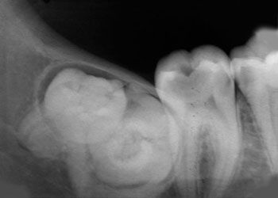
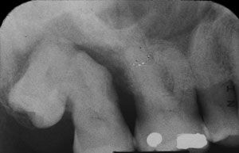
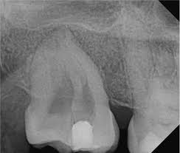
Concrescence
Concrescence: a condition where the cementum is overlying the roots of at least two teeth join together.
Occurs mainly with permanent maxillary molars

Slide 10
Concrescence
This condition may cause complications with a tooth extraction or root canal

Slide 11
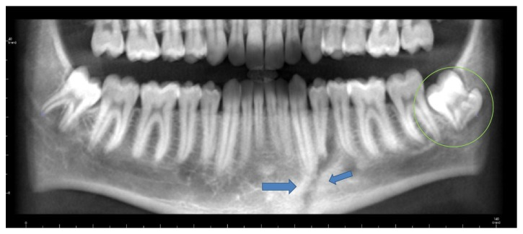
Concrescence
This isn't something that dental professionals see often, and it can go undetected if the teeth appear normal

Slide 12
Gemination, Fusion, & Concrescence

Slide 13
Sources
Gemination:
https://www.sciencedirect.com/science/article/pii/S2210261215005234
https://dentagama.com/news/tooth-gemination-in-dentistry
https://www.researchgate.net/figure/8-Gemination-of-a-mandibular-lateral-incisor-The-crown-has-a-groove-on-the-labial_fig4_235915603
https://rickwilsondmd.typepad.com/rick_wilson_dmds_blog/2014/02/gemination-of-teeth.html
https://www.researchgate.net/figure/Panoramic-radiograph-showing-fusion-of-teeth-71-and-72-gemination-of-tooth-81-and_fig5_6542434
www.hindawi.com/journals/crid/2016/3759021/
Fusion:
https://www.sciencedirect.com/topics/medicine-and-dentistry/endodontic-surgery
http://www.drjjournal.net/article.asp?issn=1735-3327;year=2016;volume=13;issue=1;spage=80;epage=84;aulast=Aydemir
https://askanorthodontist.com/braces/what-is-tooth-fusion-gemination/
http://www.jisppd.com/article.asp?issn=0970-4388;year=2011;volume=29;issue=1;spage=50;epage=52;aulast=Tewari
https://www.alamy.com/wisdom-tooth-lower-left-molar-extra-large-two-tooth-in-one-fusion-gemination-or-concrescentio-image216906074.html
http://www.indjos.com/article.asp?issn=0976-6944;year=2015;volume=6;issue=1;spage=26;epage=29;aulast=Kumar;type=3

Slide 14
Sources
Concrescence:
https://www.colgate.com/en-us/oral-health/basics/mouth-and-teeth-anatomy/what-is-concrescence--
https://www.nature.com/articles/4813191
https://www.nature.com/articles/sj.bdj.2013.438
https://pdfs.semanticscholar.org/d399/d22645dc9163a3cf103d44028a54ccc473b9.pdf
www.hindawi.com/journals/crid/2016/8597872/

