Slide 1
Solar Decathlon
Breno bondarenko Costa
Arch 3630
Prof. Aptekar & Prof Azaroff

Slide 2
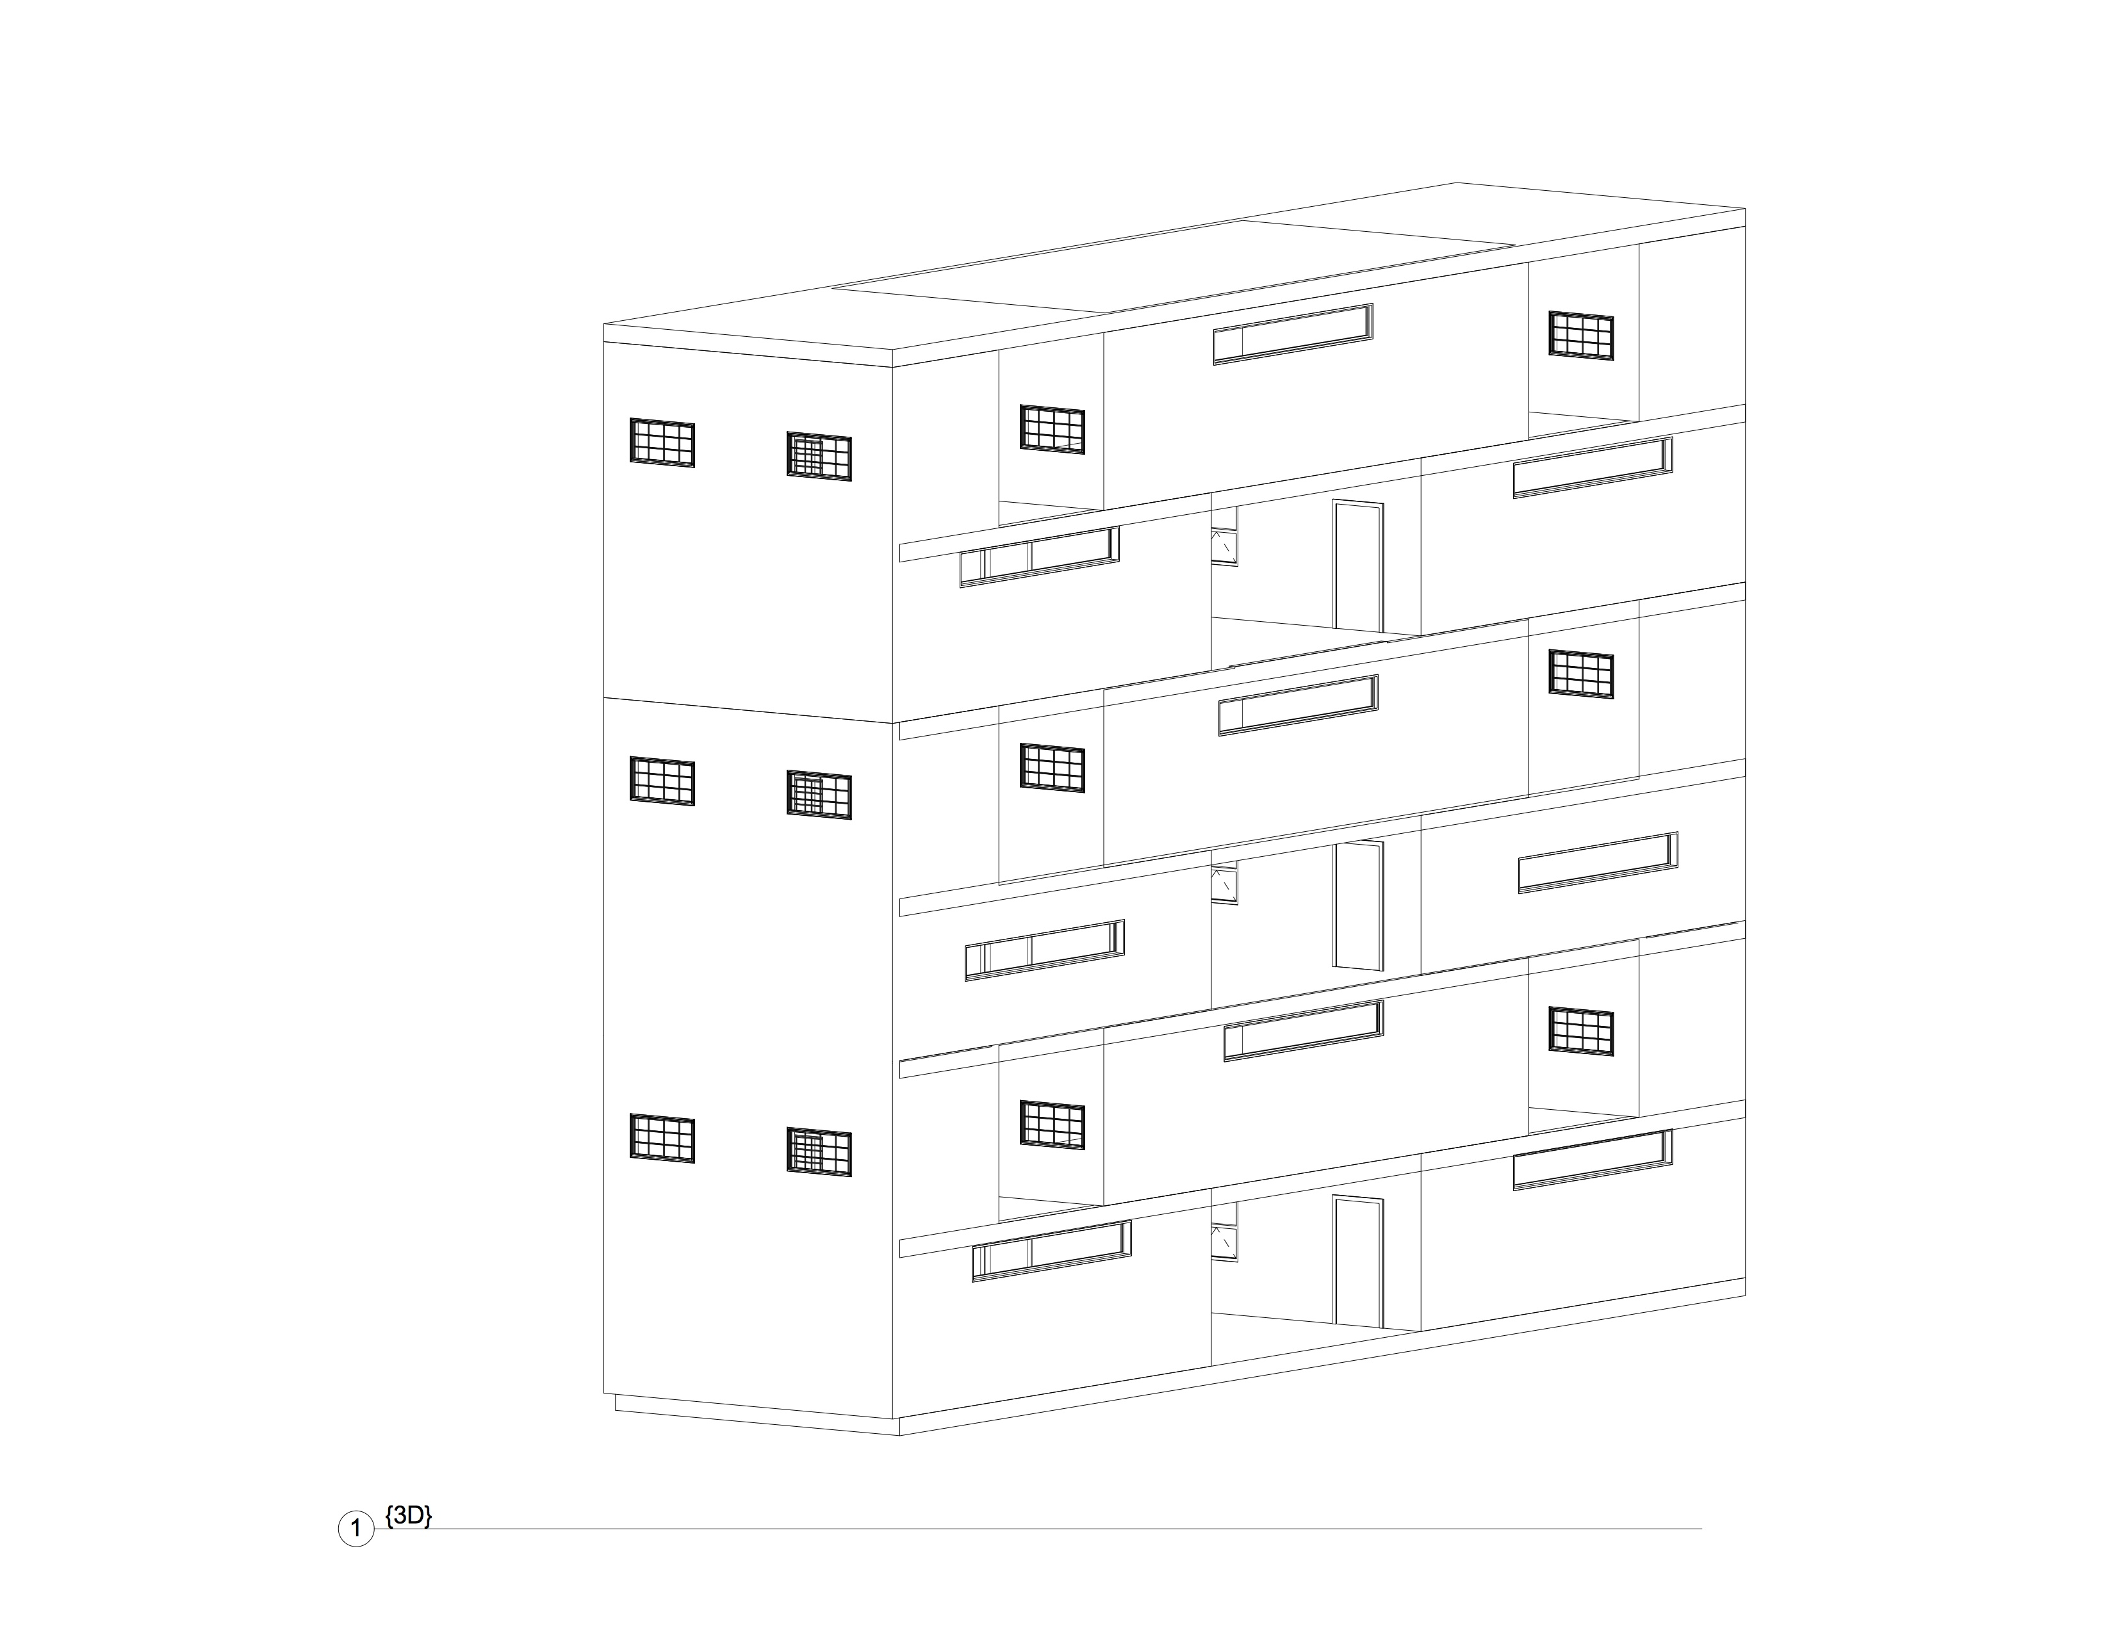
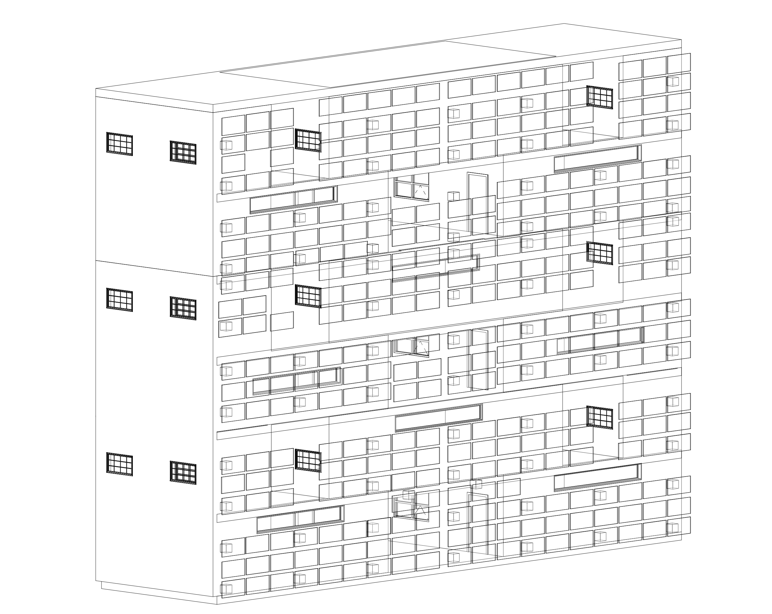
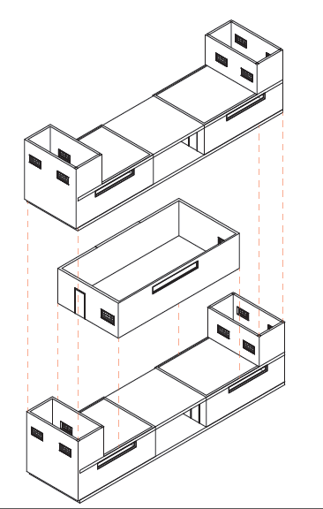
Modular Façade
Façade with panels
Façade without panels

Slide 3
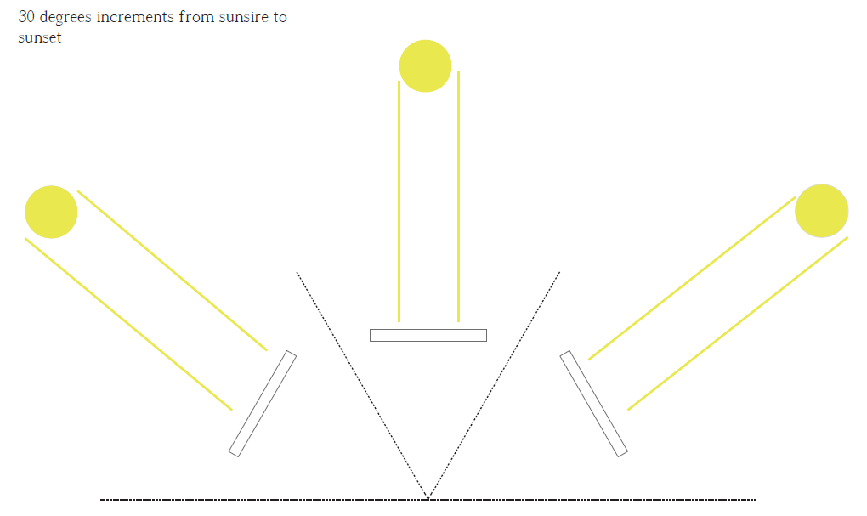
Sunrise-To-Sunset

Slide 4
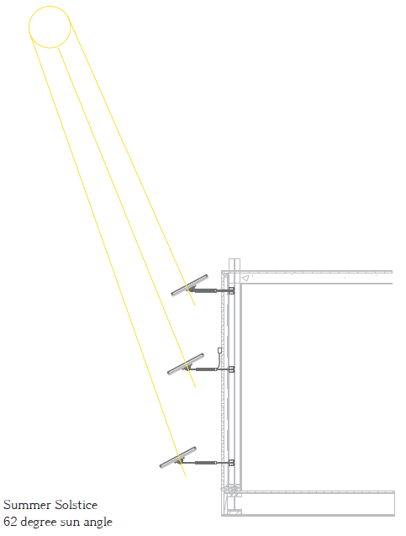
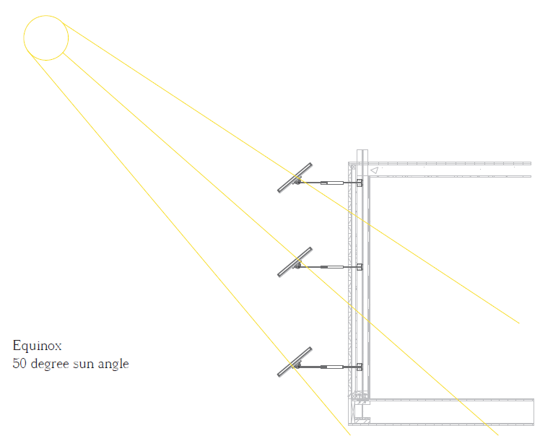
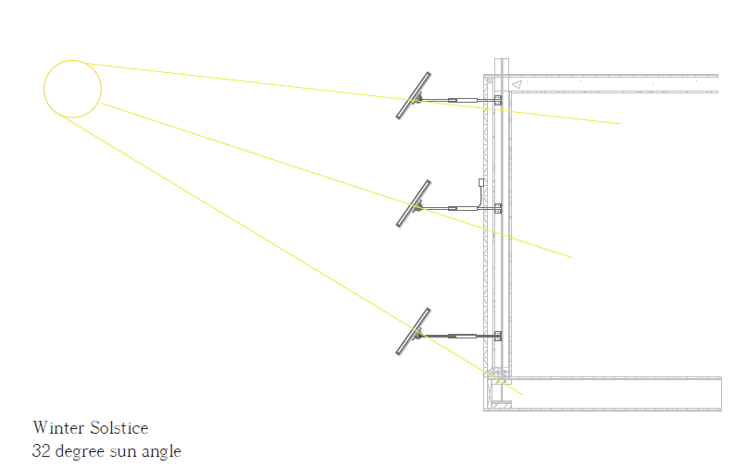
Sun Angles –Sections

Slide 5
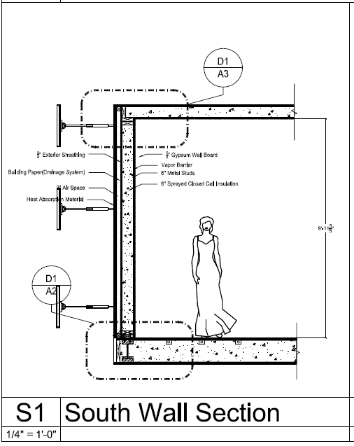
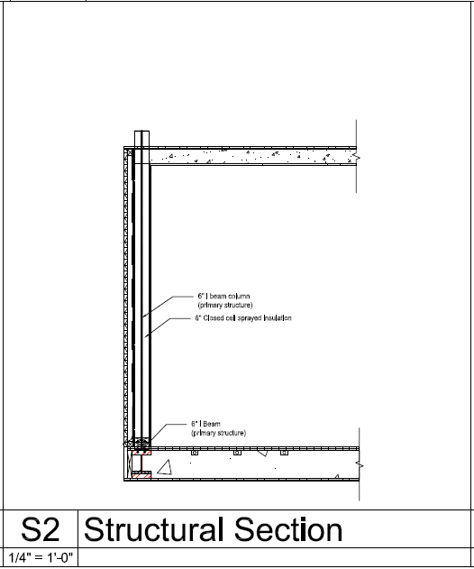
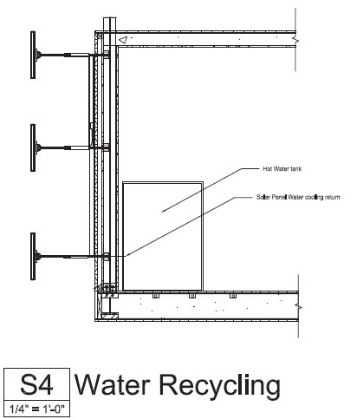
Wall Sections

Slide 6
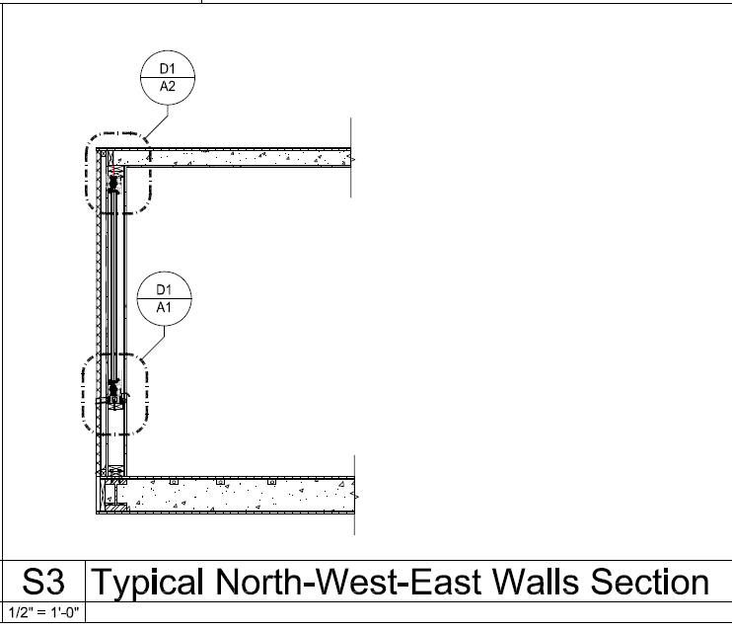
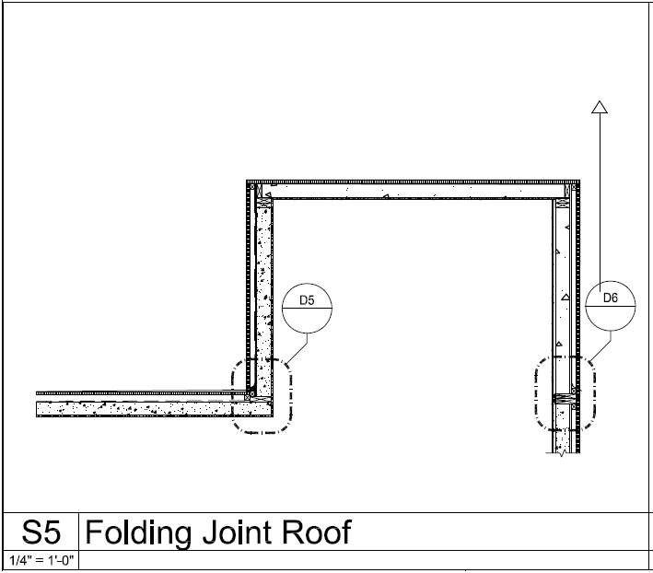
Wall Sections

Slide 7
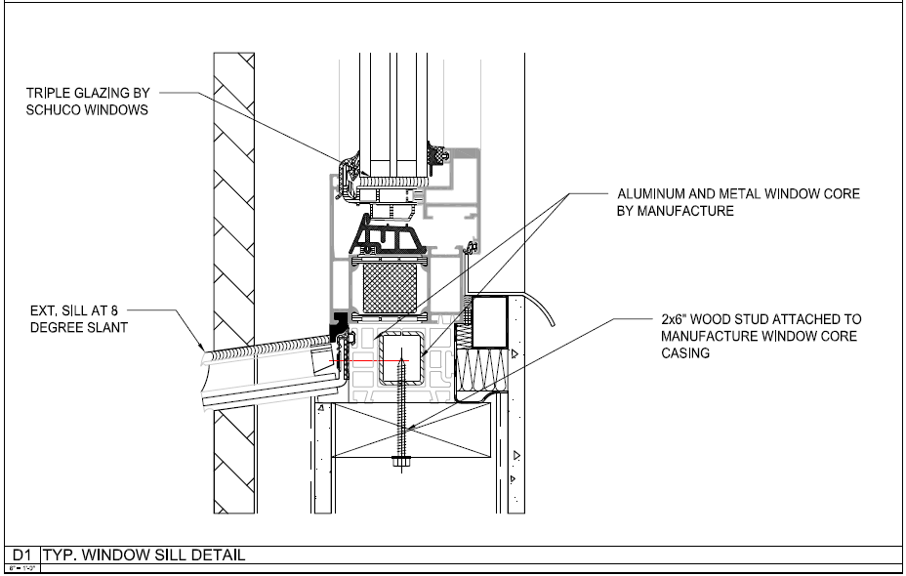
Wall Details

Slide 8
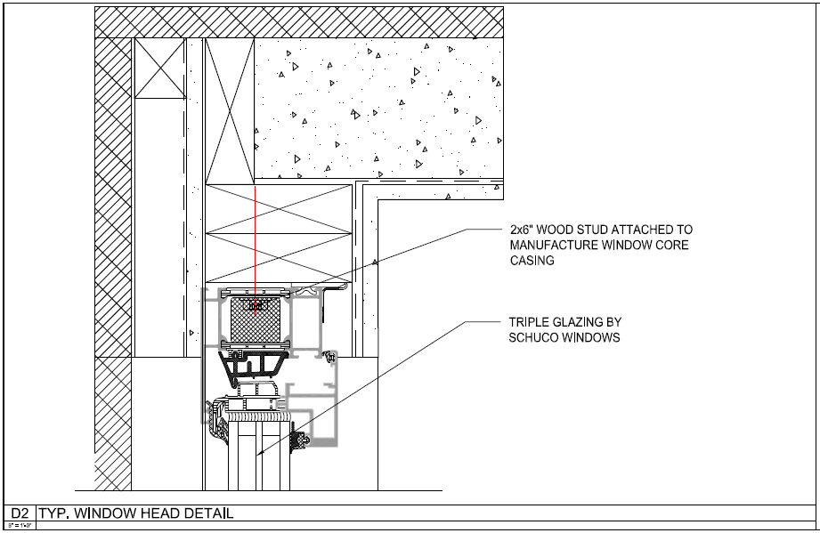
Wall Detail

Slide 9
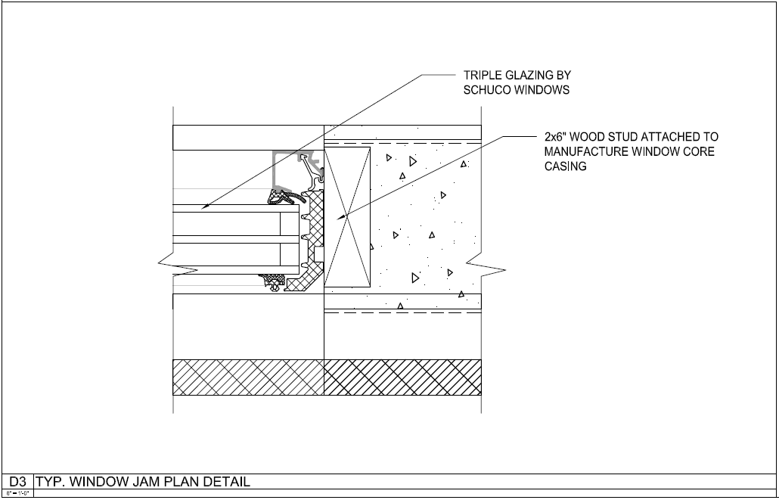
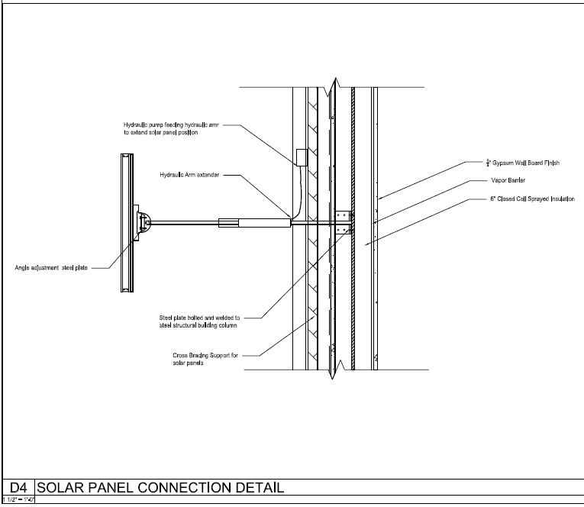
Wall Details

Slide 10
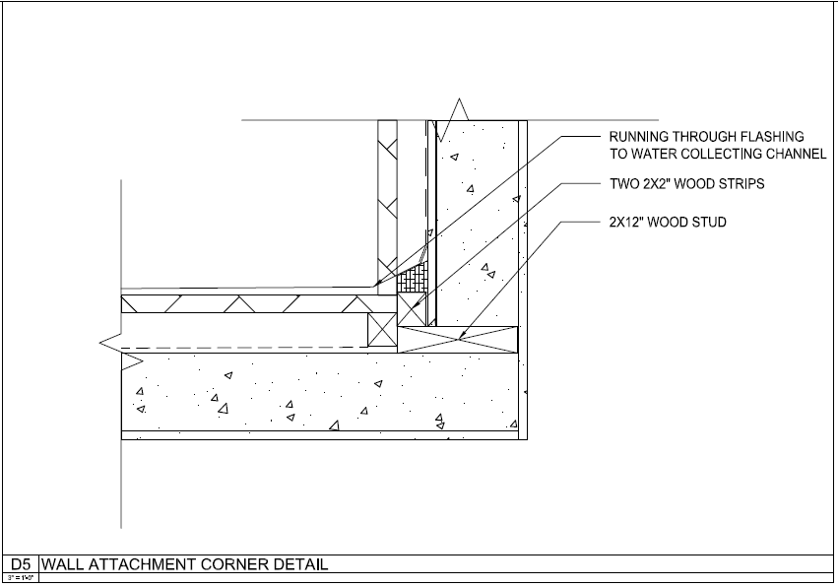
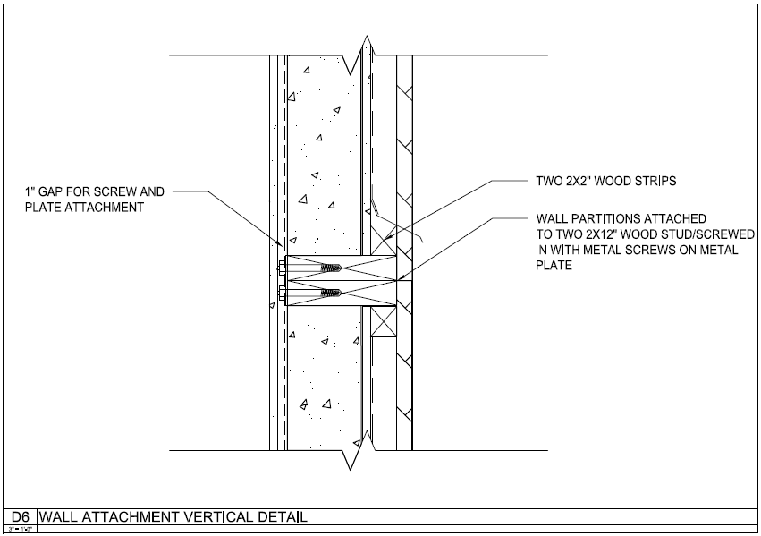
Wall Details

Slide 11
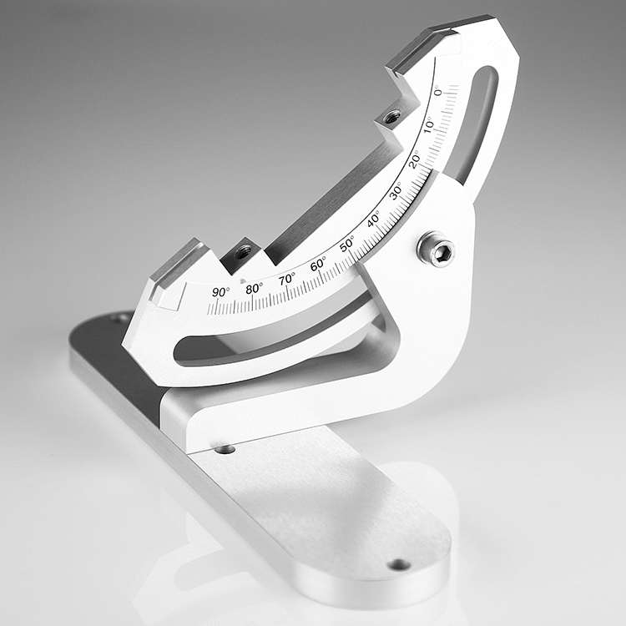
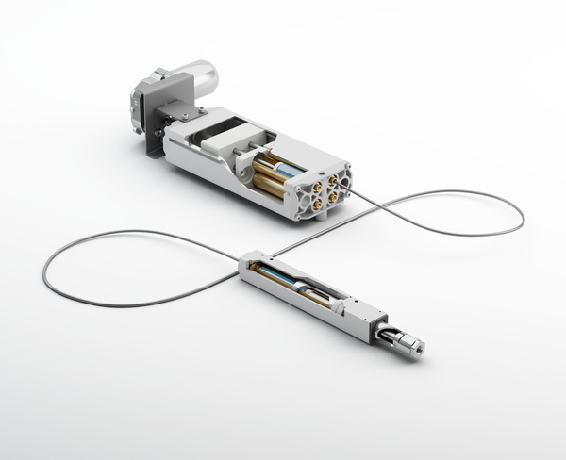
Solar Panel Connections Attachment

Slide 12
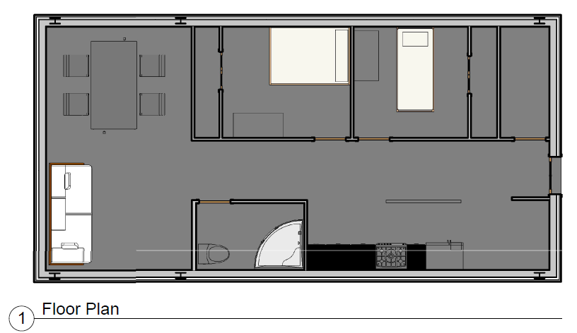
Partial Plan

Slide 13
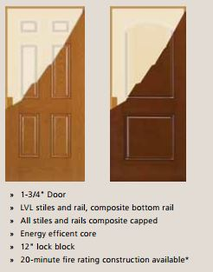
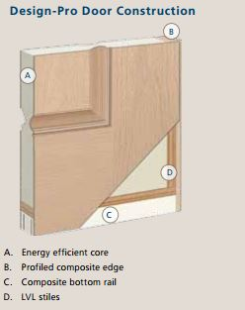
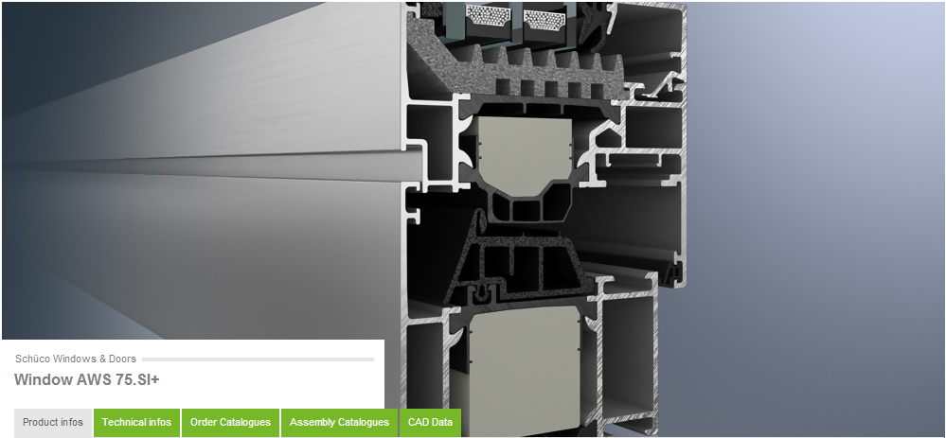
Window and Door Assembly

Slide 14
References
http://www.schueco.com/web/us/architekten/windows_and_doors/products/windows/aluminium/schueco_aws_75_si_plus/http://www.schueco.com/web/us/architekten/windows_and_doors/products/windows/aluminium/schueco_aws_75_si_plus/
http://www.jeld-wen.com/catalog/exterior-doors/architectural/fiberglass/all-panel?related=true

