Slide 1
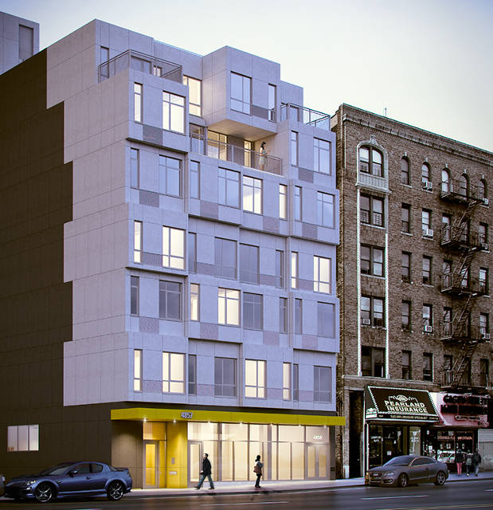
Modular Apartments

Slide 2
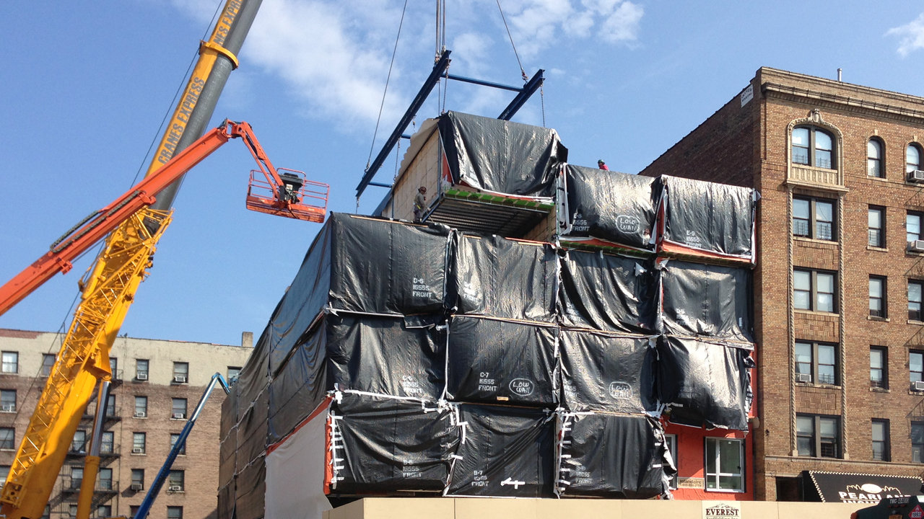
The Stack
A seven-story moderate-income residential project by Gluck+ architects, champions an exciting modular building method, one with a rich heritage but that has too rarely been implemented.
The 50-foot-wide, 150-foot-deep lot is sprinkled with a few cranes and what look like trailers but are actually building modules. From across the street, pedestrians stop in their tracks as each of the 45-foot-long oblongs seemingly takes flight. They’re slotted into place with some grace, at a pace of four a day. All of the 56 boxes are expected to be installed by next week, followed by three months of “zip up” before the first occupants move in in October. Including off-site assembly, the building will take a mere 10 months to finish--six months less than would’ve been required using traditional construction methods.

Slide 3
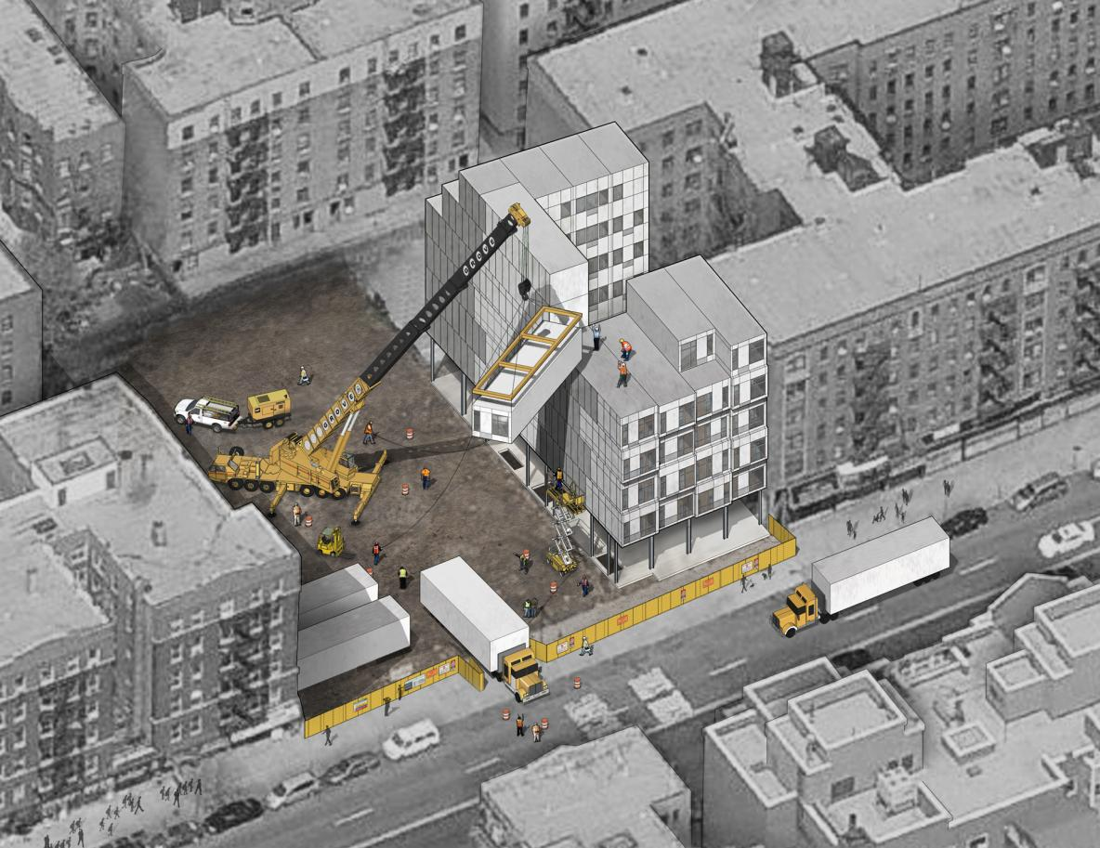

Slide 4
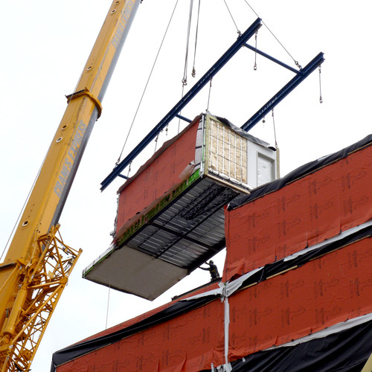
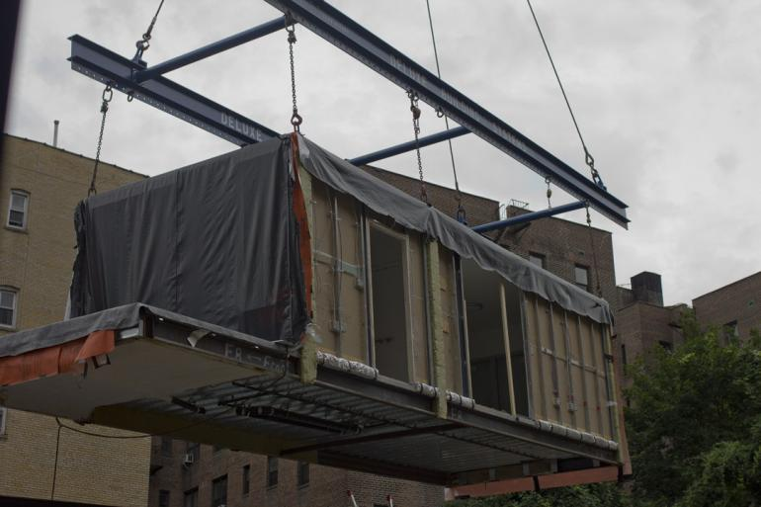
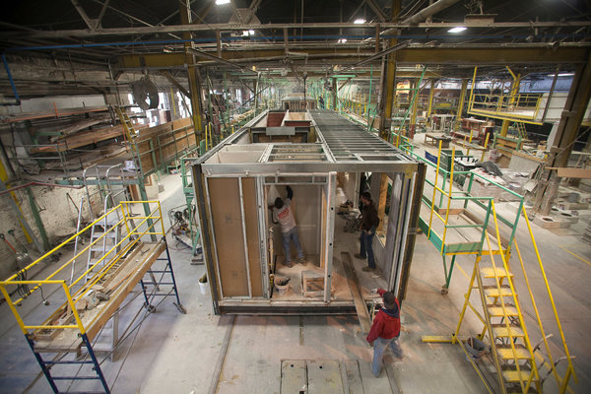

Slide 5
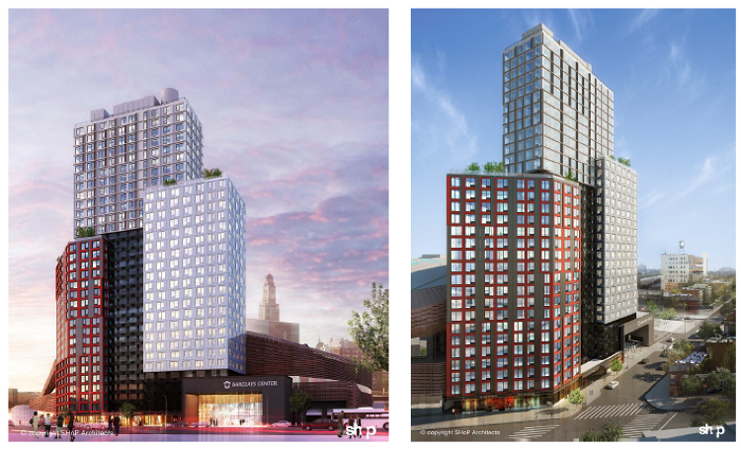
B2 Tower
Nowhere is this scenario more promising than in Brooklyn's Navy Yard, an industrial park where one factory is churning out extremely precise, 450- to 950-square-foot apartments that will click and seal together to form the largest modular high-rise building in the world. At 32 stories of stacked modular apartments, developer Forest City Ratner's "B2" building will surpass in height the 24-story student dorm erected in Wolverhampton, England, in 2009, then hailed as the tallest modular building of its kind. This past month, Co.Exist got a look inside at the reportedly faster and more efficient building process that could shape the cities we live in for years to come.

Slide 6
Another key feature of FCR'S code is how the mods will actually fit and join together. To secure the building from winds and seismic shifts, it will feature both a steel brace and a conventional foundation--a hybrid of modular and traditional construction methods. But a more radical innovation takes place in between the mods, when they are joined together by rubber sealant, like the connections between subway cars. The sealant goes on the façade in one of the final steps before the mod is trucked out. The apartments, meanwhile, require zero welding.

Slide 7
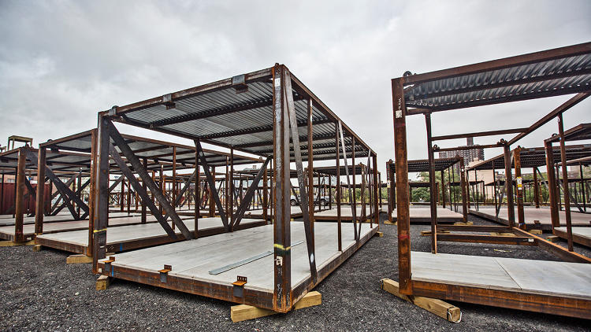
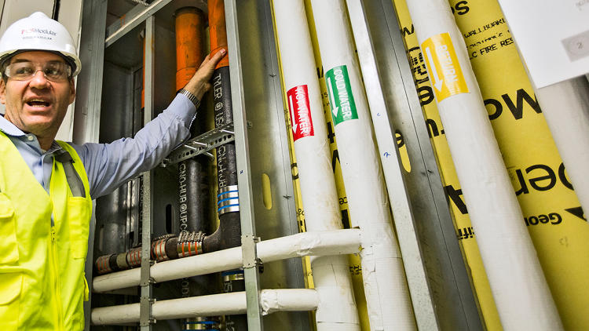
A view of the metal chassis in the Brooklyn Navy Yards.
The only construction that occurs on-site will be the plumbing connections.

