Slide 1
Modular Home Study
By Sterling M. Adames

Slide 2
Modular vs. Manufactured Homes
Modular Homes
Manufactured Homes
Modular homes are residences constructed entirely in factories and transported to their sites on flatbed trucks.
Wind and rain do not cause construction delays or warp building materials. In addition, modular homes:
must conform to the same local, state and regional building codes as homes built on-site;
are treated the same by banks as homes built on-site. They are easily refinanced, for example;
follow the same market trends as site-built houses;
must be structurally approved by inspectors;
can be of any size, although the block sections from which they are assembled are uniformly sized;
are often more basic than homes built on-site, but they tend to be sturdier;
are highly customizable. Design is usually decided by the buyer before construction has begun; and
generally take eight to 14 weeks to construct. Differing from a site-built home, the foundation can be dug at the same time that the house is being constructed. From Modular vs. Manufactured Homes - InterNACHI http://www.nachi.org/modular-manufactured-homes.htm#ixzz2wPdC09mj
The term “manufactured home” is the most recent label for what were once called “mobile homes” or “trailers.” They are relatively inexpensive, small, and are held to less stringent standards than modular and site-built homes.
They are available in three sizes that escalate as follows: “single-wide,” “double-wide” and “triple-wide.” In addition, manufactured homes:
conform only to Housing and Urban Development (HUD) code. Some homes contain a red tag that confirms that the unit was manufactured in compliance with this code;
are inspected, but do not have to be structurally approved by an inspector;
are manufactured in sections at factories;
are never more than one story;
do not have a permanent or conventional foundation;
tend to lose value over time because they are difficult to expand or improve;
are transported to the site on their own wheels;
are transported on steel chassis that are never removed;
are often placed on property owned by others, such as public land that is leased by the homeowner;
are treated as a separate lending category from modular and on-site built homes; and

Slide 3
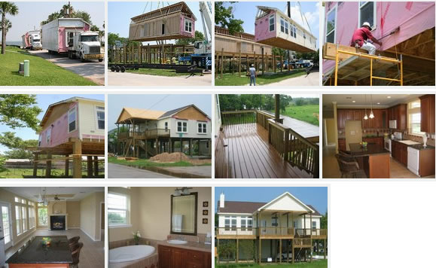
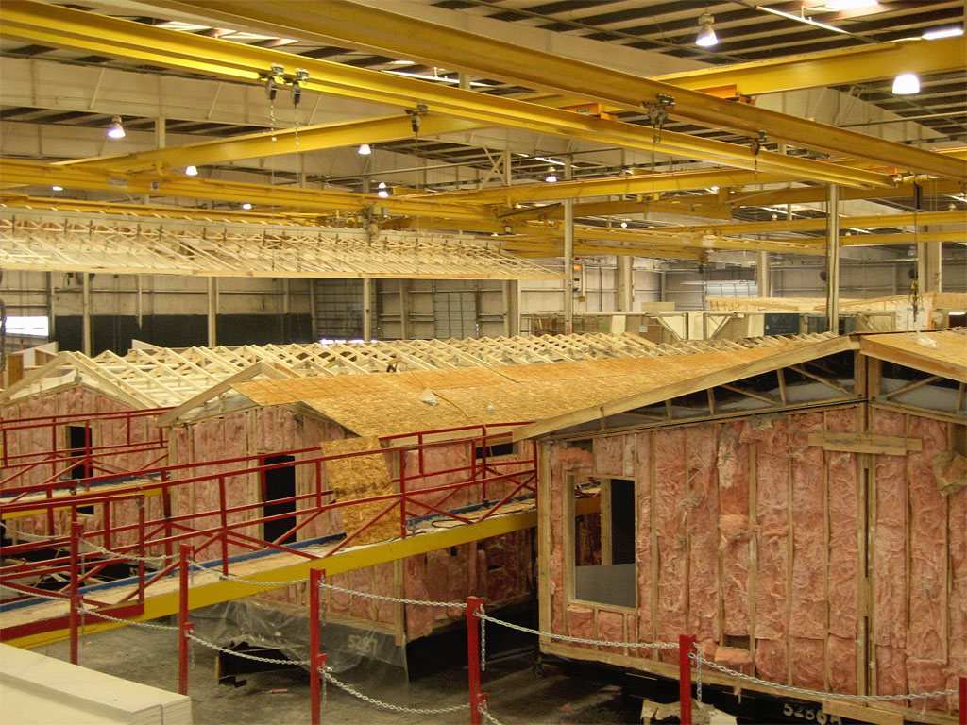
Modular Home Building Process
http://www.youtube.com/watch?v=zvcHZp4Nkok

