Slide 1
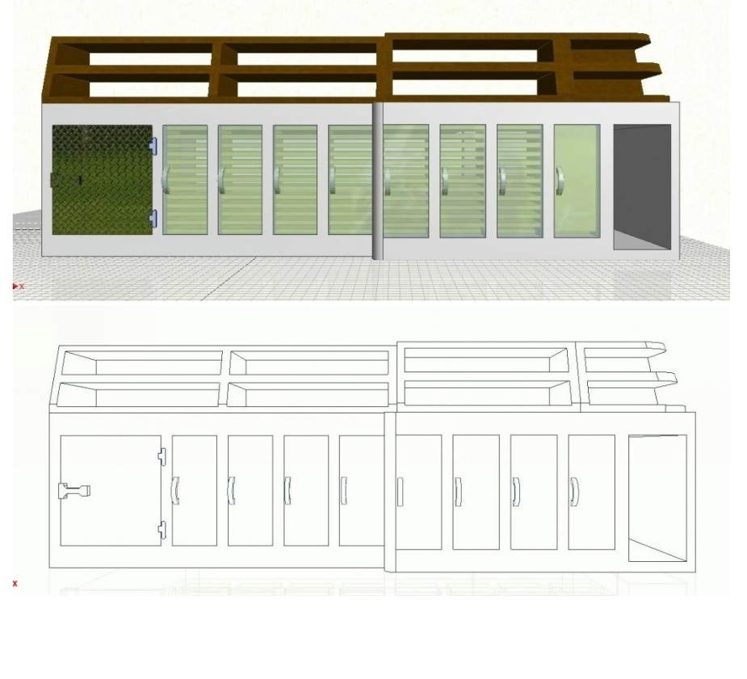
Custom & Aesthetically Pleasant Carpentry
Final Project De la Cruz Construction
2322
December 9, 2013

Slide 2
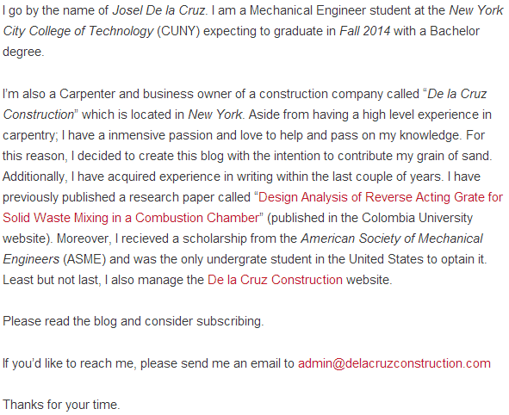
Bio (About the Blogger)

Slide 3
Mission Statement
The strategic mission of Custom & Aesthetically Pleasant Carpentry is to provide exceptional services in the interest of educating, helping and inspiring all readers by consistently uploading potential content pertaining to the carpentry field with especial attention to custom-made and aesthetic projects

Slide 4
Typical Single Post
Narrative: Built my first office (from scratch)
Overall and detailed description of the topic
Project duration
Pros and cons of the materials, objects or techniques used.
Explanation of the differences and the result of each methods
External links
Post

Slide 5
Typical Blog Series
Storefront Renovation of a Mini Market
Materials used with specifications
Step by step process
Slideshow (pictures) showing the process development
An external link to keep on reading the following post of the series
Gave credit to whom credit is due
Post

Slide 6
Thank you for your time!
Thanks for listening !!
If interested, please subscribe to my blog:
http://openlab.citytech.cuny.edu/delacruzconstruction

