Slide 1
New York City College of Technology Department dental hygiene department Case presentation
Danna Colon

Slide 2
Patient Profile
Ms. C is a 23 year-old Asian female.
The patient’s status is single, unemployed, and lives and the city.
Her last dental and hygiene visit was in 2018.
The patient states that she uses a manual toothbrush twice a day. She flosses every 2 days and rinses every 2 days with Listerine. The patient was instructed to use electric toothbrush twice a day and rinse with Listerine antiseptic twice a day.

Slide 3
Health history overview
Blood Pressure: 125/94, Pulse:94, ASA: II
Medical Condition:
Hypertension
Current Medication:
Amlodipine: 5mg/day

Slide 4
Hypertension
According to the American Hearth Association ”High blood pressure (HBP or Hypertension) is when your blood pressure, the force of your blood pushing against the walls of your blood vessels, is consistently too high.”
HBP harm the heart and blood vessels by “making them work more and less efficiently” (American Heart Association, 2016).
Force and friction cause by HBP overtime damage the inside of the arteries. As a result, LDL (bad) cholesterol forms plaque along the walls of the arteries, which lead to atherosclerosis.

Slide 5
Hypertension
High blood pressure (hypertension) is knowns as a “silent killer,” and with time as the accumulation of plaque in the arteries and the damage increases, further harms can result in the rest of your body. The damage overtime can lead to conditions such as arrhythmia, heart attack and stokes.
Reference:
https://www.heart.org/en/health-topics/high-blood-pressure/the-facts-about-high-blood-pressure/what-is-high-blood-pressure

Slide 6
Amlodipine
Amlodipine is a calcium channel blocker use in the treatment of hypertension.
Amlodipine is associated with gingival enlargement, and this condition is managed by scaling and root planning.
Reference:
https://www.ncbi.nlm.nih.gov/pmc/articles/PMC3118083/

Slide 7
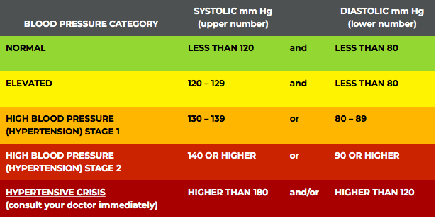
Dental Hygiene Management
As per the American Hearth Associations they are 5 blood pressure categories.
We can only treat patient in categories 1 – 4, if the patient has a hypertensive crisis, a medical consultation is need it immediately.
https://www.heart.org/en/health-topics/high-blood-pressure/understanding-blood-pressure-readings

Slide 8
Comprehensive Assessments

Slide 9
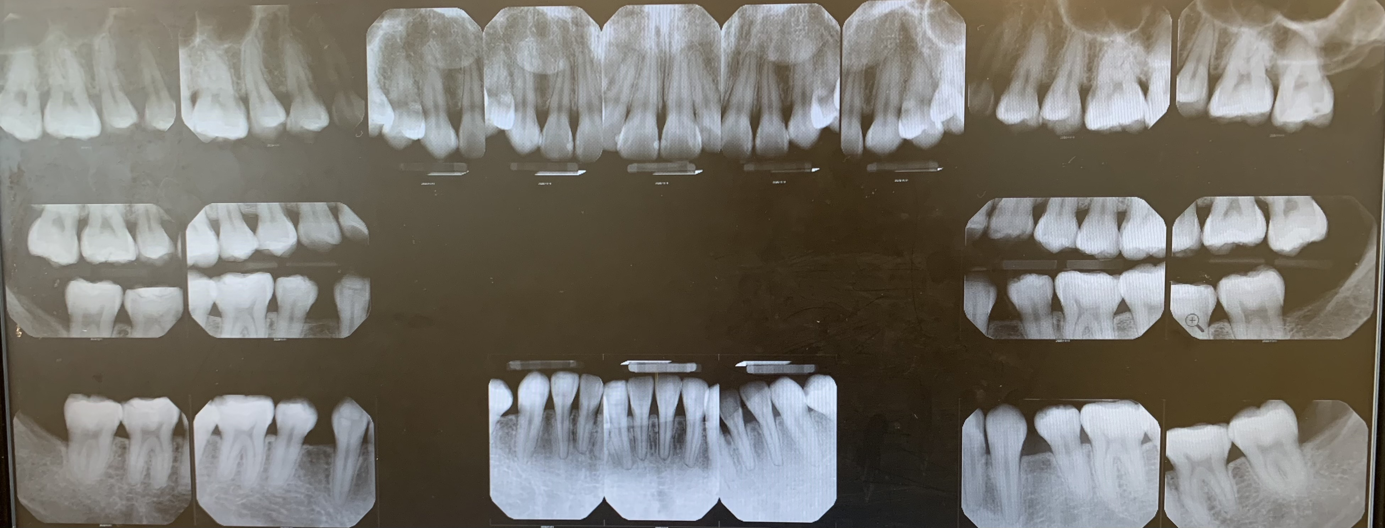
Radiographs
Radiograph shows evidence of generalized horizontal bone loss and localized vertical bone loss on maxillary posteriors. Teeth # 24 and 25 have shorter root,
Radiographic evidence of suspicious lesions on #9-M and #18-M.
Composite restoration on #-2O, #3-O, #4-O, #5-O, #7-M, #8-MD, #9-MD, #10-M, #11-OD, #18-OB, #19-OB, #20-O, #29-O, #30-OB and #31-OB.

Slide 10
Summary of clinical findings
Extraoral/Intraoral Findings: Scalloped tongue, bilateral hyperpigmentation of the tongue and enlarged tonsils.
Occlusion: Bilateral class III occlusion, overjet/overbite – edge to edge.
Deposits: Generalized heavy subgingival calculus deposits on all quadrants. Localized moderate supragingival calculus deposits on lower interiors lingual.

Slide 11
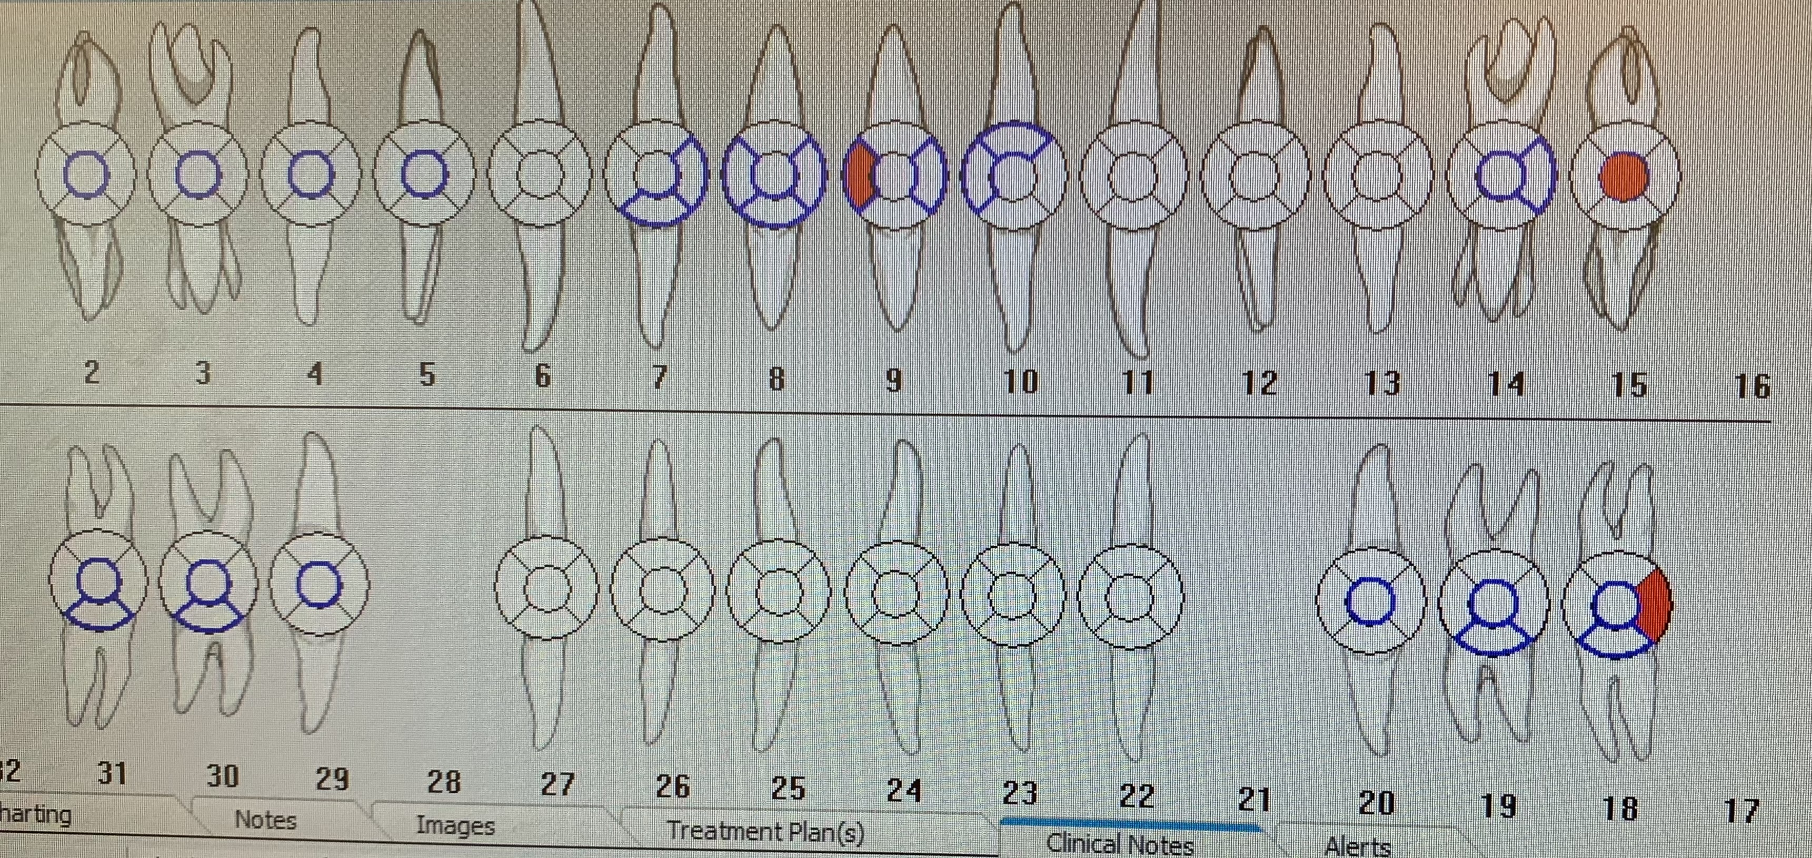
Dental Charting
Composite restoration on #-2O, #3-O, #4-O, #5-O, #7-M, #8-MD, #9-MD, #10-M, #11-OD, #18-OB, #19-OB, #20-O, #29-O, #30-OB and #31-OB.
Suspicious carious lesions on #9-M, #15-O, and #18-D.

Slide 12
Gingival description and periodontal status
Gingival Description: Generalized pink gingiva and roll margins. Generalized marginal redness, lost of stippling on maxillary anterior lingual, the gingiva is soft.
Periodontal Status: Stage I/Grade B based on clinical and radiographic evidence.

Slide 13
Periodontal charting

Slide 14
Dental hygiene diagnosis
Periodontal Diagnosis:
Stage I/Grade B
Radiographic evidence of generalized gingival 2mm recession, generalized horizontal bone loss and localized vertical bone loss.
Generalized probing depth readings of 2-5 mm on all quadrants.
Generalized heavy subgingival calculus deposits on all quadrants.

Slide 15
Dental hygiene care plan
Visit One:
Pi/OHI: Power toothbrushing. Although Ms. C reported using a manual toothbrush; she mention having a new electric toothbrush at home.
Exposure of digital radiograph FMS.
Visit Two:
OHI: Listerine antiseptic.
Scale LRQ and URQ, with pain management Oraqix.
Visit Three:
Scale ULQ and LLQ, with pain management Oraqix. Engine polish and apply fluoride varnish.

Slide 16
Implementation
Visit One:
FMS digital radiograph was exposed. Findings were discussed with the patient.
The patient was instructed to used her electric toothbrush and Listerine antiseptic rinse twice a day.

Slide 17
Implementation
Visit Two:
Pt reported no changes on medical history, no recent hospitalizations/surgeries. BP was 122/83, P:91. IO: WNL.
Gingival statement: generalized pink gingiva, with no stippling on maxillary anterior lingual, papilla is rolled. Generalized moderate marginal inflammation.
OHI: start using power toothbrush, and continue using Listerine 2x a day. Professor recommended to increase frequency of flossing.
Debridement of UR and LRQ, with pain management Oraqix 2.5%. Surfaces that need re-scaling on the buccal area #3-MD, #4-D, #5-M, #-6M, #7-M, #25-D, #26-D, #30-M, #31-MBD, and on the lingual #6-D, #25-M, #26-M and #27M.

Slide 18
Implementation
Visit Three:
Temperature: 97.1 Covid questionnaire reviewed verbally, not previously tested and reports no known exposure or symptoms. Pt reported not changes on medical history. BP was 137/91, P:92 1st reading, and 2nd reading after 25 min and water intake was BP:144/105, P:82.
Pt dismissed due to hypertension type II and advised to follow up with physician for consultation. Must present medical clearance before returning to clinic as a patient.

Slide 19
Implementation
Visit Four:
Pt reported no changes on medical history, no recent hospitalizations/surgeries. BP was 122/96, P:86. Covid screening performed, temperature: 97.0
IO: Moderate marginal inflammation on LRQ and URQ, still present. Also bleeding upon exploring. Residual calculus on #3-MD, #4-M, #5-M, #6-M, #7-M, #8-MD, #25-D, #26-D, #30-M, #31-MBD, and on the lingual #6-D, #25-M, #26-M, and #27-M.
Scaled LRQ and URQ. Applied oraqix 5% on LRQ and applied 1 capsule of carbocane plane (PSA and MSA) on the URQ. ½ capsule of carbocane plase, PSA ULQ. Patient experience pain radiating up and under the eye, and than felt heaviness which remained until end of session.

Slide 20
IMplementation
Visit Five: Pt reported no changes on medical history, no recent hospitalizations/surgeries. BP was 120/88, P:88. Covid screening performed, temperature: 97.0
Inflammation reduced on previously scaled areas (URQ and LLQ), from moderate marginal inflammation to slight marginal inflammation. There is not bleeding upon exploring, and less marginal redness present. Pt compliant with OHI given at previous visit and states that she started using her electric toothbrush.
Residual calculus present on #3-M, #25D and #26D. Treatment plan modified whitening added.
Debridement of residual calculus was completed. After residual calculus was scaled, I proceeded to debride the ULQ and LLQ with hand instruments.
Engine polished. Colgate Optic White kit purchased. Teeth whitening information was give, consent obtained. Initial shade was taken as B2, photo obtained. First application performed for 10 min. Pt did not have any discomfort. Kit was given for home use.

Slide 21
Evaluation of care
Ms. C treatment was extended due to several inconvenient. Her subgingival calculus was extremely tenacious, and difficult to remove with hand instrumentation. Also, her blood pressure was out of control, so she had to get a clearance from her doctor.
If Ms. C continues implementing the oral hygiene care and uses the referral given to visit the general dentist, she would accomplish stability in her oral cavity.

Slide 22
Continued care recommendations
The ra-care recommendation given to the patient is three months.
A three month re-care was recommended to the patient due to her periodontal status. We would like her to get frequent prophylaxis in order to maintain a stable oral health.

