Slide 1
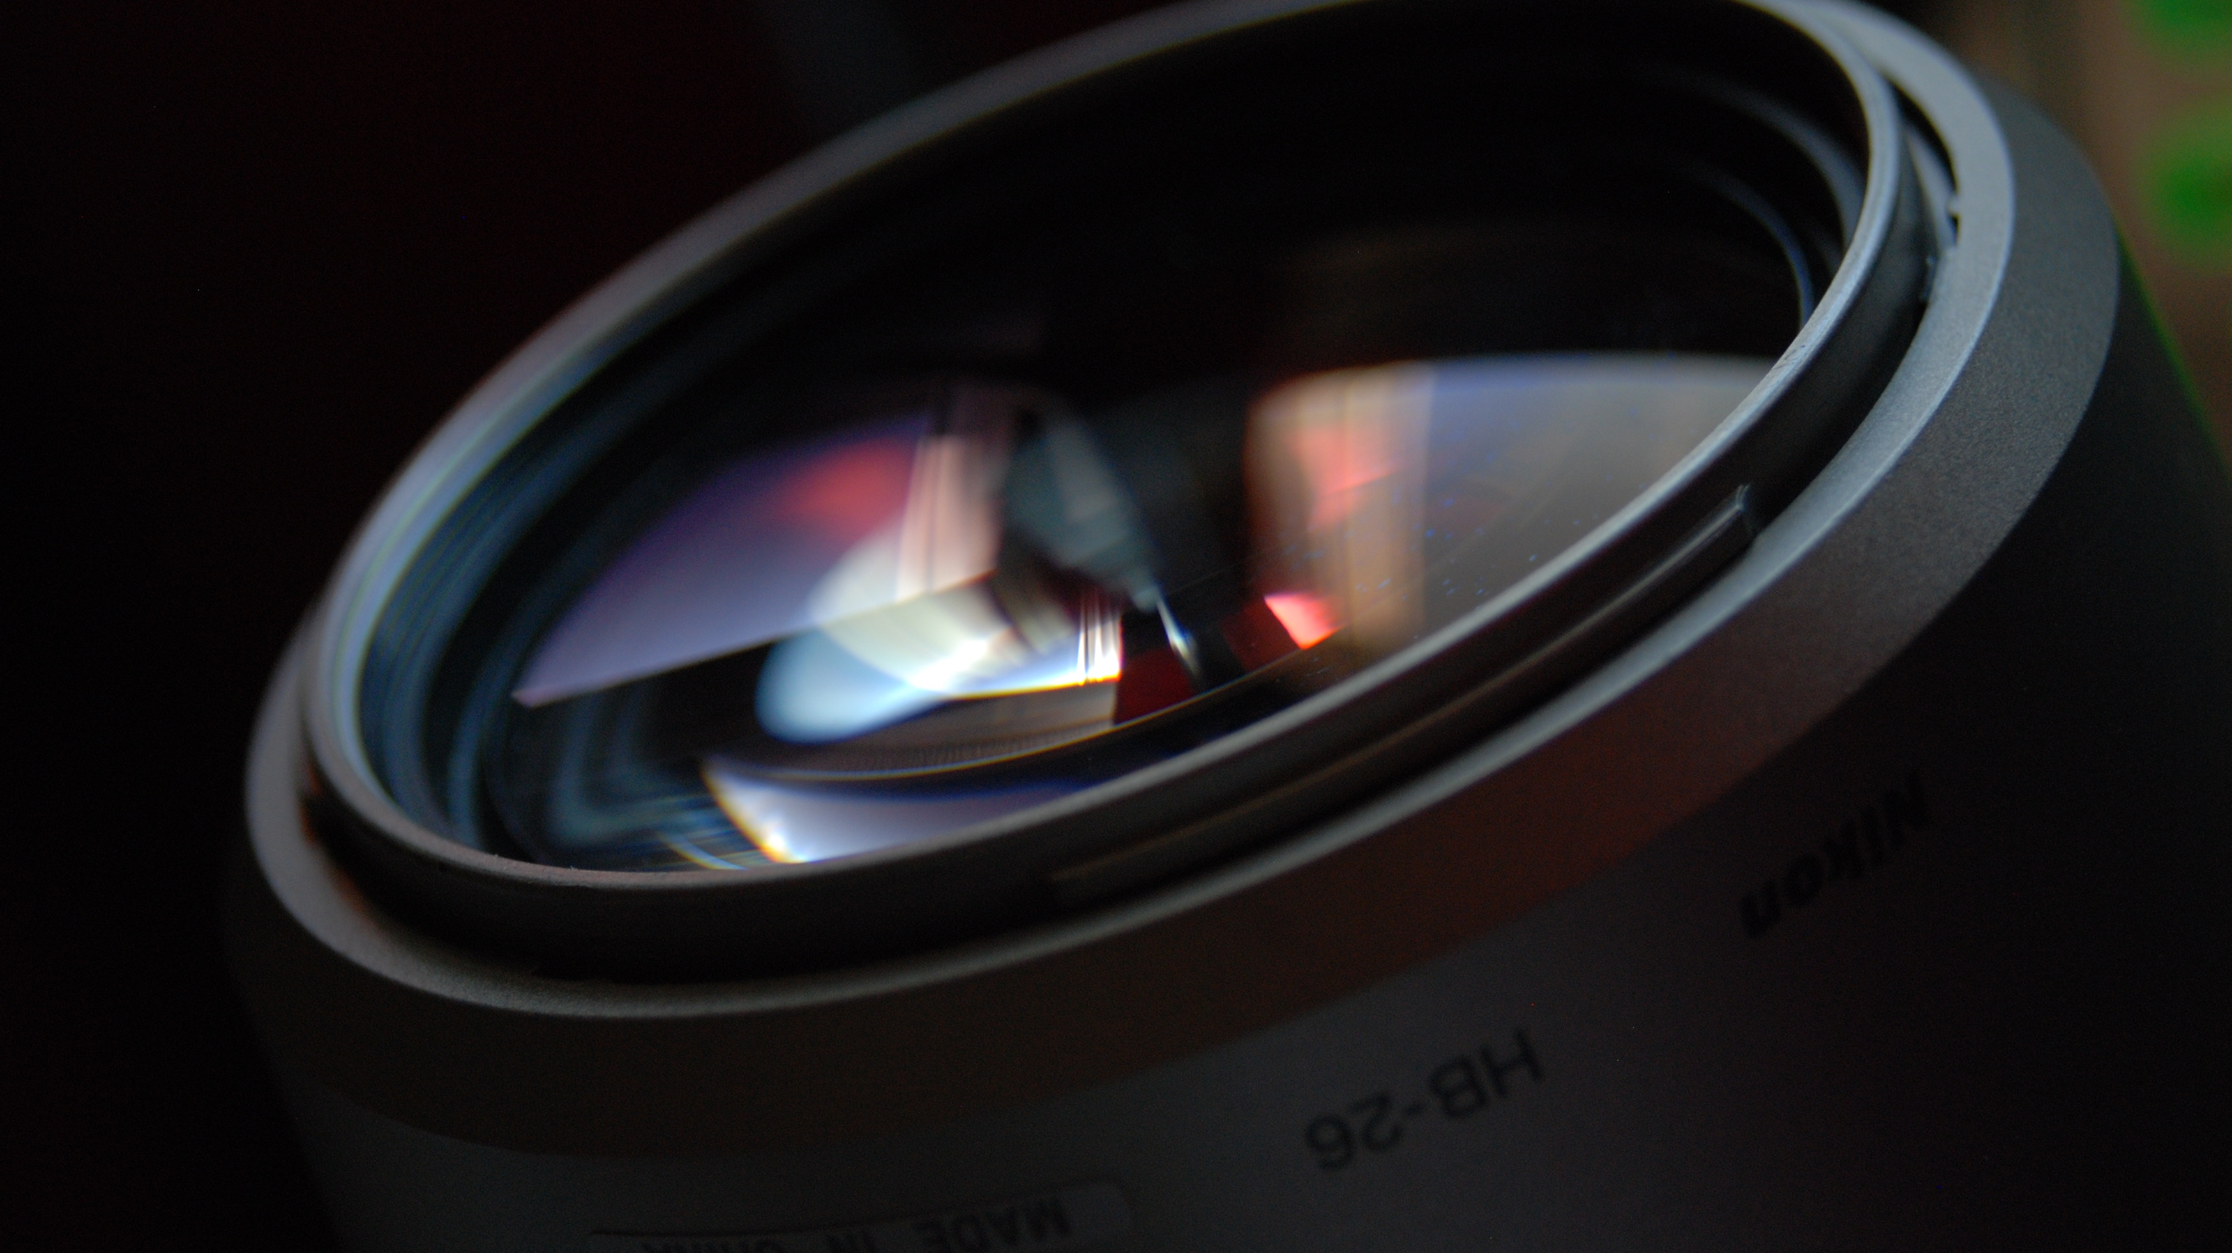
A culmination project based documentary
Dileydi Cabrera

Slide 2
Main points
Equipment
Goals VS Results
Takeaways

Slide 3
Interviewees
Vince Valdez & Tatyana Price

Slide 4
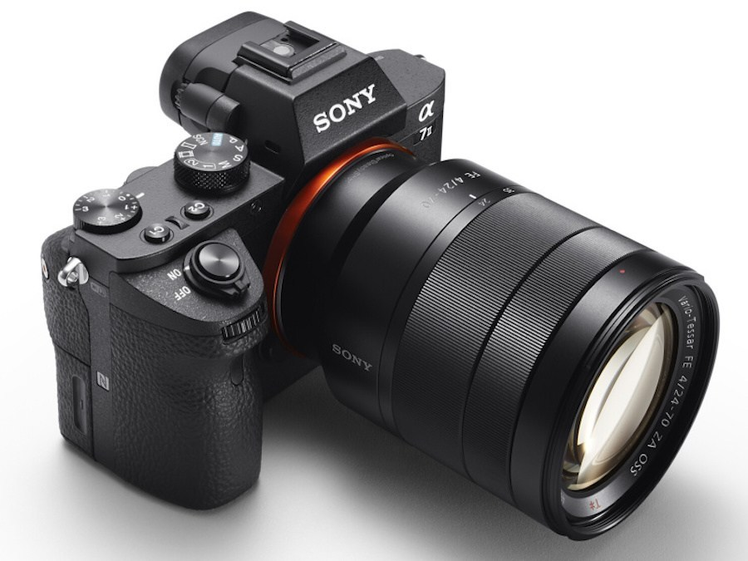
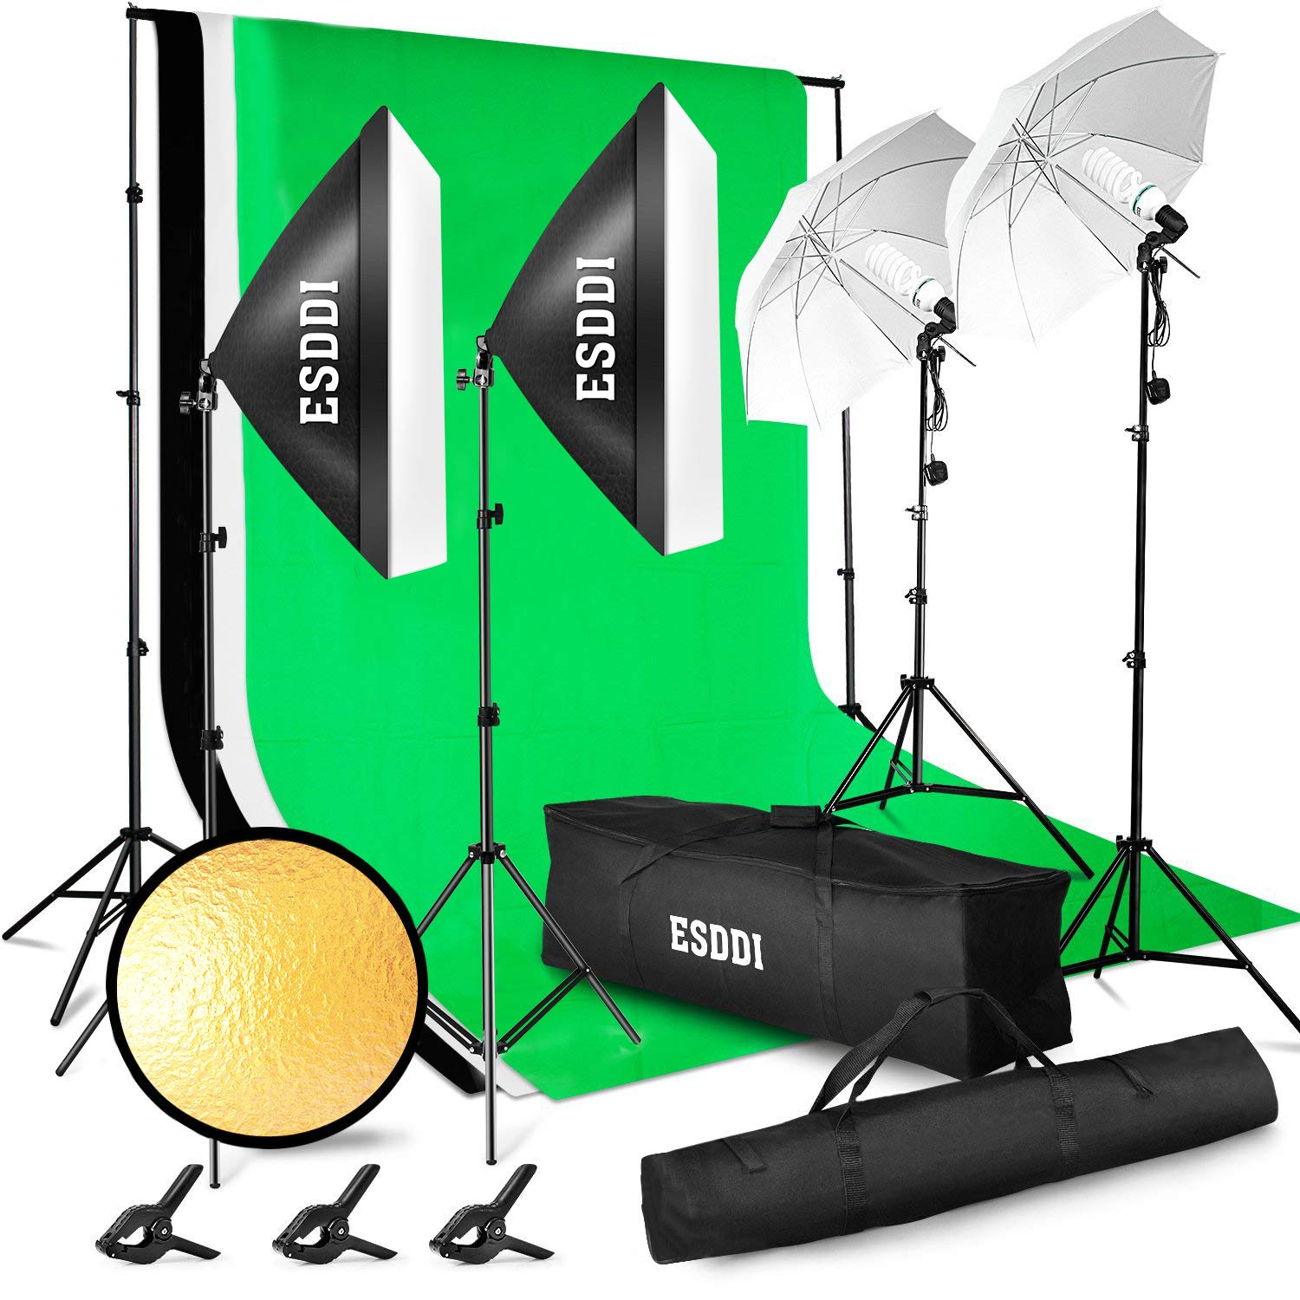
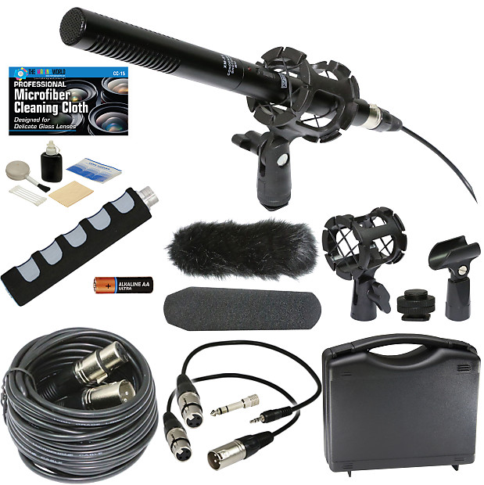
Equipment
Sony A7III & Sony 28-70mm Telephoto Lens
Adobe Premiere Pro & Audition CC 2018
Unidirectional Condenser Shotgun Mic
By The Imaging World
ESDDI Lighting Kit

Slide 5
Budget
WITHOUT THE CAMERA
WITH THE CAMERA

Slide 6
Goals VS Results

Slide 7
Goals VS Results
Producer

Slide 8
Goals VS Results
Producer
Director

Slide 9
Goals VS Results
Producer
Director
Editor

Slide 10
Goals VS Results
Producer
Director
Editor
Pre-Production

Slide 11
Goals VS Results
Producer
Director
Editor
Pre-Production
Production

Slide 12
Goals VS Results
Producer
Director
Editor
Pre-Production
Production
Post-Production

Slide 13
Goals VS Results
Producer
Director
Editor
Pre-Production
Production
Post-Production
Finding Subjects
Production Calendar
Schedule

Slide 14
Goals VS Results
Producer
Director
Editor
Pre-Production
Production
Post-Production
Finding Subjects
Production Calendar
Schedule
People not wanting to be filmed
Exposure Issues
Setting up interview

Slide 15
Goals VS Results
Producer
Director
Editor
Pre-Production
Production
Post-Production
Finding Subjects
Production Calendar
Schedule
People not wanting to be filmed
Exposure Issues
Setting up interview
Less Material to work with
Editing days before presentation
Change in editing format

Slide 16
Goals VS Results – Pre-production
Finding Subjetcts
Calendar
Schedule

Slide 17
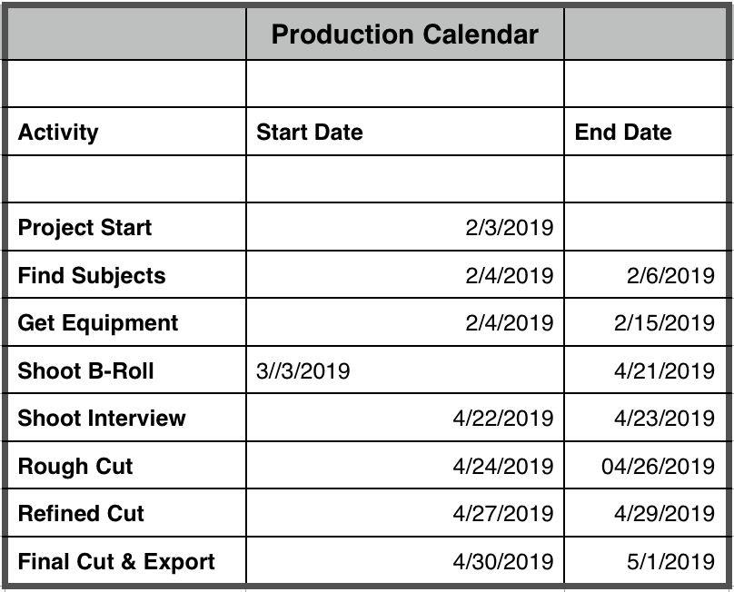
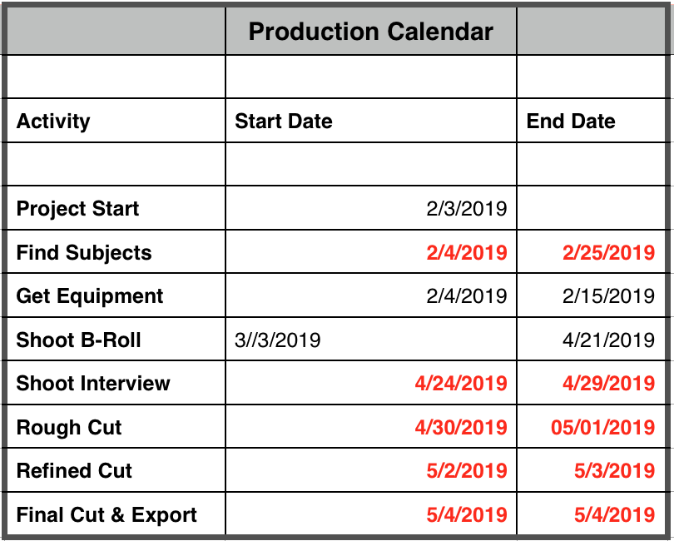
Production Calendar

Slide 18
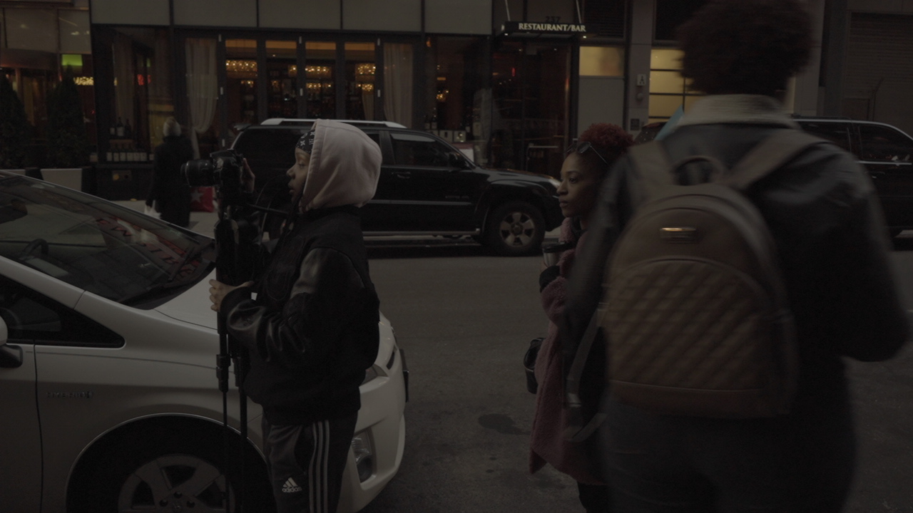
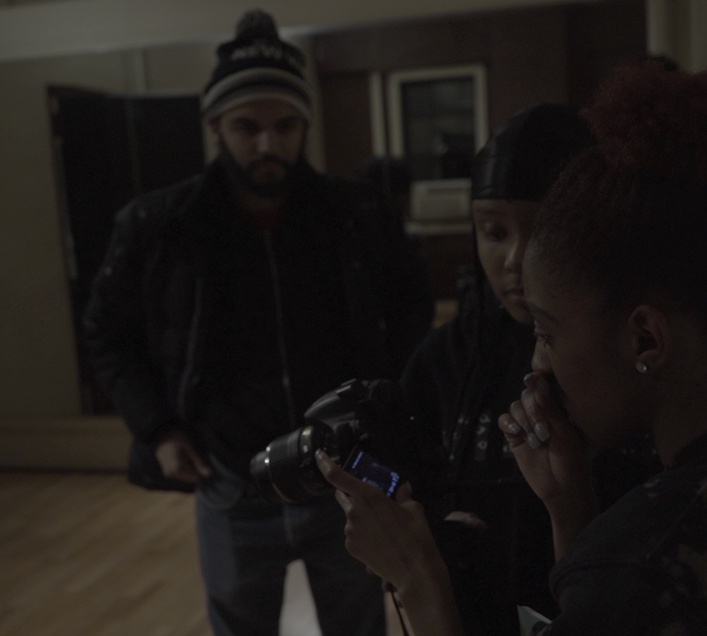
Exposure Issues
Underexposed Image
Low ISO

Slide 19
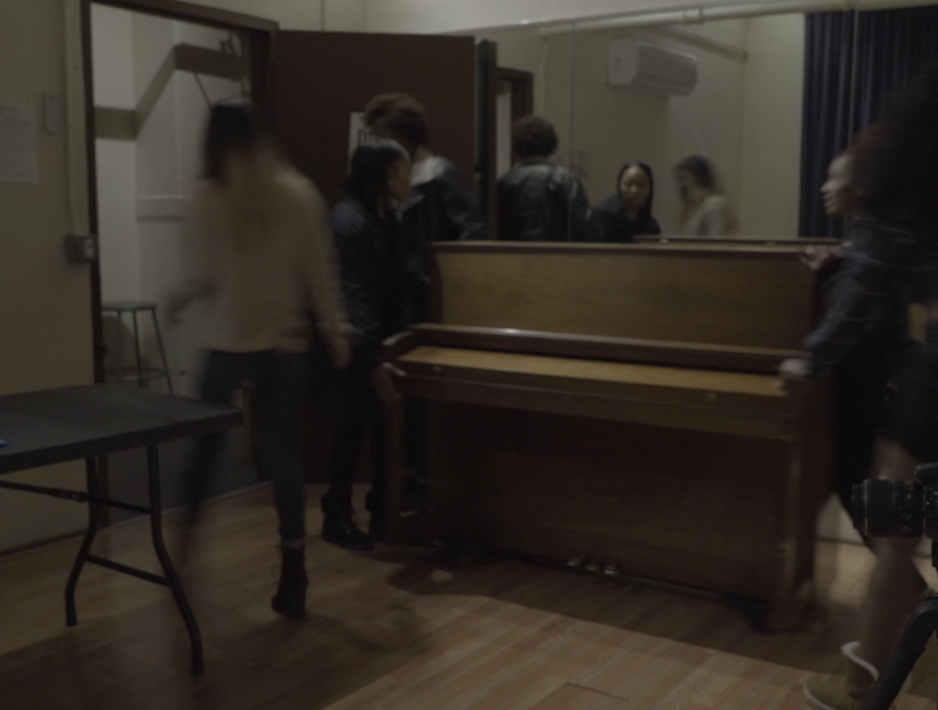
Exposure Issues
Low Shutter Speed

Slide 20
Setting up the Interviews
Location
Availability

Slide 21
Editing Challenges
Change in editing format
Editing days before presentation

Slide 22
Time consuming

Slide 23
What I learned
Pre-production is crucial.
The earlier you start organizing and planning, the better your project will be.
Work with reliable people.
Work with commited, excited and available people.

Slide 24
Conclusion
Glad to have chosen this project because I learned a lot.
Depending on other student's projects to do my project meant a lot of variables.
Next time I'll do a much better work

Slide 25
acknowledgements
Andrew Pawluk
Vince Valdez
Tatyana Price
Ryoya Terao

