Slide 1
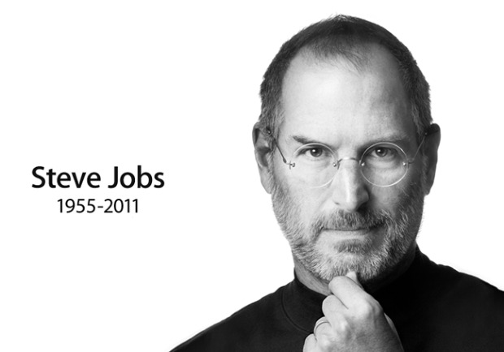
The Man Behind Your Music Box

Slide 2
Introduction
When you think of Steve Jobs, what comes to your mind? Most would say that guy who made those Apple products. Others would say that he was a visionary who paved the way for other developers. He took life and ran with it using his imagination and his dream of technology. Not only was he the creator of Apple, he was a symbol of persistence.

Slide 3
Why Steve Jobs???
He was a pioneer.
He was a trend setter.
He inspired others to take initiative and to follow their dream.
He made Apple Inc.

Slide 4
How does Steve Jobs success relate to Art and Design and Graphic Arts?
He used an interesting sleek style to his Apple Computers that set it apart from Windows Computers.
Majority of graphic artists and designers use Apple Products to express their talents.

Slide 5
Steve’s Early Life
Steve Jobs was born in San Francisco, California, on February 24, 1955.
He was put into adoption by his parents who were both graduates from the University of Wisconsin.
He was adopted by Clara and Paul Jobs and was named Steven Paul Jobs. Clara worked as an accountant and Paul was a Coast Guard veteran and machinist.
In high school, he met his future partner, Steve Wozniak, and they both had a big interest in technology and hooking up digital chips.

Slide 6
Steve’s Early Life
Jobs enrolled at Reed College in Portland, Oregon but lacked direction so he dropped out after 6 months.
In 1976, when Jobs was just 21, he and Wozniak started Apple Computers. They started in his family’s garage and Jobs funded the project by selling his Volkswagen bus while Wozniak sold his scientific calculator.
The rest is history.

Slide 7
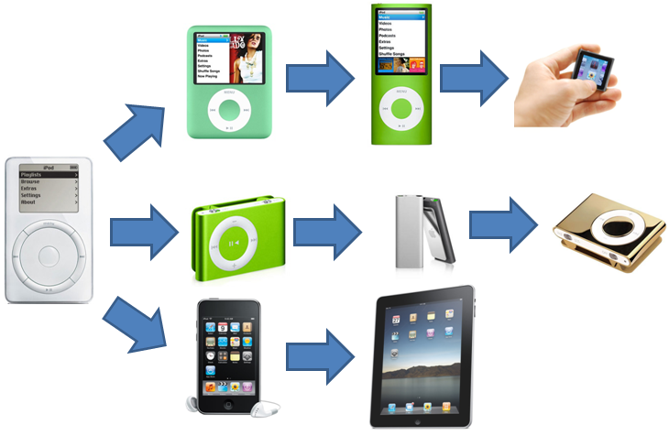
Accomplishments
He made many revolutionary products used for music and other creative purposes. One of his outstanding products was the Iphone, which is the most used smart phone in the world.

Slide 8
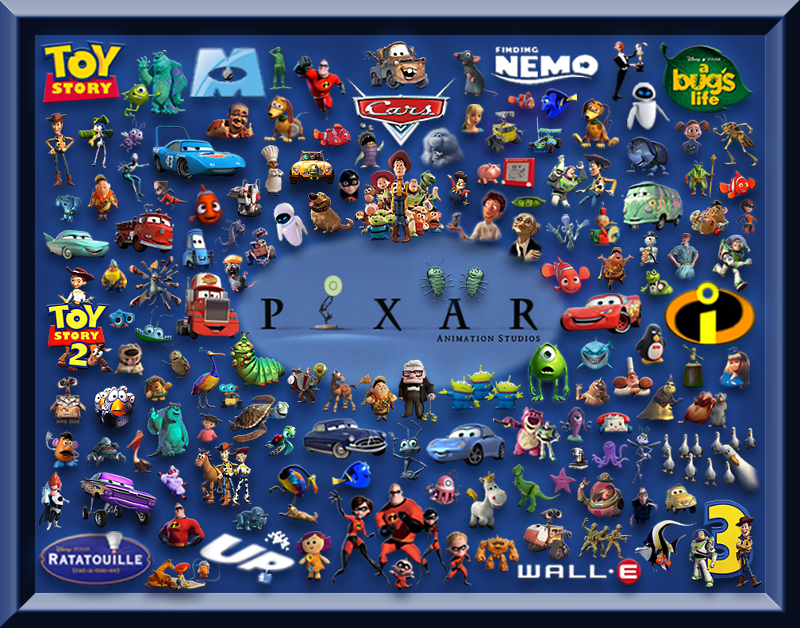
Accomplishments
Jobs also co-founded and served as chief executive of Pixar Animation Studios; he became a member of the board of directors of The Walt Disney Company in 2006, when Disney acquired Pixar.

Slide 9
What is the next Iproduct?
If I would to choose what would be the next Iproduct, I would like it to be called the Imood. Did you ever think about having your own soundtrack to your life? Of course you do, everyone does. Well with this prototype, it detects how your feeling just like a mood ring and then plays music depending on your emotion. It will sell like hotcakes.

Slide 10
Conclusion
In conclusion, Steve Jobs was a man who took his dream and ran with it. He went through many problems along the way, but he continued on and became a great American icon. He pretty much was the definition of the American dream, coming from nothing and making something out of it.

Slide 11
References
http://en.wikipedia.org/wiki/Steve_Jobs
http://blogs-images.forbes.com/connieguglielmo/files/2012/11/Steve-Jobs-dates.jpg
http://www.forbes.com/sites/connieguglielmo/2012/10/03/untold-stories-about-steve-jobs-friends-and-colleagues-share-their-memories/
http://g3ict.org/design/js/tinymce/filemanager/userfiles/Image/case_studies/Apple%20products.jpg
http://images4.fanpop.com/image/photos/22900000/Pixar-Movies-and-Characters-toy-story-22923966-1008-792.jpg
http://media.culturemap.com/crop/af/c8/600x600/Steve_Jobs_waving-2.jpg

Slide 12
