Slide 1
Cartoon Remix
By: David Binns

Slide 2
Project Summary:
The purpose of this project is to modify an old cartoon, (Tom and Jerry 1941), by removing white noise, and renewing the sound effects. Also, filling in any missing sound.

Slide 3
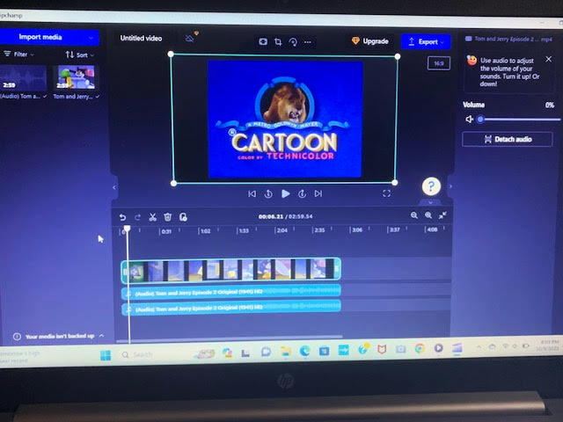
Removing Audio:
Using an editing software called Microsoft Clipchamp, it allowed me to remove the audio.
By clicking on the source monitor, the audio tracks turns green and a new window appears.
The window has the option called, “Detach audio”. After clicking it, the audio tracks become muted.

Slide 4
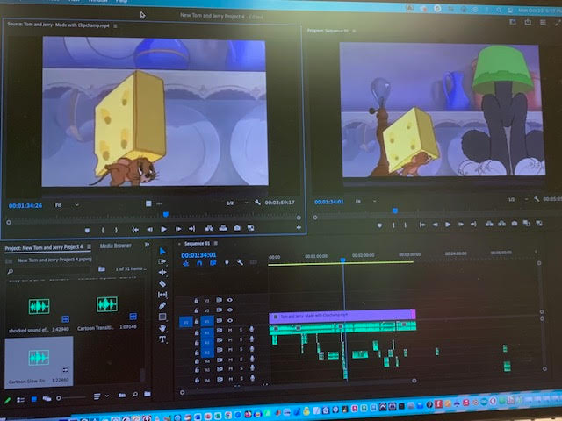
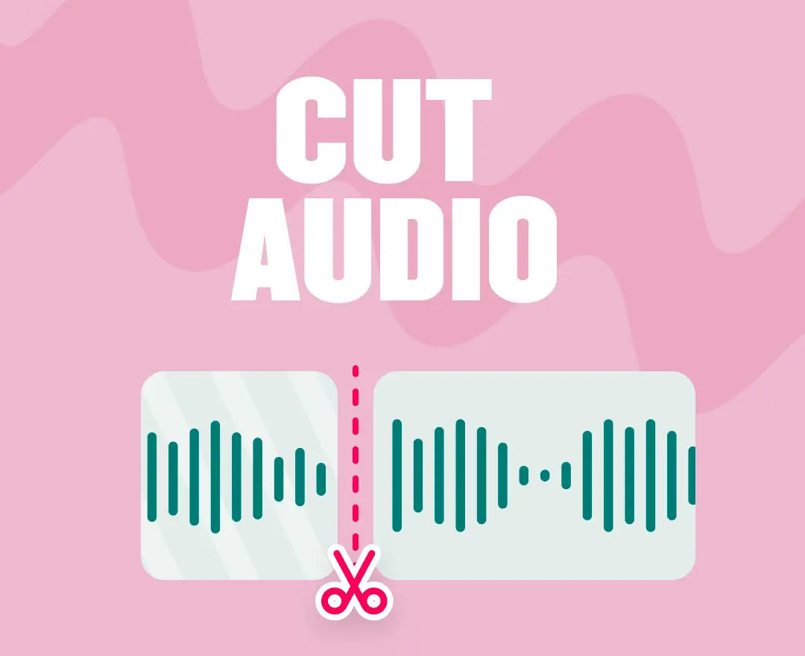
Trimming Audio:
In Adobe Premiere Pro, there’s a tool called the “Razor” tool. The Razor tool is able to cut out any section of an audio.
It’s also a difficult tool to use. You can accidentally over/or under cut too much audio.

Slide 5
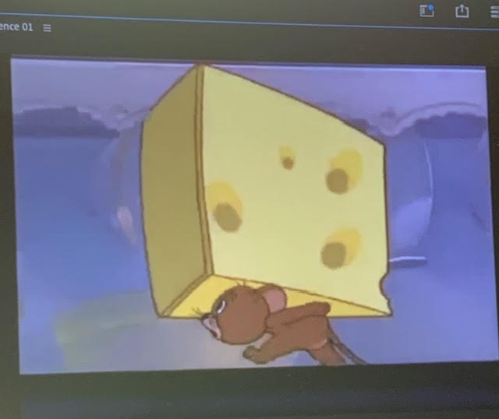
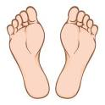
Foot Step Effects:
Before: In the original version, there wasn’t any foot step effects. The music mostly used flute effects for the walking patterns.
After: In the edited version, a squeaky sound effect appears everytime Jerry walks.

Slide 6
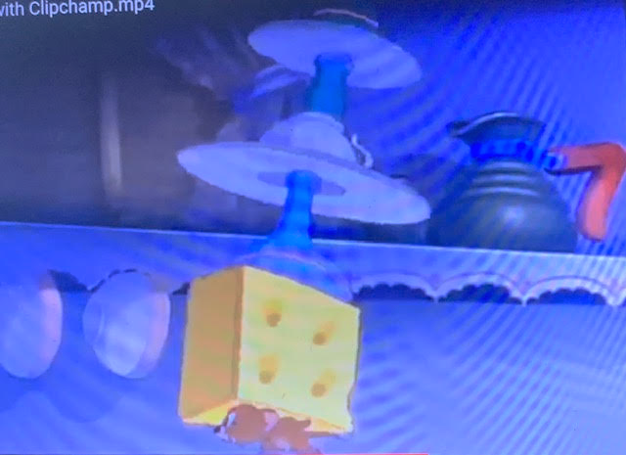
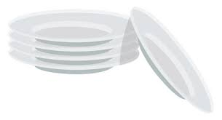
Stacking Plates Effect:
Before: In the original version, whenever Tom was stacking the plates onto another, there wasn’t any sound for the plate piling.
After: In the edited version, whenever Tom stacks the plates, there is a sfx.

Slide 7
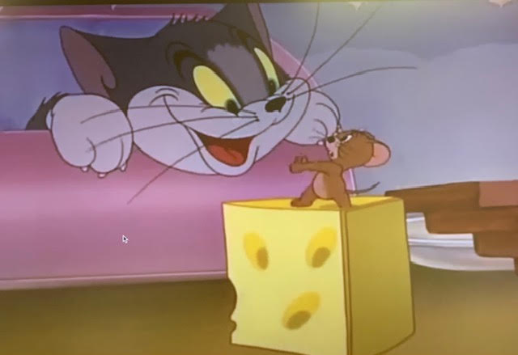
Cabinet Effect:
Before: In the original version, when Tom opened the cabinet, there wasn’t any sound effect.
After: In the edited version, when Tom opened the cabinet, there was a clicking sound effect. By using the sounds of a cabinet opening, it made the same scene more realistic.

Slide 8
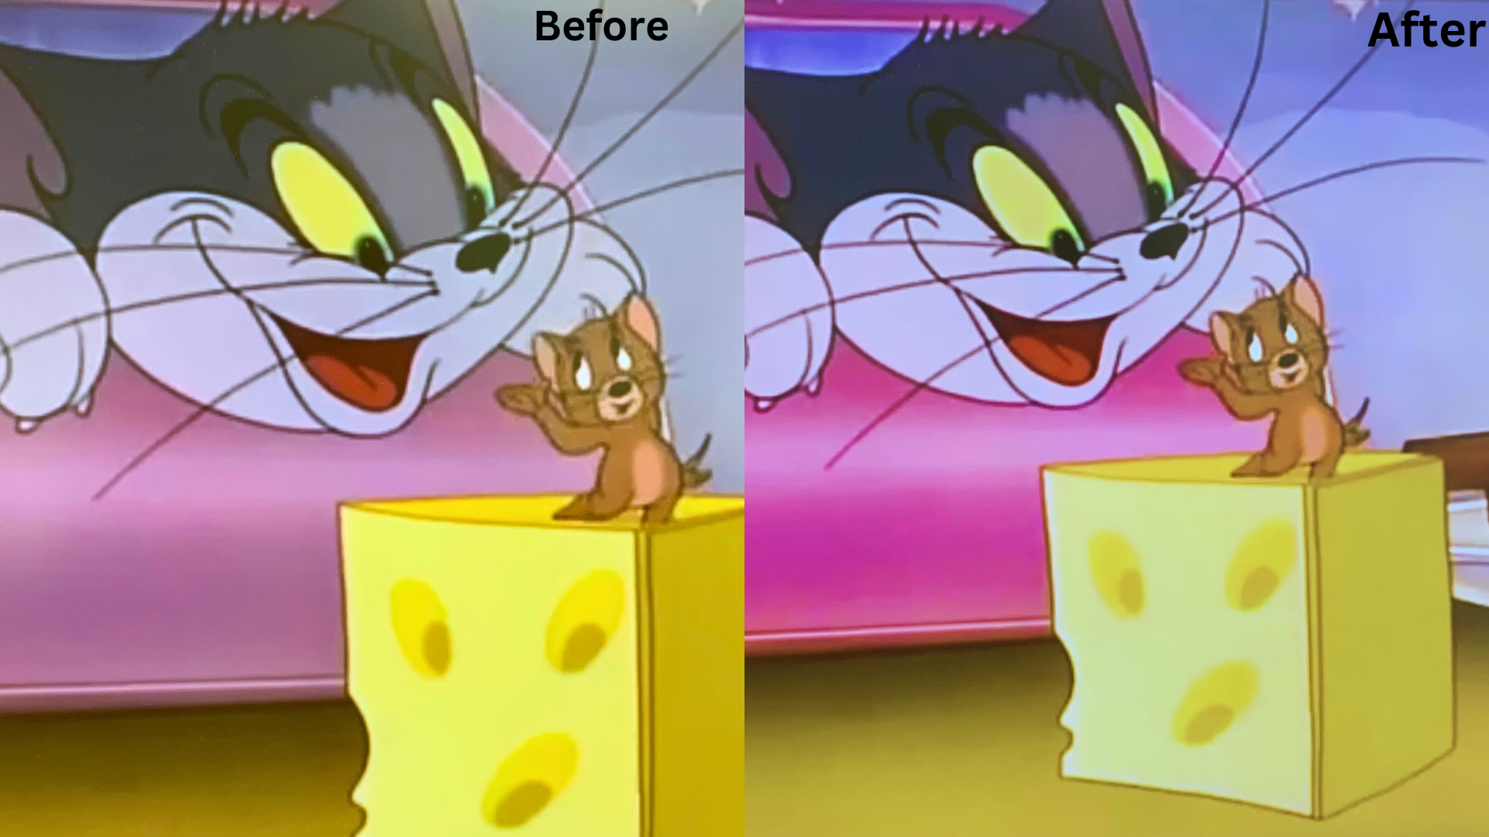
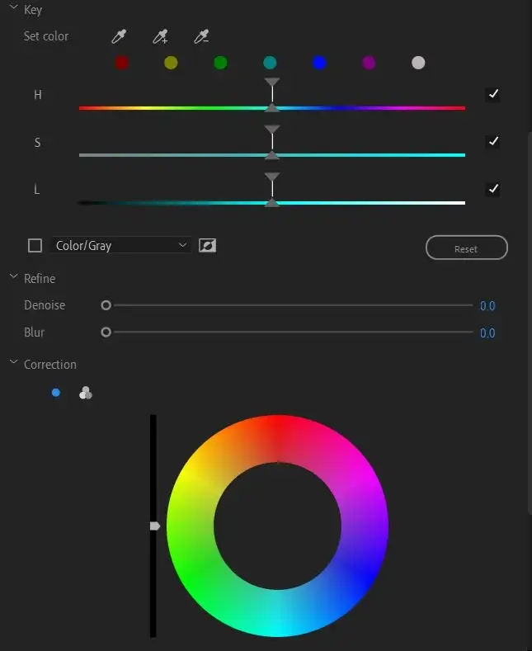
Improving The Colors:
Color Correction: Improves the color in multiple areas like the background, objects, etc.
Reduced blurriness: By increasing the threshold, the quality of the clip became clearer.
Increased Brightness: By increasing the contrast, the visualization became lighter by removing some of the shadows.

Slide 9
Work Sources:
https://pixabay.com/sound-effects/search/%20insert/
“Royalty Free Background Music, Sound FX | FesliyanStudios.” Www.fesliyanstudios.com, www.fesliyanstudios.com/.
YouTube. “YouTube.” YouTube, 2023, www.youtube.com/.
“Trimming Clips.” Adobe.com, 2023, helpx.adobe.com/premiere-pro/using/trimming-clips.html. Accessed 7 Dec. 2023.

