Slide 1
Culmination
Diane Baez

Slide 2
Project
10-minute short film
Drama/Mystery
https://youtu.be/OWDZwNw6waQ
Roles
Diane Baez: video editor
Maurice Fulton: writer, director, producer, fx editor etc,.

Slide 3
Schedule
Pre-Production
Script: 1/4/21 – 2/19/21
Cast & location: 2/15/21 – 2/28/21
Production
Filming: 3/3/21 – 3/12/21
Post-Production
Editing: 3/19/21 – 5/3/21

Slide 4
Required Resources
Wifi
Laptop
External hard drive
Editing software
Adobe Premiere Pro
AVID
Adobe Audition
Documentation
Script
Storyboard

Slide 5
Budget
AVID
$9.99 per month
Adobe Premiere Pro
CUNY student account = FREE
Adobe Audition
CUNY student account = FREE

Slide 6
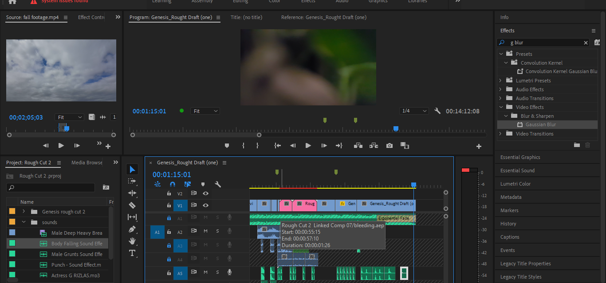
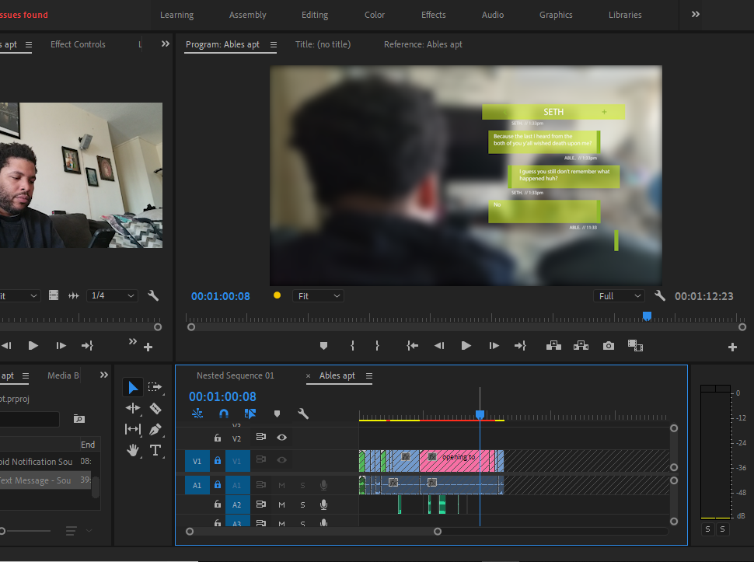
The Process
Organizing footage
Marking in & out
Assembly
Make edits
Add effects
Color correction
Audio touch up
Render & Share

Slide 7
Challenges
Collaboration
Time
Color Correction
Audio

Slide 8
Conclusion
YouTube
Small film festival
Future/career in video editing
Personal projects

Slide 9
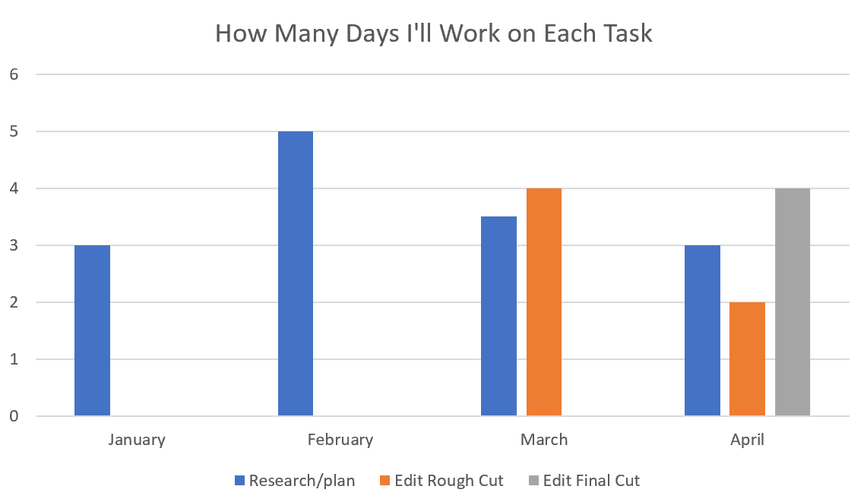
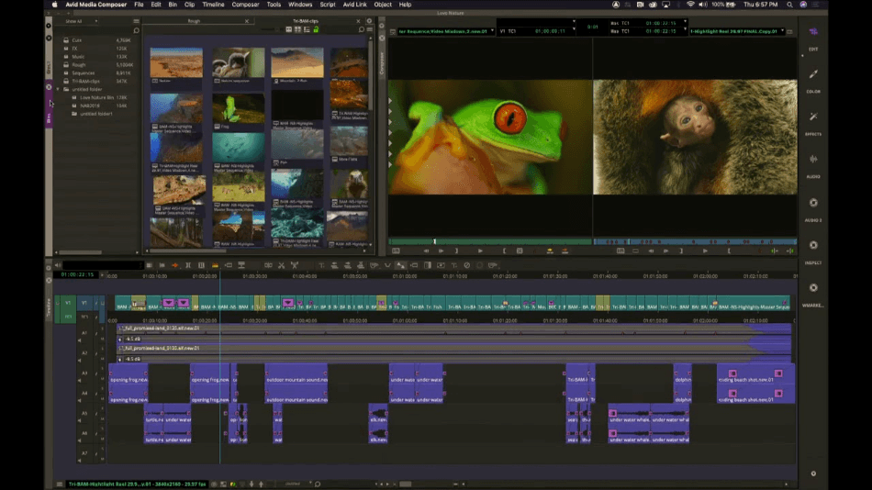
“Genesis” Diane Baez Department of Entertainment Technology
Summary
Maurice Fulton and I will be working on a short 5 to 7 minute long story together as a way to express our artistic abilities for our culmination project. As the series will be a drama-mystery, its purpose is to keep the audience on edge but still entertained. Maurice will be responsible for the content as he will write, direct, and film whereas I will be the video editor. As for the purpose of the assignment, it will prove to us and our audience what we are capable of and what we need to work on.
The short film, Genesis, is about three brothers, Cain, Able, and Seth, who are still dealing with their grief, in different ways, a year later after their mother Eva passed away from cancer. When Eva got sick, Able refused to assist, leaving Seth and Cain alone, watching her as she passed. Unable to forgive Able, Seth and Cain try to make amends but Able is murdered, thrown off from a roof but by who? The story starts from the beginning, told from Able’s perspective as he travels to NJ to meet with his brothers. The storyline takes place in present day New York and New Jersey.
Description
To successfully utilize video editing skills and the use of special effects to accurately portray a short drama-mystery film. Through organization and communication, it will be easy to shoot and provide the content in order for it to be edited. With a weekly schedule, rough and final cuts will be provided in a timely manner for review and official release on Maurice’s YouTube Channel.
Methods
Research online of editing styles used in other films similar in genre
Research on appropriate color correction
Research online on how to create effects on Premiere Pro & AVID
Plan and schedule time to edit based on due dates
Results
When finished, the short film will be uploaded onto Maurice’s YouTube channel where his subscribers can watch it for free. As a result, we hope that our project successfully entertains the audience. Depending on the feedback we receive online and from our peers, we can also try to screen it at any film festivals. I hope I get the most from this experience when it comes video editing. I hope I develop better techniques and expand my creativity. I know I will benefit from this experience as I will take what I learned as an editor and collaborator with me when I find a job in the industry after I graduate as a video editor. Conclusion
Although I won’t be on set, when shooting, it is important to keep your distance, 6 feet apart, and wear masks at all time to ensure safety and security for the project to be completed efficiently. Luckily for Maurice, his cast and crew are mostly family so cross contamination is not extreme. It will also be important to consistently sanitize the equipment when being used. As for the equipment, being advised on the right ones to use and going through trial and error is the best way to go about the situation in order to find out what works best when filming.
Schedule
Calendar | Q1 | Q2 | Q3 | Q4
Pre-Production | Script + Storyboard 1/4/21 | location 2/15/2020 | Cast + crew 2/21/2021 | Everything Complete 2/28/2021
Production & Post-Production | Filming Start 3/1/2021 | Filming Ends 3/13/2021 | Post-production Starts (Editing) 3/19/2021 | Post-production Ends 4/1/2021
Deliverables
Calendar
Rough and Final cuts
YouTube link
Final Summary
Poster
Required Resources
Access to internet
My personal laptop
External hard-drive
Assess to editing software
AVID Media Composer
Premiere Pro
After Effects
Chart
The Process
Maurice will be in charge of creating and shooting the content. As this is originally his idea, with his advisement, I will be considered his Assistant Director as I help manage the project and make sure we are organized so that things run as smoothly as possible while also meeting deadlines. Not only will I keep things in check, but I will also be the video editor..
AVID Media Composer
Budget
Item | Estimate Amt | Total Spent
AVID Media Composer | $9.99 monthly | $19.98
Estimate | $9.99 Total | $19.98

