Slide 1
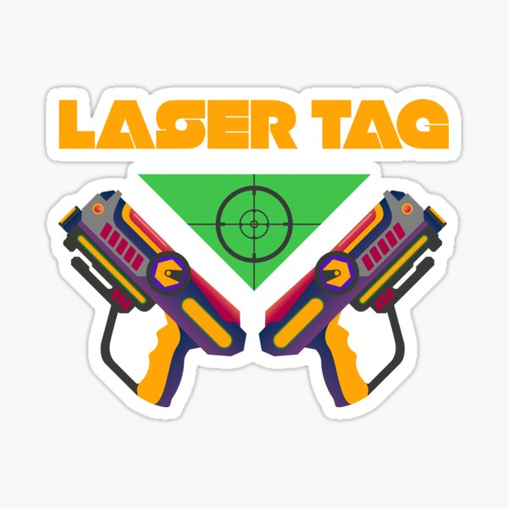
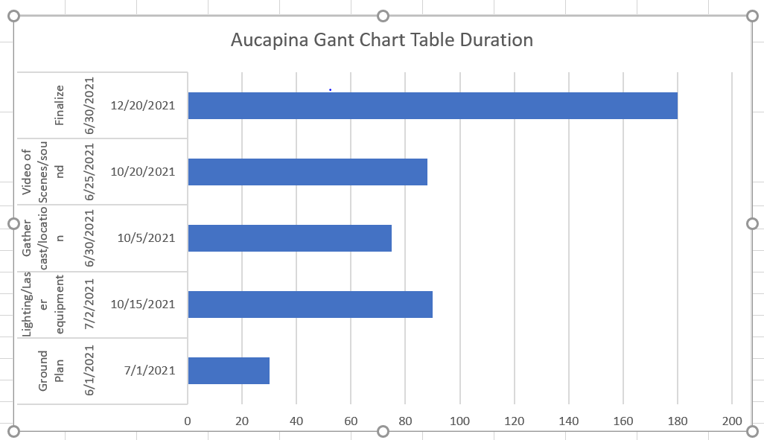
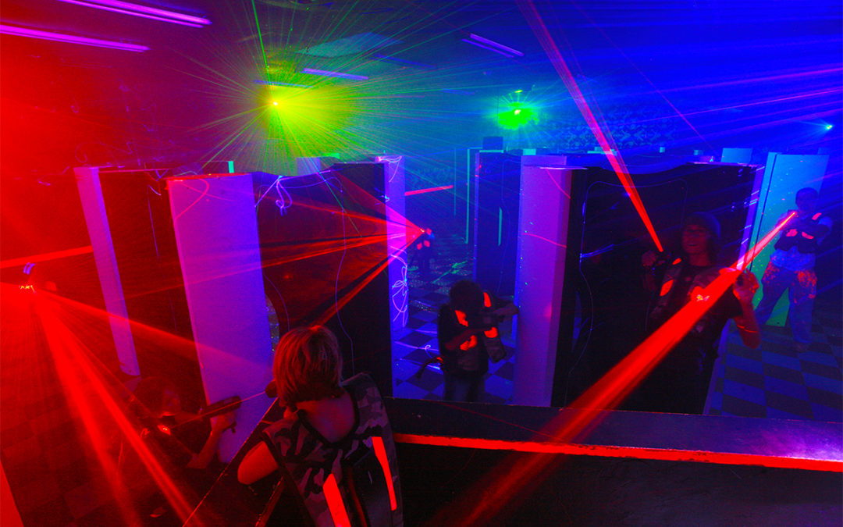
LASER TAG Project By: Diana Aucapina
Summary
Playing laser tag would be fun project to do. Never done Laser tag in a long time since my childhood. Therefore, what I want to bring back especially everything we been through this past year which is happiness and just have fun at any age. Growing up watching Disney was privilege, today kids will never know what is like back then when we had the great childhood and best movies of all time. So, I want to be responsible and give all those children who did not get chance to see and for those who miss their childhood and want to relive it again. I want to make everyone feel welcome and experience the movie in another fun way such as Laser tag having get to be with one of your favorites characters in the movie would be amazing and taking pictures for memories that will most likely be dress up as your favorite characters heroes at the laser tag. Unfortunately, because Covid I had to transform it into vector works so I needed to create a visual 3D ground plan where it allows me to create an attraction laser tag maze.
Description
For my cumulation I want to make a laser tag about defeating villain from Disney because I want to do something fun and adventure for kids, teens and even adult to be a hero for once. I would still need to use special lights and equipment for laser tag also sound effects, would have help on video scenes to put on scream to make laser tag look real. I would use an NBA real size basketball court ground plan.
Methods
Choose what type of lighting and video
Ground/lighting plan
What scenes and sound effect to use
Build a scenery of Laser tag
Finalized story
Cast/Crew
Rehearsal lights of laser
Rehearsal Scenes and sound effects
Finish the piece
Deliverables
Schedule / Calendar
Complete ground plan
Budget/ Poster
Maze Map
Required Resources
Lighting equipment
Console of lighting
Laser Tag ground plan of location
Vector works/ Light wright
Results
By the end of this, I hope I have a finished plan and can just create it and will be fun for people to enjoy seeing what I have establish. Having people helping along the way of giving me ideas and where to put the light on ground plan. Having help with recording and surveillance because we need to make sure everyone is safe and not in danger just like how we did for The Hotel Gravesend. I would include safety exits on the attraction ground plan of course.
Conclusion
In conclusion, this will help organize my project because at first did not know what to do and now having so many ideas along the process can really change the plan or add it to this culmination which I think can impact my project. Another is paper works, the budget, schedule and cast of making this project happen and help me figure out to exactly to be in charge and know what I can do especially would something I feel like I am going to have fun with. Also, with the changes I will have struggles I hope the project will come out how I wanted to be visualized can't wait for you to see what I have created.
The Process
To makes a laser tag about defeating villains from Disney because I want to do something fun and adventure for kids or teens also for them to be hero and what is like to fight crime. Finding what special light to use, other equipment like video or sound.
Finding a location will be hard to find where we can build it up or in this case what layout of ground plan have right measurements for me use a laser tag. I would use Vector works of how I would visualize the ground plan of the location and where the lights should go. Once it done, have it testing it out the laser tag to make sure everything is safe to use and its position right.

